Slide 1
Module D-Functions
Pointer

Slide 2
Pointer
Explain what a pointer is and where it is used
Explain how to use pointer variables and pointer operators
Assign values to pointers
Explain pointer arithmetic
Explain pointer comparisons

Slide 3
What is a Pointer?
A pointer is a variable, which contains the address of a memory location of another variable
If one variable contains the address of another variable, the first variable is said to point to the second variable
A pointer provides an indirect method of accessing the value of a data item
Pointers can point to variables of other fundamental data types like int, char, or double or data aggregates like arrays or structures

Slide 4
What are Pointers used for?
Some situations where pointers can be used are -
To return more than one value from a function
To pass arrays and strings more conveniently from one function to another
To manipulate arrays easily by moving pointers to them
instead of moving the arrays itself
To allocate memory and access it
(Direct Memory Allocation)

Slide 5
Pointer Variables
A pointer declaration consists of a base type and a variable name preceded by an *
General declaration syntax is :
type *name;
For Example:
int *var2;

Slide 6
Pointer Operators
There are 2 special operators which are used with pointers
&
and
*
The & operator is a unary operator and it returns the memory address of the operand
var2 = &var1;
The second operator * is the complement of &. It is a unary operator and returns the value contained in the memory location pointed to by the pointer variable’s value
temp = *var2;

Slide 7
Assigning Values To Pointers-1
Values can be assigned to pointers through the & operator.
ptr_var = &var;
Here the address of var is stored in the variable ptr_var
It is also possible to assign values to pointers through another pointer variable pointing to a data item of the same data type
ptr_var = &var;
ptr_var2 = ptr_var;

Slide 8
Assigning Values To Pointers-2
Variables can be assigned values through their pointers as well
*ptr_var = 10;
The above declaration will assign 10 to the variable var if ptr_var points to var

Slide 9

Pointer Arithmetic-1
Addition and subtraction are the only operations that can be performed on pointers
Let us assume that var is stored at the address 1000
Then ptr_var has the value 1000 stored in it. Since integers are 2 bytes long, after the expression “ptr_var++;” ptr_var will have the value as 1002 and not 1001

Slide 10
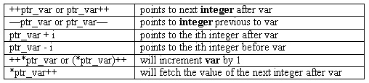
Pointer Arithmetic-2
Each time a pointer is incremented, it points to the memory location of the next element of its base type
Each time it is decremented it points to the location of the previous element
All other pointers will increase or decrease depending on the length of the data type they are pointing to

Slide 11
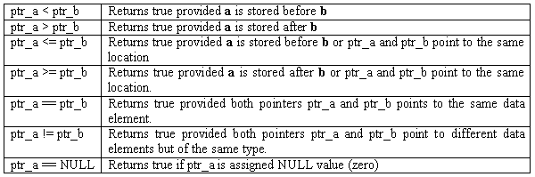
Pointer Comparisons
Two pointers can be compared in a relational expression provided both the pointers are pointing to variables of the same type
Consider that ptr_a and ptr_b are 2 pointer variables, which point to data elements a and b. In this case the following comparisons are possible:

Slide 12
Summary
Pointer
Explain what a pointer is and where it is used
Explain how to use pointer variables and pointer operators
Assign values to pointers
Explain pointer arithmetic
Explain pointer comparisons
Q&A

