Slide 1
Module D-Functions
Modularity
Scope of a variable

Slide 2
Modularity
Structured Design
In-Class Practice
Functions
Prototypes
Style

Slide 3
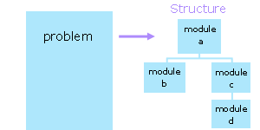
Structured Design
In designing a program, we subdivide the problem conceptually into a set of design units. We call these design units modules. In subdividing the problem, we reduce the number of factors with which to deal simultaneously.

Slide 4
Module
We select each module so that it
  is easy to upgrade,
  contains a readable amount of code, and
  can be used as part of the solution to some other proble
In designing a module, we
  select a descriptive identifier for the module,
  identify the tasks to be performed within the module.

Slide 5
Module…
In a structured design
each module has one entry point and one exit point,
each module is highly cohesive (performs a single task ), and
each module exhibits low coupling.

Slide 6
Cohesion
Cohesion is a measure of the focus within a module.
A module is highly cohesive if it performs a single task.
A module is low in cohesion if it performs a collection of unrelated tasks.
In designing a cohesive module, we ask whether a certain task belongs:
  The reason to include it is that it is related to the other tasks in some particular manner.
  A reason to exclude it is that it is unrelated to the other tasks.

Slide 7
Degrees of cohesion
low cohesion - generally unacceptable
  "coincidental" - unrelated tasks
  "logical" - related tasks of which only one is performed - the module identifier suggests a choice
  "temporal" - multiple logically unrelated tasks that are only temporally related
high cohesion - generally acceptable
  "communicational" - the tasks share the same data - all tasks are carried out each time
  "sequential" - multiple tasks in a sequentially dependent relationship - output of one task serves as input to another task - the module identifier suggests an assembly line
  "functional" - performs a single specific task - the module identifier suggests a precise verb phrase

Slide 8
Low cohesion - Example
The degree of cohesion for a module that
  calculates the PST and GST on a sale,
  checks if a barcode is valid, and
  raises an integer to the power of another integer
The module has low cohesion. For an improved design, we identify each task as a separate module

Slide 9
Coupling
Coupling is a measure of the degree of interrelatedness of a module to its referring module(s).
A module is low in coupling if it performs its tasks on its own.
A module is highly coupled if it shares that performance with some other module including the referring module.
In designing for low coupling, we ask what kind of data to avoid passing to the module.

Slide 10
Coupling classification
The data classifications include
  "data" - used by the module but not to control its execution
  "control" - controls the execution of the module
  "external" - part of an environment external to the module that controls its execution
  "common" - part of a global set of data
  "content" - accesses the internals of another module

Slide 11
Highly coupled -Example
A control flag that tells a module whether to accept
  integer input from the user, or
  floating-point input from the user
Controls the execution of the module from outside the module. A module that accepts such a control flag is highly coupled. For an improved design, we create two separate modules - one that accepts integer input and one that accepts floating-point input, neither of which receives any control flag.

Slide 12
In-class practice
Design a program that either calculates the value of an integer raised to the power of an integer exponent or the arithmetic mean of a series of integers, depending upon a choice made by the user.
  list all of the tasks that the program should perform to solve this problem
  identify the modules for the problem structure
  check that each module is high in cohesion
  check that each module is low in coupling

Slide 13
Functions
In C, we represent a module by a function.
A function may receive data and may return a value.
The description of the internal logic of a function as the function's definition

Slide 14
Function Definition
A function definition consists of a header and a body.
The body is the code block that contains the module instructions and generates the return value.
The header, which precedes the body, includes the module name and the list of parameters that receive the module data enclosed within parentheses.

Slide 15
syntax of a function definition
returnDataType functionIdentifier ( dataType parameterIdentifier, dataType parameterIdentifer, ... )
{
/* declarations here */
/* logical constructs here */
return /* return expression here */;
}

Slide 16
Explain on functional syntax
returnDataType is the data type of the value returned by the function.
functionIdentifier is the name of the module.
The parameterIdentifiers between the parentheses are the names of the parameters.
The dataTypes are the data types of the parameters.

Slide 17
void Functions
To identify a function that does not return any value, we specify void for the return data type and exclude any expression from the return statement:
Alternatively, we can omit the return statement altogether.
A function that does not return a value is called a subroutine or procedure in other languages.

Slide 18
Calls
We use function calls to transfer execution control to functions. The syntax of a function call is
functionIdentifier (argument1,argument2,...);
Once a function finishes executing its own instructions, it returns control to the point immediately following the initiating call.

Slide 19
Pass By Value
The function receives copies of the data supplied by the arguments in the function call (the compiler allocates space for each parameter and initializes each parameter to the value of the corresponding argument in the function call)
So anything passed into a function call is unchanged in the caller's scope when the function returns.

Slide 20
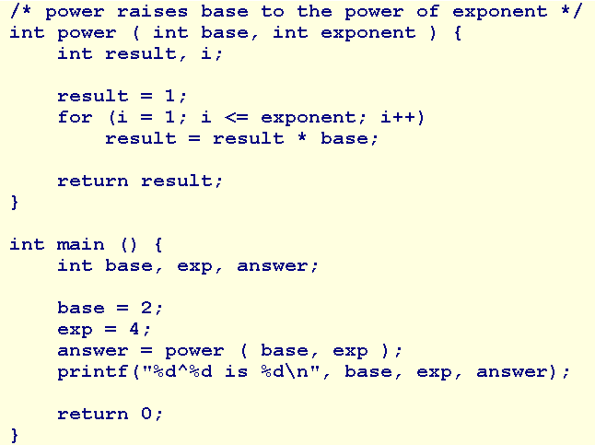
Pass By Value…

Slide 21
main function
The main() function is the function to which the operating system transfers control at the start of execution.
main returns a value to the operating system upon completing execution. C compilers assume an int where we don't provide a return data type.
The operating system typically accepts a value of 0 as an indicator of success and may use this value to control subsequent execution of other programs. .

Slide 22
Coercion
If there is a mismatch between the data type of an argument and the data type of the corresponding parameter, the compiler, wherever possible, coerces the value of the argument into the data type of the parameter.
  int answer;
  answer = power ( 2.5, 4 );//2^4=16

Slide 23
In-Class Practice
Code the function calls and headers for your design of the power/arithmetic-mean program.

Slide 24
Prototypes
Function prototypes describe the form of a function without specifying the implementation details.
To validate the number of arguments, the compiler needs to know the number of parameters.
To coerce argument values, the compiler needs to know the data types of the parameters.
To determine the data type of the call expression, the compiler needs to know the return data type of the function.
A function prototype provides these three pieces of information.

Slide 25
syntax of a prototype
  returnDataType functionIdentifier ( dataType [parameterIdentifier], dataType [parameterIdentifier], ... );
A function prototype ends in a semi-colon and has no function body.
The parameter identifiers are optional.
We place function prototypes near the head of our source file and before any function definitions.
For Example: int power (int, int);

Slide 26
#include
We can collect function prototypes into file (along with any #define directives) and refer to the file in our program. Such a file is called a header file.
We use the #include directive to instruct the compiler to insert a copy of the header file into our source code.
Syntax:
  #include "filename" //in current directory
  #include <filename> // in system directories

Slide 27
Style
For style, we
  declare a prototype for each function definition
  specify the return data type in each function definition
  specify void for a function with no parameters
  avoid calling the main function recursively
  include parameter identifiers in the prototype declarations
  use generic comments and variables names so that we can use the function in a variety of applications without modifying its code

Slide 28
Summary
Modularity
Structured Design
In-Class Practice
Functions
Prototypes
Style
Q&A

Slide 29
Scope of a Variable
Local or Global Variables
Basic Validation
Visibility
Walkthroughs with Functions
In-Class Practice

Slide 30
Extern and Scope
The status of any variable in a program is described by two aspects: its extent and its scope.
Its extent is that part of the program over which the variable has memory allocated for it; that is, the lifetime or storage duration of the variable.
The scope of a variable is that part of a program over which the variable is visible; that is, the part over which expressions can access the variable.
The extent of a variable sets the limits on its scope. Variables that are defined within any function are limited in scope to the function within which they are defined. They are invisible outside the function.
Module-D2-Scope of a variable

Slide 31
Local or Global
A variable that is defined within either a function or code block is a local variable.
A variable that is declared outside any function including main is a global variable. The compiler allocates memory for global variables separately and that memory cannot be shared with any other variable. Global variables introduce a high degree of coupling, avoid using global variables altogether .
Module-D2-Scope of a variable

Slide 32
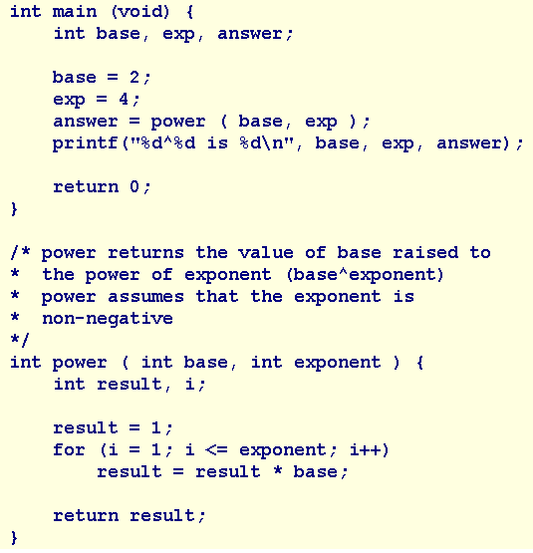
Basic Validation
Let us elaborate our design to accomodate input of the integer values from the user.
what happens?
Let us also add a supporting function that discards any unwanted input.

Slide 33
Visibility
A local variable is visible from its declaration to the end of the code block within which that variable was declared.

Slide 34
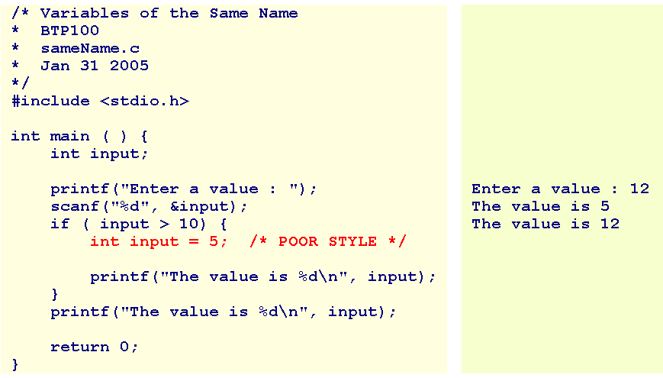
Visibility

Slide 35
Summary
Scope of a Variable
Local or Global Variables
Basic Validation
Visibility
Walkthroughs with Functions (read at home)
Practice (home work)
Q&A

