Slide 1
Module F-Arrays
Simple Data Structures

Slide 2
Arrays
A data structure is a collection of data types designed to store information in some optimal way.
Data structures improve readability and simplify coding considerably.
The simplest example of a data structure is an array.

Slide 3
Session Objectives
Class Problem (without array)
Array Definition
Array Declaration
Array Elements
Array Initialization
Passing Arrays To Functions
Solution (with array)
In-Class Practice

Slide 4
Class Problem (without array)-1
Design and code a program that displays the binary equivalent of a positive integer less than 32767. The program prompts the user for a positive whole number and uses iteration constructs and array syntax

Slide 5
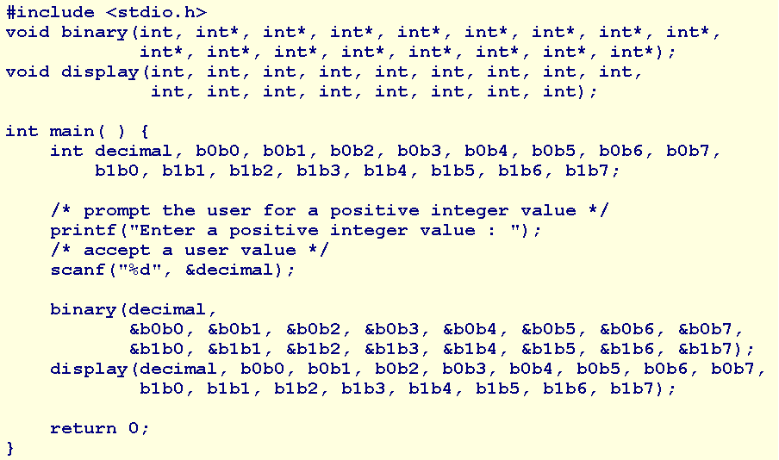
Class Problem (without array)-2

Slide 6
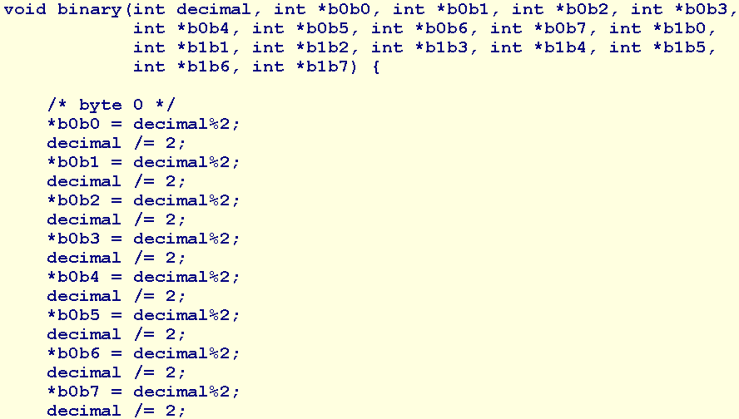
Class Problem (without array)-3

Slide 7
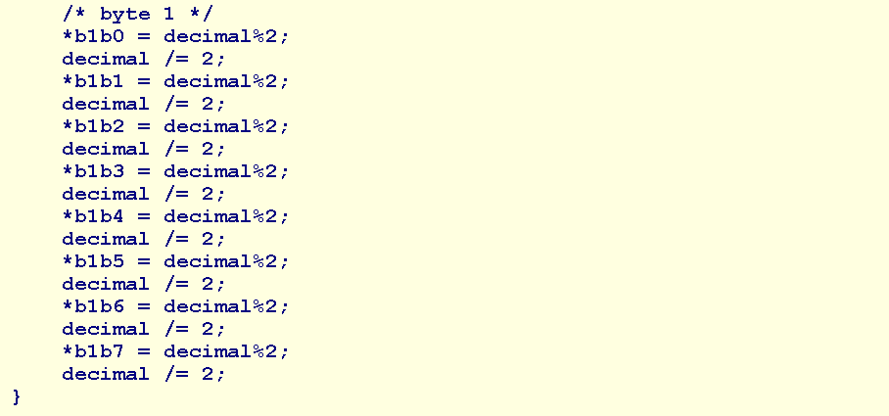
Class Problem (without array)-4

Slide 8
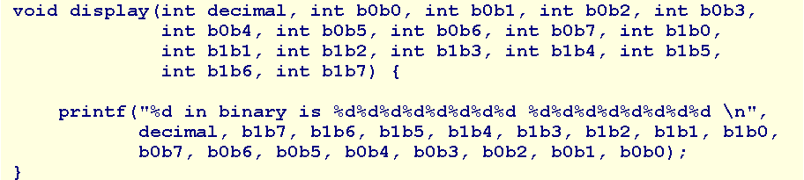
Class Problem (without array)-5
What are the disadvantages of this solution?

Slide 9
Array Definition
An array is an ordered set of related elements of common data type that are stored contiguously in memory.

Slide 10
Array Declaration
dataType identifier [ size ];
For example,
int digit[16];
allocates contiguous storage in primary memory for an array named digit of 16 int elements.

Slide 11
Array Elements
The fundamental unit of an array is an element.
Each element holds has an index and holds one data value.
Index numbering starts at 0 and extends to one less than the size of the array.
To refer to an element, we use the array name followed by bracket notation around the element index.
  For example,
  we denote the 4-th element of digit by digit[3]
The index may be an integer variable, an integer expression or an integer constant.

Slide 12
Array Initialization
  dataType arrayIdentifier[ size ] = { value, ... , value };
  For example:
  int digit[BITS] = {0,0,0,0,0,0,0,0,0,1,0,1,1,1,0,0};
  Or
  int digit[] = {0,0,0,0,0,0,0,0,0,1,0,1,1,1,0,0};

Slide 13
Passing Arrays To Functions-1
Because compilers store the elements of an array contiguously in memory, passing the address of the array to a function is sufficient to enable access to all of the elements of the array within the function.
The location of any element is simply the produce of the offset from the address of the first element and the number of bytes in a sinlge element.
By only passing the address of the array, we avoid copying the array, which may be a rather expensive operation.

Slide 14
Passing Arrays To Functions-2
Arguments
The syntax of a function call that passes an array is
  functionIdentifier ( arrayIdentifier, ... )
Where functionIdentifier is the name of the function and arrayIdentifier is the array name without brackets.

Slide 15
Passing Arrays To Functions-3
Parameters
The syntax of a function header that receives an array address is
  dataType functionIdentifier ( dataType arrayIdentifier [ ], ... )
The brackets following arrayIdentifier inform the compiler that the parameter holds the address of a one-dimensional array

Slide 16
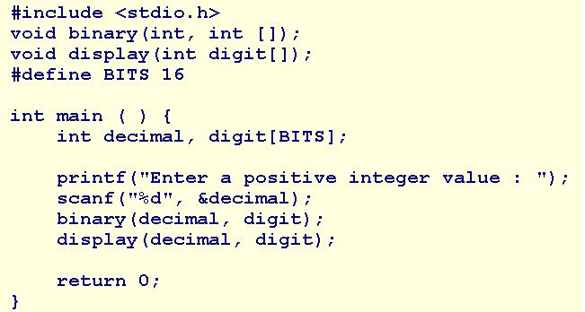
Solution with array-1

Slide 17
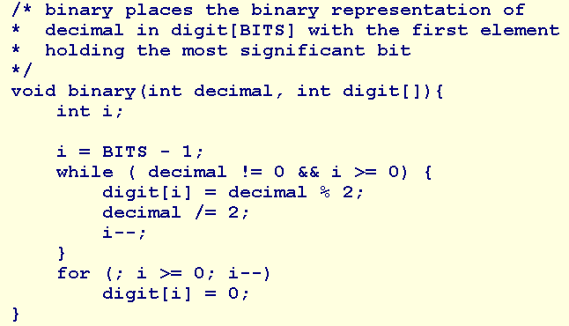
Solution with array-2

Slide 18
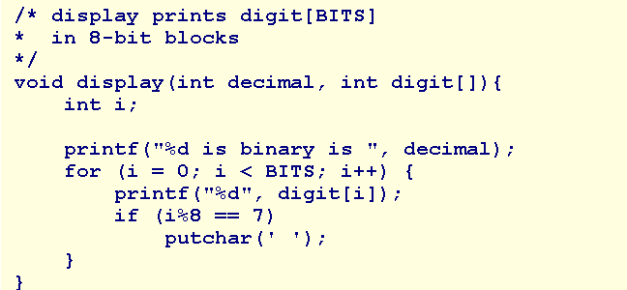
Solution with array-3

Slide 19
Summary
Array
Class Problem (without array)
Array Definition
Array Declaration
Elements
Initialization
Passing Arrays To Functions
Solution (with array)
Q&A

Slide 20
In Class Practice
Design and code a program named coinToss.c that
  prompts the user for the number of times to toss a coin,
  accepts a positive value as the number of times,
  simulates the coin tosses for the requested number of times, and
  reports the percentage of head results and the percentge of tail results for the coin tosses.

