Slide 1
Module G-Strings
Strings

Slide 2
Session Objectives
Strings in C
Null Byte Terminator
Declaration
Output

Slide 3
Null Byte Terminator-1
The null byte is the character with the value (code) 0.
We refer to the null byte using the escape sequence '\0'.

Slide 4
String-1
We use the null byte to locate the last meaningful element in a string.
We store the null byte immediately after the last meaningful element.

Slide 5
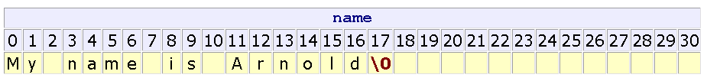
String-2
The number of elements occupied by a string is one byte more than the number of non-null characters in the string.

Slide 6
Declaration
Declare a string in the same way that we declare a character array, except that we allocate space for the terminator null byte.
char name[31]; /* room for 30 characters */
or
char name[31] = "My name is Arnold";
or
char name[31] = {'M','y',' ','n','a','m','e',' ','i','s',' ', 'A','r','n','o','l','d','\0'};

Slide 7
Output
printf uses the conversion specifier %s to process strings
For example:
  char name[31] = "My name is Arnold";
  printf("%s\n", name );

Slide 8
Summary
Strings
Null Byte Terminator
Declaration
Output
Q&A

