Slide 1
Module G-Strings
String Input
String Functions and Arrays of Strings

Slide 2
Session Objectives
String Input
  scanf
  gets
  using getchar()
String Functions and Arrays of Strings
Functions
  strlen
  strcpy
  strcmp
  strcat
Arrays of Strings
  Input and Output
  Passing to Functions
  Sorting an Array of Names
In Class Practice

Slide 3
scanf-1
scanf accepts two conversion specifiers in the format string:
  %s
  %[ ]

Slide 4
scanf-2
The %s conversion specifier
reads all characters until the first whitespace character,
stores the characters read in memory locations starting with the address passed to scanf,
stores the null byte in the memory byte following the last character accepted and
leaves the delimiting whitespace plus any subsequent characters in the input buffer,
ignores any leading whitespace characters.

Slide 5
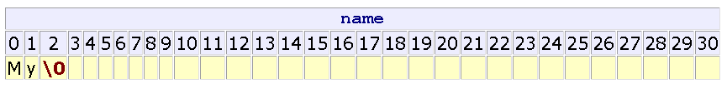
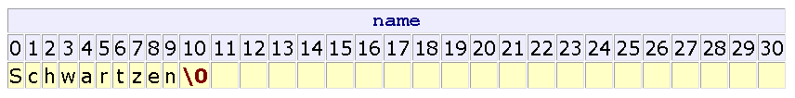
scanf example-1
char name[31];
scanf("%s", name );
Enter: My name is Arnold
char name[31];
scanf("%[10]s", name );
Enter: Schwartzenegger

Slide 6
scanf-3
The %[^\n] conversion specifier
reads all characters until the newline ('\n'),
stores the characters read in memory locations starting with the address passed to scanf,
stores the null byte in the byte following that where scanf stored the last character and
leaves the delimiting character (here, '\n') in the input buffer.

Slide 7
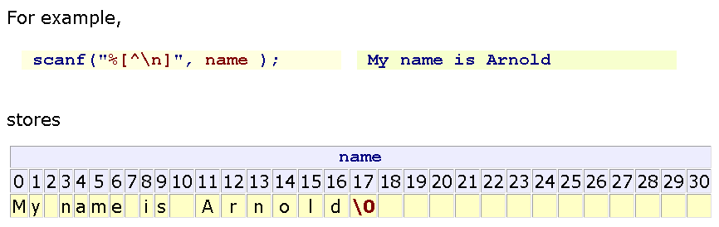
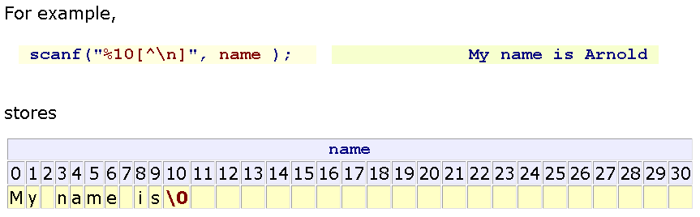
scanf example-2

Slide 8
%[ ] conversion specifier
%[abcd] Searches the input field for any of the characters a, b, c, and d
%[^abcd] Searches the input field for any characters except a, b, c, and d
%[0-9] To catch all decimal digits
%[A-Z] Catches all uppercase letters
%[0-9A-Za-z] Catches all decimal digits and all letters
%[A-FT-Z] Catches all uppercase letters from A through F and from T through Z.

Slide 9
gets
gets is a standard library function that
  accepts an empty string
  uses the '\n' as the delimiter
  throws away the delimiter after accepting the string
  appends the null byte to the end of the set stored
The prototype for gets is
char* gets(char [ ]);
(gets is dangerous. It can fill beyond the memory that allocated for the string)

Slide 10
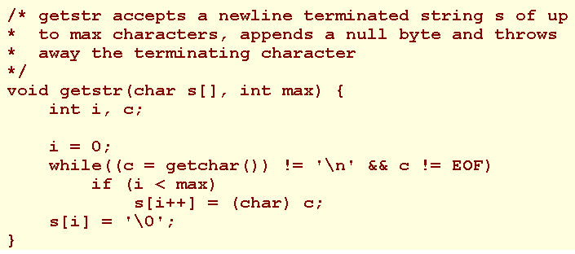
String input using getchar()

Slide 11

String operators
String is an array of char. Array names alone refer to addresses rather than the values stored in the array elements. Accordingly, we cannot apply the operators:
The string library <string.h> contains the functions for string manipulation

Slide 12
strlen
unsigned int strlen(char []);
strlen returns the number of characters in the string excluding the null byte terminator.

Slide 13
strcpy
char* strcpy(char destination[ ], char source[ ]);
strcpy copies source into destination and returns the address of destination.
Ensure that there is sufficient space in destination to hold

Slide 14
strcmp
int strcmp(char s1[ ], char s2[ ]);
strcmp returns:
0 if s1 and s2 are identical,
a negative value if s1 less than s2 a positive value if s1 greater than s2

Slide 15
strcat
char* strcat(char destination[ ], char source[ ]);
strcat appends source to destination and returns the address of destination.
Ensure that there is sufficient space in destination to include both the original string and the appended source.

Slide 16
Arrays of Strings
A string array declaration takes the form
  char identifier[NO_OF_STRINGS][NO_OF_BYTES_PER_STRING];
For example, to declare an array of 5 names, where each name holds up to 30 characters, we write
char names[5][31];

Slide 17
Arrays of Strings Example
char names[5][31] = { "Harry", "Jean", "Jessica", "Irene", "Jim" };

Slide 18
Input and Output
  char identifier[NO_OF_STRINGS][NO_OF_BYTES_PER_STRING];
The address of a string in an array of strings is
identifer[string index]

Slide 19
Passing to Functions
To pass an array of strings to a function, we specify the array name as the argument.
To receive an array of strings as a function parameter, we use the form
dataType functionIdentifier (
dataType identifier[ ][NO_OF_BYTES_PER_STRING], ... )
For example:
void foo (name[][31], int a){ ... }

Slide 20
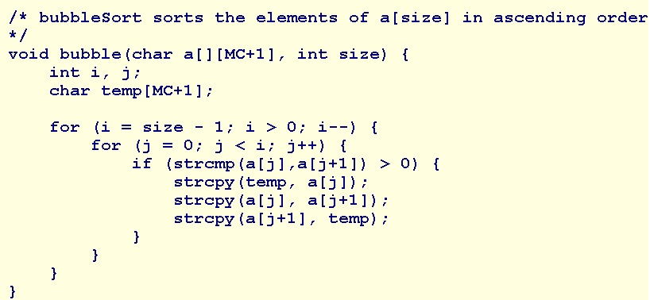
Sorting an Array of Names

Slide 21
Summary
String Input
  scanf
  gets
  using getchar()
String Functions and Arrays of Strings
Functions
  strlen
  strcpy
  strcmp
  strcat
Arrays of Strings
  Input and Output
  Passing to Functions
  Sorting an Array of Names
Q&A

Slide 22
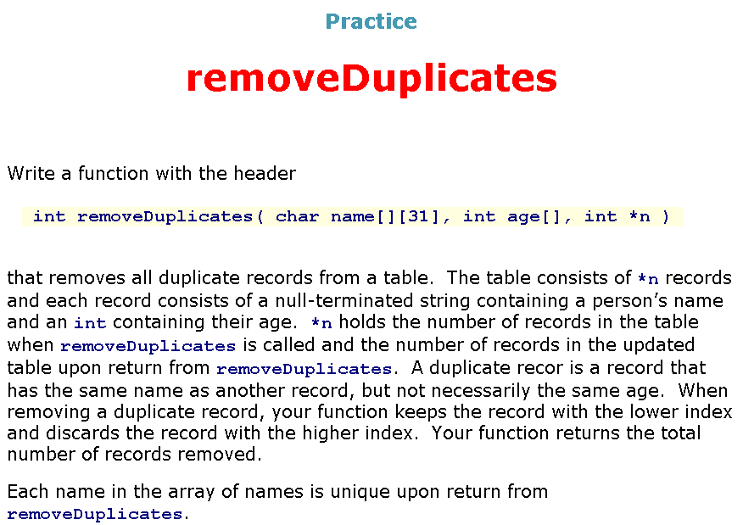

Slide 23
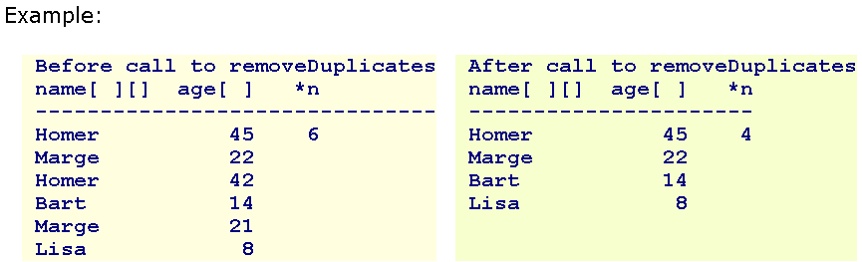
removeDuplicates

