Slide 1
Unity动画系统
韩红雷

Slide 2
Mecanim
Easy workflow and setup of animations for all elements of Unity including objects, characters, and properties.
Support for imported animation clips and animation created within Unity
Humanoid animation retargeting - the ability to apply animations from one character model onto another.
Simplified workflow for aligning animation clips.
Allows animators to work more independently of programmers, prototype and preview their animations before gameplay code is hooked in.
Management of complex interactions between animations with a visual programming tool.
Animating different body parts with different logic.
Layering and masking features

Slide 3
Animation Clip
Smallest building blocks of animation in Unity
They represent an isolated piece of motion, such as RunLeft, Jump, or Crawl, and can be manipulated and combined in various ways to produce lively end results
Animation clips can be selected from imported FBX data (see FBXImporter settings for Animations)

Slide 4
Avatar
After a model file (FBX, COLLADA, etc.) is imported, you can specify what kind of rig it is in the Rig tab of the Model Importer options

Slide 5
Humanoid animations
For a Humanoid rig, select Humanoid and click Apply. Mecanim will attempt to match up your existing bone structure to the Avatar bone structure. In many cases, it can do this automatically by analysing the connections between bones in the rig.
If the match has succeeded, you will see a check mark next to the Configure menu

Slide 6
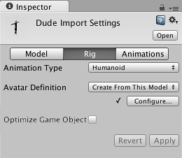

Slide 7
Non-humanoid animations
Two options for non-humanoid animation are provided: Generic and Legacy
Generic animations are imported using the Mecanim system but don’t take advantage of the extra features available for humanoid animations
Legacy animations use the animation system that was provided by Unity before Mecanim
There are some cases where it is still useful to work with legacy animations

Slide 8
Animation workflow
Each of these pieces - the Animation Clips, the Animator Controller, and the Avatar, are brought together on a GameObject via the Animator Component
This component has a reference to an Animator Controller, and (if required) the Avatar for this model. The Animator Controller, in turn, contains the references to the Animation Clips it uses.

Slide 9
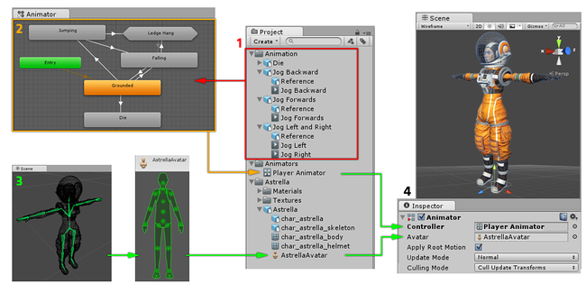

Slide 10
Animator
Animation clips are imported from an external source or created within Unity
The animation clips are placed and arranged in an Animator Controller
The States (which may represent animations or nested sub-state machines) appear as nodes connected by lines
This Animator Controller exists as an asset in the Project window.
The rigged character model has a specific configuration of bones which are mapped to Unity’s common Avatar format. This mapping is stored as an Avatar asset as part of the imported character model, and also appears in the Project window as shown.
When animating the character model, it has an Animator component attached, which has both the Animator Controller and the Avatar assigned. The animator uses these together to animate the model.
The Avatar reference is only necessary when animating a humanoid character. For other types of animation, only an Animator Controller is required.

Slide 11
Humanoid Characters
Need to have a rigged and skinned humanoid type mesh.
A character model is generally made up of polygons in a 3D package or converted to polygon or triangulated mesh, from a more complex mesh type before export.
A joint hierarchy or skeleton which defines the bones inside the mesh and their movement in relation to one another, must be created to control the movement of the character. The process for creating the joint hierarchy is known as rigging.
The mesh or skin must then be connected to the joint hierarchy in order to define which parts of the character mesh move when a given joint is animated. The process of connecting the skeleton to the mesh is known as skinning.

Slide 12
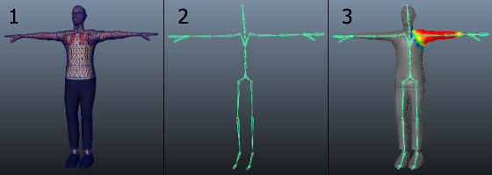

Slide 13
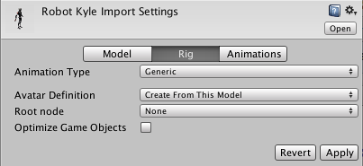
Generic Animations in Mecanim
The full power of Mecanim is most evident when you are working with humanoid animations
However, non-humanoid animations are also supported although without the avatar system and other features

Slide 14
Root node in generic animations
In the case of Generic animations, the skeleton can be arbitrary, and we need to specify a reference bone, or the “root node”
Selecting the root node allows us to establish correspondence between animation clips for a generic model, and blend properly between animations that are not “in place”.
The root node is also essential for separating animation of bones relative to reach other and motion of the root in the world (controlled from OnAnimatorMove).

Slide 15
Animating objects and properties in Unity using Mecanim
You can create animation clips which animate any object or component property using Unity’s animation window
These animation clips can then be arranged into a state machine in exactly the same way as external animation clips such as character animations
For example, you could animate the motion of a camera, the colour of a light, the individual frames of a sprite animation, or a public property of a script.

Slide 16
Set up animation
Create a New Animator Controller
Open the Animator Window to edit the Animator Controller
Drag the desired animation clip into the Animator Controller Window
Drag the model asset into the Hierarchy.
Add the animator controller to the Animator component of the asset.

Slide 17
Looping animation clips
The animation clip representing the walk cycle, begins and ends in a similar pose (e.g. left foot on the ground), to ensure there is no foot sliding, or strange jerky motions. Mecanim provides convenient tools for this. Animation clips can loop based on pose, rotation, and position.
If you place the Start / End marker in a place where the curve for the property is green, it is more likely that the clip can loop properly. The loop match indicator will show how good the looping is for the selected ranges.

Slide 18
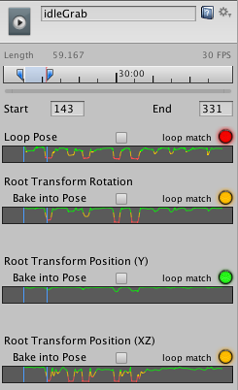
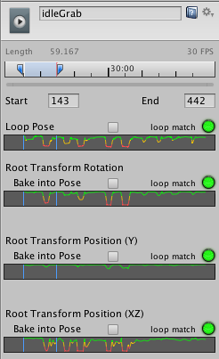

Slide 19
Masking Imported Clips
Masking allows you to discard some of the animation data within a clip, allowing the clip to animate only parts of the object or character rather than the entire thing
You could create a mask for the throwing animation limiting it to just the right arm, upper body and head
To apply a mask to an imported animation clip, first select the imported animation file in your project view, then in the import settings in the inspector, select the Animations button.

Slide 20
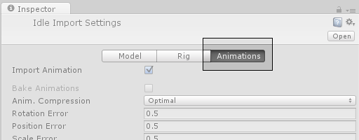


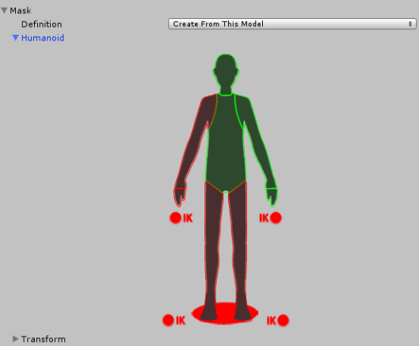
Then scroll all the way to the bottom of the inspector to find the Mask heading, among the four fold-out headings as shown:

Slide 21
Animation Curves on Imported Clips
Animation curves allow you to add additional animated data to an imported clip, which can allow you to animate the timings of other items based on the state of an animator
For example, in a game set in icy conditions, an extra animation curve could be used to control the emission rate of a particle system to show the player’s condensing breath in the cold air.

Slide 22
Expand the curves heading, and click the plus icon to add a new curve to the current animation clip
If your imported animation file is split into multiple animation clips, each clip can have its own custom curves.
The curve’s X-axis represents normalized time and always ranges between 0.0 and 1.0 (corresponding to the beginning and the end of the animation clip respectively, regardless of its duration).

Slide 23
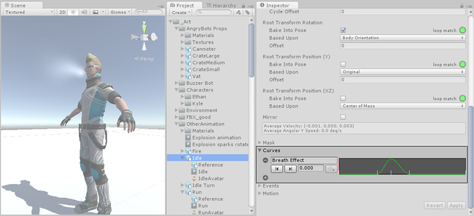
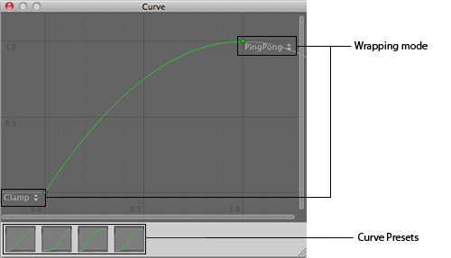

Slide 24
Animation Curves and Animator Controller parameters
If you have a curve with the same name as one of the parameters in the Animator Controller, then that parameter will take its value from the value of the curve at each point in the timeline
For example, if you make a call to GetFloat from a script, the returned value will be equal to the value of the curve at the time the call is made
Note that at any given point in time, there might be multiple animation clips attempting to set the same parameter from the same controller
In that case, the curve values from the multiple animation clips are blended
If an animation has no curve for a particular parameter then the blending will be done with the default value for that parameter.

Slide 25
Animation Events on Imported Clips
These events allow you to add additional data to an imported clip which determines when certain actions should occur in time with the animation
For example, for an animated character you might want to add events to walk and run cycles indicating when the footstep sounds should play

Slide 26
When adding an event, the event needs a name, which will be the name of the function that is called when the event is triggered. For any Gameobject which uses this animation in its animator, you should make sure the Gameobject has a corresponding script attached that contains a function whose name matches the event name. Below, you can see a footstep event set up to call the “Footstep” function in a script attached to the Player Gameobject.

Slide 27
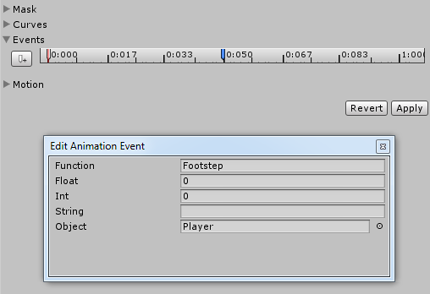

Slide 28
You can optionally choose to specify a parameter which is also sent to the function called by the event. There are four different parameter types you can use, Float, Int, String or Object.
By filling out a value in one of these fields, and implementing your receiver function to accept a parameter of that type, you can have the value specified in the event passed through to your function in the script
For example, you could pass a float value to specify how loud the footstep should be - allowing you to have quiet footstep events on a walking loop and loud footstep events on a running loop
Or you could pass a reference to an effect prefab, allowing your script to instantiate different effects at certain points during your animation

Slide 29
Selecting a Root Motion Node
When root motion is contained within an imported animation clip, that motion will be used to drive the movement and rotation of the GameObject that is playing the animation
Sometimes however it may be necessary to manually select a different specific node within the hierarchy of your animation file to act as the root motion node
Once the Root motion node has been selected, the object’s motion will now be driven by the animation from that particular object.

Slide 30
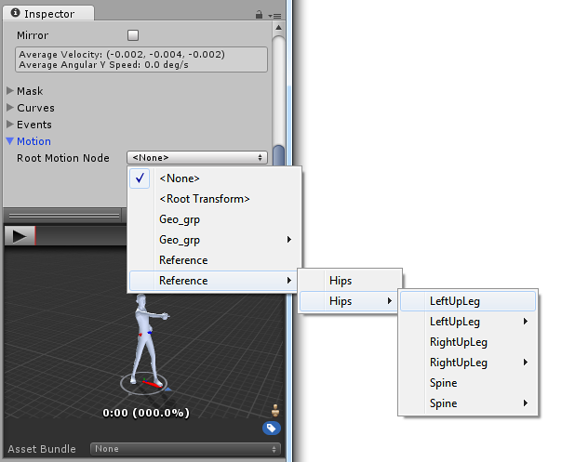

Slide 31
Using the Animation View

Slide 32
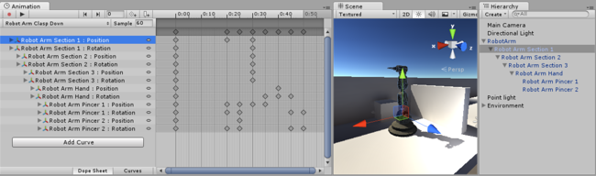

Slide 33
Viewing Animations on a GameObject
The Animation View is tightly integrated with the Hierarchy View, the Scene View, and the Inspector. Similar to the Inspector, the Animation View will show the timeline and keyframes of the animation for the currently selected Game Object
You can select a Game Object using the Hierarchy View or the Scene View. (If you select a Prefab in the Project View you can inspect its animation timeline as well, but you have to drag the Prefab into the Scene View in order to be able to edit the animation.)

Slide 34
Animator Controllers

Slide 35
In most situations, it is normal to have multiple animations and switch between them when certain game conditions occur
For example, you could switch from a walk animation to a jump whenever the spacebar is pressed
However even if you just have a single animation clip you still need to place it into an animator controller to use it on a Game Object.
The controller manages the various animation states and the transitions between them using a so-called State Machine, which could be thought of as a kind of flow-chart, or a simple program written in a visual programming language within Unity

Slide 36
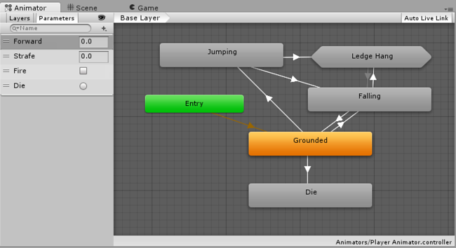

Slide 37
Animation State Machines
A character may breathe or sway slightly while idle, walk when commanded to and raise its arms in panic as it falls from a platform
A door may have animations for opening, closing, getting jammed, and being broken open
Mecanim uses a visual layout system similar to a flow-chart, to represent a state machine to enable you to control and sequence the animation clips that you want to use on your character or object

Slide 38
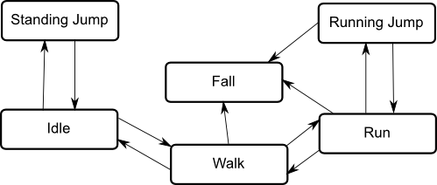
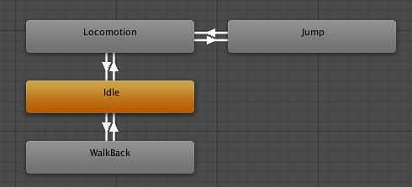

Slide 39
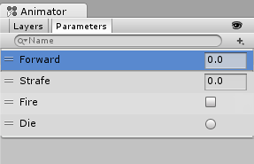
Animation Parameters
Animation Parameters are variables that are defined within an Animator Controller that can be accessed and assigned values from scripts
This is how a script can control or affect the flow of the state machine.
For example, a script can set a parameter to control a Blend Tree.

Slide 40
using UnityEngine;
using System.Collections;
public class SimplePlayer : MonoBehaviour {
Animator animator;
// Use this for initialization
void Start () {
animator = GetComponent<Animator>();
}
// Update is called once per frame
void Update () {
float h = Input.GetAxis("Horizontal");
float v = Input.GetAxis("Vertical");
bool fire = Input.GetButtonDown("Fire1");
animator.SetFloat("Forward",v);
animator.SetFloat("Strafe",h);
animator.SetBool("Fire", fire);
}
void OnCollisionEnter(Collision col) {
if (col.gameObject.CompareTag("Enemy"))
{
animator.SetTrigger("Die");
}
}
}

Slide 41
State Machine Transitions
State Machine Transitions exist to help you simplify large or complex State Machines
They allow you to have a higher level of abstraction over the state machine logic.
Each view in the animator window has an Entry and Exit node. These are used during State Machine Transitions.
always be a default transition branching from the entry node to the default state.

Slide 42
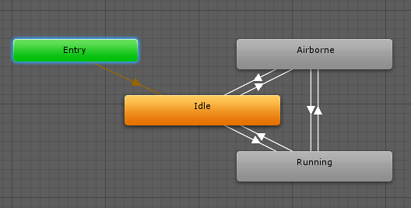
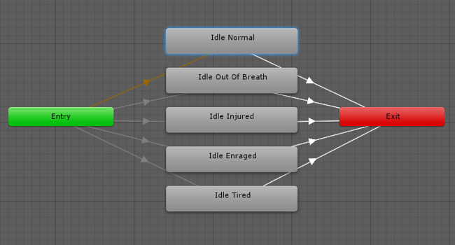

Slide 43
Each sub-state within a state machine is considered a separate and complete state machine
It is possible to mix state machine transitions with regular state transtitions, so it is possible to transition from state to state, from a state to a statemachine, and from one statemachine directly to another statemachine.

Slide 44
State Machine Behaviours
A State Machine Behaviour is a special class of script
Can attach a StateMachineBehaviour script to an individual state within a state machine
This allows you to write code that will execute when the state machine enters, exits or remains within a particular state
This means you do not have to write your own logic to test for and detect changes in state.
A few examples for the use of this feature might be to:
Play sounds as states are entered or exited
Perform certain tests (eg, ground detection) only when in appropriate states
Activate and control special effects associated with specific states

Slide 45
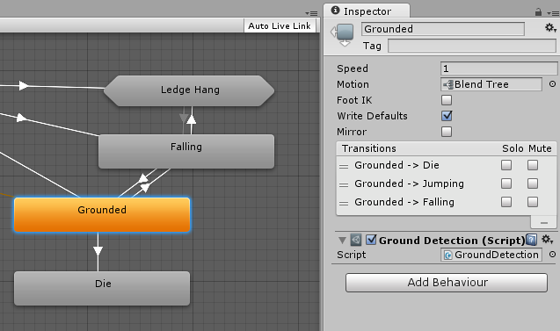

Slide 46
Sub-State Machines
It is common for a character to have complex actions that consist of a number of stages
Rather than handle the entire action with a single state, it makes sense to identify the separate stages and use a separate state for each
For example, a character may have an action called “Trickshot” where it crouches to take a steady aim, shoots and then stands up again.

Slide 47
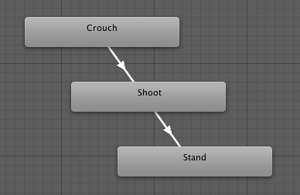
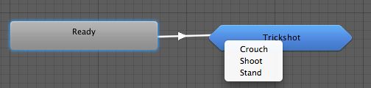

Slide 48
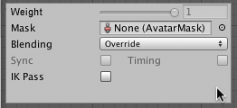

Animation Layers
Unity uses Animation Layers for managing complex state machines for different body parts
walking-jumping, and an upper-body layer for throwing objects / shooting

Slide 49
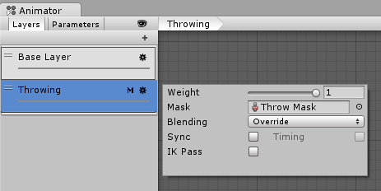
On each layer, you can specify the mask (the part of the animated model on which the animation would be applied), and the Blending type
Override means information from other layers will be ignored
Additive means that the animation will be added on top of previous layers.
The Mask property is there to specify the mask used on this layer
If you wanted to play a throwing animation on just the upper body of your model, while having your character also able to walk, run or stand still at the same time, you would use a mask on the layer which plays the throwing animation where the upper body sections are defined

Slide 50
Animation Layer syncing
Sometimes it is useful to be able to re-use the same state machine in different layers
If you want to simulate “wounded” behavior, and have “wounded” animations for walk / run / jump instead of the “healthy” ones. You can click the Sync checkbox on one of your layers, and then select the layer you want to sync with. The state machine structure will then be the same, but the actual animation clips used by the states will be distinct.
This means the Synced layer does not have its own state machine definition at all - instead, it is an instance of the source of the synced layer. Any changes you make to the layout or structure of the state machine in the synced layer view (eg, adding/deleting states or transitions) is done to the source of the synced layer
The only changes that are unique to the synced layer are the selected animations used within each state.

Slide 51
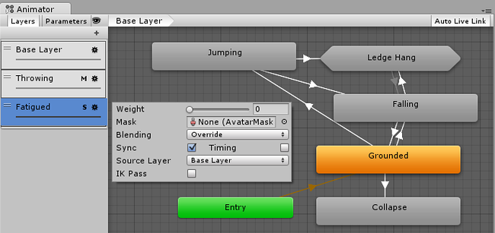

Slide 52
Solo and Mute functionality
In complex state machines, it is useful to preview the operation of some parts of the machine separately
For this, you can use the Mute / Solo functionality
Muting means a transition will be disabled. Soloed transtions are enabled and with respect to other transitions originating from the same state
You can set up mute and solo states either from the Transition Inspector, or the State Inspector (recommended), where you’ll have an overview of all the transitions from that state.

Slide 53
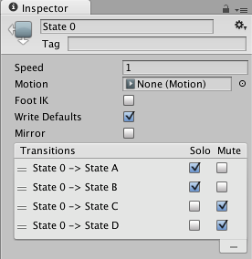
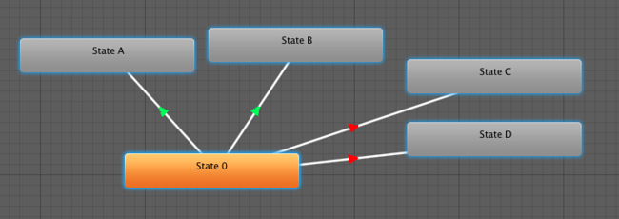
In the example above, if you are in State 0, only transitions to State A and State B will be available.
The basic rule of thumb is that if one Solo is ticked, the rest of the transitions from that state will be muted.
If both Solo and Mute are ticked, then Mute takes precedence.

Slide 54
Target Matching
Often in games, a situation arises where a character must move in such a way that a hand or foot lands at a certain place at a certain time
For example, the character may need to jump across stepping stones or jump and grab an overhead beam.
You can use the Animator.MatchTarget function to handle this kind of situation

Slide 55
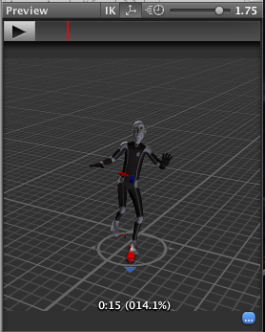
For example, you want to arrange an situation where the character jumps onto a platform and you already have an animation clip for it called Jump Up
Firstly, you need to find the place in the animation clip at which the character is beginning to get off the ground, note in this case it is 14.1% or 0.141 into the animation clip in normalized time

Slide 56
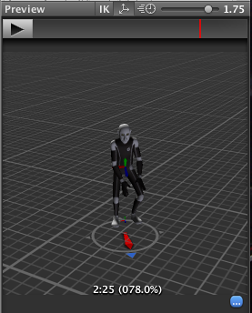
You also need to find the place in the animation clip where the character is about to land on his feet, which in this case is at 78.0% or 0.78.

Slide 57
using UnityEngine;
using System;
[RequireComponent(typeof(Animator))]
public class TargetCtrl : MonoBehaviour {
protected Animator animator;
//the platform object in the scene
public Transform jumpTarget = null;
void Start () {
animator = GetComponent<Animator>();
}
void Update () {
if(animator) {
if(Input.GetButton("Fire1"))
animator.MatchTarget(jumpTarget.position, jumpTarget.rotation, AvatarTarget.LeftFoot,
new MatchTargetWeightMask(Vector3.one, 1f), 0.141f, 0.78f);
}
}
}

Slide 58
Inverse Kinematics
Most animation is produced by rotating the angles of joints in a skeleton to predetermined values. The position of a child joint changes according to the rotation of its parent and so the end point of a chain of joints can be determined from the angles and relative positions of the individual joints it contains. This method of posing a skeleton is known as forward kinematics.
However, it is often useful to look at the task of posing joints from the opposite point of view - given a chosen position in space, work backwards and find a valid way of orienting the joints so that the end point lands at that position. This can be useful when you want a character to touch an object at a point selected by the user or plant its feet convincingly on an uneven surface. This approach is known as Inverse Kinematics (IK) and is supported in Mecanim for any humanoid character with a correctly configured Avatar

Slide 59
To set up IK for a character, you typically have objects around the scene that a character interacts with, and then set up the IK thru script, in particular, Animator functions like SetIKPositionWeight, SetIKRotationWeight, SetIKPosition, SetIKRotation, SetLookAtPosition, bodyPosition, bodyRotation

Slide 60
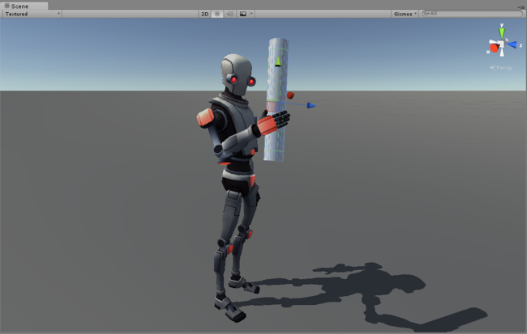

Slide 61
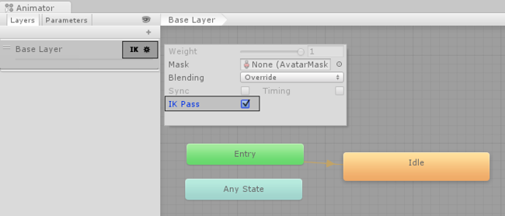

Slide 62
using UnityEngine;
using System;
using System.Collections;
[RequireComponent(typeof(Animator))]
public class IKControl : MonoBehaviour {
protected Animator animator;
public bool ikActive = false;
public Transform rightHandObj = null;
public Transform lookObj = null;
void Start ()
{
animator = GetComponent<Animator>();
}
//a callback for calculating IK
void OnAnimatorIK()
{
if(animator) {
//if the IK is active, set the position and rotation directly to the goal.
if(ikActive) {
// Set the look target position, if one has been assigned
if(lookObj != null) {
animator.SetLookAtWeight(1);
animator.SetLookAtPosition(lookObj.position);
}
// Set the right hand target position and rotation, if one has been assigned
if(rightHandObj != null) {
animator.SetIKPositionWeight(AvatarIKGoal.RightHand,1);
animator.SetIKRotationWeight(AvatarIKGoal.RightHand,1);
animator.SetIKPosition(AvatarIKGoal.RightHand,rightHandObj.position);
animator.SetIKRotation(AvatarIKGoal.RightHand,rightHandObj.rotation);
}
}
//if the IK is not active, set the position and rotation of the hand and head back to the original position
else {
animator.SetIKPositionWeight(AvatarIKGoal.RightHand,0);
animator.SetIKRotationWeight(AvatarIKGoal.RightHand,0);
animator.SetLookAtWeight(0);
}
}
}
}

Slide 63
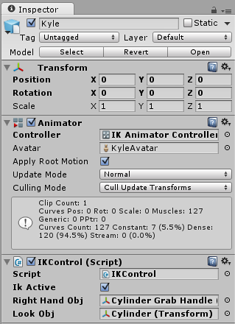
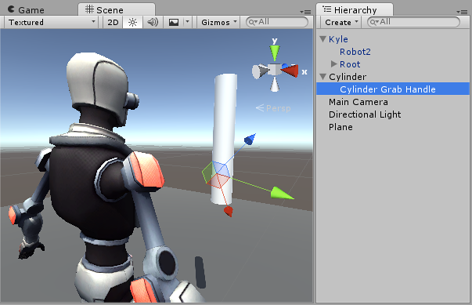

Slide 64
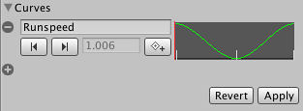
Scripting Root Motion for “in-place” humanoid animations
The animation does not contain “root motion”. For this, we can modify root motion from script
On the animation clip create a curve that will control the speed of the character (you can add a curve from the Animation Import inspector Curves-> +)
Name that curve something meaningful, like “Runspeed”

Slide 65
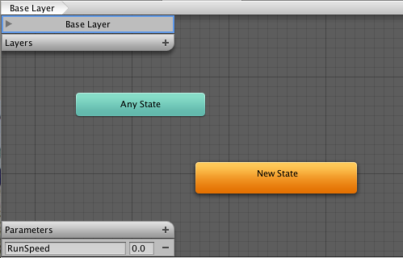
Create a new Animator Controller
Drop the desired animation clip into it
Add a parameter to the Controller with the same name as the curve (Runspeed)

Slide 66
Select the character Dude in the Hierarchy, whose inspector should already have an Animator component.
Drag RootMotionController onto the Controller property of the Animator
If you press play now, you should see the “Dude” running in place

Slide 67
using UnityEngine;
using System.Collections;
[RequireComponent(typeof(Animator))]
public class RootMotionScript : MonoBehaviour {
void OnAnimatorMove()
{
Animator animator = GetComponent<Animator>();
if (animator)
{
Vector3 newPosition = transform.position;
newPosition.z += animator.GetFloat("Runspeed") * Time.deltaTime;
transform.position = newPosition;
}
}
}

Slide 68
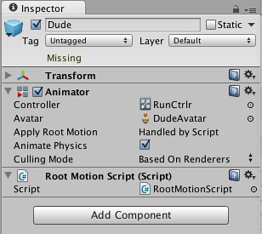
Animator component will detect that the script has an OnAnimatorMove function and show the Apply Root Motion property as Handled by Script

Slide 69
Blend Trees
Perhaps the best known example is the blending of walking and running animations according to the character’s speed. Another example is a character leaning to the left or right as he turns during a run.
Transitions VS Blend Trees
While both are used for creating smooth animation, they are used for different kinds of situations.
Transitions are used for transitioning smoothly from one Animation State to another over a given amount of time. Transitions are specified as part of an Animation State Machine. A transition from one motion to a completely different motion is usually fine if the transition is quick.
Blend Trees are used for allowing multiple animations to be blended smoothly by incorporating parts of them all to varying degrees. The amount that each of the motions contributes to the final effect is controlled using a blending parameter, which is just one of the numeric animation parameters associated with the Animator Controller. In order for the blended motion to make sense, the motions that are blended must be of similar nature and timing. Blend Trees are a special type of state in an Animation State Machine.

Slide 70
Examples of similar motions could be various walk and run animations. In order for the blend to work well, the movements in the clips must take place at the same points in normalized time. For example, walking and running animations can be aligned so that the moments of contact of foot to the floor take place at the same points in normalized time (e.g. the left foot hits at 0.0 and the right foot at 0.5). Since normalized time is used, it doesn’t matter if the clips are of different length.

Slide 71
Using Blend Trees
Right-click on empty space on the Animator Controller Window.
Select Create State > From New Blend Tree from the context menu that appears.
Double-click on the Blend Tree to enter the Blend Tree Graph.
The Animator Window now shows a graph of the entire Blend Tree while the Inspector shows the currently selected node and its immediate children.

Slide 72
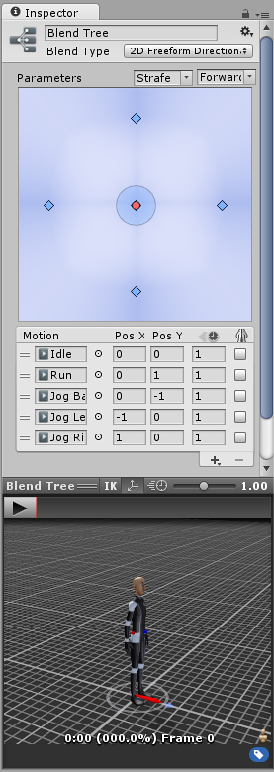
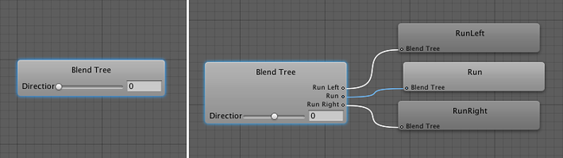

Slide 73
1D Blending
1D Blending blends the child motions according to a single parameter.
After setting the Blend Type, the first thing you need is to select the Animation Parameter that will control this Blend Tree. In this example, the parameter is direction which varies between –1.0 (left) and +1.0 (right), with 0.0 denoting a straight run without leaning.
Then you can add individual animations by clicking the small “+” button and selecting Add Motion Field from the popup menu. When you’re done, it should look something like this:

Slide 74
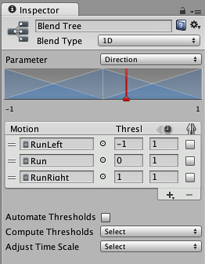
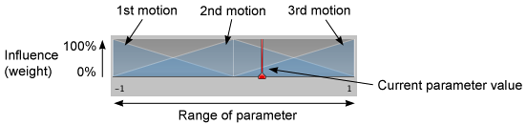

Slide 75
2D Blending
The 2D blending types blends the child motions according to two parameters.
2D Simple Directional: Best used when your motions represent different directions, such as “walk forward”, “walk backward”, “walk left”, and “walk right”, or “aim up”, “aim down”, “aim left”, and “aim right”. Optionally a single motion at position (0, 0) can be included, such as “idle” or “aim straight”. In the Simple Directional type there should not be multiple motions in the same direction, such as “walk forward” and “run forward”.
2D Freeform Directional: This blend type is also used when your motions represent different directions, however you can have multiple motions in the same direction, for example “walk forward” and “run forward”. In the Freeform Directional type the set of motions should always include a single motion at position (0, 0), such as “idle”.
2D Freeform Cartesian: Best used when your motions do not represent different directions. With Freeform Cartesian your X parameter and Y parameter can represent different concepts, such as angular speed and linear speed. An example would be motions such as “walk forward no turn”, “run forward no turn”, “walk forward turn right”, “run forward turn right” etc.
Direct: This type of blend tree lets user control the weight of each node directly. Useful for facial shapes or random idle blending

Slide 76
After setting the Blend Type, the first thing you need is to select the two Animation Parameters that will control this Blend Tree
Then you can add individual animations by clicking + -> Add Motion Field to add an Animation Clip to the blend tree

Slide 77
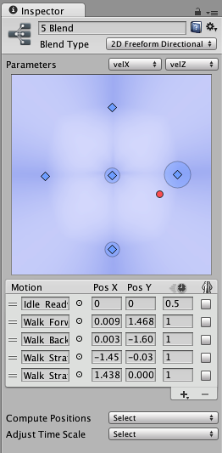

Slide 78
The positions in 2D blending are like the thresholds in 1D blending, except that there are two values instead of one, corresponding to each of the two parameters
A walking forward animation might have a velocityX of 0 and a velocityZ of 1.5

Slide 79
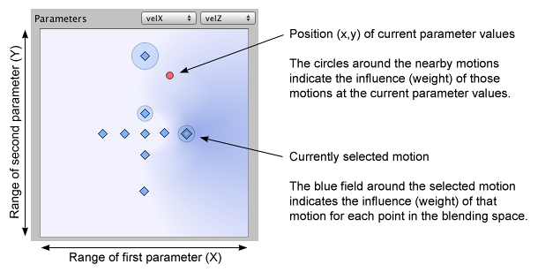

Slide 80
For example, that your parameters correspond to sideways velocity and forward velocity, and that you have an idle animation with an average velocity (0, 0, 0), a walk animation with (0, 0, 1.5), and two strafe animations with velocities of (–1.5, 0, 0) and (1.5, 0, 0) respectively. Choosing the Velocity XZ option from the drop-down would set the positions of the motions according to the X and Z coordinates of those velocities

Slide 81
Direct Blending
Using a Direct Blend Tree allows you to map animator parameters directly to the weight of a BlendTree child
This can be useful if you want to have exact control over the various animations that are being blended rather than blend them indirectly using one or two parameters (in the case of 1D and 2D blend trees).

Slide 82
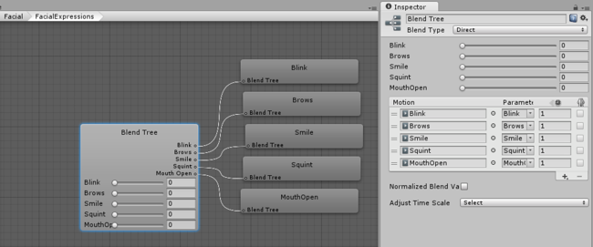

Slide 83
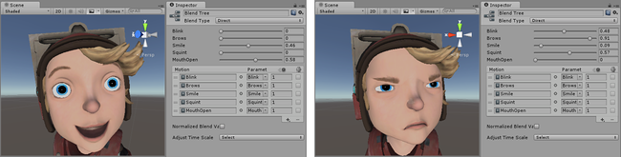
Each motion should then be assigned a corresponding parameter to directly control its blend weight in the tree
In effect, this Direct mode simply bypasses the crossfading, or the various 2D blending algorithms (Freeform Directional, Freeform Cartesian, etc) and allows you to implement whatever code you like to control the mix of blended animations.
This can be particularly useful when mixing blendshape animations for facial expressions, or when blending together additive animations.

Slide 84
Animation Blend Shapes
Once you have your Blend Shapes setup in Maya:
Export your selection to fbx ensuring the animation box is checked and blend Shapes under deformed models is checked.
Import your fbx file into Unity (assets->import new assets->[name of file].fbx).
Drag the asset into the hierarchy window. If you select your object in the hierarchy and look in the inspector, you will see your Blend Shapes are listed under the SkinnedMeshRenderer component. Here you can adjust the influence of the blend shape to the default shape, 0 means the blend shape has no influence and 100 means the blend shape has full influence.

Slide 85
Create Animations In Unity
Open the Animation window under Window->Animation.
On the left of the window click ‘Add Curve’ and add a Blend Shape which will be under Skinned Mesh Renderer.
From here you can manipulate the keyframes and Blend Weights to create the required animation.
Once you are finished editing your animation you can click play in the editor window or the animation window to preview your animation.

Slide 86
public class BlendShapeExample : MonoBehaviour
{
int blendShapeCount;
SkinnedMeshRenderer skinnedMeshRenderer;
Mesh skinnedMesh;
float blendOne = 0f;
float blendTwo = 0f;
float blendSpeed = 1f;
bool blendOneFinished = false;
void Awake ()
{
skinnedMeshRenderer = GetComponent<SkinnedMeshRenderer> ();
skinnedMesh = GetComponent<SkinnedMeshRenderer> ().sharedMesh;
}
void Start ()
{
blendShapeCount = skinnedMesh.blendShapeCount;
}
void Update ()
{
if (blendShapeCount > 2) {
if (blendOne < 100f) {
skinnedMeshRenderer.SetBlendShapeWeight (0, blendOne);
blendOne += blendSpeed;
} else {
blendOneFinished = true;
}
if (blendOneFinished == true && blendTwo < 100f) {
skinnedMeshRenderer.SetBlendShapeWeight (1, blendTwo);
blendTwo += blendSpeed;
}
}
}
}

Slide 87
Retargeting of Humanoid animations

Slide 88
One of the most powerful features of Mecanim is retargeting of humanoid animations
This means that with relative ease, you can apply the same set of animations to various character models
Retargeting is only possible for humanoid models, where an Avatar has been configured, because this gives us a correspondence between the models’ bone structure.

Slide 89
Recommended Hierarchy structure
The Imported character model, which has an Avatar on it.
The Animator Component, referencing an Animator Controller asset.
A set of animation clips, referenced from the Animator Controller.
Scripts for the character.
Character-related components, such as the Character Controller.

Slide 90
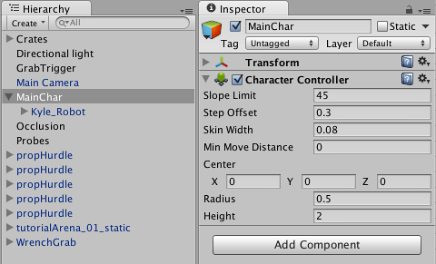
Create a GameObject in the Hierarchy that contains Character-related components

Slide 91
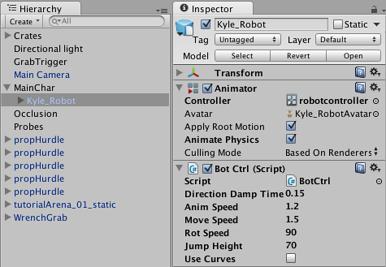
Put the model as a child of the GameObject, together with the Animator component

Slide 92
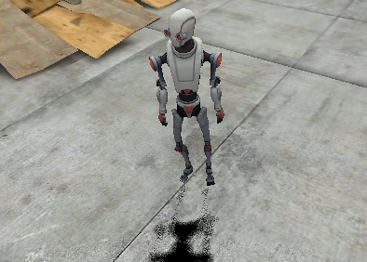
Make sure scripts referencing the Animator are looking for the animator in the children instead of the root; use GetComponentInChildren<Animator>() instead of GetComponent<Animator>().

Slide 93
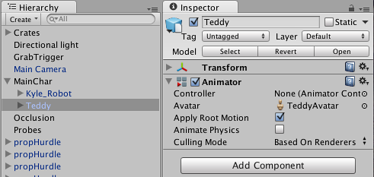
Then in order to reuse the same animations on another model, you need to:
Disable the original model
Drop in the desired model as another child of GameObject

Slide 94

Make sure the Animator Controller property for the new model is referencing the same controller asset

Slide 95
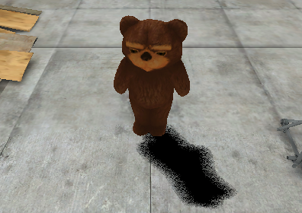
Tweak the character controller, the transform, and other properties on the top-level GameObject, to make sure that the animations work smoothly with the new model.

Slide 96
Performance and Optimization

Slide 97
Number of Bones
In some cases you will need to create characters with a large number of bones, for example when you want a lot of customizable attachments
These extra bones will increase the size of the build, and you could expect to have a relative processing cost for each additional bone
For example, 15 additional bones on a rig that already has 30 bones will take 50% longer to solve in Generic mode
When you have no animations playing using the additional bones, the processing cost should be negligible. This cost will be even lower if their attachments are non existent or hidden.

Slide 98
Multiple Skinned Meshes
Combine skinned meshes whenever possible
Splitting a character into two Skinned Mesh Renderers is a bad idea with regard to performance
It’s better if your character has just one material, but there are some cases when you might require more materials.

Slide 99
Controllers
The Animator doesn’t spend time processing when a Controller is not set to it.

Slide 100
Simple Animation
Playing a single Animation Clip with no blending can make Mecanim slower than the legacy animation system.
The Mecanim layout is optimized for animation blending and more complex setups.

Slide 101
Scale Curves
Animating scale curves is more expensive than animating translation and rotation curves. To improve performance, avoid scale animations.
Note: This does not apply to constant curves (curves that have the same value for the length of the Animation Clip ). Constant curves are optimized, and are less expensive that normal curves.

Slide 102
Layers
Most of the time Mecanim is evaluating animations, and the overhead for AnimationLayers and AnimationStateMachines is kept to the minimum
The cost of adding another layer to the animator, synchronized or not, depends on what animations and blend trees are played by the layer
When the weight of the layer is zero, the layer update will be skipped.

Slide 103
Humanoid vs. Generic Modes
When importing Humanoid animation use a BodyMask to remove IK Goals or fingers animation if they are not needed.
When you use Generic, using root motion is more expensive than not using it
If your animations don’t use root motion, make sure that you have no root bone selected.

Slide 104
Mecanim Scene
Use hashes instead of strings to query the Animator.
Implement a small AI Layer to control the Animator
You can make it provide simple callbacks for OnStateChange, OnTransitionBegin, etc.
Use State Tags to easily match your AI state machine to the Mecanim state machine.
Use additional curves to simulate Events.
Use additional curves to mark up your animations, for example in conjunction with target matching.

Slide 105
Runtime Optimizations
Always optimize animations by setting the animators’s Culling Mode to Based on Renderers, and disable the skinned mesh renderer’s Update When Offscreen property
This way animations won’t be updated when the character is not visible

