Slide 1
Multiplayer and Networking

Slide 2
Intro
Unity 5.1 has a new and improved Networking system with more flexibility and power than the networking system provided in earlier versions of Unity
It has a lower level NetworkTransport class which is a thin layer above basic sockets and then higher level components which add more useful multiplayer features.

Slide 3
Networking overview
There are two kinds of users for the Networking feature:
Users making a Multiplayer game with Unity. These users should start with the NetworkManager or the High Level API.
Users building network infrastructure or advanced multiplayer games. These users should start with the NetworkTransport API.

Slide 4
High level scripting API
Unity’s networking is integrated into the engine and the editor, allowing you to work with components and visual aids to build your multiplayer game:
A NetworkIdentity component for networked objects.
A NetworkBehaviour for networked scripts.
Configurable automatic synchronization of object transforms.
Automatic synchronization of script variables.
Support for placing networked objects in Unity scenes.
Network components

Slide 5
Internet Services
Unity offers Internet Services to support your game throughout production and release:
Matchmaking service
Create matches and advertise matches.
List available matches and join matches.
Relay server
Game-play over internet with no dedicated server.
Routing of messages for participants of matches.

Slide 6
NetworkTransport real-time transport layer
Optimized UDP based protocol.
Multi-channel design to avoid head-of-line blocking issues
Support for a variety of levels of Quality of Service (QoS) per channel.
Flexible network topology that supports peer-to-peer or client-server architectures.

Slide 7
The High Level API

Slide 8
The High Level API
For building multiplayer capabilities for Unity games
It is built on top of the lower level transport real-time communication layer, and handles many of the common tasks that are required for multiplayer games
While the transport layer supports any kind of network topology, the HLAPI is a server authoritative system; although it allows one of the participants to be a client and the server at the same time, so no dedicated server process is required
Working in conjunction with the internet services, this allows multiplayer games to be played over the internet with little work from developers.

Slide 9
The HLAPI is a new set of networking commands built into Unity, within a new namespace: UnityEngine.Networking
It is focused on ease of use and iterative development and provides services useful for multiplayer games, such as:
•Message handlers
•General purpose high performance serialization
•Distributed object management
•State synchronization
•Network classes: Server, Client, Connection, etc

Slide 10
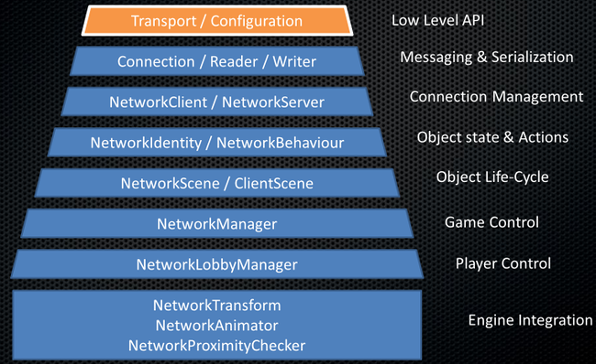

Slide 11
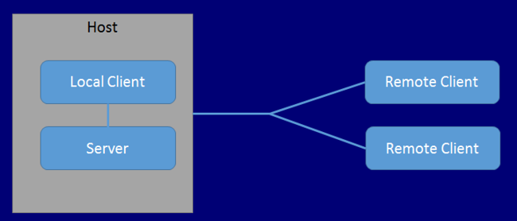
Server and Host
In the unity networking system, games have a Server and multiple Clients
When there is no dedicated server, one of the clients plays the role of the server - we call this client the “host”.

Slide 12
The host is a server and a client in the same process
The host uses a special kind of client called the LocalClient, while other clients are RemoteClients
The LocalClient communicates with the (local) server through direct function calls and message queues, since it is in the same process. It actually shares the scene with the server
RemoteClients communicate with the server over a regular network connection.
A goal of the networking system is that the code for LocalClients and RemoteClients is the same, so that developers only have to think about one type of client most of the time.

Slide 13
Instantiate and Spawn
In Unity, GameObject.Instantiate creates new Unity game objects
But with the networking system, objects must also be “spawned” to be active on the network
This can only be done on the server, and causes the objects to be created on connected clients
Once objects are spawned the Spawning System does distributed object life-cycle management and state synchronization

Slide 14
Players, Local Players and Authority
In the network system, player objects are special
There is a player object associated with each person playing the game, and commands are routed to that object
A person cannot invoke a command on another person’s player object - only their own
When a player is added and the association is made with a connection, that player object becomes a “local player” object on the client of that player
There is a property isLocalPlayer that is set to true, and a callback OnStartLocalPlayer() that is invoked on the object on the client

Slide 15
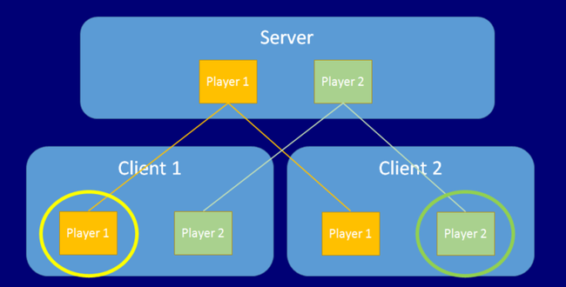
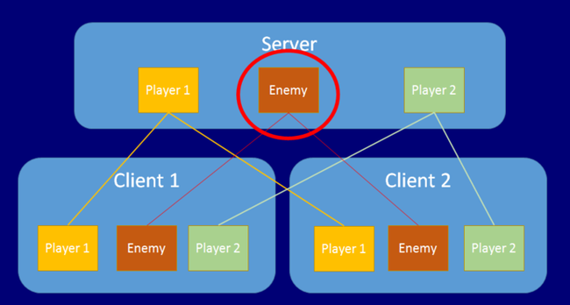

Slide 16
Client Authority for Non-Player Objects
Starting with Unity release 5.2, it is possible to have client authority over non-player objects
To spawn the object using NetworkServer.SpawnWithLocalAuthority and pass the network connection of the client to take ownership
To use NetworkIdentity.AssignClientAuthority with the network connection of the client to take ownership.
Assigning authority to a client causes OnStartAuthority() to be called on NetworkBehaviours on the object, and the property hasAuthority will be true. On other clients the hasAuthority property will still be false
Non-player objects with client authority can send commands, just like players can. These commands are run on the server instance of the object, NOT on the player associated with the connection.
Non-player objects that are to have client authority must have LocalPlayerAuthority checked in their NetworkIdentity.

Slide 17
[Command]
void CmdSpawn()
{
var go = (GameObject)Instantiate(otherPrefab, transform.position + new Vector3(0,1,0), Quaternion.identity);
NetworkServer.SpawnWithClientAuthority(go, connectionToClient);
}

Slide 18
Network Context Properties
There are properties on the NetworkBehaviour class that allow scripts to know what the network context is of a networked object at any time.
•isServer - true if the object is on a server (or host) and has been spawned.
•isClient - true if the object is on a client, and was created by the server.
•isLocalPlater - true if the object is a player object for this client.
•isAuthority - true if the object is owned by the local process

Slide 19
Using the NetworkManager

Slide 20
The NetworkManager is a component for managing the network state of a multiplayer game
It wraps up a lot of useful functionality into a single place and makes creating, running and debugging multiplayer games as simple as possible.
The NetworkManager can be used entirely without scripting. It has inspector controls in the editor that allow configuration of all of its features, and The NetworkManagerHUD supplies a simple, default user interface at runtime that allows the network game to be controlled by the user
For advanced uses, developers can derive a class from NetworkManager and customize its behaviour by overriding any of the virtual function hooks that it provides

Slide 21
Getting Started with NetworkManager
The NetworkManager can be used as the core controlling component of a multiplayer game
Create an empty game object in your starting scene, or pick a convenient manager object
Then add the NetworkManager component from the Network/NetworkManager menu item

Slide 22
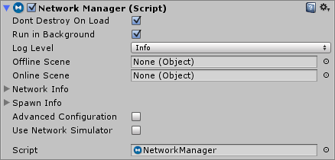

Slide 23
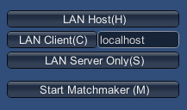
The inspector for the NetworkManager in the editor allows you to configure and control many things related to networking.
The NetworkManagerHUD is another component that works with the NetworkManager
This is good for getting started with a network project, but not intended to be used as the final UI for a game

Slide 24
Game State Management
A UNet multiplayer game can run in three modes - as a client, as a dedicated server, or as a “Host” which is both a client and a server at the same time
UNet is designed to make the same game code and assets work in all of these cases
Developing for the single player version of the game and the multiplayer version of the game should be the same thing

Slide 25
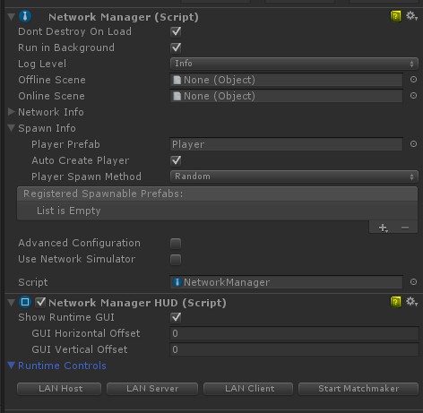

Slide 26
Spawning Management
The NetworkManager can be used to manage spawning of networked objects from prefabs
When a player prefab is set, a player object will automatically be spawned from that prefab for each user in the game. This applies to the local player on a hosted server, and remote players on remote clients. Note that the player prefab must have the NetworkIdentity component on it.
In addition to the player prefab, the prefabs of other objects that will be dynamically spawned must be registered with the ClientScene
Adding prefabs to the spawn list will make them be auto-registered.
This can be done with the ClientScene.RegisterPrefab() functions
or it can be done by the NetworkManager automatically.

Slide 27
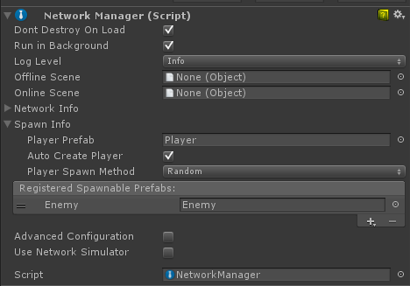

Slide 28
Once a player prefab is set, you should be able to start the game as a host and see the player object be spawned. Stopping the game should make the player object be destroyed
Running another copy of the game and connecting as a client to localhost should make another player object appear, and stopping that client should make that client’s player object be destroyed.
The player object is spawned by the default implementation of NetworkManager.OnServerAddPlayer
If you want to customize the way player objects are created, you can override that virtual function
public virtual void OnServerAddPlayer(NetworkConnection conn, short playerControllerId)
{
var player = (GameObject)GameObject.Instantiate(playerPrefab, playerSpawnPos, Quaternion.identity);
NetworkServer.AddPlayerForConnection(conn, player, playerControllerId);
}

Slide 29
Start Positions
To control where players are spawned, you can use the NetworkStartPosition component
The NetworkManager looks for NetworkStartPosition objects in a scene, and if it finds any, then it will spawn player at the position and orientation of one of them
Custom code can access the available NetworkStartPositions by the list NetworkManager.startPositions, and there is also a helper function GetStartPosition() on the NetworkManager that can be used in implementation of OnServerAddPlayer to find a start position.

Slide 30
Scene Management
Most games have more than one scene
At very least there is usually a title screen or starting menu scene in addition to the scene where the game is actually played
The NetworkManager is setup to automatically manage scene state and scene transitions in a way that works for a multiplayer game
There are two slots on the NetworkManager inspector, the offlineScene and the onlineScene. Dragging scene objects into these slots activates networked scene management.

Slide 31
When a server or host is started, the online scene will be loaded. This will then become the current network scene. Any clients that connect to that server will be instructed to also load that scene. The name of this scene is stored in the networkSceneName property.
When the network is stopped, by stopping the server or host, or by a client disconnecting, the offline scene will be loaded. This allows the game to automatically return to a menu scene when disconnected from a multiplayer game.
You can also change scenes while the game is active by calling NetworkManager.ServerChangeScene(). This will make all the currently connected clients change scene too, and will update networkSceneName so that new clients will also load the new scene.

Slide 32
While networked scene management is active, any calls to game state managerment functions such NetworkManager.StartHost() or NetworkManager.StopClient() can cause scene changes. This applies to the runtime control UI. So by setting up scenes and calling these functions it is easy to control the flow of a multiplayer game.
Note that scene changes cause all the objects in the scene to be destroyed
This could include the NetworkManager
If you want the NetworkManager to persist between scenes, then ensure the “Dont Destroy On Load” checked boxed is set to true
In simple cases, this is the best configuration
But, it is possible to have a NetworkManager in each scene with different settings to control incremental prefab loading, or different scene transitions.

Slide 33
Debugging Information
The NetworkManagerHUD inspector panel shows additional information about the state of the network at runtime
network connections
active NetworkIdentity server objects
active NetworkIdentity client objects
client peers

Slide 34
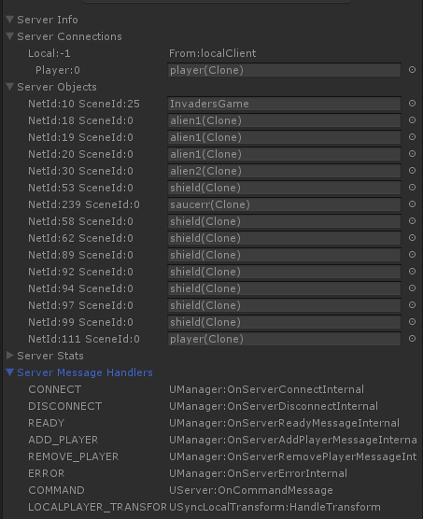

Slide 35
Matchmaking
The NetworkManager runtime UI and NetworkManager inspector UI allow interactions with the matchmaker service
The function NetworkManager.StartMatchmaker() enables matchmaking, and populates the NetworkManager.matchmaker property with a NetworkMatch object
Once this is active, the default UIs use it and callback functions on NetworkManager to let you perform simple matchmaking

Slide 36
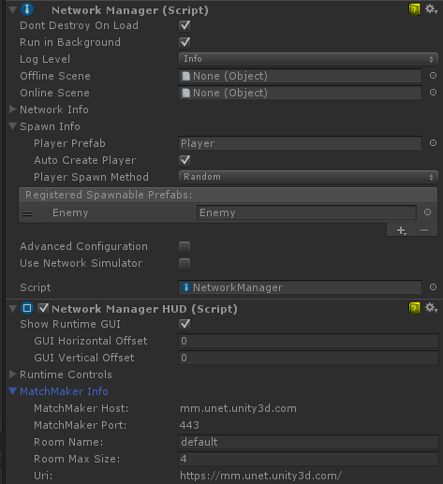

Slide 37
Customization
There are virtual functions on NetworkManager that derived classes can use to customize behaviour
When implementing these functions, be sure to take care of the functionality that the default implementations provide
For example, in OnServerAddPlayer(), the function NetworkServer.AddPlayer must be called to active the player object for the connection

Slide 38
// called when a client connects
public virtual void OnServerConnect(NetworkConnection conn);
// called when a client disconnects
public virtual void OnServerDisconnect(NetworkConnection conn)
{
NetworkServer.DestroyPlayersForConnection(conn);
}
// called when a client is ready
public virtual void OnServerReady(NetworkConnection conn)
{
NetworkServer.SetClientReady(conn);
}
// called when a new player is added for a client
public virtual void OnServerAddPlayer(NetworkConnection conn, short playerControllerId)
{
var player = (GameObject)GameObject.Instantiate(playerPrefab, playerSpawnPos, Quaternion.identity);
NetworkServer.AddPlayerForConnection(conn, player, playerControllerId);
}
// called when a player is removed for a client
public virtual void OnServerRemovePlayer(NetworkConnection conn, short playerControllerId)
{
PlayerController player;
if (conn.GetPlayer(playerControllerId, out player))
{
if (player.NetworkIdentity != null && player.NetworkIdentity.gameObject != null)
NetworkServer.Destroy(player.NetworkIdentity.gameObject);
}
}
// called when a network error occurs
public virtual void OnServerError(NetworkConnection conn, int errorCode);
Notes:
Functions invoked on the Server/Host:

Slide 39
// called when connected to a server
public virtual void OnClientConnect(NetworkConnection conn)
{
ClientScene.Ready(conn);
ClientScene.AddPlayer(0);
}
// called when disconnected from a server
public virtual void OnClientDisconnect(NetworkConnection conn)
{
StopClient();
}
// called when a network error occurs
public virtual void OnClientError(NetworkConnection conn, int errorCode);
// called when told to be not-ready by a server
public virtual void OnClientNotReady(NetworkConnection conn);
Notes:
Functions invoked on the Client:// called when connected to a server
public virtual void OnClientConnect(NetworkConnection conn)
{
ClientScene.Ready(conn);
ClientScene.AddPlayer(0);
}
// called when disconnected from a server
public virtual void OnClientDisconnect(NetworkConnection conn)
{
StopClient();
}
// called when a network error occurs
public virtual void OnClientError(NetworkConnection conn, int errorCode);
// called when told to be not-ready by a server
public virtual void OnClientNotReady(NetworkConnection conn);

Slide 40
// called when a match is created
public virtual void OnMatchCreate(CreateMatchResponse matchInfo)
// called when a list of matches is received
public virtual void OnMatchList(ListMatchResponse matchList)
// called when a match is joined
public void OnMatchJoined(JoinMatchResponse matchInfo)
Notes:
Functions invoked for the Matchmaker:

Slide 41
Object Spawning

Slide 42
Registration of spawn prefabs is most conveniently done by the NetworkManager in the editor
The “Spawn Info” section of the NetworkManager allows you to register prefabs without writing any code
This can also be done through code when a NetworkClient is created

Slide 43
using UnityEngine;
using UnityEngine.Networking;
public class MyNetworkManager : MonoBehaviour
{
public GameObject alienPrefab;
NetworkClient myClient;
// Create a client and connect to the server port
public void SetupClient()
{
ClientScene.RegisterPrefab(alienPrefab);
myClient = new NetworkClient();
myClient.RegisterHandler(MsgType.Connect, OnConnected);
myClient.Connect("127.0.0.1", 4444);
}
}
Notes:
In this example, the user would drag a prefab asset onto the alienPrefab slot on the MyNetworkManager script. So that when a alien object is spawned on the server, the same kind of object will be created on the clients. This registration of assets ensures that the asset is loaded with the scene, so that there is no stall to load the asset when it is created.

Slide 44
class Tree : NetworkBehaviour
{
[SyncVar]
public int numLeaves;
}
class MySpawner : NetworkBehaviour
{
public GameObject treePrefab;
public void Spawn()
{
GameObject tree = (GameObject)Instantiate(treePrefab, transform.position, transform.rotation);
tree.GetComponent<Tree>().numLeaves = Random.Range(10,200);
NetworkServer.Spawn(tree);
}
}
Notes:
For more advanced use cases such as object pools or dynamically created assets, there is ClientScene.RegisterSpawnHandler which allows callback functions to be registered for client side spawning.
Below is a simple example of a spawner that creates a tree with a random number of leaves.
To complete this example, the project would have a prefab asset for the tree that has the Tree script and a NetworkIdentity component. Then on the MySpawner instance in the scene, the treePrefab slot would be populated by the tree prefab asset. Also, the tree prefab must be registered as a spawnable object - either using the NetworkManager UI, or using ClientScene.RegisterPrefab() in code.
When this code runs, the tree objects created on clients will have the correct value for numLeaves from the server.
Constraints
A NetworkIdentity must be on the root game object of a spawnable prefab
NetworkBehaviour scripts must be on the same game object as the NetworkIdentity, not on child game objects
Prefabs can’t be registered with the NetworkManager unless they have a NetworkIdentity on their root object

Slide 45
Constraints
A NetworkIdentity must be on the root game object of a spawnable prefab
NetworkBehaviour scripts must be on the same game object as the NetworkIdentity, not on child game objects
Prefabs can’t be registered with the NetworkManager unless they have a NetworkIdentity on their root object

Slide 46
Object Creation Flow
Prefab with NetworkIdentity component is registered as spawnable
GameObject is instantiated from the prefab on the server
Game code sets initial values on the instance (note that 3D physics forces applied here do not take effect immediately)
NetworkServer.Spawn() is called with the instance
The state of the SyncVars on the instance on the server are collected by calling OnSerialize() on NetworkBehaviour components
A network message of type MsgType.ObjectSpawn is sent to connected clients that includes the SyncVar data
OnStartServer() is called on the instance on the server, and isServer is set to true
Clients recieve the ObjectSpawn message and create a new instance from the registered prefab
The SyncVar data is applied to the new instance on the client by calling DeSerialize() on NetworkBehaviour components
OnStartClient() is called on the instance on each client, and isClient is set to true
As gameplay progresses, changes to SyncVar values are automatically synchronized to clients. This continues until game ends.
NetworkServer.Destroy() is called on the instance on the server
A network message of type MsgType ObjectDestroy is sent to clients
OnNetworkDestroy() is called on the instance on clients, then the instance is destroyed.

Slide 47
Player Objects
Prefab with NetworkIdentity is registered as the PlayerPrefab
Client connects to the server
Client calls AddPlayer(), network message of type MsgType.AddPlayer is sent to the server
Server receives message and calls NetworkManager.OnServerAddPlayer()
GameObject is instantiated from the PlayerPrefab on the server
NetworkManager.AddPlayerForConnection() is called with the new player instance on the server
The player instance is spawned - you do not have to call NetworkServer.Spawn() for the player instance
A network message of type MsgType.Owner is sent to the client that added the player (only that client!)
The original client receives the network message
OnStartLocalPlayer() is called on the player instance on the original client, and isLocalPlayer is set to true

Slide 48
Note that OnStartLocalPlayer() is called after OnStartClient(), as it only happens when the ownership messages arrives from the server after the player object is spawned. So isLocalPlayer will not be set in OnStartClient().
Since OnStartLocalPlayer is only called for YOUR player, it is a good place to perform initialization that should only be done for the local player. This could include enabling input processing, and enabling camera tracking for the player object. Typically only the local player has an active camera.

Slide 49
Custom Spawn Functions
The default behaviour of creating spawned objects from prefabs on the client can be customized by using spawn handler functions
You can register functions to spawn and un-spawn client objects with ClientScene.RegisterSpawnHandler. This function takes two function delegates, one to handle creating objects on the client and one to handler destroying objects on the client.

Slide 50
// Handles requests to spawn objects on the client
public delegate GameObject SpawnDelegate(Vector3 position, NetworkHash128 assetId);
// Handles requests to unspawn objects on the client
public delegate void UnSpawnDelegate(GameObject spawned);

Slide 51
The assetId passed to the spawn function can be found on NetworkIdentity.asset for prefabs, where it is populated automatically
You can spawn objects with custom assetIds by using code like:
// generate a new unique assetId
NetworkHash128 creatureAssetId = new NetworkHash.Parse("e2656f");
// register handlers for assetId
ClientScene.RegisterSpawnHandler(creatureAssetId, SpawnCreature, UnSpawnCreature);
// spawn a creature - SpawnCreature will be called on client.
NetworkServer.Spawn(gameObject, creatureAssetId);

Slide 52
When using custom spawn functions, it is sometimes useful to be able to unspawn objects without destroying them. This can be done by calling NetworkServer.UnSpawnObject. This causes a message to be sent to clients to un-spawn the object, so that the custom un-spawn function will be called on the clients. The object is not destroyed when this function is called.
Note that on the host, object are not spawned for the local client as they already exist on the server. So no spawn handler functions will be called.

Slide 53
Spawning Object with Client Authority
It is possible to spawn objects and assign authority of the objects to a particular client
This is done with NetworkServer.SpawnWithClientAuthority, which takes the NetworkConnection of the client that will be made the authority as an argument.
For these objects, the property hasAuthority will be true on the client with authority and OnStartAuthority() will be called on the client with authority. That client will be able to issue commands for that object. On other clients (and on the host), hasAuthority will be false.
Objects spawned with client authority must have LocalPlayerAuthority set in their NetworkIdentity.

Slide 54
For example, to allow a player to spawn and control an object:
[Command]
void CmdSpawn()
{
var go = (GameObject)Instantiate(
otherPrefab,
transform.position + new Vector3(0,1,0),
Quaternion.identity);
NetworkServer.SpawnWithClientAuthority(go, connectionToClient);
}

Slide 55
State Synchronization

Slide 56
State Synchronization is done from the Server to Remote Clients
The local client does not have data serialized to it, since it shares the scene with the server
Data is not synchronized from remote clients to the server. This is job of Commands.

Slide 57
SyncVars
SyncVars are member variables of NetworkBehaviour scripts that are synchronized from the server to clients
When an object is spawned, or a new player joins a game in progress, they are sent the latest state of all SyncVars on networked objects that are visible to them

Slide 58
class Player : NetworkBehaviour
{
[SyncVar]
int health;
public void TakeDamage(int amount)
{
if (!isServer)
return;
health -= amount;
}
}

Slide 59
The state of SyncVars is applied to objects on clients before OnStartClient() is called, so the state of the object is guaranteed to be up-to-date inside OnStartClient().
SyncVars can be basic types such as integers, strings and floats. They can also be Unity types such as Vector3 and user-defined structs, but updates for struct SyncVars are sent as monolithic updates, not incremental changes if fields within a struct change. There can be up to 32 SyncVars on a single NetworkBehaviour script - this includes SyncLists.
SycnVar updates are sent automatically by the server when the value of a SyncVar changes. There is no need to perform any manual dirtying of fields for SyncVars.
Note that setting a SyncVar member variable inside a property setter function does not cause it to be dirtied. Trying to do this will cause a compile time warning. Because SyncVars use properties internally to mark themselves as dirty, setting them dirty inside property functions could lead to recursion problems.

Slide 60
SyncLists
SyncLists are like SyncVars but they are lists of values instead of individual values
SyncLists do not require the SyncVar attributes, they are specific classes. There are built-in SyncList types for basic types:
SyncListString
SyncListFloat
SyncListInt
SyncListUInt
SyncListBool

Slide 61
There is also SyncListStruct which can be used for lists of user-defined structs. The struct used SyncListStruct derived class can contain members of basic types, arrays, and common Unity types. They cannot contain complex classes or generic containers.
SyncLists have a SyncListChanged delegate named Callback that allows clients to be notified when the contents of the list change. This delegate is called with the type of operation that occurred, and the index of the item that the operation was for.

Slide 62
public class MyScript : NetworkBehaviour
{
public struct Buf
{
public int id;
public string name;
public float timer;
};
public class TestBufs : SyncListStruct<Buf> {}
TestBufs m_bufs = new TestBufs();
void BufChanged(Operation op, int itemIndex)
{
Debug.Log("buf changed:" + op);
}
void Start()
{
m_bufs.Callback = BufChanged;
}
}

Slide 63
Custom Serialization Functions
Often the use of SyncVars is enough for scripts to serialize their state to clients, but some cases require more complex serialization code
The virtual functions on NetworkBehaviour that are used for SyncVar serialization can be implmented by developers to perform their own custom serialization
public virtual bool OnSerialize(NetworkWriter writer, bool initialState);
public virtual void OnDeSerialize(NetworkReader reader, bool initialState);

Slide 64
The initialState flag is useful to differentiate between the first time an object is serialized and when incremental updates can be sent
The first time an object is sent to a client, it must include a full state snapshot, but subsequent updates can save on bandwidth by including only incremental changes
Note that SyncVar hook fucntion are not called when initialState is true, only for incremental updates.
If a class has SyncVars, then implementations of these functions are added automatically to the class. So a class that has SyncVars cannot also have custom serialization functions.

Slide 65
Serialization Flow
Game objects with the NetworkIdentity component can have multiple scripts derived from NetworkBehaviour

Slide 66
On the server:
Each NetworkBehaviour has a dirty mask. This mask is available inside OnSerialize as syncVarDirtyBits
Each SyncVar in a NetworkBehaviour script is assigned a bit in the dirty mask.
Changing the value of SyncVars causes the bit for that SyncVar to be set in the dirty mask
Alternatively, calling SetDirtyBit() writes directly to the dirty mask
NetworkIdentity objects are checked on the server as part of it’s update loop
If any NetworkBehaviours on a NetworkIdentity are dirty, then an UpdateVars packet is created for that object
The UpdateVars packet is populated by calling OnSerialize on each NetworkBehaviour on the object
NetworkBehaviours that are NOT dirty write a zero to the packet for their dirty bits
NetworkBehaviours that are dirty write their dirty mask, then the values for the SyncVars that have changed
If OnSerialize returns true for a NetworkBehaviour, the dirty mask is reset for that NetworkBehaviour, so it will not send again until it’s value changes.
The UpdateVars packet is sent to ready clients that are observing the object

Slide 67
On the client:
an UpdateVars packet is received for an object
The OnDeserialize function is called for each NetworkBehaviour script on the object
Each NetworkBehaviour script on the object reads a dirty mask.
If the dirty mask for a NetworkBehaviour is zero, the OnDeserialize functions returns without reading any more
If the dirty mask is non-zero value, then the OnDeserialize function reads the values for the SyncVars that correspond to the dirty bits that are set
If there are SyncVar hook functions, those are invoked with the value read from the stream.

Slide 68
public class data : NetworkBehaviour
{
[SyncVar]
public int int1 = 66;
[SyncVar]
public int int2 = 23487;
[SyncVar]
public string MyString = "esfdsagsdfgsdgdsfg";
}

Slide 69
public override bool OnSerialize(NetworkWriter writer, bool forceAll)
{
if (forceAll)
{
// the first time an object is sent to a client, send all the data (and no dirty bits)
writer.WritePackedUInt32((uint)this.int1);
writer.WritePackedUInt32((uint)this.int2);
writer.Write(this.MyString);
return true;
}
bool wroteSyncVar = false;
if ((base.get_syncVarDirtyBits() & 1u) != 0u)
{
if (!wroteSyncVar)
{
// write dirty bits if this is the first SyncVar written
writer.WritePackedUInt32(base.get_syncVarDirtyBits());
wroteSyncVar = true;
}
writer.WritePackedUInt32((uint)this.int1);
}
if ((base.get_syncVarDirtyBits() & 2u) != 0u)
{
if (!wroteSyncVar)
{
// write dirty bits if this is the first SyncVar written
writer.WritePackedUInt32(base.get_syncVarDirtyBits());
wroteSyncVar = true;
}
writer.WritePackedUInt32((uint)this.int2);
}
if ((base.get_syncVarDirtyBits() & 4u) != 0u)
{
if (!wroteSyncVar)
{
// write dirty bits if this is the first SyncVar written
writer.WritePackedUInt32(base.get_syncVarDirtyBits());
wroteSyncVar = true;
}
writer.Write(this.MyString);
}
if (!wroteSyncVar)
{
// write zero dirty bits if no SyncVars were written
writer.WritePackedUInt32(0);
}
return wroteSyncVar;
}
Notes:
The generated OnSerialize function is something like:

Slide 70
public override void OnDeserialize(NetworkReader reader, bool initialState)
{
if (initialState)
{
this.int1 = (int)reader.ReadPackedUInt32();
this.int2 = (int)reader.ReadPackedUInt32();
this.MyString = reader.ReadString();
return;
}
int num = (int)reader.ReadPackedUInt32();
if ((num & 1) != 0)
{
this.int1 = (int)reader.ReadPackedUInt32();
}
if ((num & 2) != 0)
{
this.int2 = (int)reader.ReadPackedUInt32();
}
if ((num & 4) != 0)
{
this.MyString = reader.ReadString();
}
}
Notes:
And the OnDeserialize function is something like:
If a NetworkBehaviour has a base class that also has serialization functions, the base class functions should also be called.
Note that the UpdateVar packets created for object state updates may be aggregated in buffers before being sent to the client, so a single transport layer packet may contain updates for multiple objects.

Slide 71
Remote Actions

Slide 72
The network system has ways to perform actions across the network
These type of actions are sometimes calls Remote Procedure Calls
There are two types of RPCs in the network system
Commands - which are called from the client and run on the server
ClientRpc calls - which are called on the server and run on clients.

Slide 73
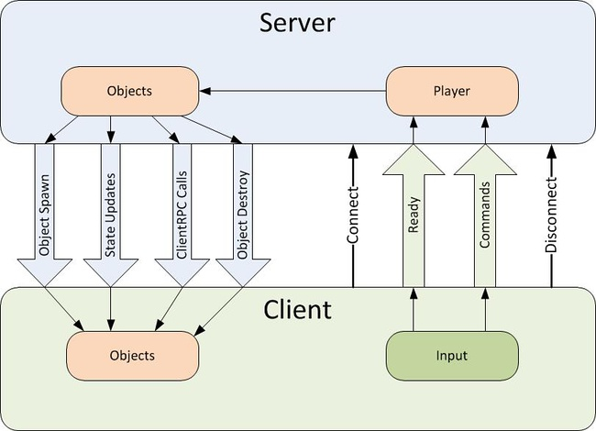

Slide 74
Commands
Commands are sent from player objects on the client to player objects on the server
can only be sent from YOUR player object, so you cannot control the objects of other players
To make a function into a command, add the [Command] custom attribute to it, and add the “Cmd” prefix
This function will now be run on the server when it is called on the client
Any arguments will automatically be passed to the server with the command.
Commands functions must have the prefix “Cmd”. This is a hint when reading code that calls the command - this function is special and is not invoked locally like a normal function.

Slide 75
class Player : NetworkBehaviour
{
public GameObject bulletPrefab;
[Command]
void CmdDoFire(float lifeTime)
{
GameObject bullet = (GameObject)Instantiate(
bulletPrefab,
transform.position + transform.right,
Quaternion.identity);
var bullet2D = bullet.GetComponent<Rigidbody2D>();
bullet2D.velocity = transform.right * bulletSpeed;
Destroy(bullet, lifeTime);
NetworkServer.Spawn(bullet);
}
void Update()
{
if (!isLocalPlayer)
return;
if (Input.GetKeyDown(KeyCode.Space))
{
CmdDoFire(3.0f);
}
}
}

Slide 76
Be careful of sending commands from the client every frame! This can cause a lot of network traffic.
By default, Commands are sent on channel zero - the default reliable channel
This can be customized with the “Channel” parameter of the [Command] custom attribute
This parameter should be an integer, representing the channel number.

Slide 77
Channel 1 is also set up by default to be an unreliable channel, so to use this, use the value 1 for the parameter in the Command attribute, like this:
[Command(channel=1)]

Slide 78
Starting with Unity release 5.2 it is possible to send commands from non-player objects that have client authority
These object must have been spawned with NetworkServer.SpawnWithClientAuthority or have authority set with NetworkIdentity.AssignClientAuthority.
Commands sent from these object are run on the server instance of the object, not on the associated player object for the client.

Slide 79
ClientRpc Calls
ClientRpc calls are sent from objects on the server to objects on clients
They can be sent from any server object with a NetworkIdentity that has been spawned
To make a function into a ClientRpc call, add the [ClientRpc] custom attribute to it, and add the “Rpc” prefix
This function will now be run on clients when it is called on the server
Any arguments will automatically be passed to the clients with the ClientRpc call
ClientRpc functions must have the prefix “Rpc”. This is a hint when reading code that calls the method - this function is special and is not invoked locally like a normal function.

Slide 80
class Player : NetworkBehaviour
{
[SyncVar]
int health;
[ClientRpc]
void RpcDamage(int amount)
{
Debug.Log("Took damage:" + amount);
}
public void TakeDamage(int amount)
{
if (!isServer)
return;
health -= amount;
RpcDamage(amount);
}
}

Slide 81
Arguments to Remote Actions
The arguments passed to commands and ClientRpc calls are serialized and sent over the network. These arguments can be:
basic types (byte, int, float, string, UInt64, etc)
arrays of basic types
structs containing allowable types
built-in unity math types (Vector3, Quaternion, etc)
NetworkIdentity
NetworkInstanceId
NetworkHash128
GameObject with a NetworkIdentity component attached

Slide 82
Player Objects

Slide 83
In the HLAPI of the network system players are special kinds of objects
They represent the player on the server and so have the ability to run commands from the player’s client
which are secure client-to-server remote procedure calls
In this server authoritative system, other non-player server side objects do not have the capability to receive commands directly from objects on clients
This is both for security and to reduce the complexity of working in a distributed environment
Routing all incoming commands from users through the player object ensures that these messages came from the right place, the right client, and can be handling in a central location.

Slide 84
When using the NetworkManager, a player is added by default when a client connects to the server
In some situations though, adding players should be deferred until some input event happens, so this behaviour can be turned off with the AutoCreatePlayer checkbox on the NetworkManager.
When a player is added, the NetworkManager will instantiate an object from the PlayerPrefab and associate it with the connection
This is actually done by the NetworkManager calling NetworkServer.AddPlayerForConnection
This behaviour can be modified by overriding NetworkManager.OnServerAddPlayer
The default implementation of OnServerAddPlayer instantiates a new player instance from the PlayerPrefab and calls NetworkServer.AddPlayer to spawn the new player instance
A custom implementation of OnServerAddPlayer must also call NetworkServer.AddPlayer, but is free to perform any other initialization it requires

Slide 85
class Player : NetworkBehaviour
{
[SyncVar]
public Color color;
}
class MyManager : NetworkManager
{
public override void OnServerAddPlayer(NetworkConnection conn, short playerControllerId)
{
GameObject player = (GameObject)Instantiate(playerPrefab, Vector3.Zero, Quaternion.Identity);
player.GetComponent<Player>().color = Color.Red;
NetworkServer.AddPlayerForConnection(conn, player, playerControllerId);
}
}

Slide 86
Ready State
In addition to players, client connections also have a “ready” state
A client that is ready is sent spawned objects and state synchronization updates; a client that is not ready, is not sent these updates
When a client initially connects to a server it is not ready. While in this state, the client is able to do things that don’t require real-time interactions with the server simulation
such as load scenes, choose avatars or fill out login boxes
Once a client has all their pre-game work done, and all their assets loaded, they can call ClientScene.Ready to enter the ready state

Slide 87
Clients can send and receive network messages without being ready, which also means without having an active player
So a client at a menu or selection screen can be connected to the game and interact with it, even though they have no player object

Slide 88
Switching Players
The player object for a connection can be replaced with NetworkServer.ReplacePlayerForConnection
This can be useful to restrict the commands that can be issued by players at certain times, such as in a pre-game lobby screen
This function takes the same arguments as AddPlayerForConnection, but allows there to already be a player for that connection. The old player object does not have to be destroyed
The NetworkLobbyManager uses this technique to switch from the LobbyPlayer to a game-play player when all the players in the lobby are ready.

Slide 89
This can also be used to respawn a player after their object is destroyed
In some cases it is better to just disable an object and reset its game attributes on respawn, but to actually replace it with a new object you could use code like:
class GameManager
{
public void PlayerWasKilled(Player player)
{
var conn = oldPlayer.connectionToClient;
var newPlayer = Instantiate<GameObject>(playerPrefab);
Destroy(oldPlayer.gameObject);
NetworkServer.ReplacePlayerForConnection(conn, newPlayer, 0);
}
}

Slide 90
If the player object for a connection is destroyed, then that client will be unable to execute Commands. They can however still send network messages.
To use ReplacePlayerForConnection you must have the NetworkConnection object for the player’s client to establish the relationship between the object and the client
This is usually the property connectionToClient on the NetworkBehaviour class, but if the old player has already been destroyed, then that may not be readily available.
To find the connection, there are some lists available. If using the NetworkLobbyManager, then the lobby players are available in lobbySlots. Also, the NetworkServer has lists of connections and localConnections .

Slide 91
Object Visibility

Slide 92
UNet supports the idea that not all objects on the server should be visible to all players in the game
This is sometimes called “Area of Interest”
players are only given visibility to objects that the game determines are relevant or interesting to them
Some game features that use this concept are Fog Of War, Stealth and proximity based visibility
This is especially important when the game world is very large on the server or contains many networked objects
Reducing the set of objects visible to player reduces login times, and ongoing bandwidth
as updates are only sent to players for objects that are visible to them.

Slide 93
NetworkProximityChecker
The simplest way to restrict object visibility for players is use the built-in [NetworkProximityChecker] component
This works in conjunction with the Unity 3D physics or 2D physics systems to only allow players to see objects that are close to them
To use this component, add it to the prefab of the networked object that you want to have restricted visibility.
The NetworkProximityChecker has some configurable parameters. Objects further away than “Vis Range” will not be visible to a player, and each player’s set of visible objects will be recalculated every “Vis Update Interval” seconds.
Object must have physics colliders to work with the NetworkProximityChecker.

Slide 94
Visibility on Remote Clients
When a player on a remote client joins a network game, only objects that are visible to the player will be spawned on that client
So even if the player enters a large world with many networked objects, the time for world entry can be kept reasonable
This applies to networked objects in the scene, but does not affect the loading of assets - the assets for registered prefabs and scene objects are still loaded.
As a player moves within the world, the set of visible objects will change
As this happens, the client is told about these changes
There is an ObjectHide message that is sent to clients when an object is no longer visible
The default behaviour for handling this message is to destroy the object
When an object becomes visible, the client receives an ObjectSpawn message

Slide 95
Visibility on the Host
As the host shares the same scene as the server, it cannot destroy objects that are not visible to the local player. Instead, there is a virtual function on NetworkBehaviour that is invoked:
public virtual void OnSetLocalVisibility(bool vis)
This function is invoked on all networked scripts on objects that change visibility state on the host
This allow each script to customize how it should respond, such as by disabling HUD elements or renderers
The default implementation in NetworkProximityChecker disables or enables all Renderer components on the object.

Slide 96
Custom Visibility
The NetworkProximityChecker is implemented using the public visibility interface of Unet
Using this interface developers should be able to implement any kind of visibility rules they desire
Each NetworkIdentity keeps track of the set of players that it is visible to. These are called the “observers” of the object
// call this to rebuild the set of players observing this object public void RebuildObservers(bool initialize);

Slide 97
The NetworkProximityChecker calls this function at a fixed interval, so the set of visible objects for each player is updated as they move around.
On the NetworkBehaviour, there are some virtual functions for determining visibility:
// called when a new player enters the game
public override bool OnCheckObserver(NetworkConnection newObserver);
// called when RebuildObservers is invoked
public override bool OnRebuildObservers(HashSet<NetworkConnection> observers, bool initial);

Slide 98
The OnCheckObservers function is called on the server on each networked object when a new player enters the game
If it returns true, then that player is added to the object’s observers
The NetworkProximityCheck does a simple distance check in its implementation of this function.
The OnRebuildObservers function is called on the server when RebuildObservers is invoked
This function expects the set of observers to be populated with the players that can see the object
The NetworkServer then handles sending ObjectHide and ObjectSpawn messages based on the differences between the old and new visibility sets
The NetworkProximityChecker uses Physics.OverlapSphere() to find the players that are within the visibility distance for this object

Slide 99
Note that to tell is an object is a player, check if it has a valid “connectionToClient” on its NetworkIdentity. For example:
var hits = Physics.OverlapSphere(transform.position, visRange);
foreach (var hit in hits)
{
// (if an object has a connectionToClient, it is a player)
var uv = hit.GetComponent<NetworkIdentity>();
if (uv != null && uv.connectionToClient != null)
{
observers.Add(uv.connectionToClient);
}
}

Slide 100
Network Messages

Slide 101
In addition to the high level facilities of commands and RPC calls, it is also possible to send raw network messages.
There is a class called MessageBase that can be extended to make serializable network message classes
This class has serialization and deserialization functions that take writer and reader objects
Developers can implement these functions themselves, or rely on code-generated implementations that are automatically created by the networking system

Slide 102
public abstract class MessageBase
{
// De-serialize the contents of the reader into this message
public virtual void Deserialize(NetworkReader reader) {}
// Serialize the contents of this message into the writer
public virtual void Serialize(NetworkWriter writer) {}
}

Slide 103
Message classes can contain members that are basic types, structs, arrays, and most of the common Unity Engine types such as Vector3
They cannot contain members that are complex classes or generic containers.
There are built-in message classes for common types of network messages:
EmptyMessage
StringMessage
IntegerMessage

Slide 104
To send a message there are Send() functions on the NetworkClient, NetworkServer, and NetworkConnection classes which work the same way
They take a message Id, and a message object that is derived from MessageBase
The code below shows how to send and handle a message using one of the built-in message classes:

Slide 105
public class Begin : NetworkBehaviour
{
const short MyBeginMsg = 1002;
NetworkClient m_client;
public void SendReadyToBeginMessage(int myId)
{
var msg = new IntegerMessage(myId);
m_client.Send(MyBeginMsg, msg);
}
public void Init(NetworkClient client)
{
m_client = client;
NetworkServer.RegisterHandler(MyBeginMsg, OnServerReadyToBeginMessage);
}
void OnServerReadyToBeginMessage(NetworkMessage netMsg)
{
var beginMessage = netMsg.ReadMessage<IntegerMessage>();
Debug.Log("received OnServerReadyToBeginMessage " + beginMessage.value);
}
}

Slide 106
public class Scores : MonoBehaviour
{
NetworkClient myClient;
public class MyMsgType {
public static short Score = MsgType.Highest + 1;
};
public class ScoreMessage : MessageBase
{
public int score;
public Vector3 scorePos;
public int lives;
}
public void SendScore(int score, Vector3 scorePos, int lives)
{
ScoreMessage msg = new ScoreMessage();
msg.score = score;
msg.scorePos = scorePos;
msg.lives = lives;
NetworkServer.SendToAll(MyMsgType.Score, msg);
}
// Create a client and connect to the server port
public void SetupClient()
{
myClient = new NetworkClient();
myClient.RegisterHandler(MsgType.Connect, OnConnected);
myClient.RegisterHandler(MyMsgType.Score, OnScore);
myClient.Connect("127.0.0.1", 4444);
}
public void OnScore(NetworkMessage netMsg)
{
ScoreMessage msg = netMsg.ReadMessage<ScoreMessage>();
Debug.Log("OnScoreMessage " + msg.score);
}
public void OnConnected(NetworkMessage netMsg)
{
Debug.Log("Connected to server");
}
}
Notes:
To declare a custom network message class and use it:
Note that there is no serialization code for the ScoreMessage class in this source code for example. The body of the serialization functions is automatically generated for this class.

Slide 107
Error Message Class
Thre is also a ErrorMessage class that is derived from MessageBase
This class is passed to error callbacks on clients and servers.
The errorCode in the ErrorMessage class corresponds to the Networking.NetworkError enumeration

Slide 108
class MyClient
{
NetworkClient client;
void Start()
{
client = new NetworkClient();
client.RegisterHandler(MsgType.Error, OnError);
}
void OnError(NetworkMessage netMsg)
{
var errorMsg = netMsg.ReadMessage<ErrorMessage>();
Debug.Log("Error:" + errorMsg.errorCode);
}
}

Slide 109
Matchmaker

Slide 110
The multiplayer networking feature includes services for players to play with each other over the internet without needing a public IP address
Users can create games, get lists of active games; and join and leave games
When playing over the internet, network traffic goes through a relay server hosted by Unity in the cloud instead of directly between the clients
This avoids problems with firewalls and NATs, allowing play from almost anywhere.

Slide 111
Matchmaking functionality can be utilized with a special script NetworkMatch, in the UnityEngine
Networking.Match namespace
The ability to use the relay server is built into the LLAPI but the matchmaker makes it easier to use
To use it, derive a script from NetworkMatch and attach it to a manager object

Slide 112
using UnityEngine;
using UnityEngine.Networking;
using UnityEngine.Networking.Types;
using UnityEngine.Networking.Match;
using System.Collections.Generic;
public class HostGame : MonoBehaviour
{
List<MatchDesc> matchList = new List<MatchDesc>();
bool matchCreated;
NetworkMatch networkMatch;
void Awake()
{
networkMatch = gameObject.AddComponent<NetworkMatch>();
}
void OnGUI()
{
// You would normally not join a match you created yourself but this is possible here for demonstration purposes.
if(GUILayout.Button("Create Room"))
{
CreateMatchRequest create = new CreateMatchRequest();
create.name = "NewRoom";
create.size = 4;
create.advertise = true;
create.password = "";
networkMatch.CreateMatch(create, OnMatchCreate);
}
if (GUILayout.Button("List rooms"))
{
networkMatch.ListMatches(0, 20, "", OnMatchList);
}
if (matchList.Count > 0)
{
GUILayout.Label("Current rooms");
}
foreach (var match in matchList)
{
if (GUILayout.Button(match.name))
{
networkMatch.JoinMatch(match.networkId, "", OnMatchJoined);
}
}
}

Slide 113
public void OnMatchCreate(CreateMatchResponse matchResponse)
{
if (matchResponse.success)
{
Debug.Log("Create match succeeded");
matchCreated = true;
Utility.SetAccessTokenForNetwork(matchResponse.networkId, new NetworkAccessToken(matchResponse.accessTokenString));
NetworkServer.Listen(new MatchInfo(matchResponse), 9000);
}
else
{
Debug.LogError ("Create match failed");
}
}
public void OnMatchList(ListMatchResponse matchListResponse)
{
if (matchListResponse.success && matchListResponse.matches != null)
{
networkMatch.JoinMatch(matchListResponse.matches[0].networkId, "", OnMatchJoined);
}
}
public void OnMatchJoined(JoinMatchResponse matchJoin)
{
if (matchJoin.success)
{
Debug.Log("Join match succeeded");
if (matchCreated)
{
Debug.LogWarning("Match already set up, aborting...");
return;
}
Utility.SetAccessTokenForNetwork(matchJoin.networkId, new NetworkAccessToken(matchJoin.accessTokenString));
NetworkClient myClient = new NetworkClient();
myClient.RegisterHandler(MsgType.Connect, OnConnected);
myClient.Connect(new MatchInfo(matchJoin));
}
else
{
Debug.LogError("Join match failed");
}
}
public void OnConnected(NetworkMessage msg)
{
Debug.Log("Connected!");
}
}

Slide 114
This script sets up the matchmaker to point to the public unity matchmaker server
It calls the base class functions for creating, listing, and joining matches
CreateMatch to create a match
JoinMatch to join a match
and ListMatches for listing matches registered on the match maker server
Internally, NetworkMatch uses web services to establish a match and the given callback function is invoked when the process is complete, like OnMatchCreate for match creation.
Populating the singleton NetworkMatch.matchSingleton tells the system to use the relay server instead of a direct connection when connecting to the game
So later, when the client actually connects to the game, it will automatically use the right relay server for the match that was chosen.

Slide 115
Scene Objects

Slide 116
Objects that are created dynamically are added to the network with NetworkServer.Spawn(), but objects that already exist in the scene are handled differently
These objects are loaded with the scene on both the client and server, and exist at runtime before any spawn messages are sent.
All objects in the scene with a NetworkIdentity component will be disabled when the scene is loaded; on both the client and the server
Then, when the scene is fully loaded, NetworkServer.SpawnObjects() is called to activate these networked scene objects
This will be done automatically by the NetworkManager when the server scene finishes loading - or can be called directly by user code
This causes the networked scene objects to be spawned in a special way - the existing instances are hooked up to the network instead of new instances being created.

Slide 117
There are some good reasons to use scene objects instead of dynamically spawned objects. These objects:
are loaded with the level, so there will be no pause at runtime
can have specific modifications that differ from prefabs
can be referenced by other object instances in the scene, which can avoid finding the objects to hook them up at runtime

Slide 118
Once scene objects have been spawned by NetworkServer.SpawnObjects() then they behave like every other spawned objects. Updates will be sent, and ClientRPC calls can be made.
If an object in scene is destroyed on the server before a client joins the game, then it will never be spawned on new clients that join.
Networked scene objects are disabled when the network is started
Any scene object with a NetworkIdentity in the scene is a networked scene object.

Slide 119
On the server, these objects are then enabled when NetworkServer.SpawnObjects() is called
When a client connects, the client is sent a ObjectSpawnScene spawn message for each of the scene objects that exist on the server, that are visible to that client
his messages causes the object on the client to be enabled and has the latest state of that object from the server in it.
So only objects that are visible to the client, and not destroyed on the server, will be activated on the client.
And like regular non-scene objects, these scene objects will be started with the latest state when the client joins the game.

Slide 120
Converting a Single Player Game to Multiplayer

Slide 121
This document describes steps to convert a single player game to a multiplayer game using the new networking system
The process described here is a simplified, higher level version of the actual process for a real game, and wont work exactly like this for every game, but it provides a basic recipe for the process.

Slide 122
NetworkManager Setup
Add a new game object to the scene and rename it to “NetworkManager”.
Add the NetworkManager component to the new game object.
Add the NetworkManagerHUD component to the game object. This will provide the default UI for managing network game state.
Notes:
See Using the NetworkManager.

Slide 123
Player Prefab Setup
Find the prefab for the player object in the game, or create a prefab from the player object.
Add NetworkIdentity component to player prefab.
Check the LocalPlayerAuthority box on the NetworkIdentity.
Set the playerPrefab in the “Spawn Info” section on the NetworkManager to the player prefab
Remove the player object instance from the scene if it exists in the scene
Notes:
See Player Objects.

Slide 124
Player Movement
Add a NetworkTransform component to the player prefab
Update input and control scripts to respect isLocalPlayer
Fix camera to use spawned player and isLocalPlayer

Slide 125
using UnityEngine;
using UnityEngine.Networking;
public class Controls : NetworkBehaviour
{
void Update()
{
if (!isLocalPlayer)
{
// exit from update if this is not the local player
return;
}
// handle player input for movement
}
}

Slide 126
Basic Player Game State
Make scripts that contain important data into NetworkBehaviours instead of MonoBehaviours
Make important member variables into SyncVars
Notes:
See State Synchronization.

Slide 127
Networked Actions
Make scripts that perform important actions into NetworkBehaviours instead of MonoBehaviours
Update functions that perform important player actions to be Commands
Notes:
See Networked Actions.

Slide 128
Non-Player Objects
Fix non-player prefabs such as enemies:
Add NetworkIdentify component
Add NetworkTransform component
Register spawnable prefabs with NetworkManager
Update scripts with game state and actions

Slide 129
Spawners
Potentially change spawner scripts to be NetworkBehaviours
Modify spawners to only run on the server, use isServer property or OnStartServer() function
Call NetworkServer.Spawn() for created objects

Slide 130
Spawn Positions for players
Add new game object and place at player start location
Add NetworkStartPosition component to new game object

Slide 131
Lobby
Create Lobby Scene
Import multiplayer-lobby package
Add GuiLobbyManager prefab to scene
Configure the manager
Scenes
Prefabs
spawners

Slide 132
Multiplayer Lobby

Slide 133
Many multiplayer games have a staging area for players to join before playing the actual game
In this area - often called the “lobby”, players may be able to pick options and be able to set themselves as ready for the game to start.
The NetworkLobbyManager is a specialized NetworkManager that provides a lobby for Unity Multiplayer games. It includes:
Limit on number of players that can join
Support for multiple players per client with a limit on number of players per client
Prevent players from joining game in-progress
Per-player ready state, so that game starts when all players are ready
Per-player configuration data
Re-joining the lobby when the game is finished
Virtual functions that allow custom logic for lobby events

Slide 134
The GuiLobbyManager is a special lobby manager that provides a user-interface for the lobby
It is available as an asset package and can be imported into Unity projects to easily add a lobby to multiplayer games
The scripts and UI prefabs in the package can be customized to make the look and feel of the lobby unique for any game.

Slide 135
Lobby Player Objects
There are two kinds of player objects - each which has a prefab slot in the NetworkLobbyManager:
LobbyPlayer Object
One for each player
Created when client connects, or player is added
Exists until client disconnects
Holds the ready flag for this player for the lobby
Handles commands while in the lobby
Add user scripts to this prefab to hold game-specific player data

Slide 136
GamePlayer Object
One for each player
Created when game scene is started
Destroyed when re-entering lobby
Handles commands while in the game

Slide 137
The NetworkLobbyPlayer component is used for LobbyPlayer objects
It supplies some virtual function callbacks that can be used for custom lobby behaviour
public virtual void OnClientEnterLobby()
{
}
public virtual void OnClientExitLobby()
{
}
public virtual void OnClientReady(bool readyState)
{
}

Slide 138
Adding the Lobby to a Game
Create a new lobby scene
Add the scene to the build settings, as the first scene
Create a new game object in the new scene, rename it to LobbyManager
Add the NetworkLobbyManager component to the LobbyManager object
Add the NetworkManagerHUD component to the LobbyManager object
Open the inspector for the NetworkLobbyManager component
Set the LobbyScene to the current scene
Set the PlayScene to the main game-play scene for the game
Create a new gameObject and rename it to LobbyPlayer
Add the NetworkLobbyPlayer component to the LobbyPlayer
Create a prefab for the LobbyPlayer and delete the instance from the scene
Set the LobbyPlayerPrefab slot to the LobbyPlayer prefab
Set the GamePlayerPrefab slot to the prefab for the player in the main game
Save the scene.
Run the game

Slide 139
This version of the NetworkLobbyManager uses the OnGUI user interface like the NetworkManagerHUD
The NetworkLobbyManager has many virtual function callbacks that can be used for custom lobby behaviour
Most important is OnLobbyServerSceneLoadedForPlayer which is called on the server for each player as they transition from the lobby to the main game
This is the ideal place to apply settings from the lobby to the player’s game-play object.

Slide 140
// for users to apply settings from their lobby player object to their in-game player object
public override bool OnLobbyServerSceneLoadedForPlayer(GameObject lobbyPlayer, GameObject gamePlayer)
{
var cc = lobbyPlayer.GetComponent<ColorControl>();
var player = gamePlayer.GetComponent<Player>();
player.myColor = cc.myColor;
return true;
}

Slide 141
Network Clients and Servers

Slide 142
Many multiplayer games will be able to use the NetworkManager to manage connections, but it is possible to use the lower level NetworkServer and NetworkClient classes directly.
When using the HLAPI, every game must have a server that hosts the game
So, each participant in a multiplayer game can be a client, a dedicated server, or a combination of server and client at the same time
This combination role is the common case of a multiplayer game with no dedicated server.

Slide 143
For multiplayer games with no dedicated server, one of the players running the game acts as the “Server” for that game
On that particular player’s instance of the game would be running a “Local Client” instead of a normal remote client
The local client uses the same Unity scenes and objects as the server, and communicates internally using message queues instead of sending messages across the network
But, to HLAPI code and systems, the local client is just another client, so almost all user code is the same whether a client is local or remote
This makes it easy to make a game that works in multiplayer and stand-alone mode with the same code.

Slide 144
A common pattern for multiplayer games is to have an object that manages the network state of the game
Below is the start of a NetworkManager script
This script would be attached to a game object that is in the startup scene of the game
It has a simple UI and keyboard handling functions that allow the game to be started in different network modes
For a real game this might be a more visually appealing menu with options such as “Start Single Player Game” and “Start Multiplayer Game”.

Slide 145
using UnityEngine;
using UnityEngine.Networking;
public class MyNetworkManager : MonoBehaviour {
public bool isAtStartup = true;
NetworkClient myClient;
void Update ()
{
if (isAtStartup)
{
if (Input.GetKeyDown(KeyCode.S))
{
SetupServer();
}
if (Input.GetKeyDown(KeyCode.C))
{
SetupClient();
}
if (Input.GetKeyDown(KeyCode.B))
{
SetupServer();
SetupLocalClient();
}
}
}
void OnGUI()
{
if (isAtStartup)
{
GUI.Label(new Rect(2, 10, 150, 100), "Press S for server");
GUI.Label(new Rect(2, 30, 150, 100), "Press B for both");
GUI.Label(new Rect(2, 50, 150, 100), "Press C for client");
}
}
}

Slide 146
This skeleton of code calls setup functions to get things going
Below are the simple setup functions for each of the scenarios
These functions create a server, or the right kind of client for each scenario
Note that the remote client assumes the server is on the same machine (127.0.0.1), for a real game this would be well known internet address or something supplied by the Match Making system.

Slide 147
// Create a server and listen on a port
public void SetupServer()
{
NetworkServer.Listen(4444);
isAtStartup = false;
}
// Create a client and connect to the server port
public void SetupClient()
{
myClient = new NetworkClient();
myClient.RegisterHandler(MsgType.Connect, OnConnected);
myClient.Connect("127.0.0.1", 4444);
isAtStartup = false;
}
// Create a local client and connect to the local server
public void SetupLocalClient()
{
myClient = ClientScene.ConnectLocalServer();
myClient.RegisterHandler(MsgType.Connect, OnConnected);
isAtStartup = false;
}

Slide 148
The clients in this code registered a callback function for the connection event MsgType.Connect
This is a built-in message of the HLAPI that is invoked when a client connects to a server. In this case, the code for the handler on the client is:
// client function
public void OnConnected(NetworkMessage netMsg)
{
Debug.Log("Connected to server");
}
Notes:
This is enough to get a multiplayer application up and running. It would now be possible to send network messages using NetworkClient.Send and NetworkServer.SendToAll, however sending messages is a low level way of interacting with the system.

Slide 149
Using the Transport Layer API

Slide 150
In addition to the High Level networking API that we provide
which provides easy-to-use systems for managing your players, networked GameObjects, and other common requirements
we also give access to a lower level API called the “Transport Layer”
This provides you with the ability to build your own networking systems at a lower level, which can be useful if you have more specific or advanced requirements for your game’s networking.

Slide 151
The Transport Layer is a thin layer working on top of the operating system’s sockets-based networking
It’s capable of sending and receiving messages represented as arrays of bytes, and offers a number of different “quality of service” options to suit different scenarios
It is focused on flexibility and performance, and exposes an API within the UnityEngine.Networking.NetworkTransport class.

Slide 152
The Transport Layer supports base services for network communication. These base services include:
Establishing Connections
Communicating using a variety of “quality of services”
Flow control
Base statistics
Additional services like communication via relay server or local discovery

Slide 153
The Transport Layer can use two protocols: UDP for generic communications, and WebSockets for WebGL. To use the Transport Layer directly, the typical workflow would be as follows:
Initialize the Network Transport Layer
Configure network topology
Create Host
Start communication (handling connections and sending/receiving messages)
Shut down library after use.

Slide 154
Initializing the Network Transport Layer
When initializing the Network Transport Layer, you can choose between the default initialization, with no arguments, or you can provide parameters which control the overall behaviour of the network layer, such as the maximum packet size and the thread timout limit.
// Initializing the Transport Layer with no arguments (default settings) NetworkTransport.Init();

Slide 155
// An example of initializing the Transport Layer with custom settings
GlobalConfig gConfig = new GlobalConfig();
gConfig.MaxPacketSize = 500;
NetworkTransport.Init(gConfig);
In above example, the Transport Layer is initialized with a custom “MaxPacketSize” value specified of 500
Custom Init values should only be used if you have an unusual networking environment and are familiar with the specific settings you need
As a rule of thumb, if you are developing a typical multiplayer game designed to be played across the internet, the default Init() settings with no arguments should be appropriate.

Slide 156
Configuration
The next step is configuration of connection between peers
You may want to define several communication channels, each with a different quality of service level specified to suit the specific types of messages that you want to send, and their relative importance within your game.

Slide 157
ConnectionConfig config = new ConnectionConfig();
int myReiliableChannelId = config.AddChannel(QosType.Reliable);
int myUnreliableChannelId = config.AddChannel(QosType.Unreliable);
In the example above, we define two communication channels with different quality of service values
“QosType.Reliable” will deliver message and assure that the message is delivered, while “QosType.Unreliable” will send message without any assurance, but will do this faster.
It’s also possible to specify configuration settings specifically for each connection, by adjusting properties on the ConnectionConfig object
However, when making a connection from one client to another, the settings should be the same for both connected peers or the connection will fail with a CRCMismatch error.

Slide 158
Topology
The final step of network configuration is topology definition. Network topology defines how many connections allowed and what connection configuration will used:
Here we created topology which allow up to 10 connections, each of them will configured by parameters defines in previous step.
HostTopology topology = new HostTopology(config, 10);

Slide 159
Host creating
As all preliminary steps have done, we can create host (open socket):
Here we add new host on port 8888 and any ip addresses. This host will support up to 10 connection, and each connection will have parameters as we defined in config object.
int hostId = NetworkTransport.AddHost(topology, 8888);

Slide 160
Communication
As host created, we can start our communication
To do this we send different command to host and check its status
There are 3 main command which we can send:
connectionId = NetworkTransport.Connect(hostId, "192.16.7.21", 8888, 0, out error);
NetworkTransport.Disconnect(hostId, connectionId, out error);
NetworkTransport.Send(hostId, connectionId, myReiliableChannelId, buffer, bufferLength, out error);

Slide 161
The first command will send connect request to peer with ip “192.16.7.21” and port 8888. It will return id assigned to this connection.
The second will send disconnect request,
And third will send message, to connection with id equal connectionId, using reliable channel with id equal myReiliableChannelId, message should be stored in buffer[] and length of the message should be defined by bufferLength.

Slide 162
For checking host status you can use two functions:
NetworkTransport.Receive(out recHostId, out connectionId, out channelId, recBuffer, bufferSize, out dataSize, out error);
NetworkTransport.ReceiveFromHost(recHostId, out connectionId, out channelId, recBuffer, bufferSize, out dataSize, out error);

Slide 163
Both of them returns event, first function will return events from any host (and return host id via recHostId) the second form check host with id recHostId
You can use any of these function inside Update() method:

Slide 164
void Update()
{
int recHostId;
int connectionId;
int channelId;
byte[] recBuffer = new byte[1024];
int bufferSize = 1024;
int dataSize;
byte error;
NetworkEventType recData = NetworkTransport.Receive(out recHostId, out connectionId, out channelId, recBuffer, bufferSize, out dataSize, out error);
switch (recData)
{
case NetworkEventType.Nothing: //1
break;
case NetworkEventType.ConnectEvent: //2
break;
case NetworkEventType.DataEvent: //3
break;
case NetworkEventType.DisconnectEvent: //4
break;
}
}

Slide 165
Point 1: No interesting events have been returned.
Point 2: Connection event come in. It can be new connection, or it can be response on previous connect command:

Slide 166
myConnectionId = NetworkTransport.Connect(hostId, "192.16.7.21", 8888, 0, out error);
NetworkEventType recData = NetworkTransport.Receive(out recHostId, out connectionId, out channelId, recBuffer, bufferSize, out dataSize, out error);
switch (recData)
{
case NetworkEventType.ConnectEvent:
if(myConnectionId == connectionId)
//my active connect request approved
else
//somebody else connect to me
break;
//...
}

Slide 167
Point 3: Data received
In this case recHostId will define host, connectionId will define connection, channelId will define channel;
dataSize will define size of the received data. If recBuffer is big enough to contain data, data will be copied in the buffer. If not, error will contain MessageToLong error and you will need reallocate buffer and call this function again.
Point 4: Disconnection signal come in. It can be signal that established connection has been disconnected or that your connect request is failed.

Slide 168
myConnectionId = NetworkTransport.Connect(hostId, "192.16.7.21", 8888, 0, out error);
NetworkEventType recData = NetworkTransport.Receive(out recHostId, out connectionId, out channelId, recBuffer, bufferSize, out dataSize, out error);
switch (recData)
{
case NetworkEventType. DisconnectEvent:
if(myConnectionId == connectionId)
//cannot connect by some reason see error
else
//one of the established connection has been disconnected
break;
\\...
}

Slide 169
WebGL support
WebSocket on client has been supported.
For client side, all steps described above (including topology and configuration) should be the same
Web clients can connect to server only, where server is standalone player (Win, Mac or Linux only)
On server you should call
NetworkTransport.AddWebsocketHost(topology, port, ip);

Slide 170
Where ip address is listening address, you can pass null as ip address in this case host will listen all network interfaces
Server can support only one Websocket Host and in the same time, it can handle generic hosts too:
Will open tcp socket handling web socket protocol on port 8887 and udp socket handling genetic protocol on port 8888.
NetworkTransport.AddWebsocketHost(topology, 8887, null);
NetworkTransport.AddHost(topology, 8888);

Slide 171
Internet Services

Slide 172
We offer Internet services which complement our networking system to support your game throughout production and release
This includes a multiuser server service to allow your game to communicate across the internet
It provides the ability for users to create matches and advertise matches, list available matches and join matches.

Slide 173
Setting up the Cloud Project ID
Before you can use the Matchmaker or the internet services you need to register a project ID first
You can get this ID by visiting https://unet.cloud.unity3d.com
There you can create a new project name and it will display the project ID when done.
In Unity go to Edit -> Project Settings -> Player. In the inspector there is a Cloud Project ID field where you can paste the ID in.

Slide 174
Matchmaking service
See

Slide 175
Networking Reference

