Slide 1


Object-based Visual Attention Quantification Using
Head Orientation in VR Applications
Honglei Han^{1,2}, Aidong Lu², Chanchan Xu¹, Unique Wells²
¹School of Animation and Digital Arts
Communication University of China
²Department of Computer Science
University of North Carolina at Charlotte, USA

Slide 2

Main question
In immersive VR, use natural interaction methods
  which are much easier to utilize excessively
May miss something are important for narrative
So it is vital for VR film directors to be able to evaluate the user’s attention

Slide 3
Immersive VR exploring features
Participants will respond to a VR as if it were real
  Place illusion (PI) and plausibility illusion (Psi) ^{[1]}
In non-immersive VR scenes, it’s harder to invoke the feeling of presence
  Perceive information through the 2D monitor
  Use unnatural interactive hardware to mingle
[1] M. Slater, “Place illusion and plausibility can lead to realistic behaviour in immersive virtual environments,” Philosophical Transactions of the Royal Society of London B: Biological Sciences, vol. 364, no. 1535, pp. 3549–3557, 2009.

Slide 4
Hypothesis
In immersive VR, users tend to move their heads more often to perceive interested objects
  As they do in real life
  So the head movement can be used as gaze predictor
In non-immersive VR, move their own eyes to gaze at objects that appear on the screen
  Inconvenient to move the avatars’ heads
  Delayed response from computer

Slide 5
User study
Use behavior analysis to verify our hypothesis
Based on recorded particular interactions
Better reflect the real-time exploration interests
Better than questionnaires used in many others
  Cannot remember everything that they just observed
  Errors might be introduced in using a postprocess

Slide 6

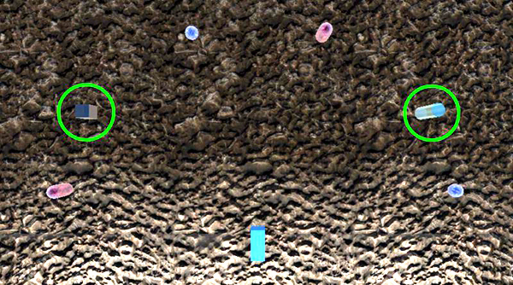
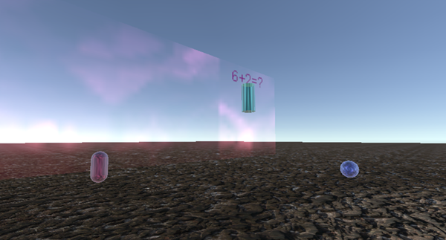
User study configuration
Task-related and background virtual objects
  Math problems solving
5 user study scenes
  Task-related objects number and moving trajectories

Slide 7
Main collected data
Included angle between view direction and the vector from the camera to the object
  It indicates how centered the object is in the camera
Is a strong hint of the objects’ visual attention degree from the participant

Slide 8
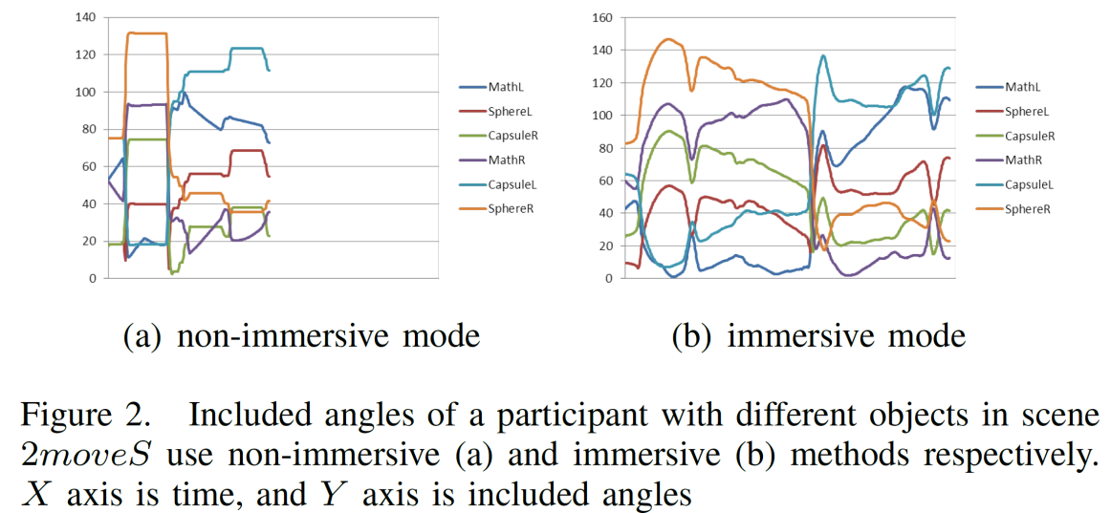
Result analysis
25 participants, backgrounds are diversified, all are familiar with how to navigate in desktop VR
Only few have experienced HMD-based
Play the scenes in both of the VR modes

Slide 9
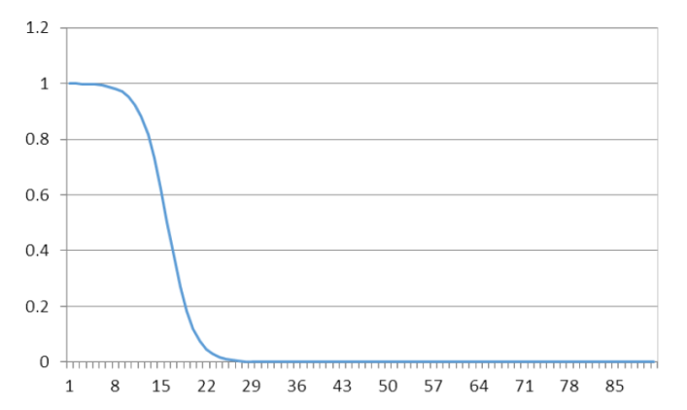
Object-based attention quantitative equation
A math model to give a higher value to the objects that have smaller included angles
  which means they are being focused on
Much lower values to larger included angles
  which means the items are being mostly disregarded

Slide 10
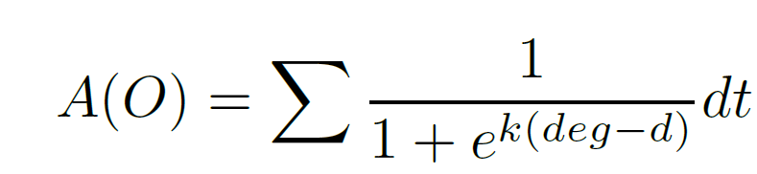
Object-based attention quantitative equation
A revised Logistic function
where k denotes the steepness of the curve; here we use 0.5
deg denotes the included angle
d denotes the sigmoid curve’s midpoint, the threshold of gazing included angles, we use 15°
The attention value is accumulated along with time t

Slide 11
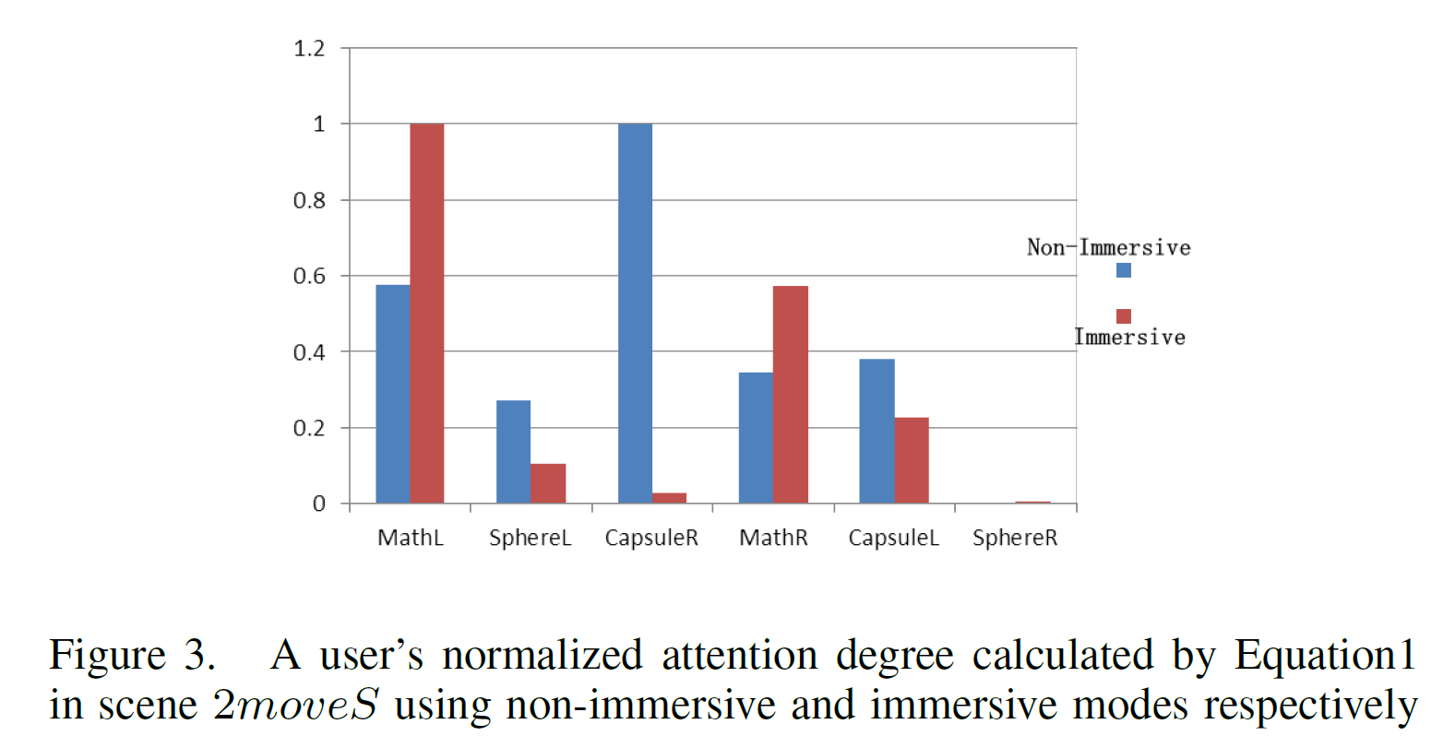
Validate

Slide 12
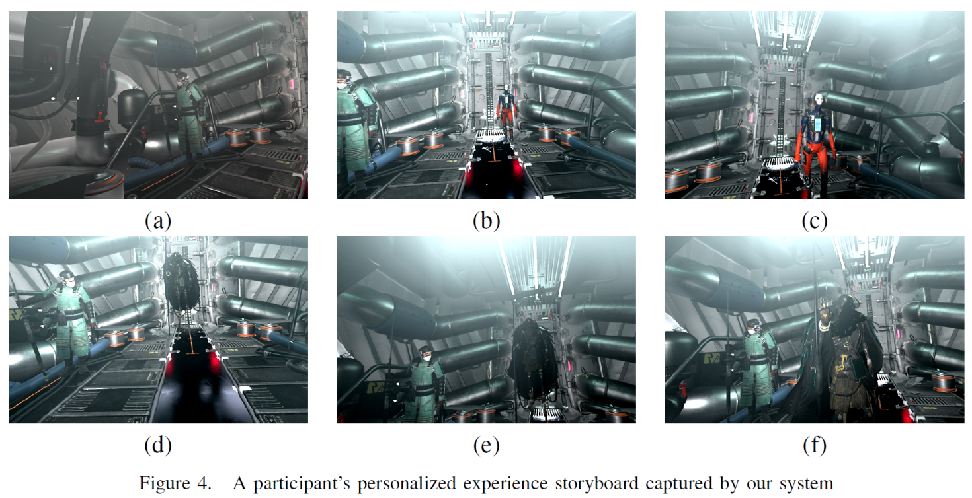
Application——personalized storyboard system in VR
The attention equation is used as a criterion
Key frame if an object received enough attention

Slide 13
Conclusion
Verified hypothesis of head movement importance in immersive VR
  Included angle is a strong hint for gazing
Proposed a quantitative object-based attention evaluation method
  Use the attention value to diagnose designed VR scene
The equation is used to VR personalized storyboard system
  Enrich user experience
  An intuitive way for designers’ review purposes.
Can be easily embedded into current immersive VR applications
  The eye tracking system is not necessary

Slide 14

Thanks for watching
More results and the source code can be found @
Questions?

