Slide 1

IT PROJECT
Lecture: Hoàng Văn Dũng

Slide 2
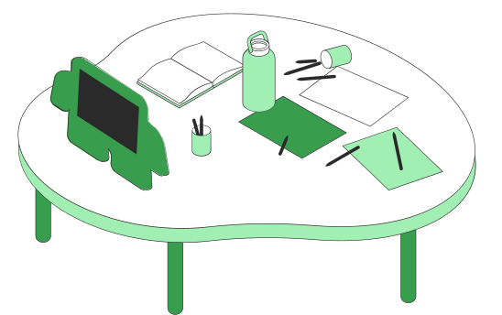
FOOD STORE MANAGEMENT APPLICATION
Nguyễn Trung Nguyên - 20110388

Slide 3


The reasons for choosing the topic
Nowadays, when the information technology is very popular. Service sectors also apply technology to their fields. Restaurants will use software to calculate or manage revenue instead of books as before. So I decided to choose this topic to build an food store app with C# language and SQL Management Database.

Slide 4
Apply the knowledge from database management subject
DATABASE
SQL Query
Trigger
Stored Procedure
View
Transaction

Slide 5
TABLE OF DATABASE
ACCOUNT
TABLE
FOOD
FOOD
CATEGORY
FOOD
BILL
BILLINFOR
CHIPHI
UserName
DisplayName
Password
TypeOfAccount
ID
Name
Status
ID
Name
ID
Name
IDCategory
Price
ID
DateCheckIn
DateCheckOut
IDTable
Staff
Discount
Status
ID
IDBill
IDFood
Count
ID
MonthChiPhi
Price

Slide 6
Apply the knowledge from winform programing subject
C# LANGUAGE
development features, including controls, graphics, data binding, and user input
Notes:
UI framework that creates rich desktop client apps for Windows. The Windows Forms development platform supports a broad set of app development features, including controls, graphics, data binding, and user input. Windows Forms features a drag-and-drop visual designer in Visual Studio to easily create Windows Forms apps.

Slide 7

INTERFACE

Slide 8
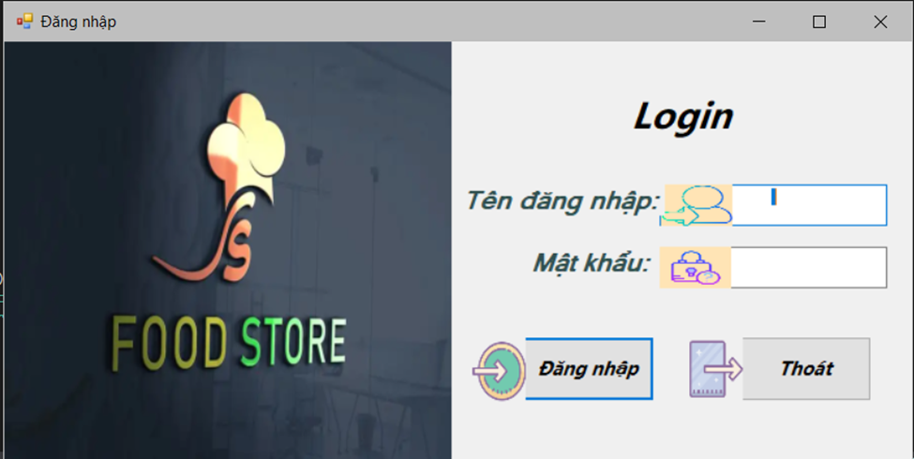
Login form

Slide 9
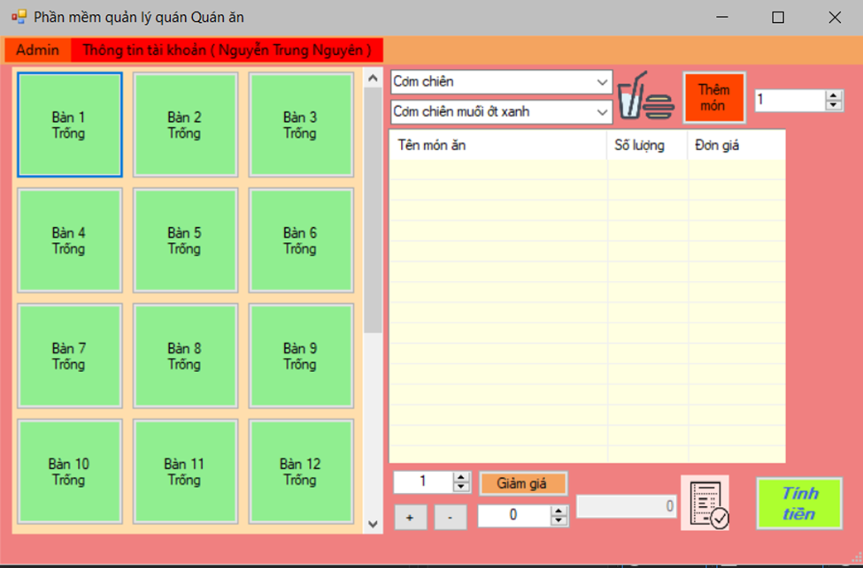
Main form

Slide 10
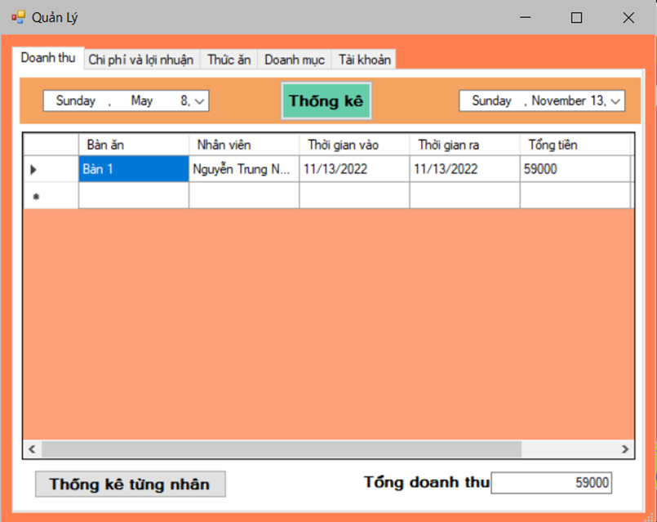
Admin form
Notes:
There are more other form and I will show you when I demo the project

Slide 11

DEMO APPLICATION

