Slide 1
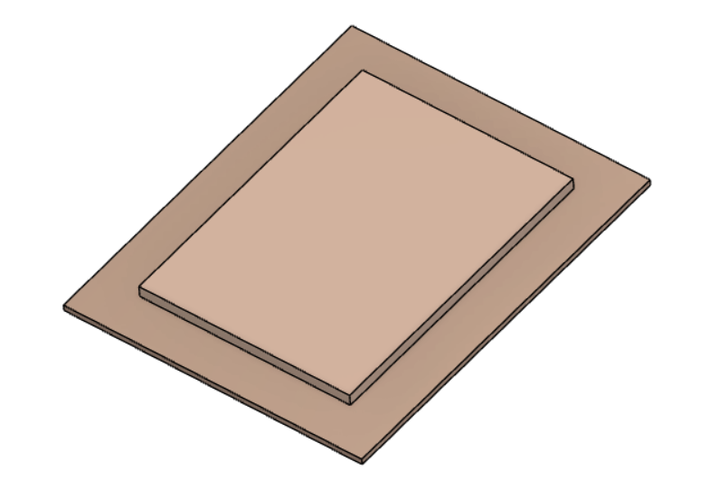
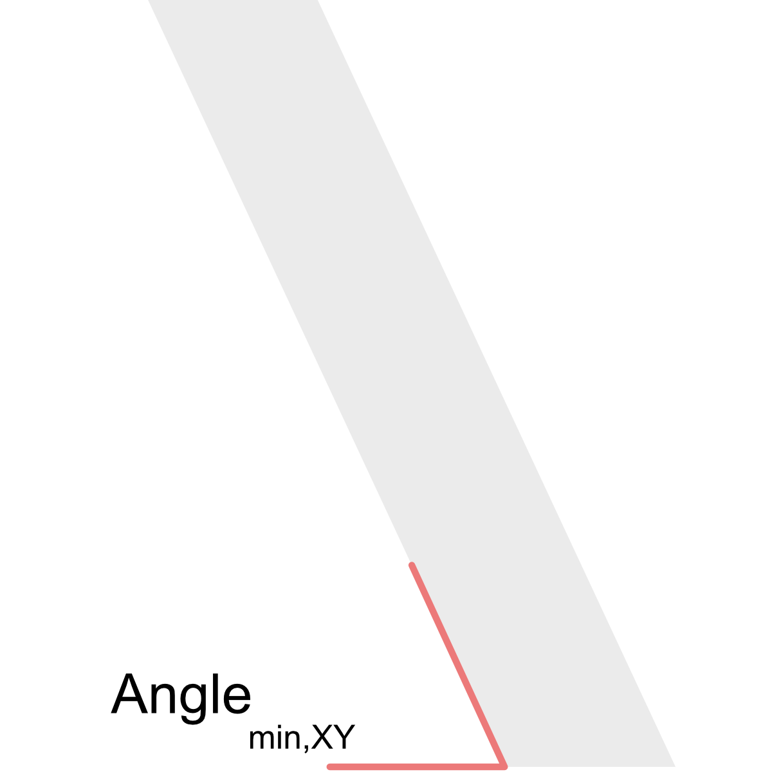
2024-2025 ASME Cold Plate Design Competition
Background: This document is meant to provide students with pertinent details for the 2024-2025 ASME K-16/IEEE EPS Cold Plate Design Competition. For this competition, students will design, analyze and optimize an additively manufactured heat sink to cool constant heat flux power electronics modules that are subjected to forced convection liquid cooling using water. Student teams will need to submit a white paper and their design files for the competition. The student teams that are evaluated as having the highest performance and most creative designs, will have an opportunity to print their designs by Fabric8Labs and test them at Intel. Finalists will also present their work at the 2025 ITherm Conference.
Design Guidelines
Table 1: Fin plate design constraints
Feature | Size
Max Cold Plate Fin Volume | 75.5 x 56.5 x 3 mm (XYZ)
Base Plate Size | 100 x 80 x 1.6 mm (XYZ)
Minimum Feature Size (positive or negative feature), dimension | 0.100 mm (XYZ)
Maximum Feature Size (positive feature), XY Dimension | 0.500 mm (e.g., a straight fin down the length of the cold plate can be up to 0.5 mm in thickness)
Maximum Feature Size (positive feature), Z Dimension | 3 mm, limited by Cold Plate fin volume
Minimum Feature Resolution (Voxel Size), XY (see next slide for detail) | 33 ⅓ µm
Minimum Feature Resolution (Voxel Size), Z | 30 µm
Minimum Feature Overhang Angle | 20° (from XY plane)
Acceptable File Formats | .STEP
Fin plate: 75.5 x 56.5 x 3mm
Baseplate: 100 x 80 x 1.6mm
Min feature overhang angle
Z
XY

Slide 2
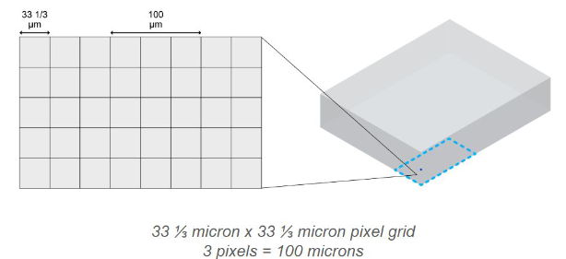
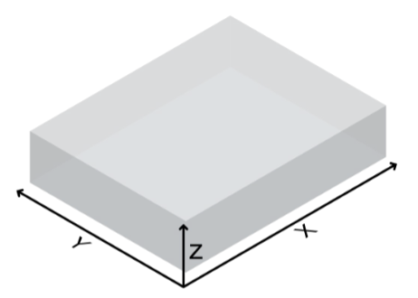
2024-2025 ASME Cold Plate Design Competition
Design Guidelines
All STEP files are sliced with an XY voxel size of 33 ⅓ x 33 ⅓ µm pixels
Therefore, X & Y dimensions of part features are defined by a grid of 33 ⅓ x 33 ⅓ µm pixels
Areas of the print that need high resolution, part feature size and spacing should be defined in increments of 33 ⅓ µm in order to maintain feature fidelity
Example: a fin/gap of 133 ⅓ / 166 ⅔ µm will align to the pixels; whereas a fin/gap of 150 / 175 µm will not align to the pixels; causing actual fin feature thickness variation in the slices and the resulting print
Z dimension defined by layer height - Minimum of 0.030 mm specified for competition
Pixel (XY Voxel)
Y
X
Boundary Conditions for Simulations
The Top Plate with inlet and outlet diameter (ID), X, Y and Z dimensions of the cold plate (top plate and bottom plate) that is given by the competition team must be used. No deviations will be acceptable.
Flow rate of 1 – 2 L/min must be used in simulation
Power load = 350 W
Coolant (PCW) inlet temperature of 20℃ must be used in simulation
The power load can be assumed to uniformly distribute over the base plate.
Design meets (manufacturing) design guidelines

Slide 3
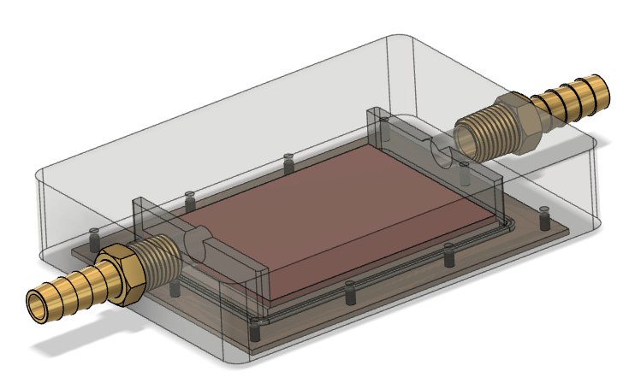
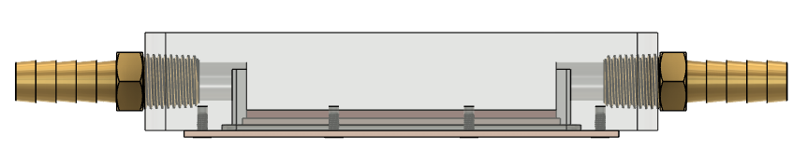
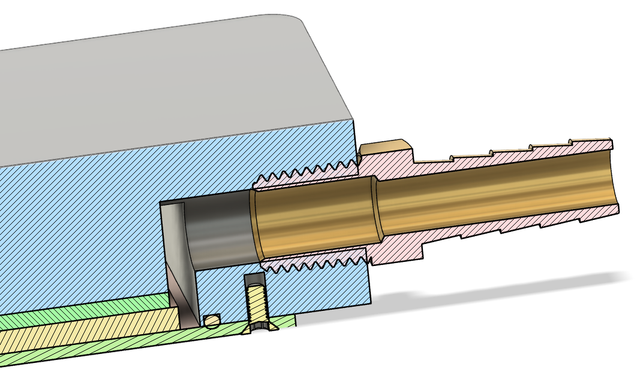
2024-2025 ASME Cold Plate Design Competition
Manifold Housing Details
Side-in Side-out Flow
2mm Silicone gasket above fin plate
⅜” ID Tube Inlet and Outlet
3.5mm Accumulator sections at ends of fin plate to ensure uniform flow
Additive Manufacturing Constraints
The cold plate will be 3D printed with pure copper. As printed, it is expected that the effective thermal conductivity is ~380 W/m·K. For modelling, it can be assumed that the surface roughness is 1.5 microns. Surface roughness can range depending on the geometry. The design and feature constraints are as defined in the Design Guidelines section.
Design Review for Manufacturability
Of the final selected designs, Fabric8Labs will perform design for additive manufacturing (DfAM) reviews for manufacturability. If required, F8L will provide design change suggestions to improve manufacturability of the parts. The DfAM review for manufacturability is envisioned to be collaborative in nature between the design team and Fabric8Labs.

Slide 4
2024-2025 ASME Cold Plate Design Competition
Cold Plate Competition Rules
Each team can submit one cold plate design
A maximum of 5 participants in one team is allowed
Each team should check with their advisor in terms of timelines for design, simulation, analysis, CAD drop to Fabric8Labs for manufacturability.
Timeline for accepting and producing prototypes will be communicated to registered teams
A full design submission must consist of a written report, CAD files, COMSOL/Icepak/Fluent/AEDT file or other software of the model, and experimental data if available.
Students making this a university project should check with their advisor(s)/professors on project deadlines for university acceptance. These dates may differ from competition dates as each university will operate based on their semester dates.
The participants retain ownership, but the competition organizers and manufacturer (Fabric8Labs) shall be granted a perpetual, non-exclusive right to use the designs for educational, research, or commercial purposes.
Students must create CAD drawings (STEP File required) and submit it for manufacturability review to Fabric8Labs
Cold plate must have distinct two parts, the top housing and the bottom fin plate; which shall be assembled for final testing.
Cold plate cooling fin region shall be the focus of the design for the competition teams.
Top plate and bottom fin plate must be put together for manufacturability.
Students must submit CAD file with drawings, COMSOL/Icepak/Fluent/AEDT file or other software of the model, written report and experimental data if available.
Students must also submit the final prototype components to the competition team for experimental evaluation
Intellectual Property
Cold Plate Form Factor/Submission Criteria

Slide 5
2024-2025 ASME Cold Plate Design Competition
Design Objectives and Scoring
The objectives for the white paper are to demonstrate the elements defined in the list below:
Highest Cost-based Figure of Merit (FOM).
Demonstrate effective use of thermal analysis and modeling.
Effectively use additive manufacturing in the design.
Well written, formatted, and clear white paper
Table 2: Scoring metrics for white paper.
Metric | Assigned Point Value
Predicted Cost-based FOM* | 25
Analytical Technique | 25
Effective use of AM | 35
Writing Style/Formatting | 15
*Note: The predicted FOM will be from standardized simulations run by the organizers in COMSOL.
The design objectives for the final competition are provided in the list below:
Cost-based Figure of Merit.
Effective use of additive manufacturing.
Presentation Skills
Designs failing to adhere to additive design requirements as laid out by Fabric8Labs during the seminar and design review will be assessed a penalty of up to 15 points.
Overall scoring will be assessed according to the details provided in Table 3, below:
Table 3: Scoring metrics for final competition.
Metric | Assigned Point Value
Experimental Cost-based Figure of Merit | 40
Effective use of AM | 35
Presentation Skills | 15

Slide 6
2024-2025 ASME Cold Plate Design Competition
Cost-based Figure of Merit
The groups should submit a cost-based Figure of Merit (FOM). This FOM can be calculated according to the following Eqn.:
Thermal resistance:
m: the mass of the fin plate
T_{in}: fluid temperature at the inlet
P_{in}, P_{out}: pressure at inlet/outlet
T_{hotspot}: max. temp. on base plate
Pressure drop:
Reference point: R_{th,ref} = 0.1 K/W, ΔP_{ref} = 30 kPa, m_{solid} = 114.7 g
Best Use of Additive Manufacturing
Use of additive manufacturing score is an assessment of the overall design aesthetic and use of AM for minimizing pressure drop, thermal resistance, etc. Creativity is rewarded in this category along with the formation of novel structures that would otherwise not be possible with conventional manufacturing methods.
Experimental Evaluation
Each team must submit their final prototype to Intel for experimental evaluation.
Experimental performance assessment will be performed at Intel for all the cold plates submitted based on the boundary conditions given by the team.
Findings of the experiment will be compared to the results of the simulations (and experiments if performed)
Measured Data for Model Validation
Experimental data and results obtained by the test-facility (Intel) will be made available to teams in Spring 2025.
6

