Slide 1

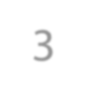
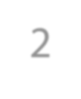
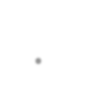
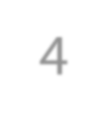
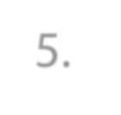
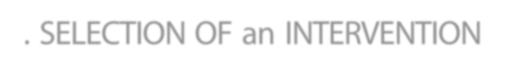
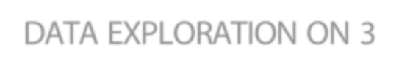
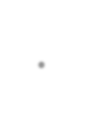

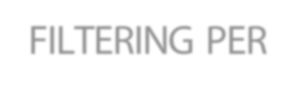
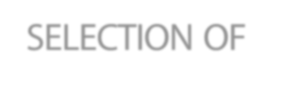
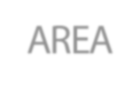
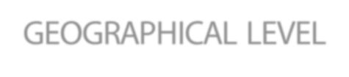
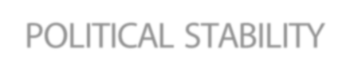
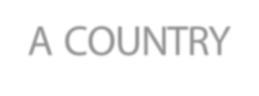













About this Dashboard
The aim of this project is to produce a report covering the three areas of expertise of a fictional NGO. These three areas of intervention are Creation of services, Service Improvement & consulting.
However, we will focus our analysis on three geographical scales, from the broadest to the most localised:
Global
Continental
Local
Therefore, the dashboard provides a global view of access to drinking water in the world, allowing a donor to target the country in which he wants DWFA to intervene.
2. SELECTION OF an INTERVENTION AREA
3. DATA EXPLORATION ON 3 GEOGRAPHICAL LEVEL
4. FILTERING PER POLITICAL STABILITY
5. SELECTION OF A COUNTRY
CREATION
SERVICES
SERVICES
IMPROVMENT
CONSULTING
Acceptance of Funding
Worldwide rate access of drinking water
Continental Disparity in access to water
Political stability
vs
Policy Efficiency
Possible intervention Area
Urban population access to Basic drinking service
Continental Disparity for
urban population in acces to water
Evolution over Time to drinking water access

Slide 2




About this Dashboard
Data sources:
Population and political stability data are from the FAO website
Mortality rate attributed to water and Basic an safely managed water services are data from the WHO website.
Nota Bene : The Policy efficiency score is calculated as follows:
(Country mortality rate due to WASH 2016) / mean (Countries mortality rate due to WASH 2016) + (Country basic access to water 2017) / mean (Countries basic access to water 2017)

