Slide 1

Telecom Customer Churn Prediction
End-to-End Data Analytics Pipeline
HANIEH REZAEI · JUNE 2026

Slide 2
Project Pipeline
01
02
Data Ingestion & EDA
Cleaning & Feature Engineering
Python + Pandas
03
04
SQL Server Export
ML Training & Tuning
05
06
Prediction on New Customers
Power BI Dashboard

Slide 3
Dataset at a Glance
6,418
32
Total Records
Features
71.2%
28.8%
Stayed
Churned
411 new customers (join_data) held out for prediction. Class imbalance addressed via class_weight='balanced' and scale_pos_weight.

Slide 4




Data Cleaning & Feature Engineering
Missing Values
Domain-aware imputation — Value_Deal→'None', Multiple_Lines→'No', Churn_Category→'Others'
New Features
Monthly_Charge_Range, Age_Group, Tenure_Group — binned for interpretability
SQL Export
Cleaned data exported to SQL Server (churn11) via SQLAlchemy

Slide 5
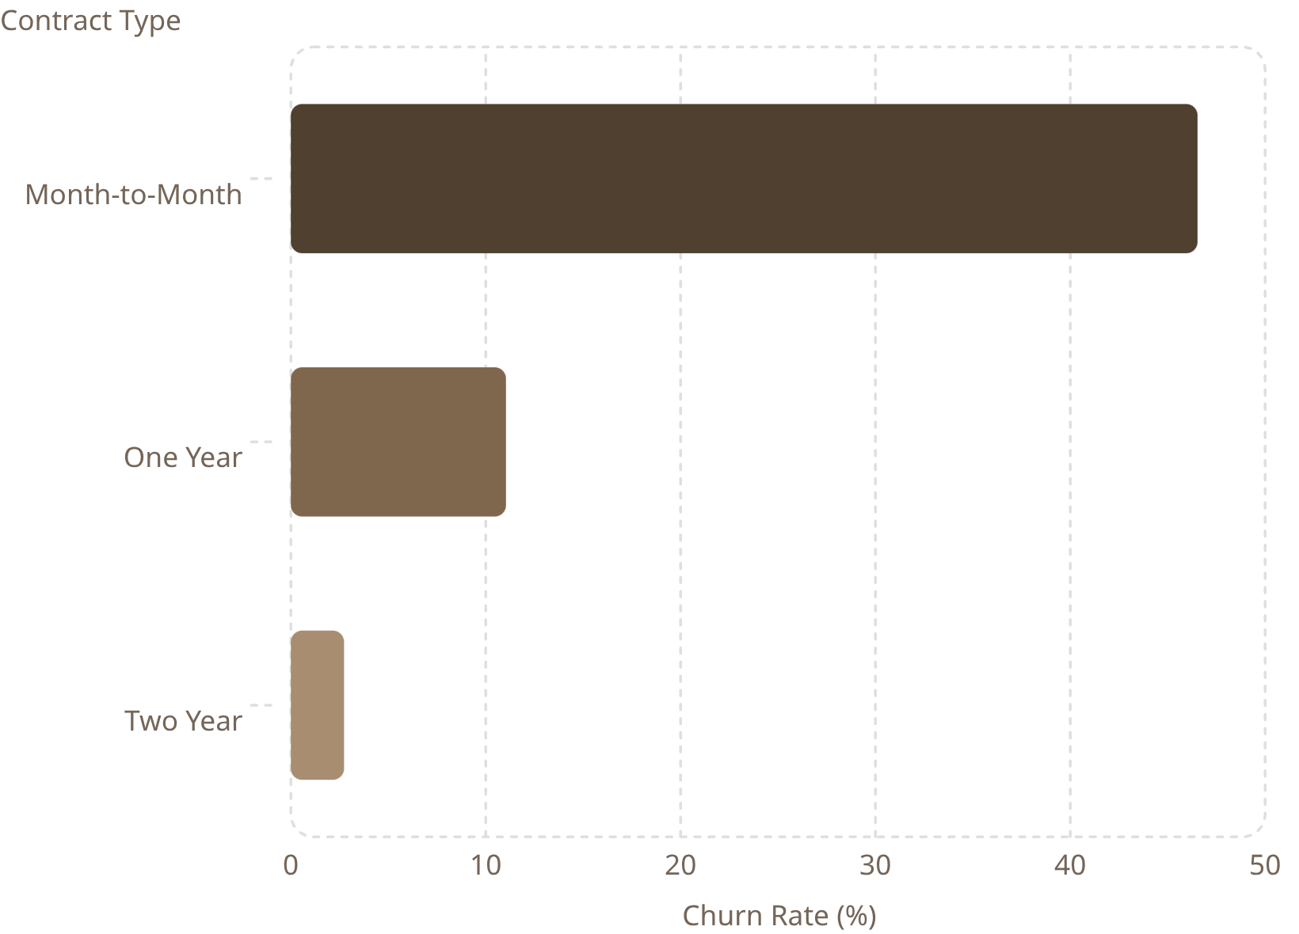
Churn by Key Segments
Contract Type is the #1 Predictor
Month-to-month customers churn at 46.5% — over 17× higher than two-year contracts.
Revenue Gap
Stayed: $3,745 avg · Churned: $1,970 avg — nearly 2× difference.

Slide 6
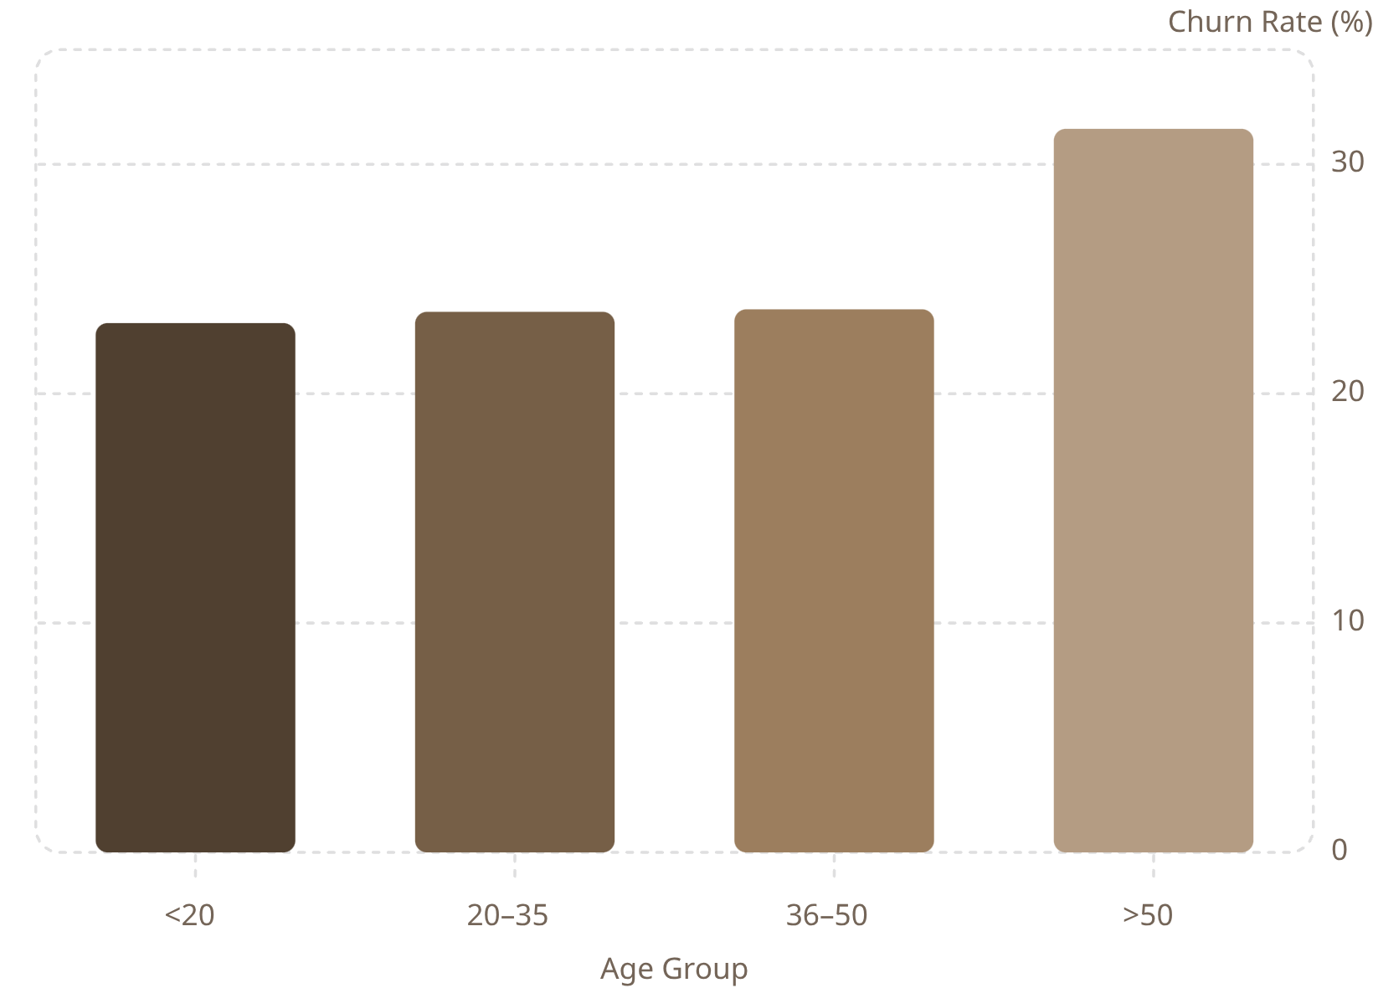
Geographic & Demographic Risk
Top 5 High-Churn States
Churn by Age Group
Jammu & Kashmir
Assam
38.13%
57.19%
Jharkhand
34.51%

Slide 7
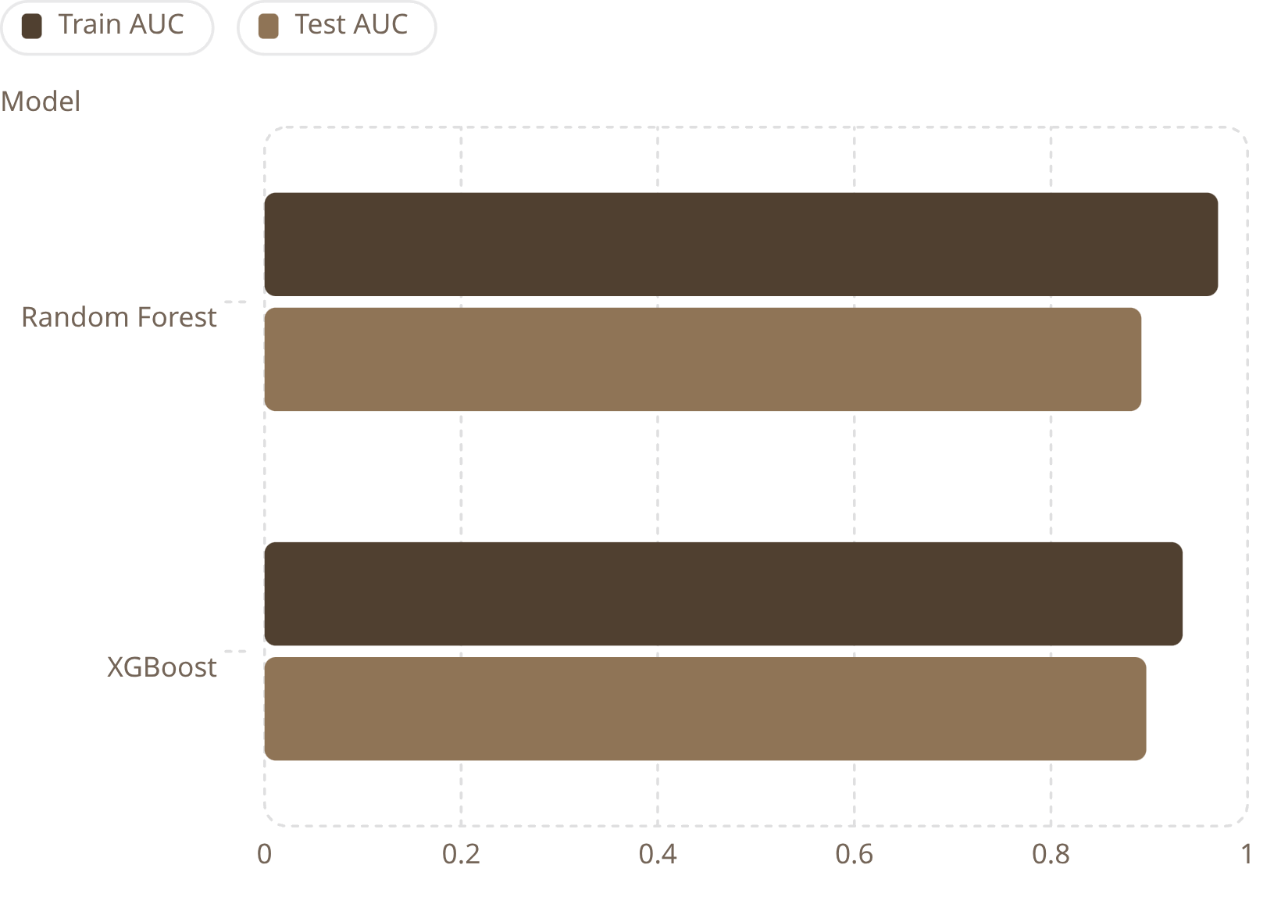
ML Models & Performance
Random Forest — Best Balanced
Accuracy: 84% · Churner Recall: 77%
Leakage-free pipeline: train/test split before encoding.
Top Feature Importance
Contract Type alone explains ~25% of predictions.

Slide 8
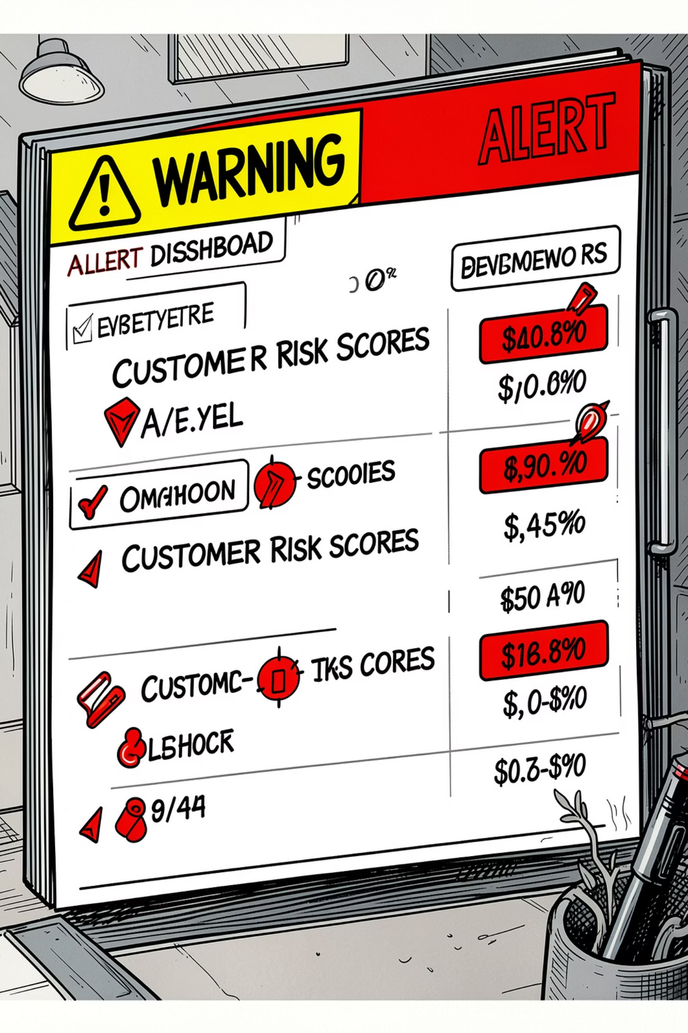
Prediction on New Customers
93.9% At Risk
Why So High?
386 of 411 new customers predicted to churn
89% on month-to-month contracts (vs 49% historical base)
Structural, Not Error
90% lack Online Security; 90% lack Premium Support

Slide 9
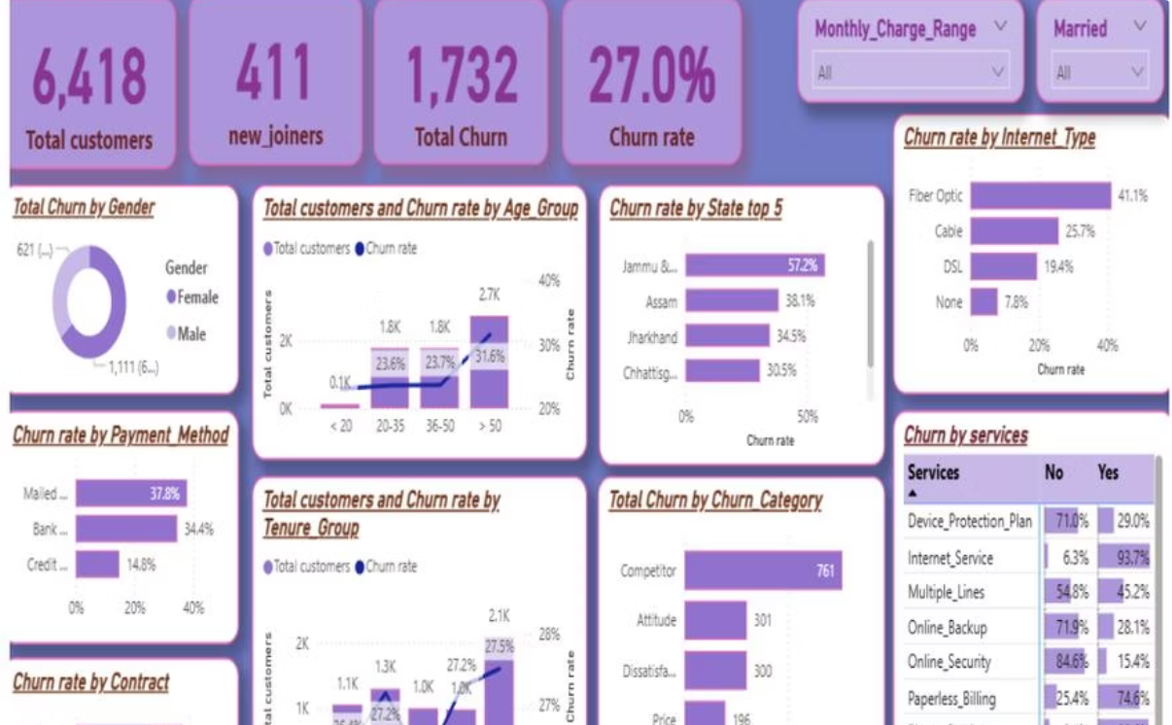
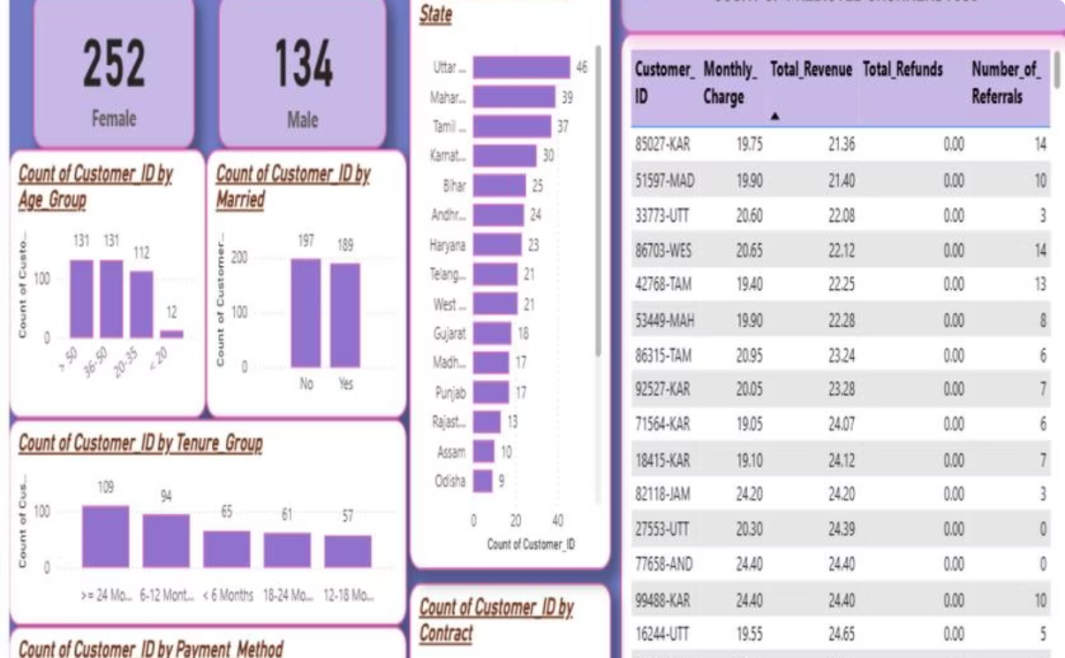
Power BI Dashboards
Summary Dashboard
Prediction Dashboard
Churn by gender, age, state, internet type, tenure & category
386 at-risk customers profiled by age, state, contract & payment method

Slide 10



Business Recommendations
0–3 Months
3–12 Months
Estimated Impact
Upgrade 386 at-risk to annual contracts; free Online Security + Premium Support
Outreach to high-score customers; review Fiber Optic pricing; restructure onboarding
~247 customers retained · ~$750K protected lifetime revenue

