Slide 1
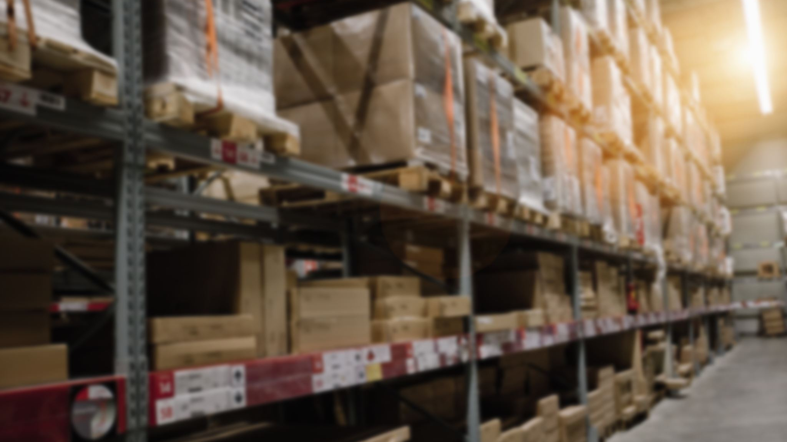
Inventory Restocking System
By Hani Ahmadie
December 2, 2024

Slide 2
Introduction
Inventory in hospitals is used for patients. The hospital needs to make sure they have the proper amount of inventory on the shelf to treat the patients.
However, it is important to manage inventory properly.
Ensure they have the right amount of inventory
Not overstock and hold their money on the shelves
Not overstock and risk inventory expiring

Slide 3
The System will
Provide a list of the inventory and restocking levels
Always provide the inventory in stock after purchase and use
Provide a list of items to be restocked

Slide 4
INPUT
1) User will enter the items, initial quantity and reorder level
2) User will enter quantity purchased
User will enter the quantity used

Slide 5
Processing
Processing
1) Data Storage: Inventory, Inventory levels and restocking levels are stored in a text file
2) Recording usage: Usage will update the amount for items in inventory
Note: Quantities cannot be less than 0
3) Threshold checking compares current stock to threshold for restocking levels

Slide 6
OUTPUT
1) The list of items in inventory when read from a text file
The balance of each item when quantity is purchase or used
The list of items required to be restocked

Slide 7
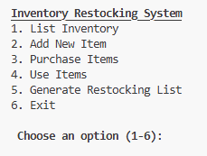
Program - Main Menu

Slide 8
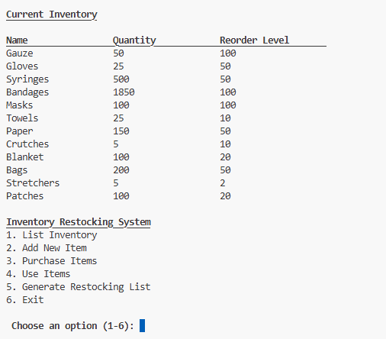
CHOICE 1 – list inventory

Slide 9
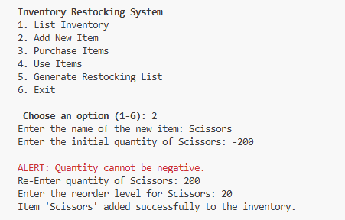
Choice 2 – add new items

Slide 10
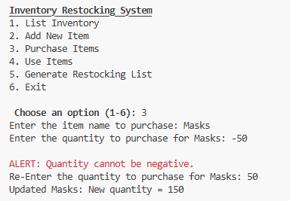
Choice 3 – purchase items

Slide 11
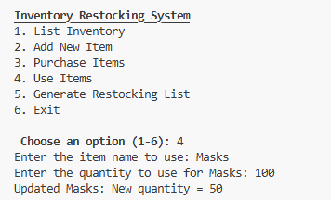
Choice 4 – Use items

Slide 12
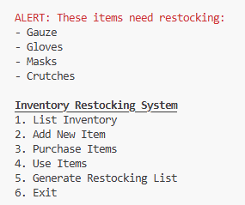
Choice 5 – generate restocking list

Slide 13
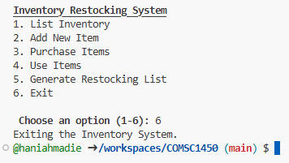
Choice 6 - exit

Slide 14
Thank you

