Slide 1
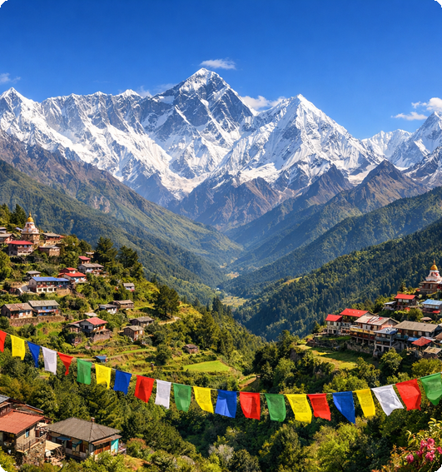
Introduction to Nepal
Nestled between China and India in the Himalayas, Nepal captivates with diverse cultures, breathtaking scenery, and rich history. This unique nation attracts travelers worldwide for its majestic mountains and vibrant heritage.
Notes:
Nepal is a small, landlocked country located in South Asia, bordered by China to the north and India to the south, east, and west. It's especially famous for being home to the Himalayas, including Mount Everest, and is celebrated for its remarkable natural beauty, variety of cultures, and ancient traditions that continue today.

Slide 2

Geographical Highlights of Nepal
Capital and Elevation
Nepal covers 147,516 sq. km with a population of 30.5M (2025 est.). The country is known for its dramatic landscape, with hills and mountains making up over 80% of its area.
Kathmandu is the capital, while Mount Everest rises to 8,848m as the highest point.
Protected Land
12 national parks safeguard more than 23% of the territory.
www.nepalinfo.gov.np
Notes:
Nepal is a diverse country, both in terrain and culture. Most of its area is mountainous, highlighted by Mount Everest, the world’s highest peak. The capital city Kathmandu serves as the primary urban center. Conservation is significant, with national parks protecting a large portion of the country.

Slide 3
Cultural Richness
Ethnic & Linguistic Diversity
Over 120 ethnic groups and 123 languages enhance Nepal's cultural landscape.
Nepal exhibits remarkable diversity with over 120 ethnic communities and 123 languages, reflecting a rich cultural mosaic infused by major religions, vibrant festivals, and iconic heritage sites.
Religious Harmony
Hinduism dominates at 81.3%, alongside Buddhism and Islam, fostering spiritual coexistence.
Celebrated Festivals & Heritage
Traditions such as Dashain, Tihar, and Holi, and sites like Kathmandu Durbar Square and Lumbini shape the nation’s identity.
www.welcomenepal.com
Notes:
Nepal stands out for its wide array of ethnicities and languages, making it incredibly diverse. The country is home to major religions like Hinduism, Buddhism, and Islam, which coexist peacefully. Key festivals and world-famous sites like Kathmandu Durbar Square and Lumbini add further depth to Nepal’s cultural significance.

Slide 4
Economy and Tourism Highlights
$41.7B Economy
Diverse sectors strengthen overall economic growth.
Nepal’s economy, estimated at $41.7B in 2025, relies on agriculture, tourism, remittances, and services. Agriculture drives about 23% of GDP, while tourism welcomes over 1.2M visitors yearly. Notably, the Everest region draws 35K+ trekkers, reinforcing tourism as about 7% of total GDP.
Agriculture at 23% of GDP
Farming remains a primary livelihood and economic base.
Tourism’s Impact
1.2M+ tourists yearly; Everest region key destination; sector drives 7% of GDP.
www.nepal.gov.np
Notes:
Nepal has a projected GDP of $41.7 billion in 2025. Agriculture comprises nearly a quarter of the economy, serving as a backbone for livelihoods. Tourism is another key contributor, with more than 1.2 million annual visitors and over 35,000 trekkers visiting the Everest region alone. Overall, tourism is responsible for about 7% of the nation’s GDP.

Slide 5
Unmatched Heights
Host to 8 of the world's 14 tallest peaks, including Everest.
Why Nepal is Cool
Adventure Meets Spirituality
Nepal captivates with its majestic peaks, vibrant traditions, and a modern spirit of progress.
Offers thrilling outdoor experiences and deep spiritual heritage.
Warm Culture
Embraces visitors with rich traditions, diverse cuisines, and genuine hospitality.
Modern Progress
Over 90% electrification with digital reach expanding rapidly.
Resilient Spirit
Globally admired for kindness and resilience.
www.welcomenepal.com
Notes:
Nepal stands out for more than just its breathtaking mountains. It's a unique mix of adventure, spiritual depth, and cultural richness. The country continues to modernize, bringing electricity and digital access to almost all its people. What truly sets Nepal apart is the warmth and resilience of its communities, making it a welcoming place for all.

