Slide 1
System Description
System | Subsystem | Justification
IOT Device | Weather Station | The AZ3166 device simulates telemetry data, sync properties with device twin.
IOT Device | Wind Farm Simulator | Simulates telemetry data generated by multiple Wind Farm Turbines each hosting multiple sensors.
Cloud Gateway | Iot Hub | Provides device registry and management, securely accepts device telemetry data. The device twin feature enables C2D sync of property values.
Cloud Service System | Time Series Insight | Handles high volumes of time-stamped telemetry data, enabling real-time analysis
Cloud Service System | Cosmo DB | Stores JSON data in highly scalable, physically-partitioned environment. Supports low-latency, high-volume query analysis,
Cloud Service System | Power BI | Rich desktop query, analysis, reporting and dashboarding capability.
Desktop Computer | Power BI Desktop | Windows application used to design and prepare the dashboards before are published.
Cloud Service System | Stream Analytics | Stream data to different paths: to Azure Function, to Azure Data Lake and to CosmoDB
Cloud Service System | Data Lake | Stores historic telemetry data in raw JSON format
Cloud Service System | Data Lake Analytics | Used for analysis of historic telemetry data to determine average values

Slide 2

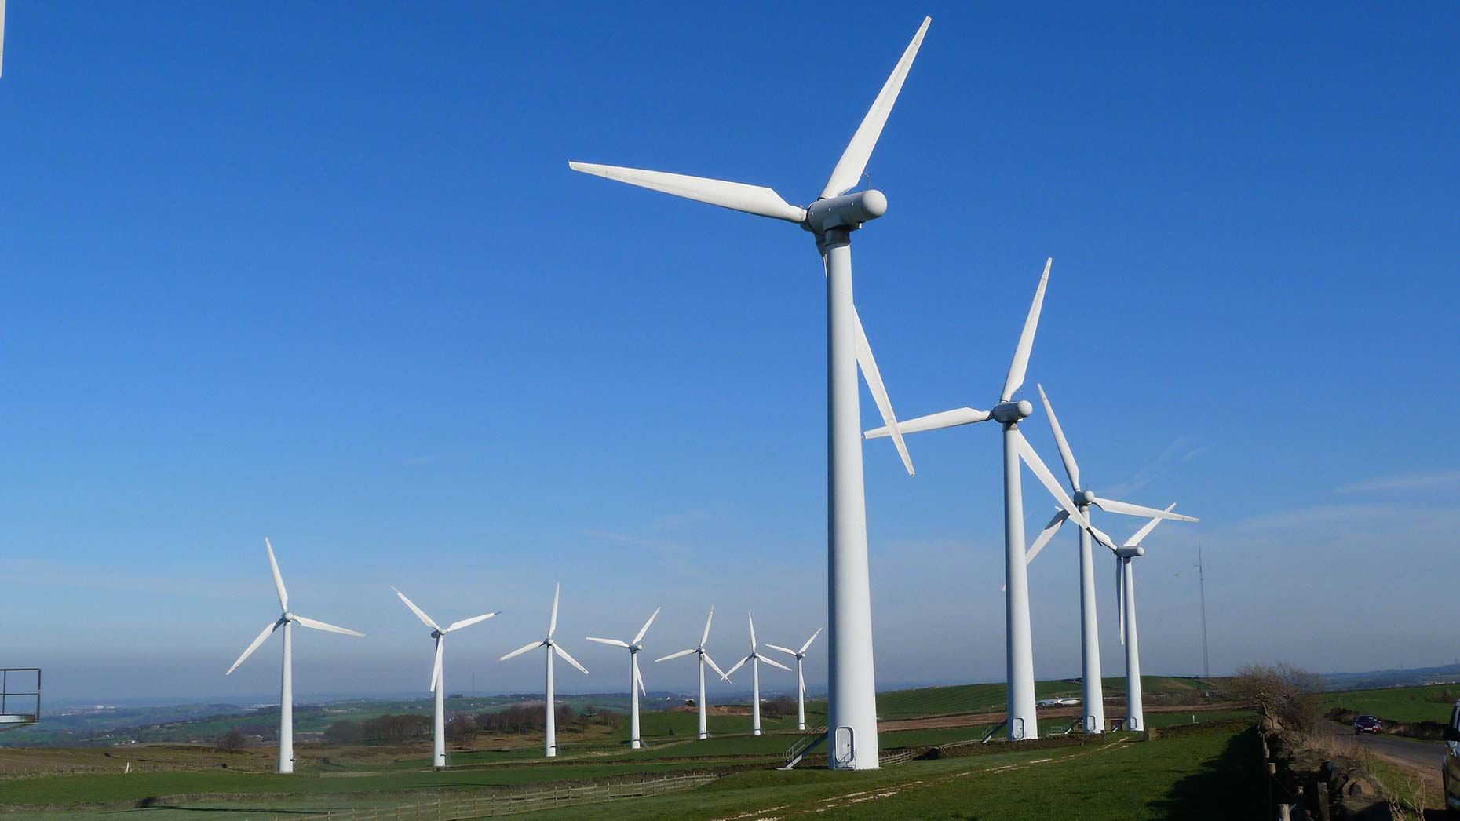


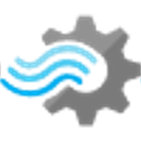
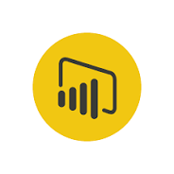

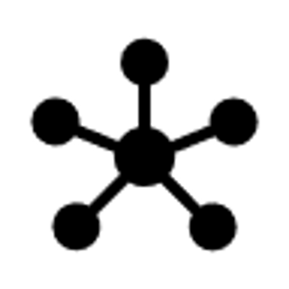

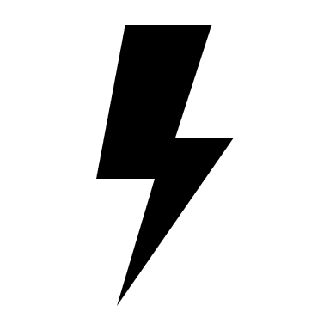
Wind Farm POV
IoTCapstoneRG
Simulated Wind Turbines
Time Series Insights
( iottsi5580ed8a )
Time Series Insights Explorer
Query API
Sensors
Cloud Gateway (IOT Hub)
telemetry: {
windSpeed
lowSpeedShaftRpm
highSpeedShaftRpm externalTemperatureCelsius generatorTemperatureCelsius rotorTemperatureCelsius
power
isTurbineBrakeOn
name }
Real time
Data Access Policies: Add permission to users
( iothub5580ed8a )
Web
Authentication: Symmetric Key
consumer
Group
Stream Analytics Job
Stream analytics job
( iotasa5580ed8a )
Power BI
Historical analysis
CosmosDB
(iotcosmos5580ed8a)
IOT Devices
Things
Insights
Actions

