Slide 1

Project in Networked Software Systems (044169) DHT Firefox Extension
January 2011

Slide 2
Supervisors & Staff
Supervisor:
Mr. Ittay Eyal
Developers:
Hani Ayoub
Daniel Aranki

Slide 3
Agenda
What is DHT?
Project Goal
Implement
High-Level Design
Example
Distribute
Analyze
Reports examples
Try 1, 2 and 3
Conclusion

Slide 4
What is a DHT?
DHT stands for Distributed Hash Table
A decentralized distributed system holds data in its nodes
Provides a lookup service similar to a hash table.
f(key)=value
Keep the data distributed dynamically
Scalable service
Notes:
When node joins the DHT, data is transferred from other nodes to it
When node leaves the DHT, data is transferred from it to other nodes
Which nodes? How? (for load balancing)
chord

Slide 5
What is a DHT? (cont.)
- Data
- Node

Slide 6
Project Goal
Determine whether a DHT can be implemented
in Mozilla Firefox web browser or not
in sense of duty time
This needs:
DHT understanding
Firefox Extensions
Statistics & Research

Slide 7
How will we answer the question?
Implement
Distribute
Analyze
Notes:
Implement
Implement a Firefox extension that gathers anonymous statistics for each user that installs the extension
Distribute (להפיץ)
Distribute the extension until we have sufficient information that we can look at and examine
Analyze
Research and examine the results (all statistics combined together) deeply and answer the question.

Slide 8
High-Level Design
Implement
Server
A machine uses Mozilla Firefox
With the statistics extension installed on it
Uses server interface for committing user data (JavaScript to PHP)
Residing in the Technion Softlab
Responsible for managing and collecting data
MySQL server for data gathering
Has interface to add/remove/update data (PHP)
Node5
Node4
Node3
Node2
Node1
One way communication

Slide 9
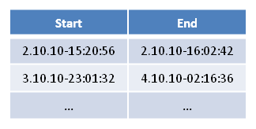
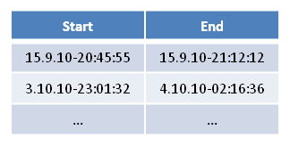
Info saved for user (example)
Implement
Node1
id: 207f4a43e8
ip: 10.185.119.254
spec: 3.6.3, Linux i686
Node2
id: 7b7dd903f3
ip: 128.69.10.158
spec: 3.5.9, Win 6.1
User
25bacc13fa9a
Node3
id: 809a32b769
ip: 169.185.0.120
spec: 3.7.4,Linux x64
Notes:
A user may have more than one node
Installation demo

Slide 10
Status
Distribute
72 Nodes - 59 Users. Includes:
Friends, Friends’ friends
Anonymous users
Firefox testers
Us
10 Months of gathering info (and counting…)
~11K usages
~820 days (~20K hours) of duty time

Slide 11
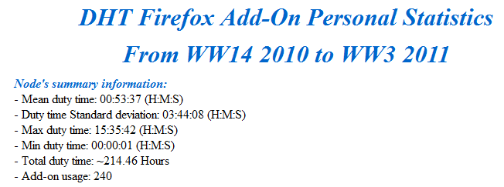
Reports
Analyze
Personal Report
Summary info for each user (example)

Slide 12
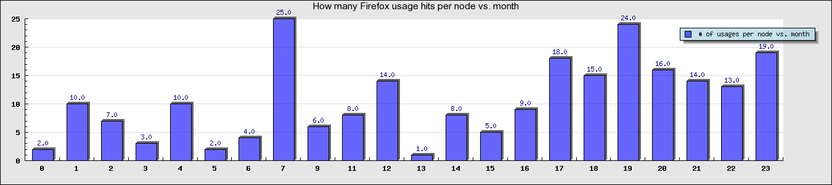
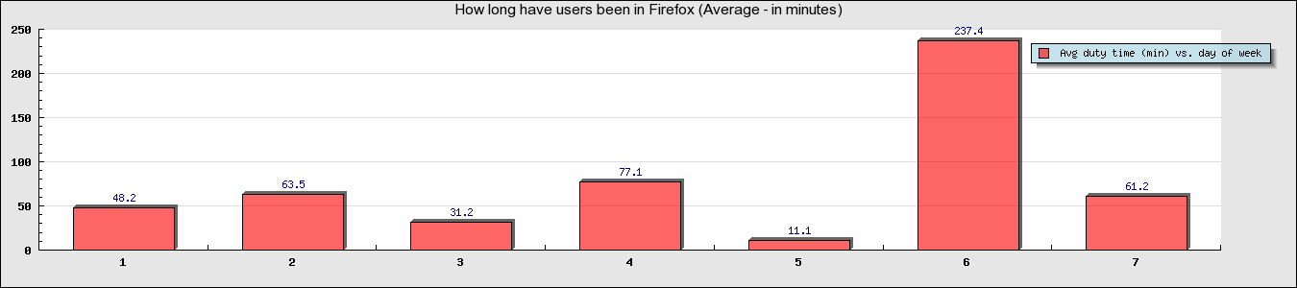
Reports (cont.)
Analyze
Personal Report
Graphs for each user (examples)
How long the user have been in Firefox (min) vs. day of week
How many times the user used the extension per node vs. month
All graphs are dynamically created!

Slide 13
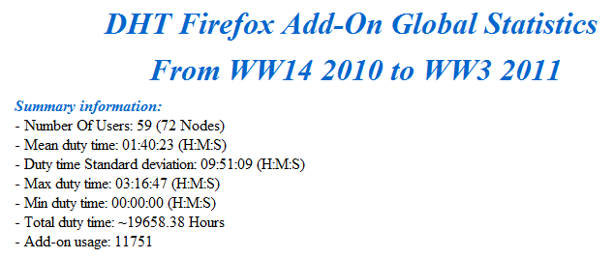
Reports (cont.)
Analyze
Global Report
All statistics combined

Slide 14
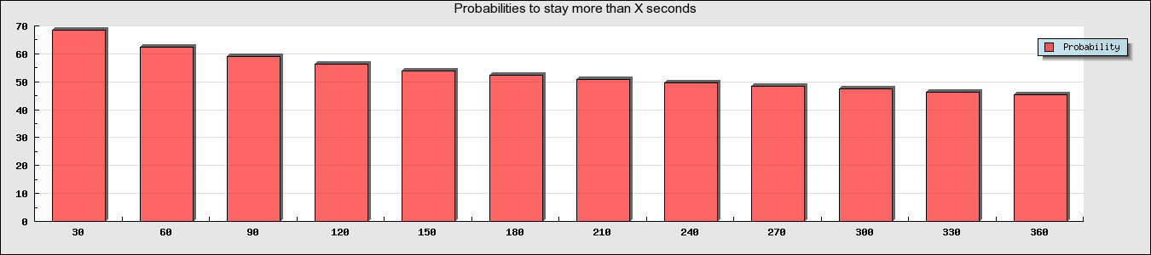
Reports (cont.)
Analyze
Global Report
Graphs used for analysis (example)
Probability that a user stays more than X time (seconds)
T | 30 | 60 | 90 | 120 | 150 | 180 | 210 | 240 | 270 | 300 | 330 | 360
P | 68 | 63 | 59 | 56 | 54 | 52 | 51 | 49 | 48 | 47 | 46 | 45

Slide 15
Can DHT be implemented?
Analyze

Slide 16
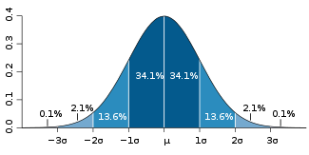
Try1: Mean Duty time and SD
Analyze
Standard Deviation
Measurement of variability or diversity
Shows how much variation there is from the average
Probability
Duty Time
Notes:
מדד סטטיסטי לתיאור הפיזור
מדידת שונות
מונח "סטייה" מתכוונים למרחק בין ערך בקבוצה לבין הממוצע
מבחינה מתמטית סטיית התקן היא השורש הריבועי של השונות

Slide 17
Try1: Mean Duty time and SD
Analyze
Small SD raises the confidence level of predicting the duty time of the next user and Vice-Versa
SD = Zero
Theoretical prediction is precise (low error rate)
SD = Same order of mean duty time
hard to predict next user’s duty time (high error rate)
Average duty time: 5382 seconds (~1.5 hours)
SD: 28474 seconds (~8 hours)

Slide 18
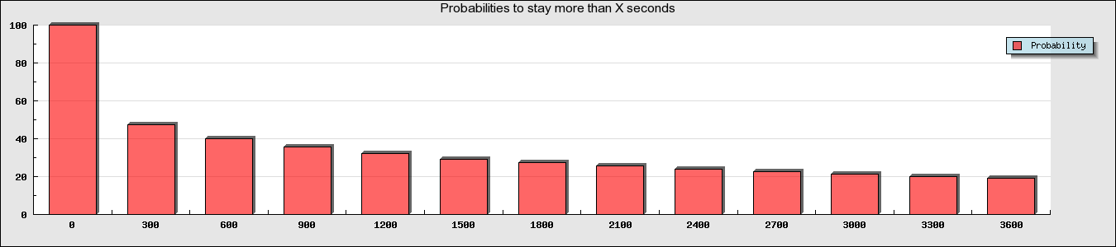
Try2: Static Analysis
Analyze
Using (inverse) accumulative probability
What % of the nodes used Firefox for more than X sec
Allow us to determine what uses can a DHT be good for
Example:
Between 0 and 1 hour with offset of 5 min
T | 0 | 5 | 10 | 15 | 20 | 25 | 30 | 35 | 40 | 45 | 50 | 55 | 60
P | 100 | 48 | 41 | 36 | 33 | 30 | 28 | 26 | 25 | 23 | 22 | 21 | 20
Notes:
פונקציית הצטברות (של הסתברות)

Slide 19
Try2: Static Analysis
Analyze
But, how can we raise our confidence level in knowing which user will stay further more in Firefox?
Add dynamic behavior

Slide 20
Try3: Dynamic Analysis
Analyze
What do we really need from the statistics?
predicting duty time
given that a user has been in FF for X_{start} time, what is the probability for the user to stay more than X_{end} time?
Such info helps us decide:
Node degree
When a node becomes ready to join DHT graph.
What kind of DHT (heavy/light data sharing, etc..) the node is suitable for
Minimizing data loss

Slide 21
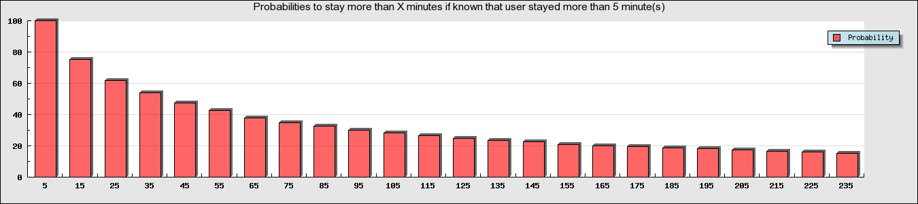
Try3: Dynamic Analysis
Analyze
Example:
Given that a user stayed in Firefox for 5 minutes
Calculate the probability that he’ll stay for another 10, 20, … minutes?
T | 5 | 15 | 25 | 35 | 45 | 55 | 65 | 75 | 85 | 95 | 105 | 115 | 125 | 135 | 145 | 155 | 165 | 175 | 185 | 195 | 205 | 215 | 225 | 235
P | 100 | 75 | 62 | 54 | 47 | 42 | 38 | 35 | 32 | 30 | 28 | 26 | 25 | 23 | 22 | 21 | 20 | 20 | 19 | 18 | 17 | 17 | 16 | 15

Slide 22
Conclusion
Analyze
DHT data structure can be implemented in Firefox
Several overlay networks
Different weights
Depends on data size
When user stays “long enough”
Raise him to heavier overlay
What is “long enough”?
Notes:
DHT data structure can be implemented in Firefox
Several overlay networks – Different weights
Each overlay network will have different weight depending on the maximum data size it features
The more confident we are that a node will stay ‘long enough’, attach him to an overlay network that holds such heavy data
‘long enough’ will be defined using a minimal acceptable probability for users to further stay in the DHT ‘long enough’ in order to be able to complete the transferring of the data of the maximal size in the overlay network.
In order to make this clearer, we’ll present a concluding example.

Slide 23
Concluding example
Analyze
Assumptions:
Sizes: 30MB - 100MB
Transfer rate: 0.1MB/Sec (5 minutes to transfer 30MB)
Minimal accepted probability: 80% (P_{minimal}=0.8)
Means:
User joins the DHT when we’re 80% certain that he will stay more 5 min
Notes:
Assumptions:
A DHT that will distribute sensitive data of sizes that range between 30MB and 100MB.
Average transfer rate of 0.1MB/Sec. (i.e. nominal transfer time for 30MB data is 300 seconds = 5 minutes).
Sensitive means that the minimal accepted probability to insure complete data transfer is 80%. Thus, Pminimal=0.8
We need to insure that we let users join the DHT only when we are 80% certain they can stay 5 minutes longer.

Slide 24
Concluding example (cont.)
Analyze
According to the data:
Online for less than 2.5 min?
Probability to stay 5 more min < 0.8
User needs to stay 2.5 min to join the DHT
Next checkpoint: 7.5 min
Online for 7.5 min?
Longest extra duty time with P=0.8 is 9 min
In 9 min DHT can transfer 54MB
Next overlay network weight is 54MB.

Slide 25
Concluding example (cont.)
Analyze
Next checkpoint: 16.5 min
Online for 16.5 min?
Longest extra duty time with P=0.8 is 12.5 min
In 12.5 min DHT can transfer 75MB
Next overlay network weight is 75MB.
Next checkpoint: 29 min
Online for 29 min?
Longest extra duty time with P=0.8 is 17 min
In 17 min DHT can transfer 102MB
Next overlay network weight is 100MB (target).
Notes:
Next checkpoint: 16.5 minutes
Given that the user is online for 16.5 minutes, the longest extra duty time with probability of at least 0.8 is 12.5 minutes.
12.5 minutes is the nominal time to transfer 75MB of data. Thus, the next overlay network weight is 75MB.
Next checkpoint: 29 minutes
Given that the user is online for 29 minutes, the longest extra duty time with probability of at least 0.8 is 17 minutes.
17 minutes is the nominal time to transfer 102MB of data. Thus, the next overlay network weight is 100MB (the target).
Note: these decisions should be made dynamically by the DHT according to the most updated data.

Slide 26
Concluding example (cont.)
Analyze
Parameter | Meaning | Value
T_enter_DHT | The time that needs to pass before the node gets attached to the lightest DHT overlay network | 2.5 minutes
T1 | The time between joining the lightest DHT overlay network and the first checkpoint | 5 minutes
T2 | The time between the first and the second checkpoints | 9 minutes
T3 | The time between the second and the third checkpoints | 12.5 minutes
T4 | The time between the third and the fourth (last) checkpoints | 17 minutes
W1 | The file size limit of the first overlay network (lightest) | 30MB
W2 | The file size limit of the second overlay network | 54MB
W3 | The file size limit of the third overlay network | 75MB
W4 | The file size limit of the fourth overlay network (heaviest) | 100MB (target)

Slide 27
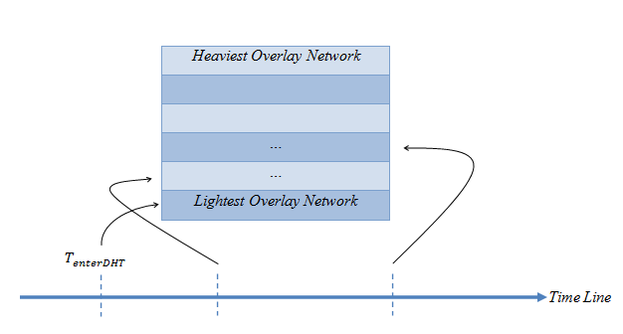
Concluding example (cont.)
Analyze
Note: these decisions should be made dynamically by the DHT according to the most updated data.
Notes:
Next checkpoint: 16.5 minutes
Given that the user is online for 16.5 minutes, the longest extra duty time with probability of at least 0.8 is 12.5 minutes.
12.5 minutes is the nominal time to transfer 75MB of data. Thus, the next overlay network weight is 75MB.
Next checkpoint: 29 minutes
Given that the user is online for 29 minutes, the longest extra duty time with probability of at least 0.8 is 17 minutes.
17 minutes is the nominal time to transfer 102MB of data. Thus, the next overlay network weight is 100MB (the target).
Note: these decisions should be made dynamically by the DHT according to the most updated data.

Slide 28

Q&A

