Slide 1
DHT Firefox Extension
What is a DHT?
Supervisor:
Ittay Eyal
Developers:
Hani Ayoub
Daniel Aranki
Distributed Hash Table
Decentralized distributed system holds data in its nodes
Keep data distributed dynamically
Scalable system
New node enters the DHT
Existing node exits the DHT
- Data
- Node

Slide 2
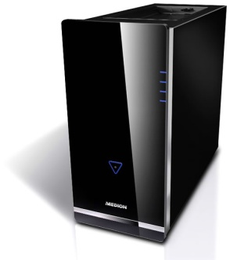

Project Goal
How?
Determine whether a DHT can be implemented
in Mozilla Firefox web browser or not
in sense of duty time
Implement: Firefox extension
That gathers statistics
Distribute: The extension
Analyze: The results
And answer the project question
Server
A machine uses Mozilla Firefox
With the statistics extension installed on it
Uses server interface for committing user data (JavaScript to PHP)
Residing in the Technion Softlab
Responsible for managing and collecting data
MySQL server for data gathering
Has interface to add/remove/update data (PHP)

Slide 3
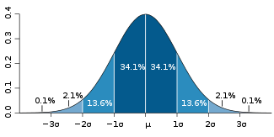

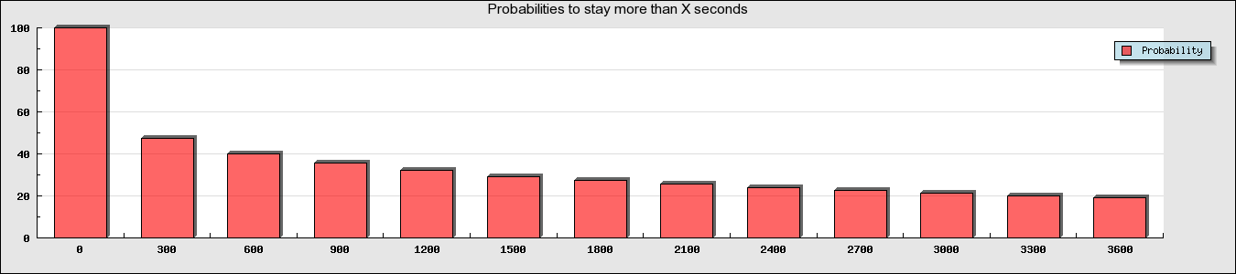

Conclusion: Can DHT be implemented?
1st Approach: Standard Deviation
hard to predict next user’s duty time (high error rate)
2nd Approach: Static Analysis
Using (inverse) accumulative probability
What % of the nodes used Firefox for more than X sec
T | 0 | 5 | 10 | 15 | 20 | 25 | 30 | 35 | 40 | 45 | 50 | 55 | 60
P | 100 | 48 | 41 | 36 | 33 | 30 | 28 | 26 | 25 | 23 | 22 | 21 | 20
Notes:
מדד סטטיסטי לתיאור הפיזור
מדידת שונות
מונח "סטייה" מתכוונים למרחק בין ערך בקבוצה לבין הממוצע
מבחינה מתמטית סטיית התקן היא השורש הריבועי של השונות

Slide 4

Conclusion: Can DHT be implemented?
3rd Approach: Dynamic Analysis
predicting duty time
given that a user has been in FF for X_{start} time, what is the probability for the user to stay more than X_{end} time?
Several Overlays
Heaviest Overlay Network
…
…
Lightest Overlay Network
Time Line
T_{enterDHT}
T₁
T₂
After T_{enterDHT} the user enters the system
After T₂ the user joins 2nd overlay
After T₃ the user joins 3rd overlay
Joins 1st overlay
Notes:
מדד סטטיסטי לתיאור הפיזור
מדידת שונות
מונח "סטייה" מתכוונים למרחק בין ערך בקבוצה לבין הממוצע
מבחינה מתמטית סטיית התקן היא השורש הריבועי של השונות

Slide 5
Heaviest Overlay Network
…
…
Lightest Overlay Network
Time Line
T_{enterDHT}
T₁
T₂

