Slide 1
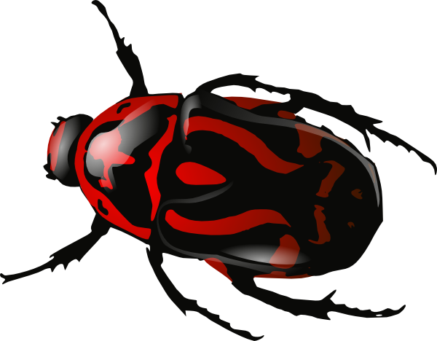
Intro. To Robotics 236927
Nemala project
Daniel Aranki
Hani Ayoub
September 2009

Slide 2
Main idea
Map data-type
Cell decomposition.
Finds the path.
Choose between two curve options when needed
First comparison: farthest from closest obstacle
Second comparison: starts with same orientation as current robot orientation
Two types of paths (used for Bug Mode)
Red: exhausted path
Green: the rest

Slide 3
Main idea (cont.)
Bug Mode
Based on Bug 2
Try:
First bypass chance
Choose between left\right hand side bypass
Drive forward until no obstacle seen from relevant side sonar
If no orthogonal green path found:
Second bypass chance
Keep driving forward till the robot meets the obstacle’s end
(Then, orthogonal green path is guaranteed)

Slide 4
Main idea (cont.)
Goal
Navigate with minimal turns
Tuning
First tuning
Final tuning
Calibration
Find global drift (Value and Direction)
Helps driving forward and turning

Slide 5
Difficulties and drawbacks
Slow Sonar’s response
This disables us to continuously read sonar while driving
Inaccurate Sonar’s readings
Deal with situation where sonar constantly read completely wrong distance
Particle Filter does NOT help in this case
Sonar’s dynamic range is not promising in terms of lower bound (~20 cm)
The fact that only one robot is good for all.

