Slide 1
Simulation of Wealth Distribution using Agent Based Modelling
Mohamad Hanifan / 23518026

Slide 2

Background
The study was conducted to model the distribution of wealth and the factors that influence it

Slide 3

Contents
01
Background
02
SIMULATION RESULTS
03
Conclusion

Slide 4
MODEL
>>>>>>>>>
>>>>>>>>>

Slide 5

Agent
Attribute:
Wealth (w)
Saving Factor (λ)

Slide 6



Transaction
Every cycle every pair of agents will transact some amount of their wealth
This transaction can generalize any kind of buying or selling activities, i.e buying some food, pay for school, investment

Slide 7






Transaction – How much?

Slide 8

Transaction – Pair Selection
The selection of agents who make transactions is done with probabilities based on their wealth.
More wealth it has, more often it doing transaction

Slide 9

Tax
On some period of time, some percentage of every agent’s wealth will be taken as tax.
The tax then distributed evenly to every agent.

Slide 10

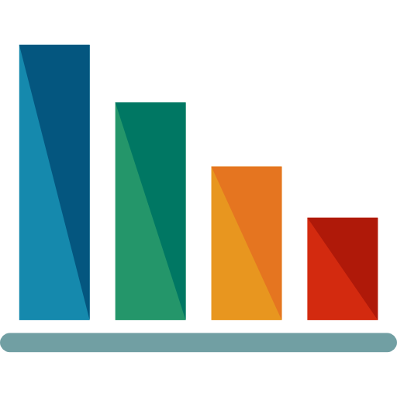
Agent Classes
HIGH CLASS
MIDDLE CLASS
LOW CLASS

Slide 11
SIMULATION RESULTS

Slide 12
Random Saving Factor
Saving factor is random between [0.1 – 0.9] for every agents

Slide 13

Effect of Saving Propensity
Gini Index value tends to be low with the increasing of saving propensity factor

Slide 14

Effect of Tax
Parameter :
Tax Frequency : 100x / 1000 cycles
Saving Factor : random [0.1-0.9]

Slide 15
Effect of Tax (2)
Parameter :
Tax Frequency : 100x / 1000 cycles
Saving Factor : random [0.1-0.9]
Tax Factor : 50%

Slide 16
CONCLUSION

Slide 17
Conclusion
The increase in saving propensity causes wealth to be distributed more evenly, indicated by the smaller gini index value
Sharing the results of tax withdrawals evenly only causes an instantaneous increase in the distribution of wealth

