Slide 1
Getting Started with Japanese Corpora via NINJAL
David Honeycutt

Slide 2
Goals
By the end of this workshop, you can run basic → advanced searches and export results for frequency + n-gram analysis.
Audience
Linguists new to Japanese corpora
Those interested in Japanese NLP annotation
Notes:
What are we gonna do?
Who is this workshop for?

Slide 3
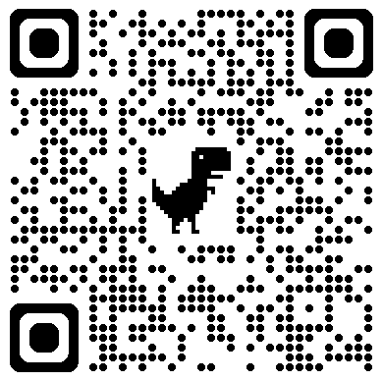
Today, you will…
Workshop Files
Discover what corpora are available
Apply and/or log in
Search terms via the 日本語日常会話コーパス (Corpus of Everyday Japanese Conversation)
Export results as a CSV
Do quick bigram/trigram analysis with Python code (I will provide you with the code)

Slide 4

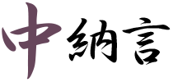
What is Chunagon?
Web application by NINJAL for searching Japanese corpora
Supports simple string search and morphology-aware search (varies by corpus)
Key idea: searches are often over tokenized / annotated units, not “words” as you’d intuit them

Slide 5
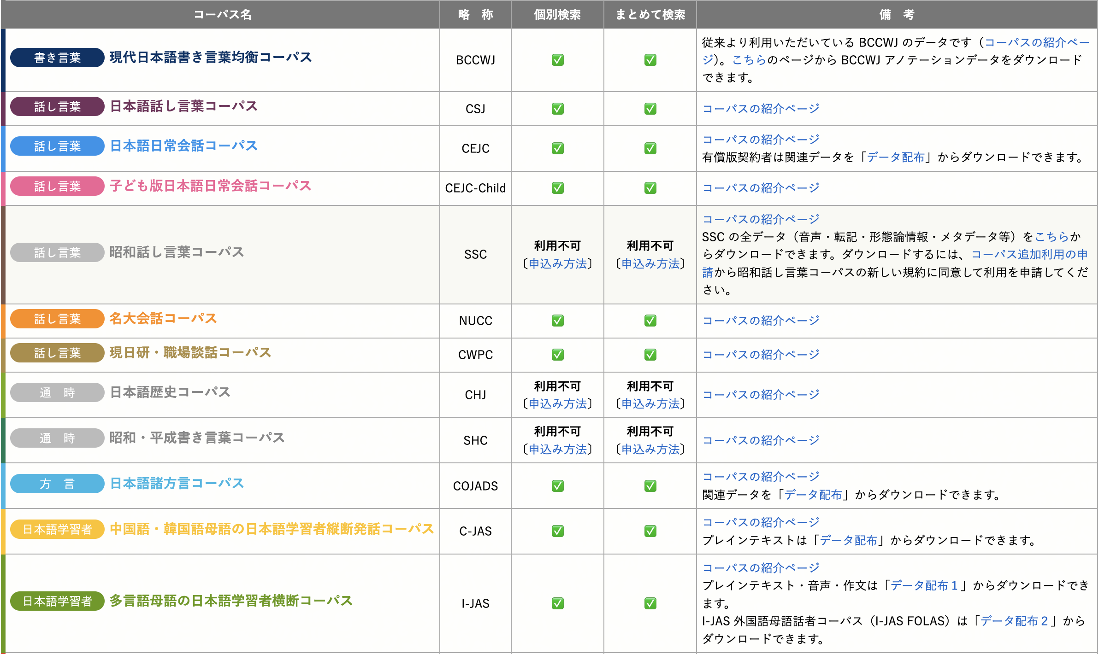
Notes:
When you log in to Chunagon, you’ll see a screen like this. Look at all of the corpora available! Some of these you will notice that I do not have access to because I did not sign up for them.
Today, we will use the CEJC.

Slide 6
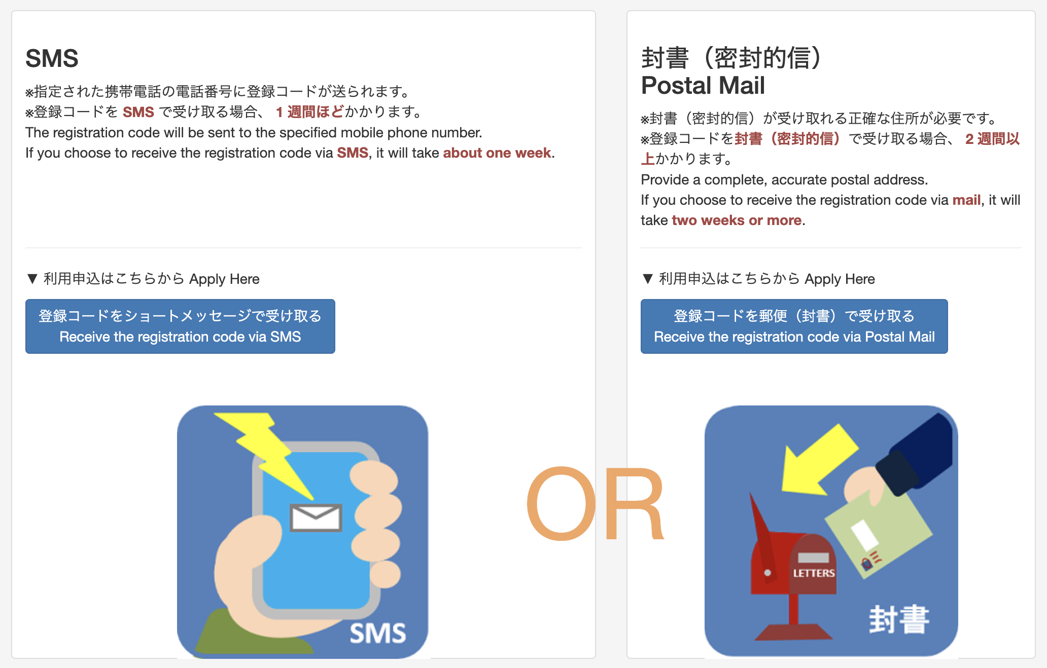
Access
You will first need to create a Chunagon account
Then you can apply for specific corpora
Notes:
For me, the SMS did not work; nothing came through.
So I contacted them and they used email to help me get access.

Slide 7
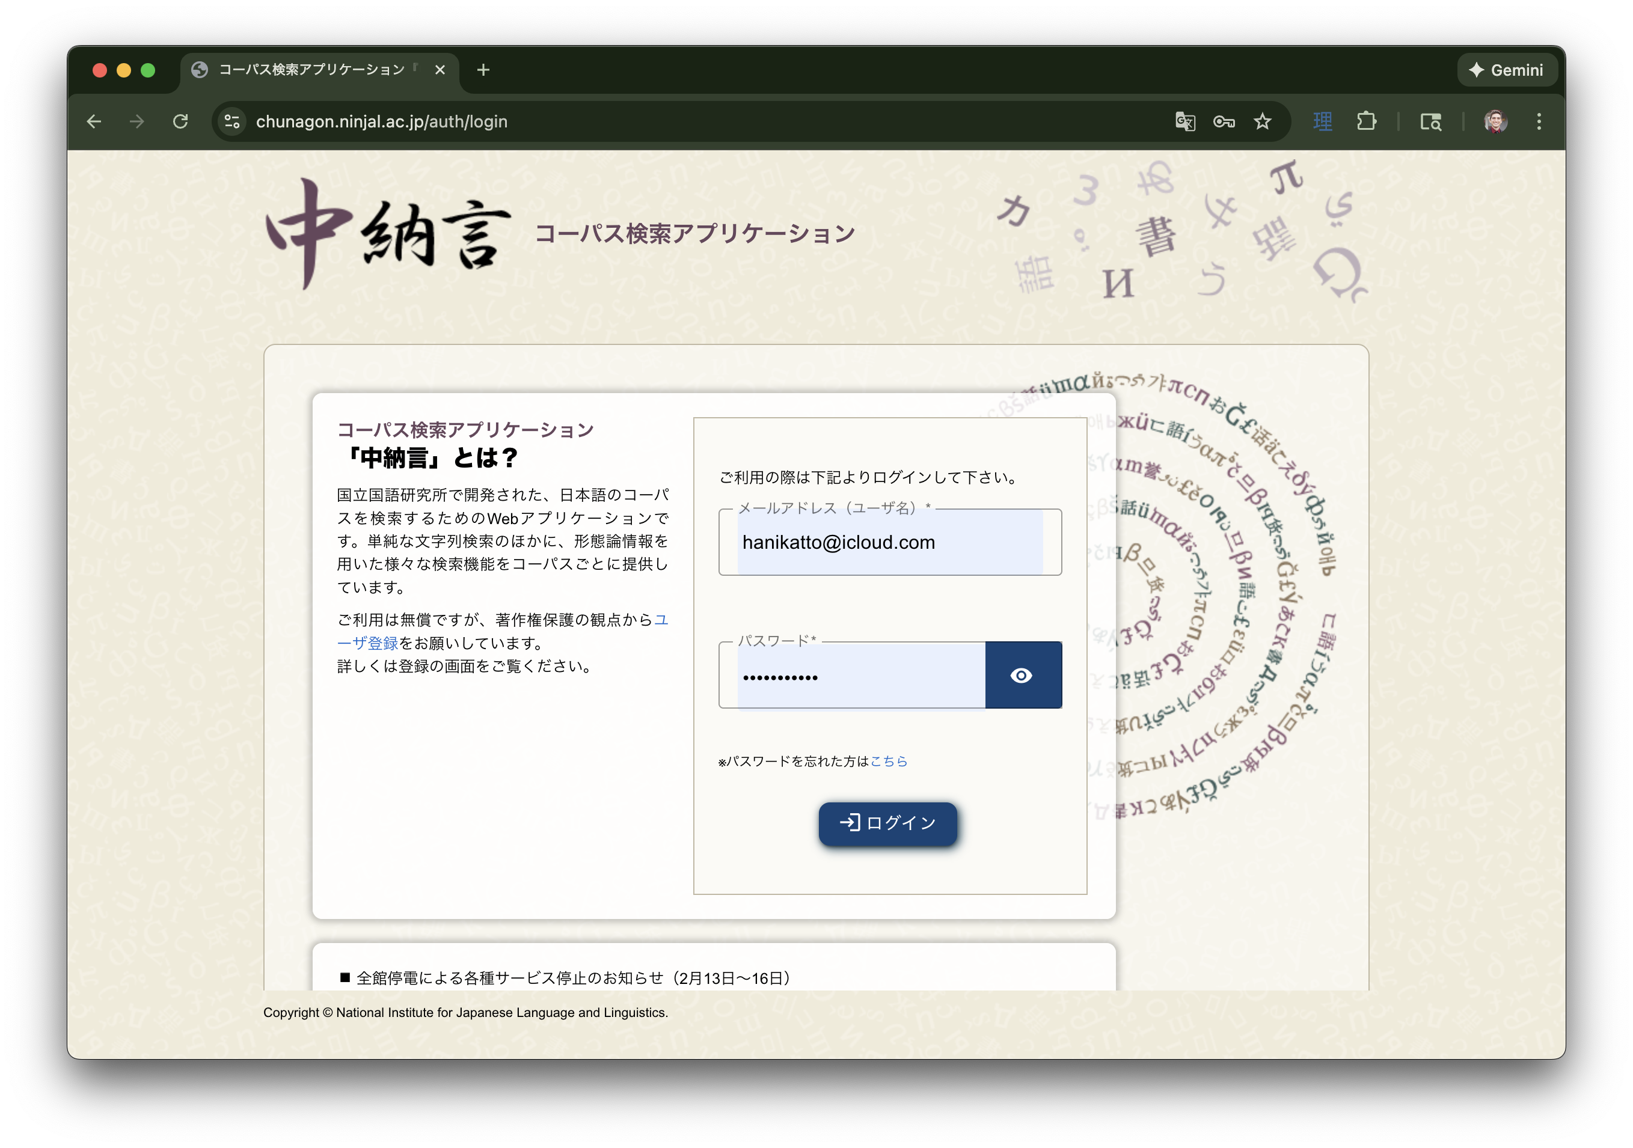
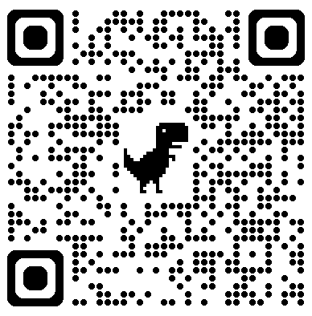
Logging in
Once you have access, you can login on this page:

Slide 8
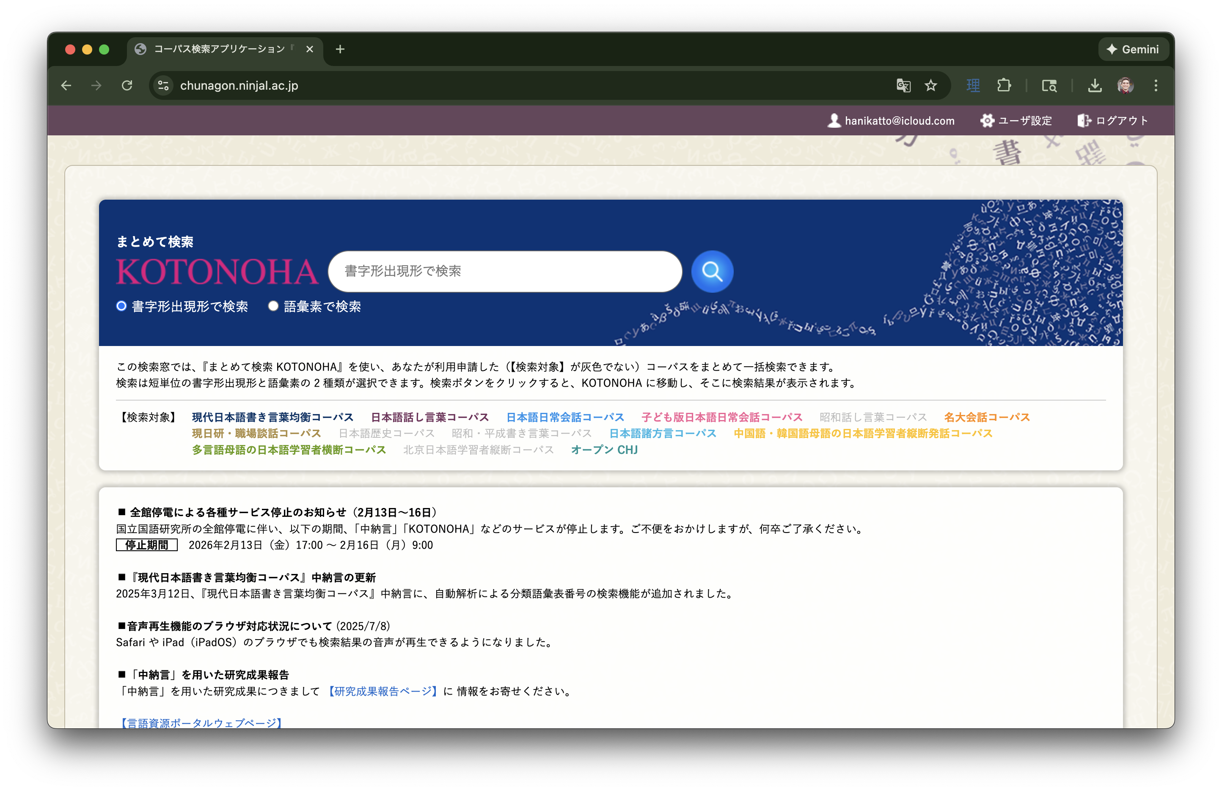
What is KOTONOHA?
Use it to quickly compare/search across corpora at a high level
Let’s try…
Notes:
After you’ve successfully logged in, you will see this page. At the top is the KOTONAHA search bar. You can use this to [READ POINT 1]
Let’s try a few terms: [車], [パソコン], [漢字], and now a hard one: [ロクロ]（語彙素読み）

Slide 9
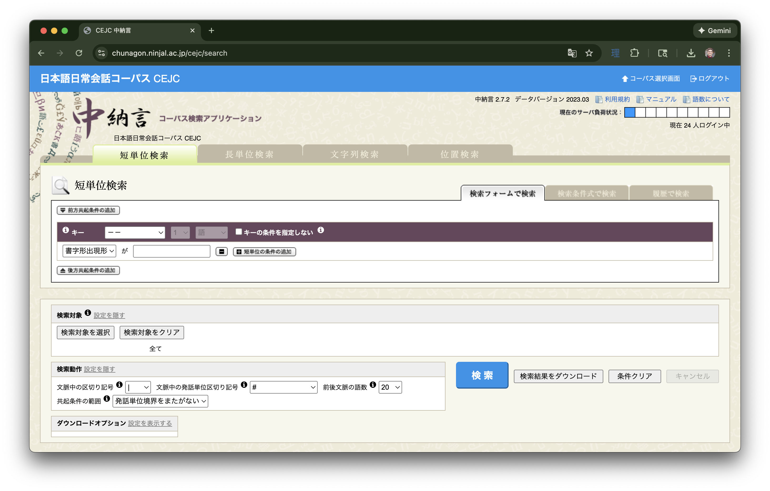
Let’s use CEJC
Try searching the following terms. Did you have any issues?
パソコン
である
かっこいい
Notes:
The first term should go fine, but the next two should not. [Why did you have problems with these two and not with the first one?] → (Because パソコン is one lemma but である and かっこいい are technically two lemmas.)
Use this time to explore some of the features of the results page for パソコン.
Change the 文脈中の区切り記号 to なし and re-run the search. Highlight the difference
Change the 文脈中の発話単位区切り記号 and re-run. Highlight the difference
Specify 検索対象 and indicate how important it is for research, especially spontaneous speech
Play some audio as an example
Show how to export and highlight the options for export
Mess with some other settings

Slide 10
Let’s use CEJC
Try searching the following terms. Did you have any issues?
パソコン
である
かっこいい
Notes:
Let’s talk about these guys. Multi-lemma expressions can be done either in 短単位検索 OR 長単位検索. 長単位検索 is probably easier, but let’s see how to do it using 短単位検索 first.

Slide 11
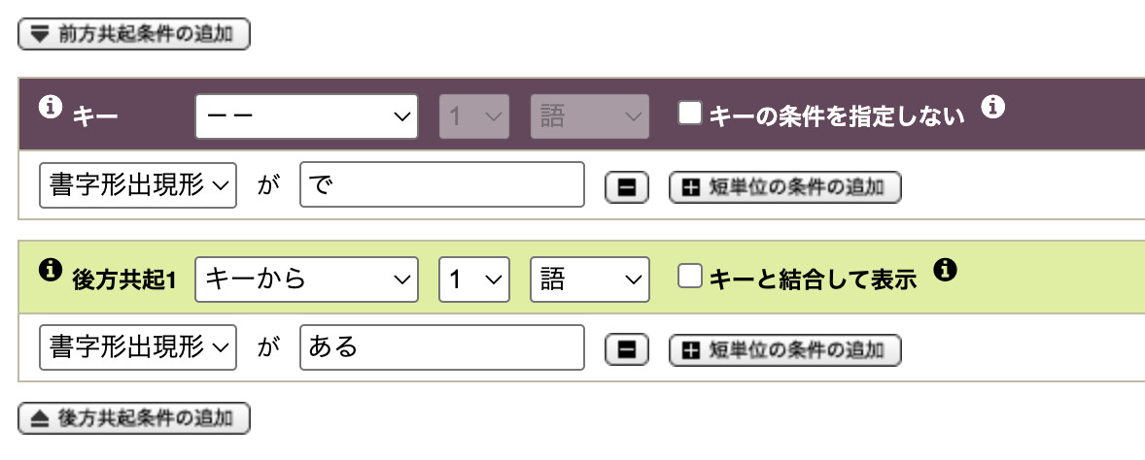
Let’s use CEJC
Try searching the following terms. Did you have any issues?
パソコン
である
かっこいい
Notes:
Here’s the first one.

Slide 12
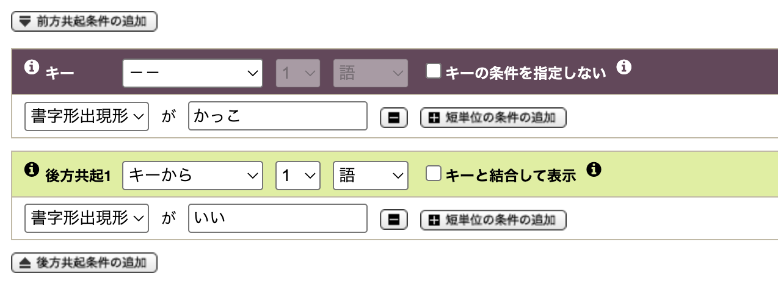
Let’s use CEJC
Try searching the following terms. Did you have any issues?
パソコン
である
かっこいい
Notes:
And here’s the second one.
This is really great if you want to focus on a particular lemma with certain conditions for surrounding words or affixes.

Slide 13
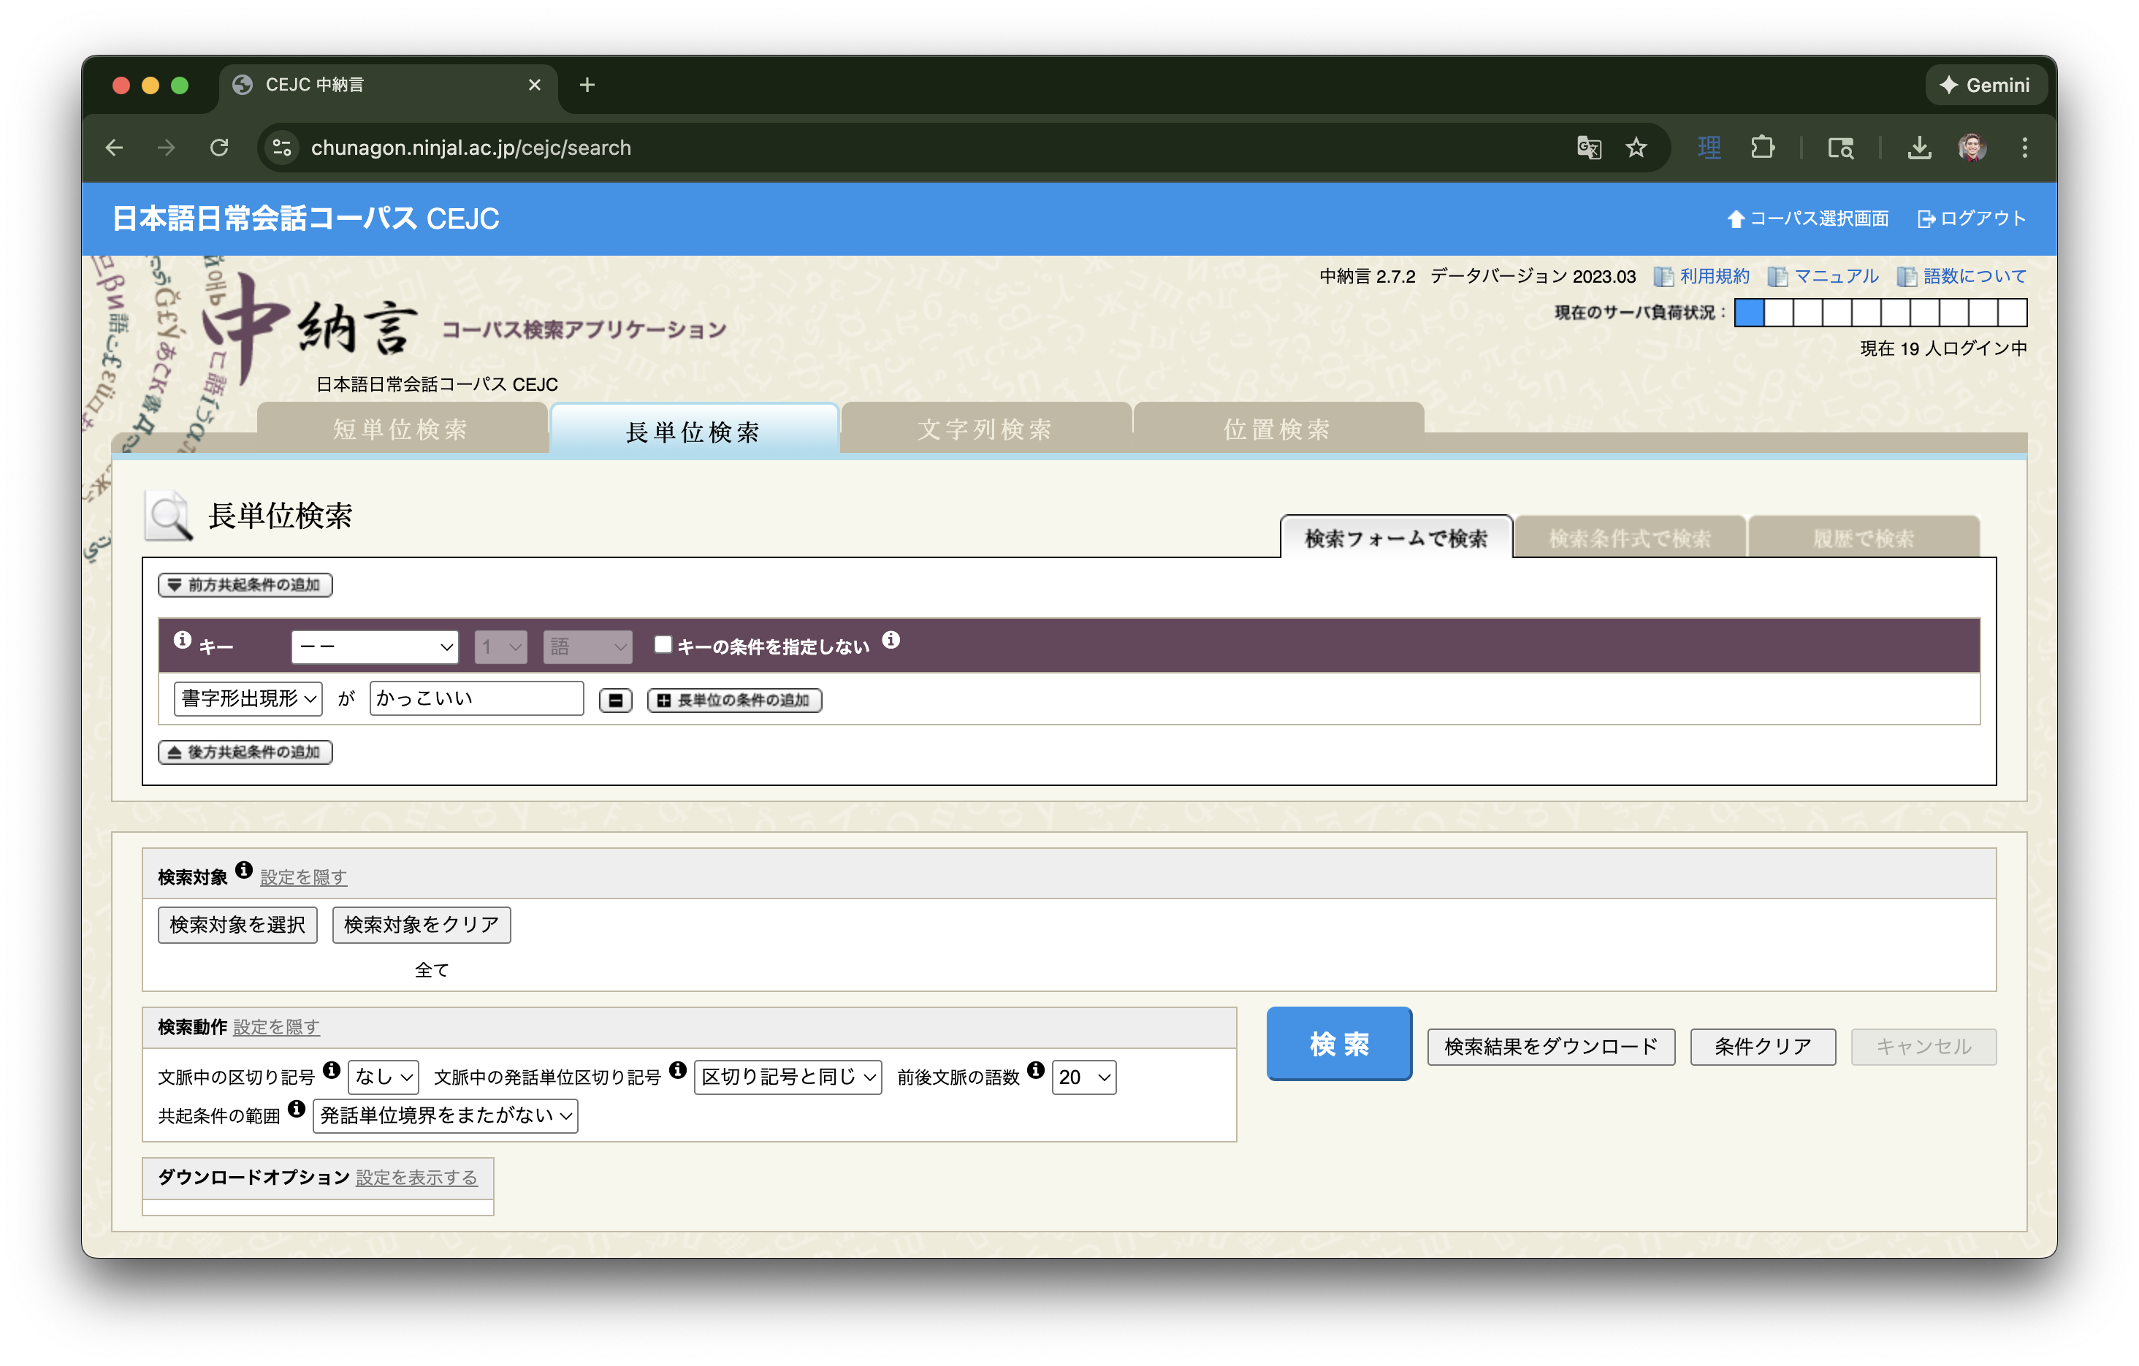
Let’s use CEJC
Of course, this is made easier using the multi-text search bar

Slide 14
Let’s use CEJC
What if I wanted to look for expressions like the following: よくない ご飯 野球選手 良ければ
飲んだりして お寿司 かもしれない 行っ＿
Notes:
For よくない, use the following setting: 語彙素[良い] AND 活用形／小分類[連用形-一般] with 書字形出現形[ない].
For 良ければ, use the following setting: 語彙素[良い] AND 活用形／小分類[仮定形-一般].
For expressions on the right side, the answers are given in the cheat sheet.

Slide 15
Case study: Calculate Collocations
We want to know how L1 Japanese speakers use the phrase じゃ in idle chit-chat.
After you locate all instances of this phrase, export the file and calculate/observe the following:
What POS typically comes before じゃ? After?
What bigram/trigram collocations exist with this phrase?
What do these results tell us about じゃ?
Notes:
First, we need to adjust the 検索対象 to reflect only idle chit-chat which often reflect spontaneous speech.
Then we have to make sure we’re getting the right じゃ.
Then we need to make sure our token delimiter and utterance boundary symbols are set.
Then we can export the file and run Python code on it to help answer our question. I will provide the Python code for you!
Let’s go to Chunagon and make our necessary adjustments.
To find the code to analyze bigram and trigram collocations, go to this link: https://colab.research.google.com/drive/1GLCJdlbzo3N32_-1_GLlukQY1Iim43Su?usp=sharing

Slide 16
Q&A
Any questions or comments?

