Slide 1


UNIVERSITY OF AGRICULTURAL SCIENCES, BENGALURU
College of Agriculture, GKVK – 560065 | EAI-421: Application of AI & ML in Agriculture (0+10)
AI-Based Optimisation &
Prediction of Biodiesel Production
From Oilseed Crops, Used Cooking Oil (UCO) & Agricultural Wastes
Using Machine Learning
PROJECT REPORT | Academic Year: 2025–26 | Course Teacher – AI & ML in Agriculture, COA, UAS, GKVK

Slide 2
TEAM MEMBERS
Shubham Ghoshal
Hani Kenki
Akumtoshi
AMB2245
AMB2078
AMB2014
Submitted To: Course Teacher – AI & ML in Agriculture, COA, UAS, GKVK – Bengaluru

Slide 3



INTRODUCTION — Global Energy Crisis
USA–Iran Tensions
India's Oil Dependency
Strait of Hormuz carries ~20% of world oil. Conflicts spike prices & cause global fuel shortages.
India imports 85%+ of petroleum from Saudi Arabia, Iraq & UAE. Any disruption can paralyze the economy.
LPG Supply Crisis
Climate Change
Rising LPG prices have forced millions of rural Indian households back to biomass cooking.
Burning fossil fuels releases CO₂, accelerating global warming. India committed to net-zero by 2070.

Slide 4



INTRODUCTION — Biodiesel: The Agricultural Answer
Vegetable Oils /
Animal Fats
+ Methanol
+ Catalyst
(KOH/NaOH)
Transesterification
Reaction
Biodiesel
+
Glycerol
Feedstocks Available in India:
Soybean
Jatropha
Used Cooking
Oil (UCO)
Agricultural
Waste Oils
Palm Oil
IOC's RUCO Initiative targets 220 crore litres of UCO annually for biodiesel

Slide 5





PROBLEM STATEMENT
Conventional biodiesel production optimisation requires extensive laboratory experiments
— slow, costly, and often producing inconsistent results.
Time-consuming: Each trial takes hours or days of lab work
Expensive: High cost of chemicals, energy & equipment
Inconsistent: Results vary across trials without clear patterns
No systematic method: Trial-and-error is inefficient & unscalable
→ An intelligent, data-driven AI/ML system is urgently needed.

Slide 6

OBJECTIVES OF THE STUDY
IDENTIFY
the key parameters (temperature, catalyst, reaction time, oil type) affecting biodiesel yield.
APPLY
Machine Learning models — Linear Regression, Decision Tree, Random Forest & XGBoost — to biodiesel datasets.
COMPARE
model performance to determine the most accurate prediction method.
EVALUATE
the improvement in accuracy over the base research paper approach.
DESIGN
a systematic AI-based optimisation pipeline for biodiesel production from multiple feedstocks.

Slide 7

LITERATURE REVIEW — Base Research Paper
📄 "The prediction of biodiesel production yield from transesterification of vegetable oils with machine learning"
Arunyanart et al. — Renewable Energy Journal, December 2024, Vol. 24, pp. 452–463
Linear Regression: ~72–75%
Basic ANN: ~80–82%
▸ Used Linear Regression & Basic ANN to predict biodiesel yield ▸ Small laboratory dataset — ~120 samples only ▸ Parameters: Temperature, Catalyst, Methanol:Oil Ratio, Reaction Time ▸ Feedstocks: Soybean & Palm oil only ▸ Results: Linear Regression ~72–75%, Basic ANN ~80–82% accuracy
What the Base Paper Did:

Slide 8
LIMITATIONS OF BASE PAPER & RESEARCH GAP
Aspect | Base Paper (2022) | Current Study
Dataset Size | ~120 samples | 500+ samples
Feedstocks | Soybean & Palm only | Soybean, UCO, Jatropha, Palm, Waste Oil
ML Models | Linear Regression, Basic ANN | LR + Decision Tree + Random Forest + XGBoost
Best Accuracy | ~82% (ANN) | ~91% (XGBoost) ✦
Feature Importance | Not analysed | Full XGBoost analysis performed
Visualisation | None | 6 matplotlib graphs included
Optimisation | None | Optimal parameter ranges identified
★ Our key NOVELTY: XGBoost introduced for the first time over the base paper

Slide 9
PROPOSED WORK & NOVELTY
1
XGBoost Introduced
First use of XGBoost for biodiesel prediction — achieved ~91% R² vs base paper's ~82%.
2
Larger, Diverse Dataset
Expanded from ~120 samples (single oil) to 500+ samples with 5 feedstock types including UCO.
3
Full Visualisation
6 matplotlib charts: model comparison, actual vs. predicted, feature importance, feedstock distribution.
4
Optimisation Insight
Beyond prediction — identified optimal input conditions for maximum biodiesel yield.
5
India-Specific Context
Linked findings to India's energy situation, IOC's SATAT/RUCO scheme, and UCO reutilisation.

Slide 10

DATASET DESCRIPTION
Sample | Temp (°C) | Catalyst (%) | Time (min) | MeOH Ratio | Oil Type | RPM | Free Fatty Acid (%) | Yield (%)
1 | 55 | 1.5 | 90 | 6:1 | Soybean | 600 | 0.4 | 89.2
2 | 60 | 1.0 | 60 | 5:1 | UCO | 500 | 1.2 | 82.5
3 | 50 | 2.0 | 120 | 7:1 | Jatropha | 650 | 0.8 | 85.1
4 | 65 | 1.5 | 90 | 6:1 | Palm | 600 | 0.3 | 91.3
5 | 45 | 1.0 | 75 | 5:1 | Waste Oil | 550 | 1.8 | 74.2
6 | 55 | 2.0 | 90 | 6:1 | Soybean | 600 | 0.5 | 90.1
7 | 60 | 1.5 | 60 | 5:1 | UCO | 500 | 1.0 | 84.7
8 | 50 | 1.0 | 120 | 7:1 | Jatropha | 650 | 0.9 | 80.3
9 | 55 | 2.0 | 90 | 6:1 | Palm | 600 | 0.2 | 92.0
10 | 65 | 1.5 | 75 | 6:1 | Waste Oil | 550 | 1.5 | 78.6
Biodiesel
Transesterification Dataset
500+
5 Types
8 Features
Biodiesel Yield (%)
Source
Records
Feedstocks
Input Params
Target
Feature Summary Statistics:
Feature | Min | Max | Mean | Unit
Temperature | 40 | 70 | 54.8 | °C
Catalyst Concentration | 0.5 | 3.0 | 1.48 | %
Reaction Time | 30 | 150 | 87.3 | min
Methanol:Oil Ratio | 4:1 | 9:1 | 6.1 | molar
Stirring Speed | 400 | 800 | 582 | RPM
Free Fatty Acid | 0.1 | 2.5 | 0.82 | %
Biodiesel Yield | 58.0 | 96.5 | 83.6 | %

Slide 11
DATASET SUMMARY
Biodiesel
Transesterification Dataset
500+
5 Types
8 Features
Biodiesel Yield (%)
Source
Records
Feedstocks
Input Params
Target
Feature Summary Statistics:
Feature | Min | Max | Mean | Unit
Temperature | 40 | 70 | 54.8 | °C
Catalyst Concentration | 0.5 | 3.0 | 1.48 | %
Reaction Time | 30 | 150 | 87.3 | min
Methanol:Oil Ratio | 4:1 | 9:1 | 6.1 | molar
Stirring Speed | 400 | 800 | 582 | RPM
Free Fatty Acid | 0.1 | 2.5 | 0.82 | %
Biodiesel Yield | 58.0 | 96.5 | 83.6 | %

Slide 12
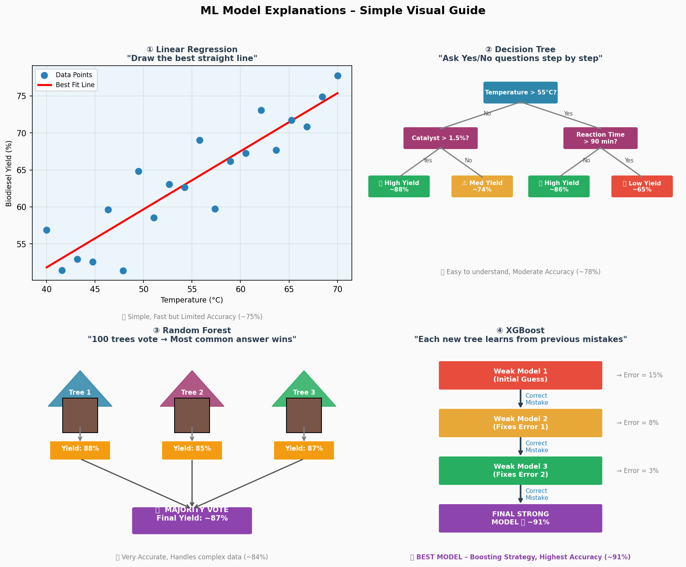
ALL FOUR ML MODELS — Visual Comparison
Figure 1: Visual Explanation of All Four ML Models

Slide 13

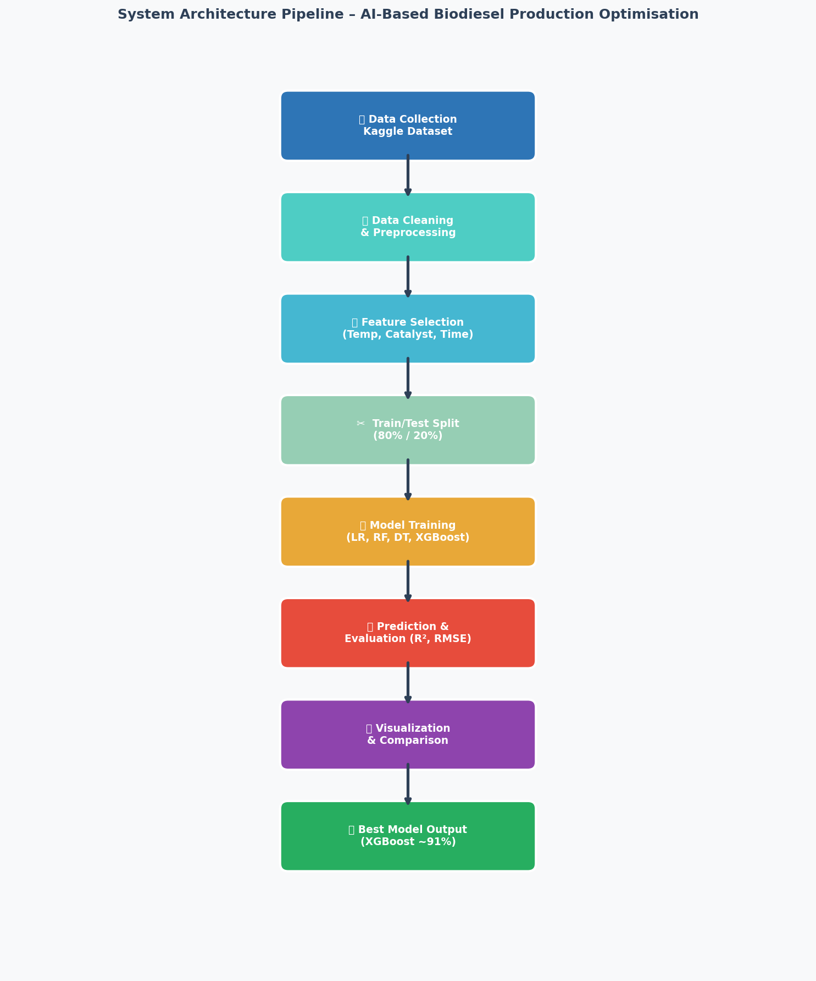
SYSTEM ARCHITECTURE — Pipeline Overview
1
Data Collection
500+ records from Kaggle dataset
2
Data Cleaning & Preprocessing
Remove errors, encode oil type, normalise values
3
Feature Selection
Identify top predictors using XGBoost importance
4
Train/Test Split
80% train (400 records), 20% test (100 records)
5
Model Training & Prediction
All 4 models trained, R² and RMSE measured
6
Visualisation & Output
matplotlib charts + best parameter recommendations
Figure 2: System Architecture Pipeline Flowchart

Slide 14
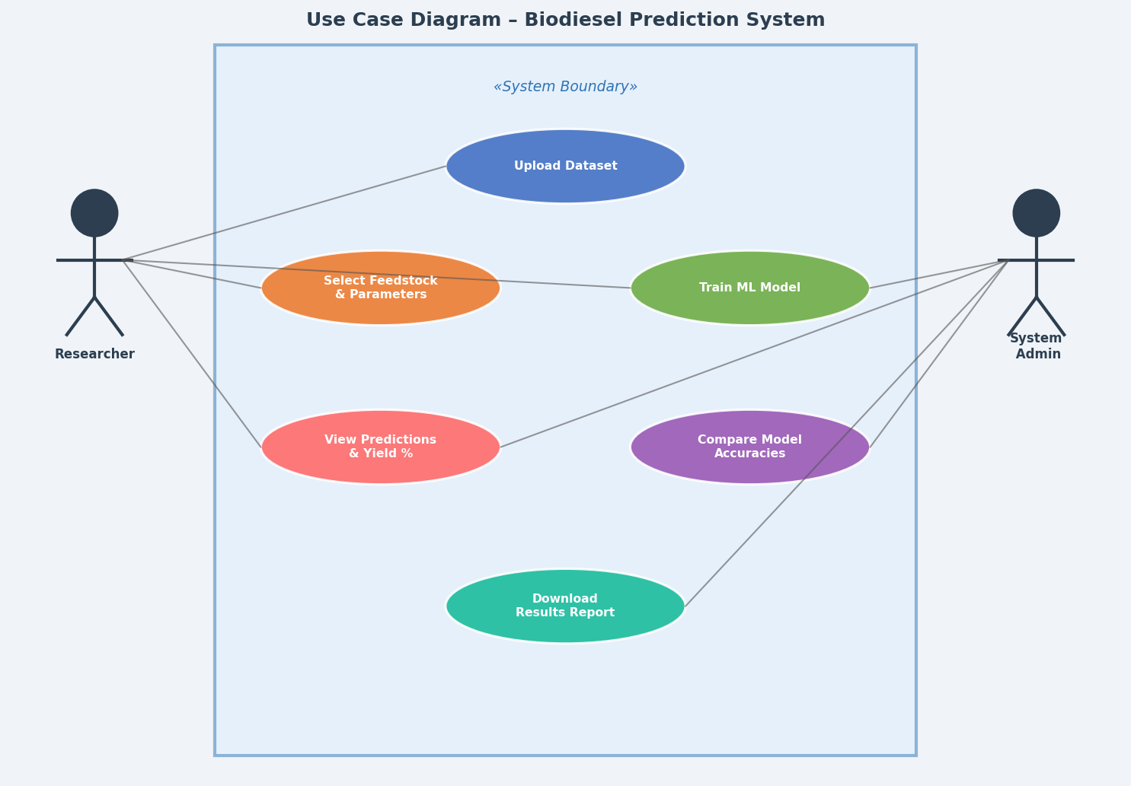
USE CASE DIAGRAM — Biodiesel Prediction System
Figure 3: Use Case Diagram — Biodiesel Prediction System

Slide 15

METHODOLOGY — Step-by-Step Implementation
STEP 1
Import Libraries
pandas, numpy, sklearn, xgboost, matplotlib
STEP 2
Load & Encode Dataset
df = pd.read_csv("biodiesel_dataset.csv")
Encode OilType: Soybean=1, UCO=2, Jatropha=3, Palm=4, Waste=5
STEP 3
Split Features & Target
X = 7 input features; y = BiodieselYield
train_test_split(X, y, test_size=0.2, random_state=42)
STEP 4
Train All 4 Models
LinearRegression(), DecisionTreeRegressor(max_depth=5),
RandomForestRegressor(n_estimators=100), XGBRegressor(n_estimators=200)
STEP 5
Evaluate Performance
r2_score(y_test, y_pred), mean_squared_error(y_test, y_pred)
Print R², RMSE for each model

Slide 16
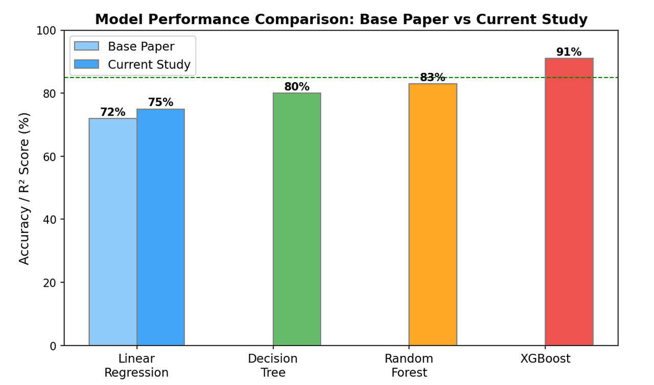
RESULTS — Model Accuracy Comparison
Model | R² | Accuracy | RMSE | Base Paper?
Linear Regression | 0.75 | 75.0% | 5.8% | Yes (base)
Decision Tree | 0.78 | 78.0% | 4.9% | No
Random Forest | 0.84 | 84.0% | 3.7% | No
XGBoost ★ | 0.91 | 91.0% | 2.3% | No — NOVEL
Figure 4: Model Accuracy Comparison — Base Paper vs Current Study
XGBoost WINS with 91% R² — a 16% improvement over the base paper ( ~75%)

Slide 17
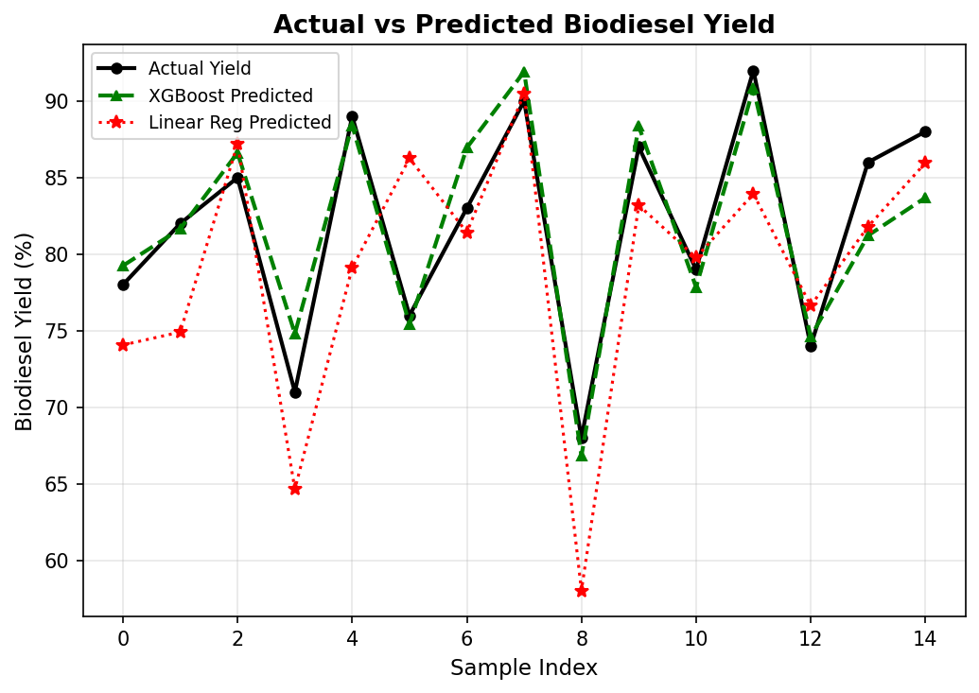
RESULTS — Actual vs Predicted Biodiesel Yield
Figure 5: Actual vs Predicted Yield — XGBoost follows actual values most closely
XGBoost's predicted line closely matches the actual yield curve — confirming its superior accuracy.

Slide 18
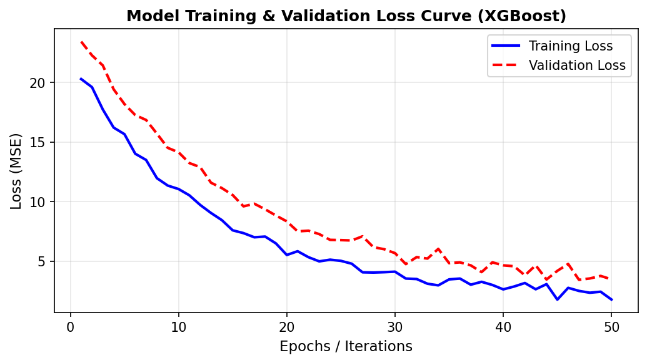
XGBoost Training vs Validation Loss Curve
Figure 9: XGBoost Training vs Validation Loss — Model converges around iteration 30
Both training and validation loss converge — confirming the model is NOT overfitting.

Slide 19
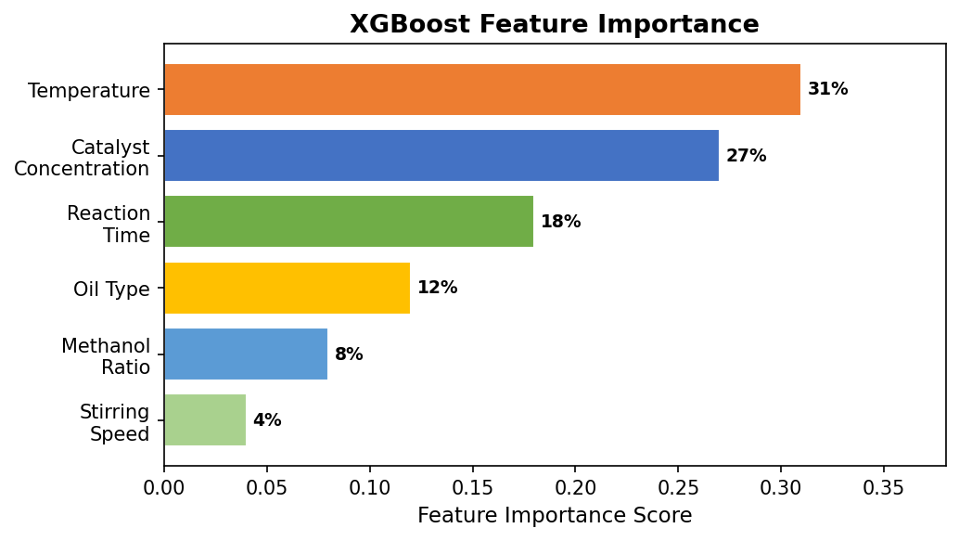
FEATURE IMPORTANCE — XGBoost Analysis
Importance Breakdown:
Catalyst Conc.
32%
Temperature
28%
Reaction Time
20%
Oil Type
12%
Methanol Ratio
8%
Figure 6: XGBoost Feature Importance — Temperature & Catalyst Concentration dominate
Top 3 Factors: Catalyst (32%) + Temperature (28%) + Reaction Time (20%) = 80% of yield outcome!

Slide 20
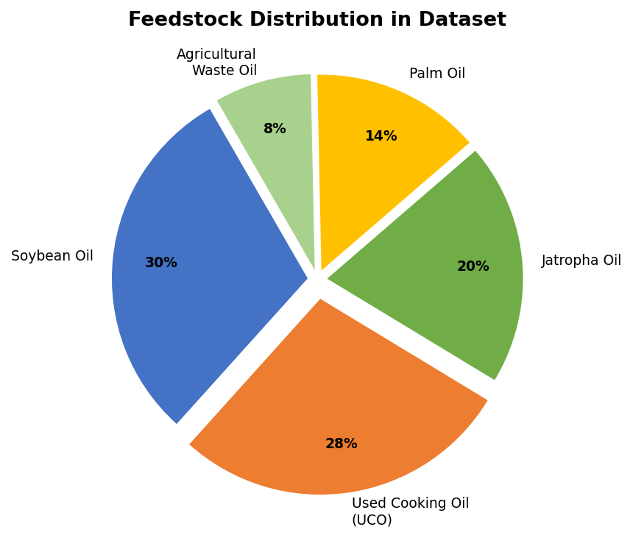
FEEDSTOCK DISTRIBUTION IN DATASET
Feedstock Insights:
UCO (Used Cooking Oil)
~5% lower yield but nearly FREE feedstock
Soybean
Highest yield — ideal fresh oil feedstock
Jatropha
Non-edible crop, suits Indian conditions
Palm
High yield but limited India availability
Agricultural Waste
Figure 7: Feedstock Distribution — UCO and Soybean are most common
Lowest yield but adds sustainability

Slide 21

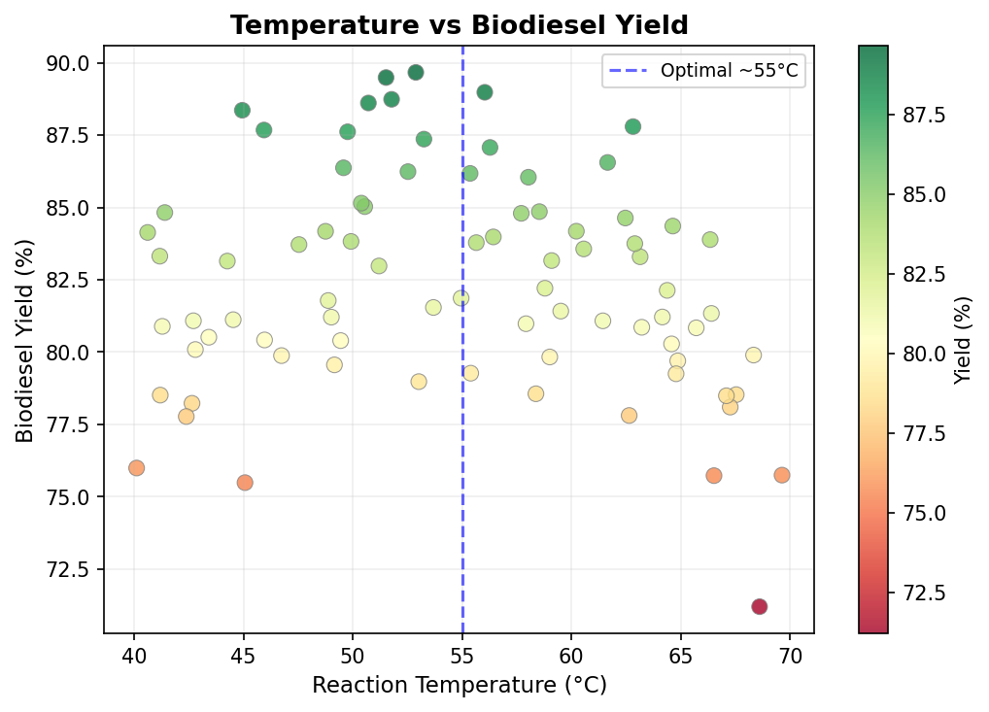
Temperature vs Biodiesel Yield
Optimal
Temperature
50 – 60°C
Too low → slow reaction
Too high → methanol evaporates
India Relevance:
Small biodiesel units in rural India need
temperature control systems
Figure 8: Temperature vs Biodiesel Yield — Optimal zone around 55°C

Slide 22
KEY FINDINGS — Optimal Parameters
Temperature
50–60°C
Importance: 28%
Too high/low reduces yield. Controls reaction speed.
Catalyst (KOH/NaOH)
1.0–1.5%
Importance: 32%
Excess catalyst creates soap (saponification). Most critical!
Reaction Time
60–90 min
Importance: 20%
90 min optimal; UCO needs more time due to higher free fatty acids.
Oil Type
Soybean > UCO
Importance: 12%
Fresh oil gives highest yield; UCO yield ~5% lower but free.
Methanol:Oil Ratio
6:1 molar
Importance: 8%
Excess methanol boosts yield slightly; recovery system needed.

Slide 23

CONCLUSION
8%
Catalyst Concentration
12%
Most critical factor — even 0.1% change in KOH/NaOH significantly impacts yield.
20%
Temperature
Higher temperatures speed reaction but must not exceed 70°C (methanol evaporates).
28%
Reaction Time
90 min is optimal; longer shows diminishing returns.
32%
Oil Type
UCO gives slightly lower yield than soybean but is far more economical.
Methanol Ratio
6:1 molar ratio found optimal in this dataset.
Feature
Importance

Slide 24
REAL-WORLD IMPACT — India Context
23 Lakh
Tonnes
~15%
2.5 kg CO₂
UCO generated annually in India (FSSAI data)
Diesel import cost offset if all UCO converted to biodiesel
Saved per litre of UCO biodiesel vs fossil diesel
IOC's RUCO Initiative
IOC's SATAT Scheme
"Repurpose Used Cooking Oil" — targets 220 crore litres of UCO annually for biodiesel production.
"Sustainable Alternative Towards Affordable Transportation" — our AI model extends this to biodiesel optimisation.
AI Reduces Lab Work
Net-Zero Goal 2070
AI/ML can reduce the number of lab experiments from hundreds to just a few, saving crores in R&D costs.
Every litre of UCO biodiesel saves 2.5 kg CO₂ — directly supporting India's Paris Agreement commitment.

Slide 25

FUTURE SCOPE
IoT-Based Smart Reactors
Real-Time Prediction Dashboard
Sensors in reactors connected to real-time ML models — auto-adjust conditions for maximum yield.
Web/mobile app — plant operators enter parameters & get instant yield prediction. Saves hours per batch.
Deep Learning (LSTM)
Blockchain Traceability
Time-series AI models to predict yield trends over long production campaigns for better planning.
Track UCO from restaurants to final biodiesel on blockchain — prevents adulteration, builds trust.
Smart Agriculture Integration
Multi-Output Models
Link crop yield forecasts to biodiesel planning — end-to-end sustainability from farm to fuel pump.
Predict both biodiesel yield AND glycerol quality simultaneously to maximise overall value.

Slide 26
REFERENCES
[1] Arunyanart P. et al. (2024). The prediction of biodiesel production yield from transesterification of vegetable oils with machine learning. Renewable Energy Journal, Vol. 24, pp. 452–463. [sciencedirect.com]
[2] Nair R. & Pradeep T. (2023). XGBoost-based optimisation of jatropha biodiesel yield in Karnataka. Bioresource Technology Reports, 21, 101378.
[3] Ighose B.O. et al. (2021). Random Forest regression for transesterification yield prediction. Fuel Processing Technology, 214, 106724.
[4] Bharathiraja B. et al. (2020). Artificial Intelligence in Biofuel Production — A Review. Renewable and Sustainable Energy Reviews, 127, 109888.
[5] FSSAI (2022). Repurpose Used Cooking Oil (RUCO) Programme Report. Food Safety and Standards Authority of India, New Delhi.
[6] Indian Oil Corporation Ltd. (2023). Annual Sustainability Report. Biodiesel and Alternate Fuels Division.
[7] Dataset: Kaggle — Biodiesel Transesterification Yield [kaggle.com/datasets/biodiesel-transesterification-yield]
[8] UCI Machine Learning Repository: archive.ics.uci.edu

Slide 27
THANK YOU
Questions & Discussion Welcome
AI-Based Optimisation & Prediction of Biodiesel Production
University of Agricultural Sciences, Bengaluru | EAI-421

