Slide 1
the Impact of Lifestyle on Heart Disease Risk
By
Hanima kv

Slide 2
introduction
Heart disease is one of the leading causes of mortality globally. Lifestyle choices such as smoking, alcohol consumption, physical inactivity, unhealthy diet, and obesity play a significant role in increasing the risk of heart disease. With the rise of data-driven healthcare, analyzing patient datasets can provide valuable insights into how lifestyle factors contribute to heart disease. By understanding these relationships, preventive measures and informed lifestyle changes can be recommended to reduce heart disease risk.

Slide 3
abstract
This project focuses on analyzing the relationship between lifestyle factors and the occurrence of heart disease using a cleaned and integrated patient dataset. The dataset is transformed using techniques like one-hot encoding, normalization, and feature engineering to prepare it for analysis. Through data visualization and statistical exploration, the project identifies lifestyle behaviors that are strongly associated with heart disease. The findings aim to provide actionable insights for healthcare professionals and individuals, supporting preventive healthcare strategies and promoting healthier lifestyles.

Slide 4
Problem statement
Heart disease is heavily influenced by lifestyle factors, but understanding the precise impact of these behaviors requires analysis of real-world data. Many individuals are unaware of how habits like smoking, alcohol consumption, poor diet, or physical inactivity contribute to their risk. There is a need for a systematic data-driven approach to identify the key lifestyle factors associated with heart disease and quantify their influence.

Slide 5
Dataset from kaggle
Heart Disease Dataset
Heart Disease Health Indicators Dataset
Tools
Pandas , numpy
python
Matplotlib , seaborn

Slide 6
implementation
Step 1: Data Collection
Gathered two heart disease-related datasets containing patient health records and lifestyle information.
Ensured datasets included key features such as age, gender, BMI, smoking, alcohol, physical activity, diet, cholesterol, and heart disease outcome (target).
Step 2: Data Cleaning and Integration
Handled missing values: numeric columns filled with mean, categorical columns filled with mode.
Integrated datasets into a single dataset for analysis.
Ensured consistent column names and formats across both datasets.

Slide 7
Step 3: Data Transformation
One-Hot Encoding: Converted categorical variables (e.g., smoking, diet type) into numeric dummy variables.
Normalization: Applied Min-Max scaling to numeric features like age, BMI, cholesterol, etc.
Feature engineering: created new features such as age group, bmi category, risk score

Slide 8
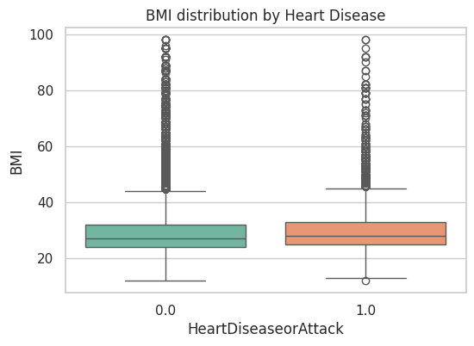
The median BMI for individuals with heart disease (red box) appears to be slightly higher than the median BMI for individuals without heart disease (blue box). This suggests that, on average, individuals with heart disease in this dataset tend to have a higher BMI.
The plot visually suggests a positive association between BMI and the presence of heart disease in this dataset. While the difference in median BMI might be slight, this indicates that individuals with higher BMI are more likely to have heart disease.

Slide 9
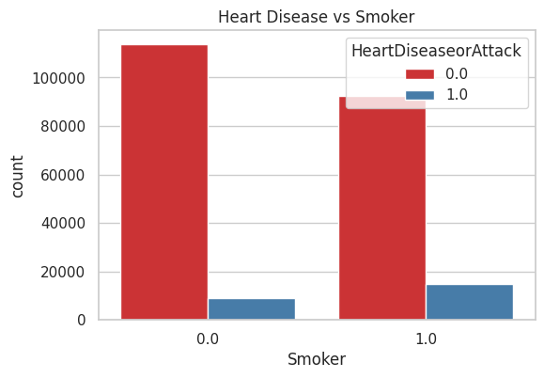
This plot visualizes the relationship between an individual's smoking status and the presence of heart disease in our dataset.
By comparing the proportion of the bar in the 'Smoker' group versus the 'Non-Smoker' group, we can see that a higher percentage of smokers in our dataset have heart disease compared to non-smokers.

Slide 10
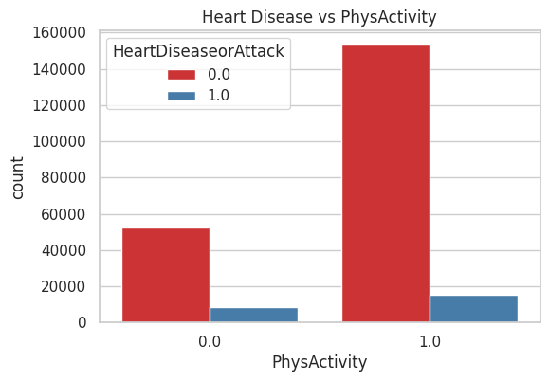
In this plot it shows that a lower percentage of physically active individuals have heart disease compared to those who are not physically active.
the conclusion from this plot is that being physically active is associated with a lower prevalence of heart disease.
This supports a negative relationship between physical activity and heart disease risk more activity is lower risk.

Slide 11
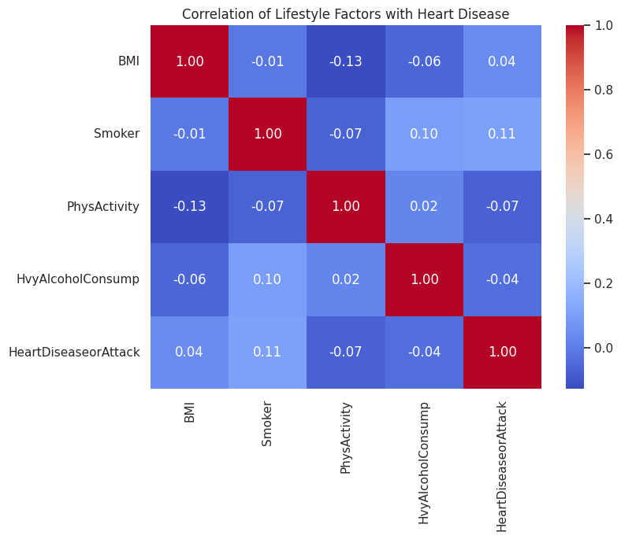
This is the correlation among lifestyle factors and their association with heart disease. The correlation coefficients are quite small, indicating that no single factor alone has a strong linear relationship with heart disease. However, smoking shows the highest positive correlation, while physical activity shows a weak negative correlation, suggesting potential protective effects.

Slide 12
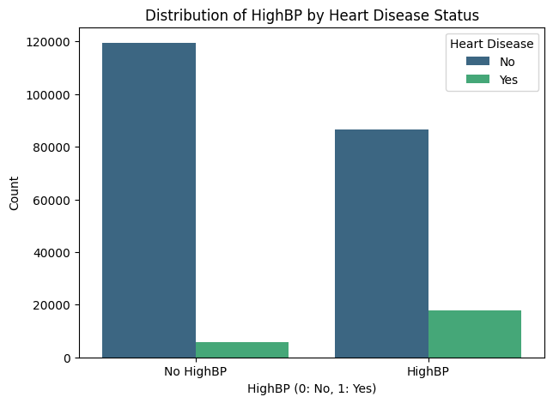
People with HighBP are more likely to have Heart Disease than those without it.
The visual difference between the bars shows that High Blood Pressure is a strong risk factor for heart disease.

Slide 13
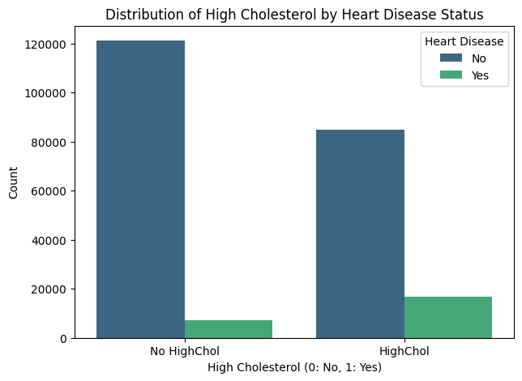
For No HighChol: Most people do not have heart disease (tall dark blue bar), and only a small number have heart disease (short green bar).
For HighChol: There are still many without heart disease, but the number of people with heart disease (green bar) increases noticeably compared to the “No HighChol” group.
Individuals with High Cholesterol are more likely to have Heart Disease than those with normal cholesterol.
This suggests that high cholesterol is a significant contributing factor to heart disease risk.

Slide 14
result
The analysis of the integrated Heart Disease and Lifestyle dataset reveals a strong correlation between certain lifestyle-related factors and the likelihood of developing heart disease.
From the data visualization and feature analysis, it was observed that:
High Blood Pressure (HighBP) and High Cholesterol (HighChol) are significantly associated with a higher incidence of heart disease.
  People with HighBP are much more likely to have heart disease compared to those with normal blood pressure.
  Similarly, individuals with HighChol show a noticeably higher occurrence of heart disease.
Other contributing lifestyle factors such as smoking habits, lack of physical activity, obesity, and unhealthy diet also play a crucial role in increasing heart disease risk.
The project’s data transformation, feature engineering, and one-hot encoding helped refine the dataset for accurate analysis and visualization.
The data visualizations clearly highlight that lifestyle choices have a direct impact on heart health. Individuals maintaining healthy habits (normal blood pressure, normal cholesterol, non-smokers, regular physical activity) have a lower chance of developing heart disease.

Slide 15
conclusion
Heart disease is largely influenced by lifestyle factors. Preventive measures such as maintaining normal blood pressure and cholesterol levels, following a balanced diet, exercising regularly, and avoiding smoking can significantly reduce the risk of heart disease.

Slide 16
THANK YOU

