Slide 1


Slide 2
What is Ubuntu?
Linux-based operating system for desktops, laptops, and servers
Completely Free and Open Source
Officially supports Intel x86, AMD 64-bit

Slide 3
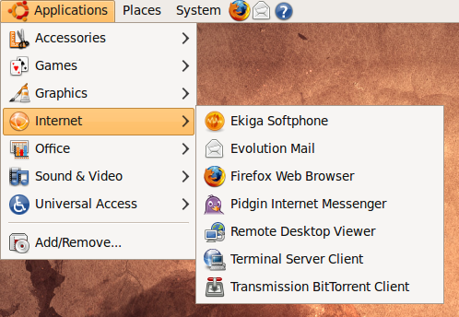
On-line with Ubuntu
Browse the web
Send email
Chat with friends
Remote desktop control
Video conferencing

Slide 4
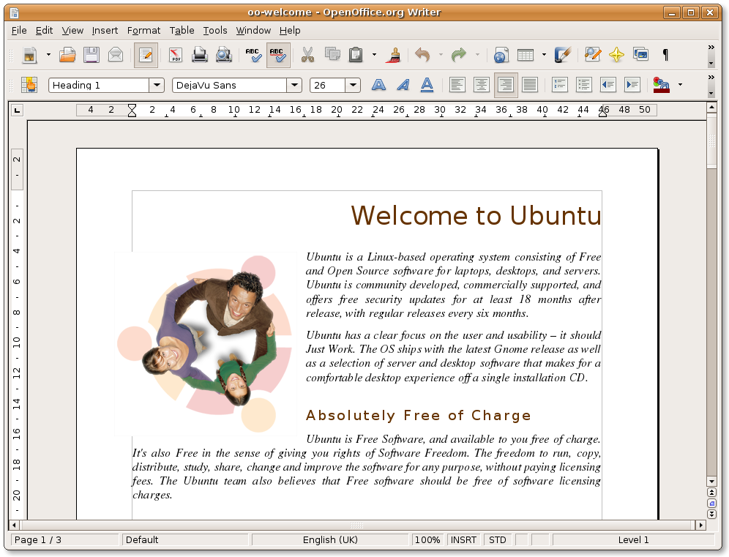
Office tools
Create presentations
Build spreadsheets
Write, edit documents
Create databases
Compatible with other office productivity products

Slide 5
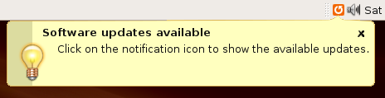
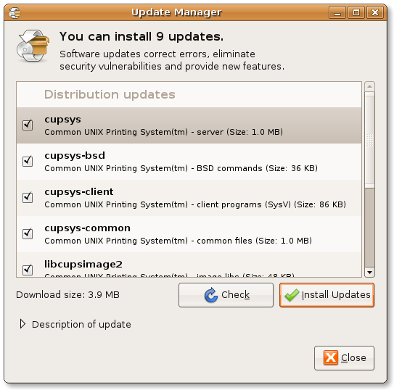
Free security updates
Automatic announcements
Easy to follow instructions

Slide 6
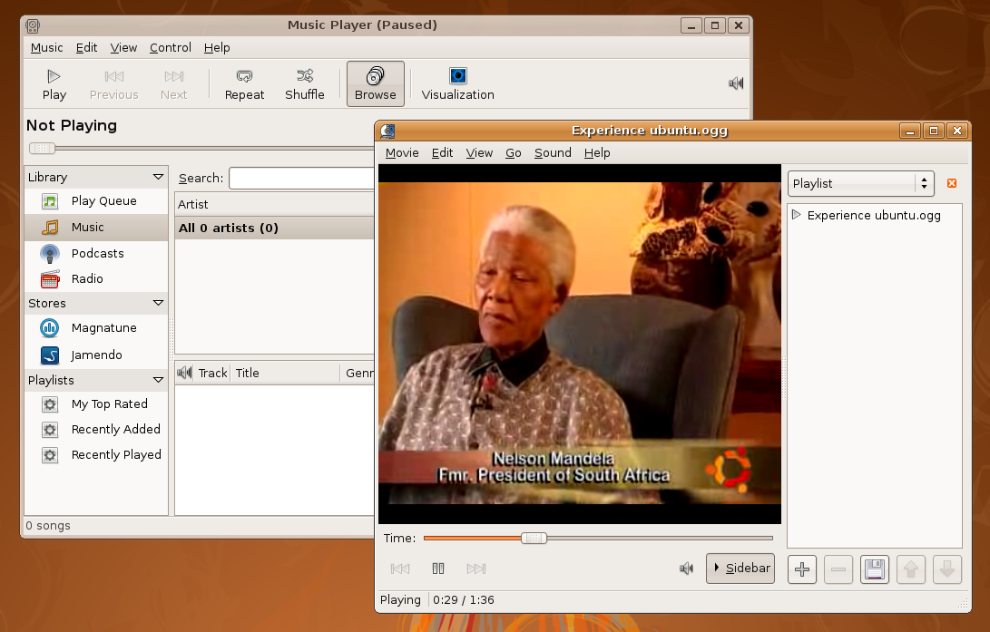
Multimedia
Play and manage:
Music
Podcasts
Web radio
Videos
And much more

Slide 7
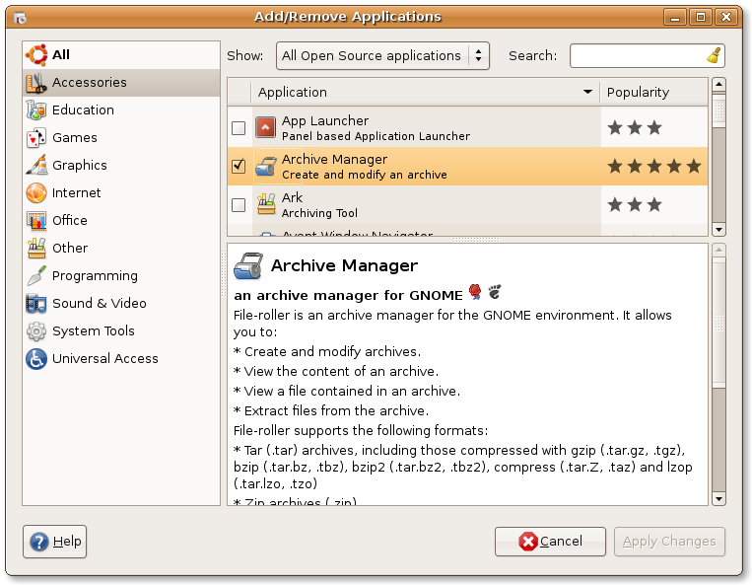
Add/Remove programs
Hundreds of free software packages
Secure and simple package manager
All at the click of a button!

Slide 8
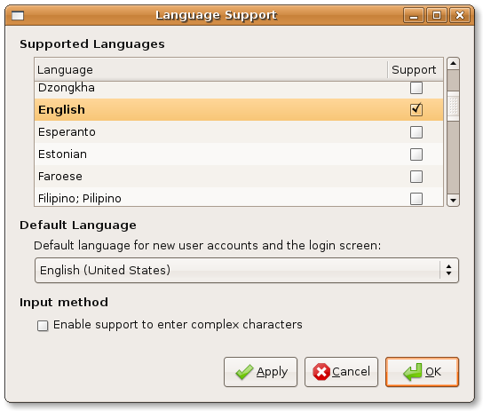
In over 40 languages
... from Arabic to Xhosa
Smart Common Input Method support
Open to your translation contributions

Slide 9
And much more...
Accessibility
  simple high visibility themes
  screen magnifiers and screen readers
  on-screen keyboard
Documentation
  System documentation through the Help program
  Ubuntu Desktop Guide
  Ubuntu Server Guide

Slide 10
The Ubuntu Promise
Genuine Freedom and Flexibility
Zero Licensing Fees
First Class Support: Commercial and Community
Collaboration to the Core
Localisation and Customisation
Certification: Hardware, Software, Skills

