Slide 1
Project 4: CosmoTransition
Hani, Amal, Srijana
Computational Physics
Dec 2025

Slide 2
Phase Transitions in the Early Universe
Motivations
The Story
CosmoTransition
Hanieh Moradipasha

Slide 3
Motivations
Matter-Antimatter Asymmetry
Gravitational Waves
Dark Matter Relic Density
Black Holes
Topological Defects

Slide 4
The Story
Through a PT system changes its form and properties.
Symmetry group changes:
G -> H -> ... -> SU(3) x SU(2) x U(1) -> SU(3) x U(1)
Dramatic, 1st-Order, Smooth, 2nd-order
Like water!

Slide 5
The Story
First-order phase transitions occur through the formation of bubbles of the new phase in the middle of the old phase; these bubbles then expand and collide until the old phase disappears completely and the phase transition is complete.

Slide 6
The Story
Dynamics of PT controlled by propagating velocity of bubble walls.
Internal pressure & external friction
Critical Bubbles drive PT.
Calculating bubble profile
Bubble nucleation rate at T=0:
Bubble nucleation rate at finite T:

Slide 7
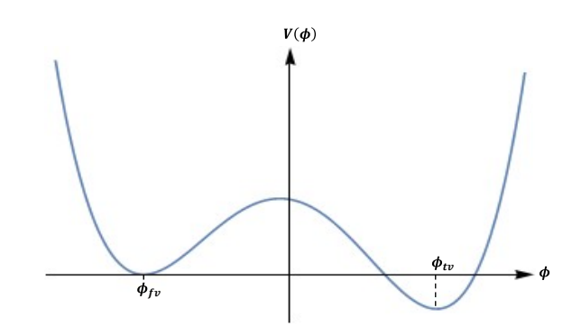

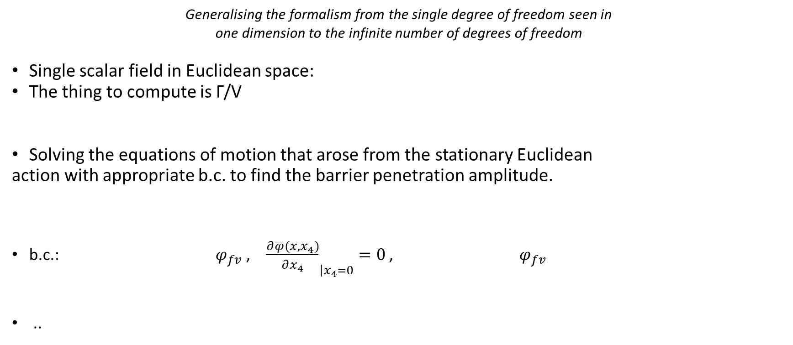
Vacuum Decay in QFT
The Bounce
Bounce Solution
Generalising the formalism from the single degree of freedom seen in
one dimension to the infinite number of degrees of freedom
Single scalar field in Euclidean space:
The thing to compute is Γ/V
Solving the equations of motion that arose from the stationary Euclidean
action with appropriate b.c. to find the barrier penetration amplitude.
b.c.: $φ_{fv}$ , ${\frac{∂\overline{φ}(x,x_{4})}{∂x_{4}}}_{\left|x_{4}=0\right.}=0$ , $φ_{fv}$
..

Slide 8
Vacuum Decay in QFT
Interested in the classical solutions which are topologically nontrivial.

Slide 9
Vacuum Decay in QFT
We don’t have perfectly adequate small-coupling approximation in perturbation theory!
Particle analogy -> No barrier penetration is seen in any order of perturbation theory.
Phenomena in QFT: Instantons
Solutions to the classical equations of motion that emerge when approaching tunnelling problems in Euclidean space.

Slide 10
CosmoTransition
• SingleFieldInstanton:
- Solves 1D Euclidean bounce equation assuming O(4) symmetry
• findProfile():
- Computes instanton solution φ(r)
- Outputs radial coordinate r and field profile φ(r)
Potential :- Defines multi-field scalar potential V(φx, φy)
- Scalar potential V(ϕ): def V1(ϕ); def V2(ϕ)
- Derivative of the potential: def dV1(ϕ); def dV2(ϕ)
makePlots():
-φ(r): bubble profile (size & wall thickness)
To analyze cosmological phase transitions
Algorithms to find the temperature-dependent phase minima, their critical temperatures, and the actual nucleation temperatures and tunneling proles of the transitions.

Slide 11
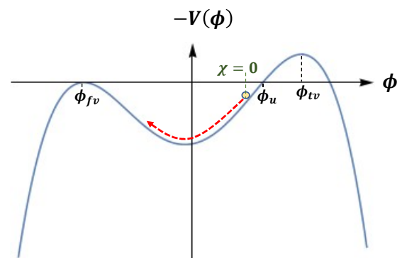
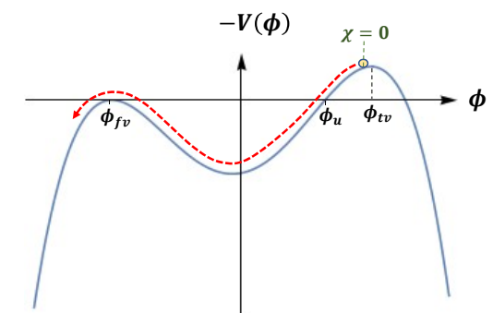
Bubble Profile
1-dimention Solution:
overshoot/undershoot method: Find initial placement of particle.
Thick-walled bubbles & Thin-walled bubbles
Variable X:
Undershoot
Overshoot

Slide 12
Bubble Profile
Thin wall approximation:
False and true vacua are nearly degenerate
Energy difference is very small.
ΔV=Vfalse ​− Vtrue​ ≪ Vbarrier
The potential barrier is high and narrow
Bubble nucleation produces a large-radius bubble
Thick wall approximation:
The false and true vacua are not nearly degenerate
The energy difference between vacua is large.
The potential barrier is low and broad
Bubble nucleation produces a small-radius bubble

Slide 13
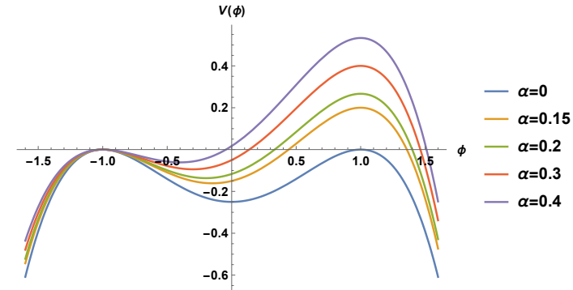

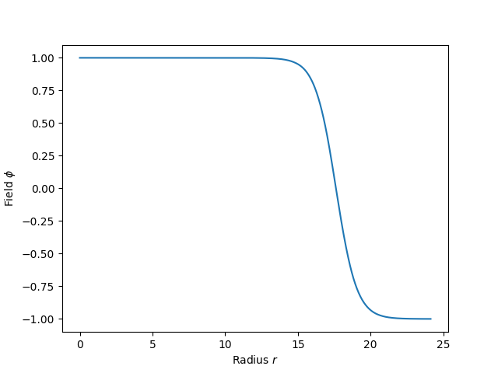
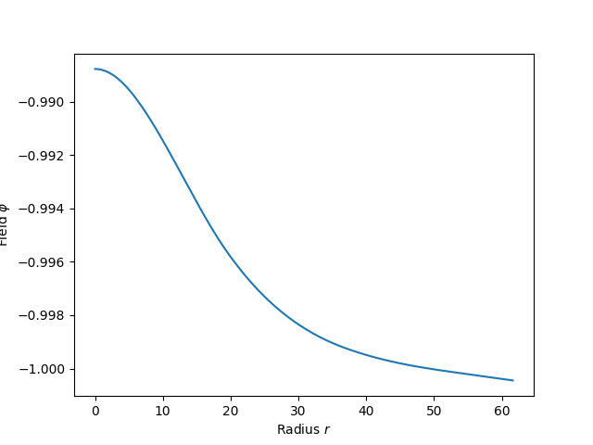

From CosmoTranstions
Example 1:
$$φ_{tv}=1, φ_{fv}=−1$$
Thin-wall Tunneling: α=0.02
Thick-wall Tunneling: α=0.25

Slide 14
From CosmoTranstions
from cosmoTransitions.tunneling1D import SingleFieldInstanton
import matplotlib.pyplot as plt
# Thin-walled
def V1(phi): return 0.25*phi**4 - 0.49*phi**3 + 0.235 * phi**2
def dV1(phi): return phi*(phi-.47)*(phi-1)
profile = SingleFieldInstanton(1.0, 0.0, V1, dV1).findProfile()
plt.plot(profile.R, profile.Phi)
# Thick-walled
def V2(phi): return 0.25*phi**4 - 0.4*phi**3 + 0.1 * phi**2
def dV2(phi): return phi*(phi-.2)*(phi-1)
profile = SingleFieldInstanton(1.0, 0.0, V2, dV2).findProfile()
plt.plot(profile.R, profile.Phi)
plt.xlabel(r"Radius $r$")
plt.ylabel(r"Field $\phi$")
plt.show()

Slide 15
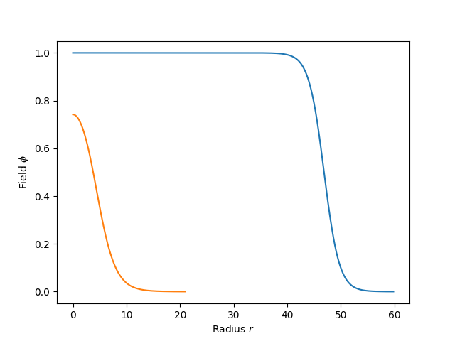
From CosmoTranstions

