Slide 1
CosmoTransition
Hani, Amal, Srijana
December 2025

Slide 2
CosmoTransition
• SingleFieldInstanton:
- Solves 1D Euclidean bounce equation assuming O(4) symmetry
• findProfile():
- Computes instanton solution φ(r)
- Outputs radial coordinate r and field profile φ(r)
Potential :- Defines multi-field scalar potential V(φx, φy)
- Scalar potential V(ϕ): def V1(ϕ); def V2(ϕ)
- Derivative of the potential: def dV1(ϕ); def dV2(ϕ)
- Method of the Potential class: def V(self, X); def dV(self, X)
fullTunneling():
- Finds least-action tunneling path in multi-field space
- Reduces problem to effective 1D instanton
makePlots():
-φ(r): bubble profile (size & wall thickness)
- Contours + path: tunneling trajectory in field space
To analyze cosmological phase transitions
Algorithms to find the temperature-dependent phase minima, their critical temperatures, and the actual nucleation temperatures and tunneling proles of the transitions.

Slide 3
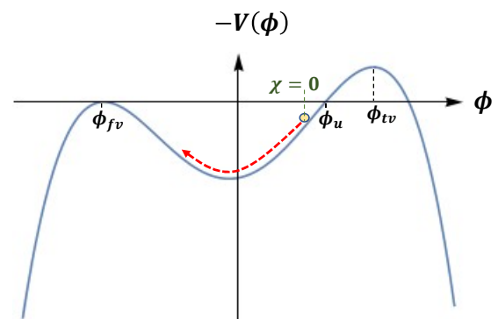
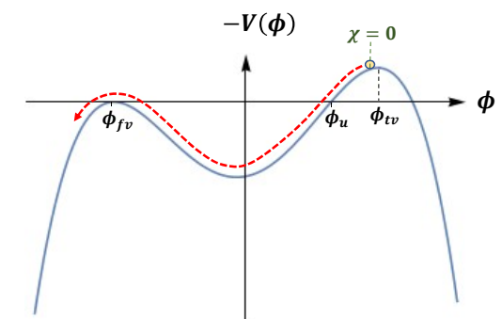
Bubble Profile
1-dimention Solution:
overshoot/undershoot method: Find initial placement of particle.
Thick-walled bubbles & Thin-walled bubbles
Variable X:
Undershoot
Overshoot

Slide 4
Bubble Profile
Multi-dimension Solution:
Path deformation: Initial guess
Trick: Find the right path.
Algorithm:
Calculates the bubble profile using the o/u method.
Deforms the path in a series of steps.
At each step it calculates the normal force.
Moves the points in that direction times some small stepsize.
Repeating the procedure a few times, the deformation should converge after a single step.
The algorithm will
return the final tunneling solution.

Slide 5
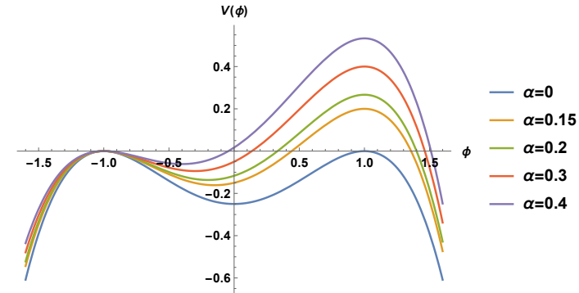

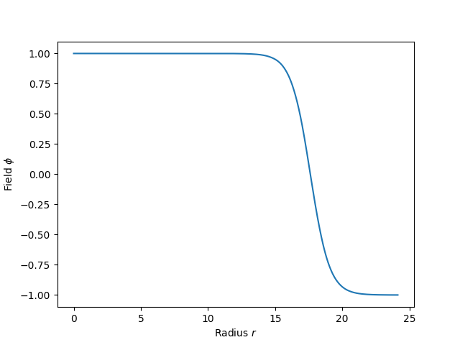
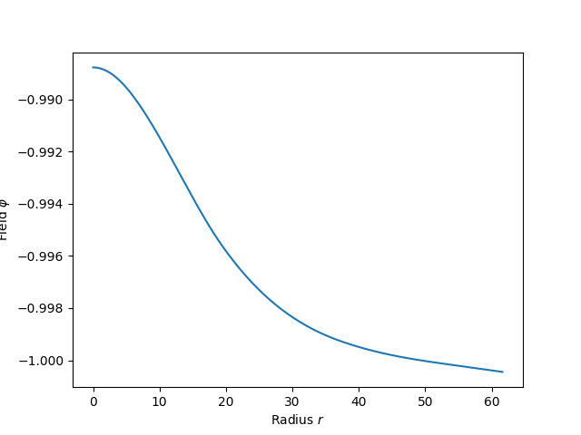

From CosmoTranstions
Example 1:
$$φ_{tv}=1, φ_{fv}=−1$$
Thin-wall Tunneling: α=0.02
Thick-wall Tunneling: α=0.25

Slide 6
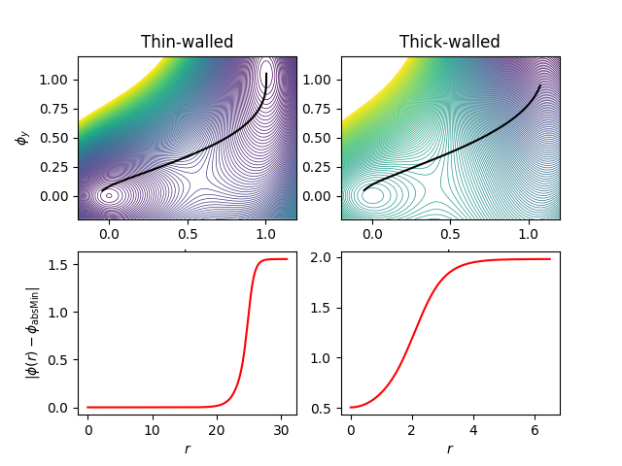
From CosmoTranstions
Example 2:
Path deformation converged. 40 steps. fRatio = 1.92926e-02
Path deformation converged. 29 steps. fRatio = 1.98492e-02
Path deformation converged. 1 steps. fRatio = 9.11781e-02
Path deformation converged. 37 steps. fRatio = 1.98389e-02
Path deformation converged. 25 steps. fRatio = 1.93061e-02
Path deformation converged. 1 steps. fRatio = 7.36852e-02
Thin-walled instanton
Potential(delta=0.02)
Thick-walled instanton
Potential(delta=0.4)

Slide 7
From CosmoTranstions
from cosmoTransitions.tunneling1D import SingleFieldInstanton
import matplotlib.pyplot as plt
# Thin-walled
def V1(phi): return 0.25*phi**4 - 0.49*phi**3 + 0.235 * phi**2
def dV1(phi): return phi*(phi-.47)*(phi-1)
profile = SingleFieldInstanton(1.0, 0.0, V1, dV1).findProfile()
plt.plot(profile.R, profile.Phi)
# Thick-walled
def V2(phi): return 0.25*phi**4 - 0.4*phi**3 + 0.1 * phi**2
def dV2(phi): return phi*(phi-.2)*(phi-1)
profile = SingleFieldInstanton(1.0, 0.0, V2, dV2).findProfile()
plt.plot(profile.R, profile.Phi)
plt.xlabel(r"Radius $r$")
plt.ylabel(r"Field $\phi$")
plt.show()

Slide 8
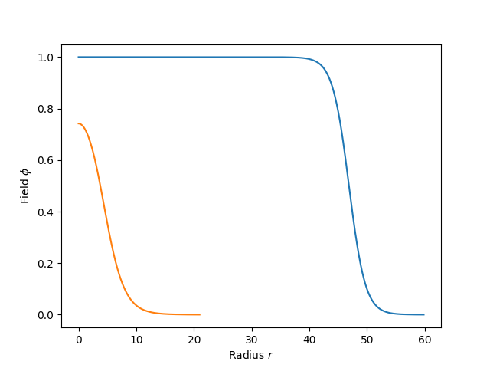
From CosmoTranstions

Slide 9
From CosmoTranstions
Do the Exercise and answer these questions:
Question 1: Looking at your plot, which minimum appears to be the stable one? Which is metastable?
Question 2: Based on the energies, which minimum is stable and which is metastable?
Question 3: At what approximate radius does the bubble wall (the transition region) occur?

