Slide 1
Project 4: CosmoTransition
Hani, Amal, Srijana
Computational Physics
Dec 2025

Slide 2
Phase Transitions in the Early Universe
Motivations
The Story
CosmoTransition
Hanieh Moradipasha

Slide 3
Motivations
Matter-Antimatter Asymmetry
Gravitational Waves
Dark Matter Relic Density
Black Holes
Topological Defects

Slide 4
The Story
Through a PT system changes its form and properties.
Symmetry group changes:
G -> H -> ... -> SU(3) x SU(2) x U(1) -> SU(3) x U(1)
Dramatic, 1st-Order, Smooth, 2nd-order
Like water!

Slide 5
The Story
First-order phase transitions occur through the formation of bubbles of the new phase in the middle of the old phase; these bubbles then expand and collide until the old phase disappears completely and the phase transition is complete.

Slide 6
The Story
Dynamics of PT controlled by propagating velocity of bubble walls.
Internal pressure & external friction
Critical Bubbles drive PT.
Calculating bubble profile
Bubble nucleation rate at T=0:
Bubble nucleation rate at finite T:

Slide 7
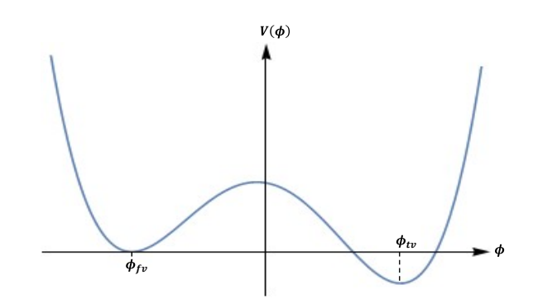

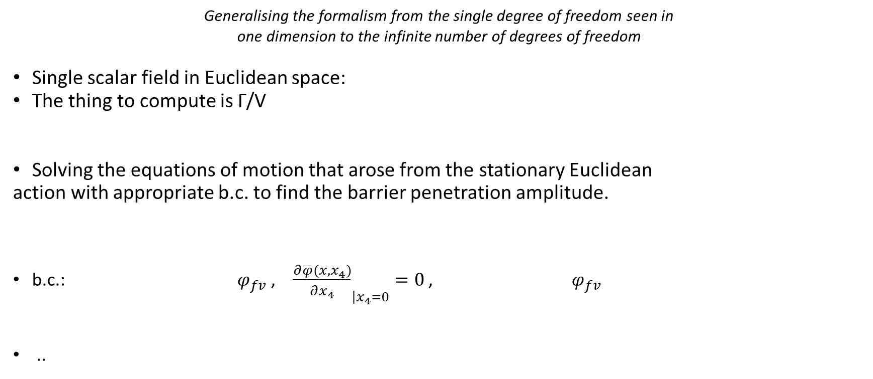
Vacuum Decay in QFT
The Bounce
Bounce Solution
Generalising the formalism from the single degree of freedom seen in
one dimension to the infinite number of degrees of freedom
Single scalar field in Euclidean space:
The thing to compute is Γ/V
Solving the equations of motion that arose from the stationary Euclidean
action with appropriate b.c. to find the barrier penetration amplitude.
b.c.: $φ_{fv}$ , ${\frac{∂\overline{φ}(x,x_{4})}{∂x_{4}}}_{\left|x_{4}=0\right.}=0$ , $φ_{fv}$
..

Slide 8
Vacuum Decay in QFT
Interested in the classical solutions which are topologically nontrivial.

Slide 9
Vacuum Decay in QFT
We don’t have perfectly adequate small-coupling approximation in perturbation theory!
Particle analogy -> No barrier penetration is seen in any order of perturbation theory.
Phenomena in QFT: Instantons
Solutions to the classical equations of motion that emerge when approaching tunnelling problems in Euclidean space.

Slide 10




Vacuum Decay in QFT
The Bounce
*Wick Rotation (Imaginary time)
to go to Euclidean space.
Radial coordinate in 4-dim Euclidean space:
e.o.m for Bounce:
b.c. : ,
Analogous to e.o.m for
a 1D instanton in QM

