Slide 1

Webscraping using BeautifulSoup
Hanisha Patchineelam

Slide 2
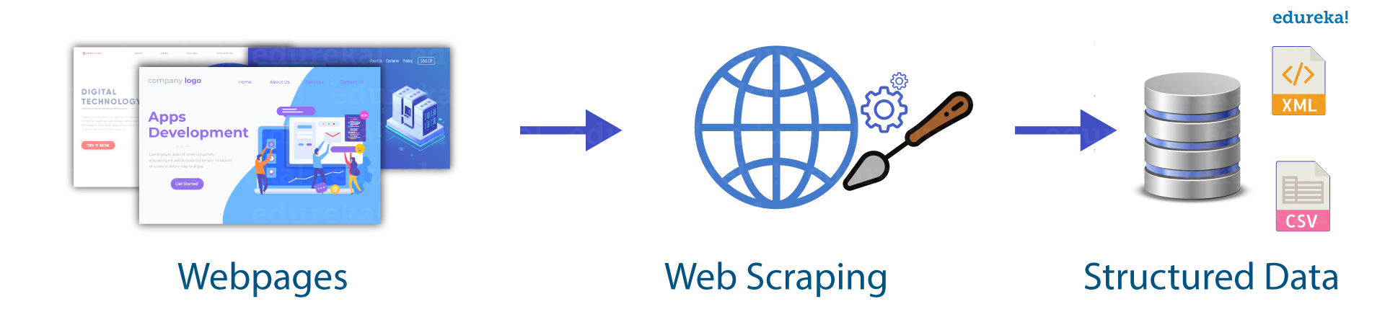
What is webscraping?
Web scraping is nothing but parsing out the data from the website and pulling out the information you exactly want and put it on an excel sheet or Json file format. For this I have used beautifulSoup.
BeautifulSoup is a library for python used for extracting data.
For this project, I have designed a simple website using html and want to show to demo on how we can scrape. But this method can be used for a professional websites to scrape the content you want to put on the excel sheets.
For example, below I have attached an image of how exactly web scarping works.

Slide 3
Environmental setup
First, install the following python packages. pip install requests pip install beautifulsoup4
Then, we can start importing all the necessary packages.
import requests
from bs4 import BeautifulSoup

Slide 4
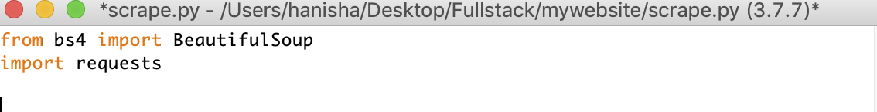
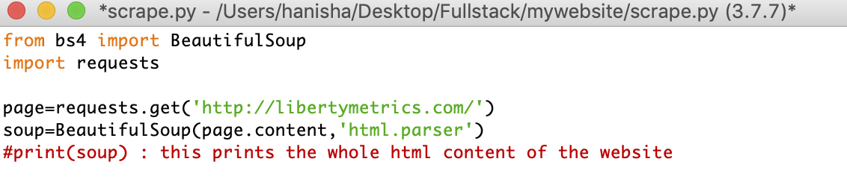
Implementation
To perform webscraping, I imported the libraries shown below.
After importing the modules, I specified the url of the website to get the html of the page. I checked with the view page source of the website to verify if I got the same content. Here, I have used http://libertymetrics.com.

Slide 5
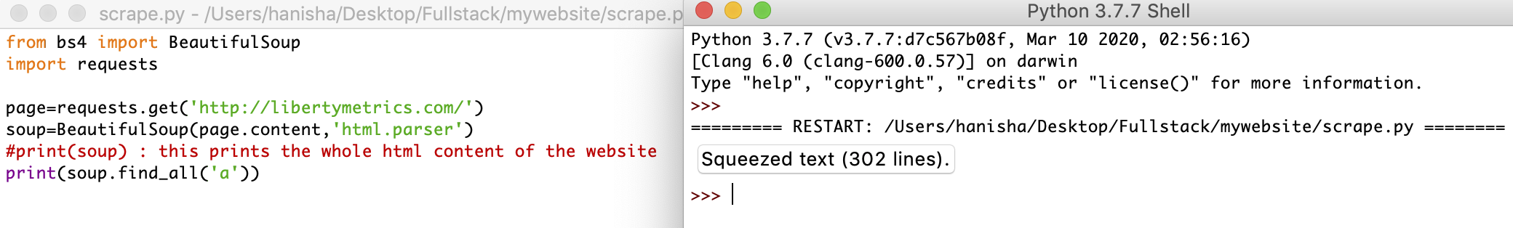
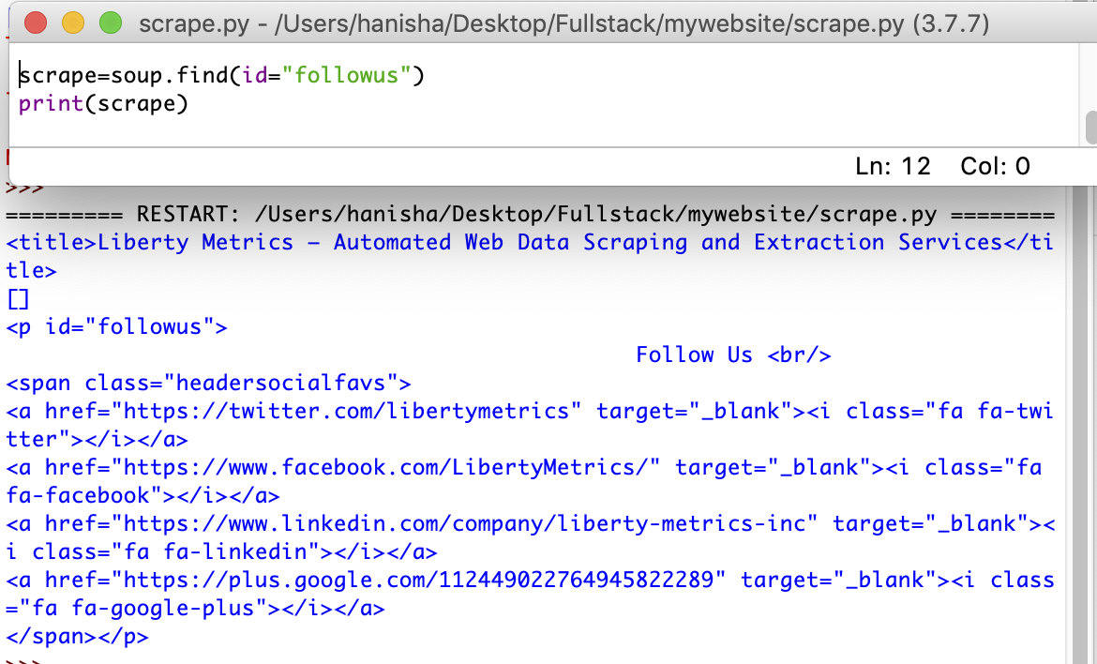
Now, I have created a BeautifulSoup object from the html by passing the html to the beautifulSoup() function
The soup opject allows you to get the information of the website. For example, I want to find all the ‘a’ tags in the website. I get the below output
Similarly, If I can fetch a specific ID of the website, I created a var scrape and printed scrape as below It shows everything inside that div.

Slide 6
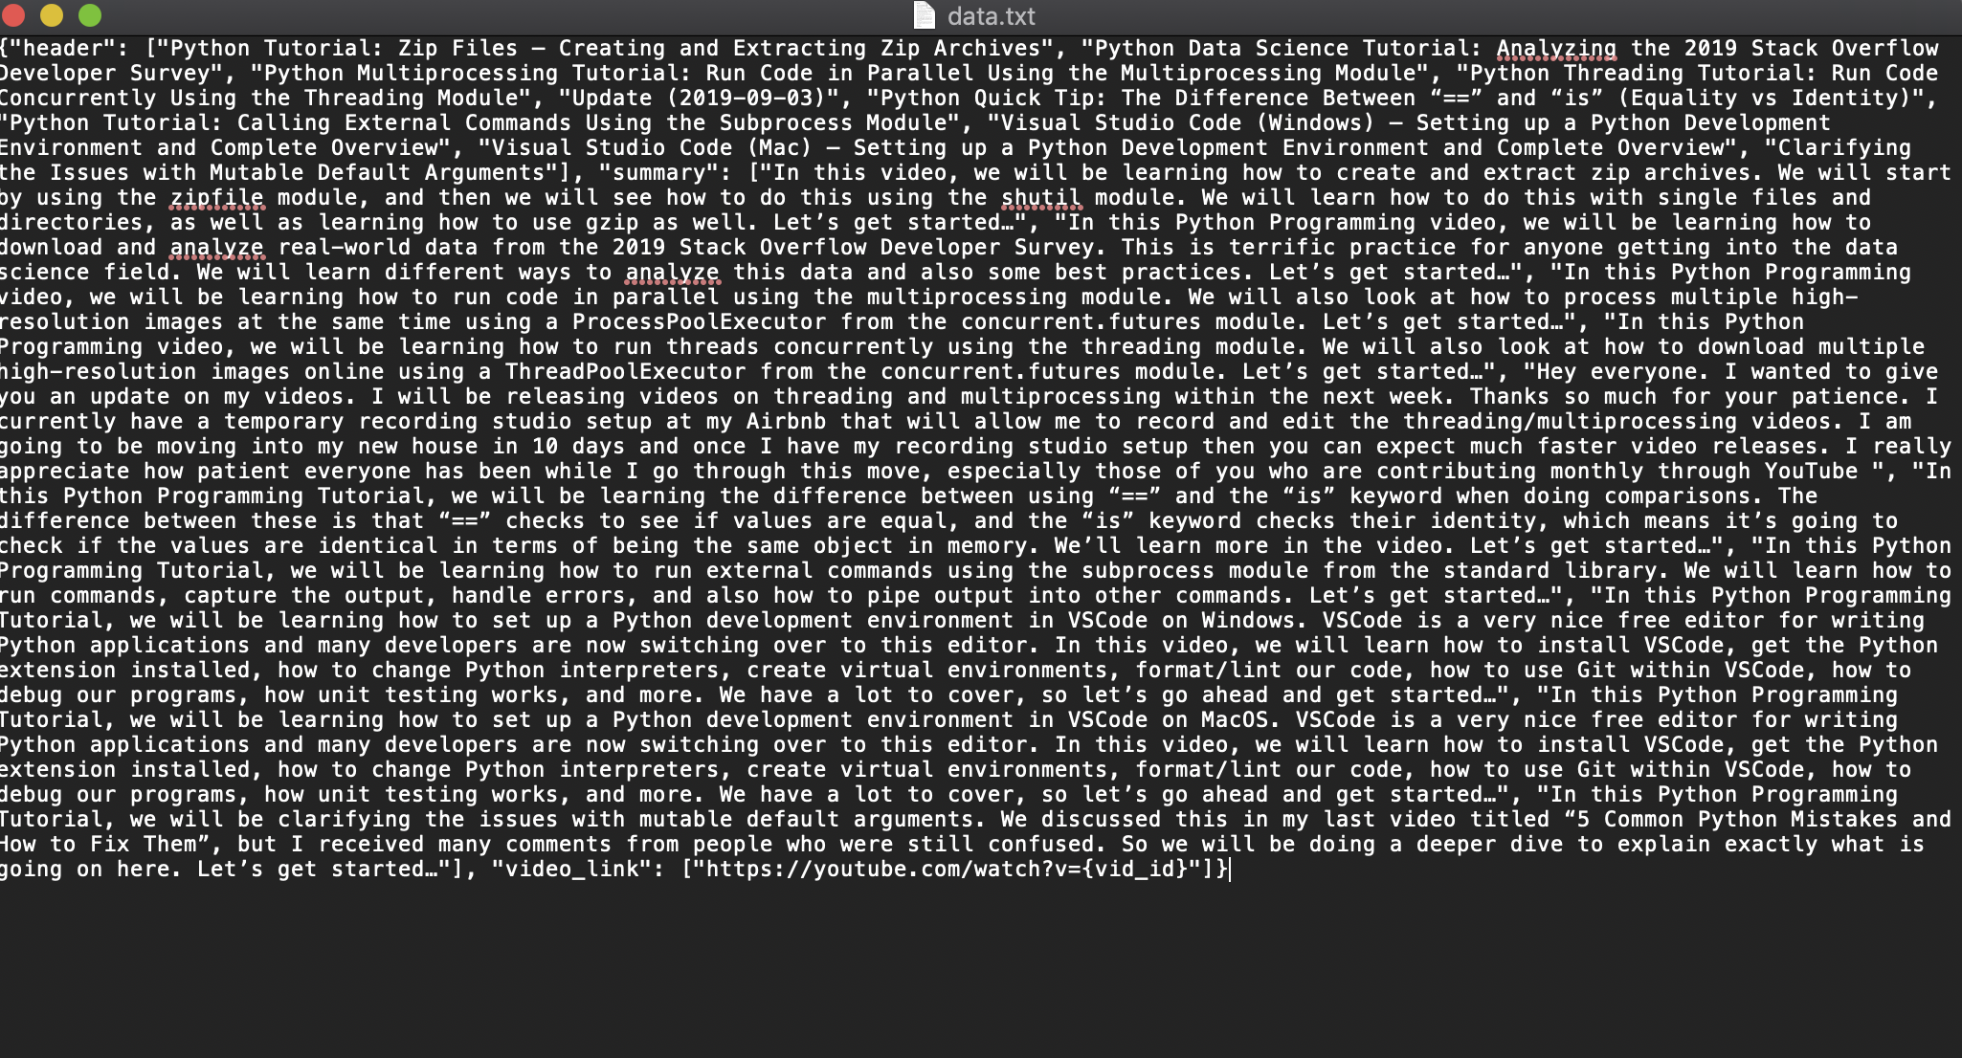
JSON FILE OF A SAMPLE WEBSITE THAT I HAVE WORKED ON.

