Slide 1
Experiential Learning Phase -I :
CS235AI
Operating Systems
Topic : Simple File System
Hanisha R
1RV22CS244

Slide 2
PRESENTATION CONTENTS
PROBLEM STATEMENT
REFERENCE TO OS
METHODOLOGY
REFERENCE PAPERS

Slide 3
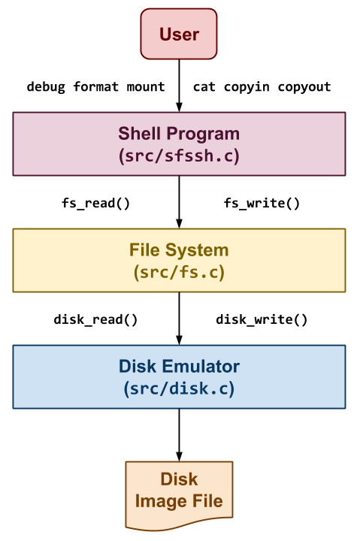
Problem Statement
Create SimpleFS, a simplified Unix-like File System, consisting of a shell application, file system component, and disk emulator. Develop in C to manage on-disk data structures, handle disk operations, and provide a user-friendly interface for filesystem tasks. Deliverables include source code, documentation, and a demonstration video, aiming to deepen understanding of file systems and low-level system programming.
Relevance of the project to the course
This project is crucial for understanding operating systems as it involves practical work on filesystem design, disk management, and system-level programming. By implementing SimpleFS, students gain hands-on experience in building filesystem structures, managing disk operations, and interacting with hardware resources. This project enhances understanding of filesystem architecture, storage optimization, and system-level programming, making it highly relevant to the study of operating systems.

Slide 4
Summary of the Phase I report
Design: Create a detailed blueprint of the SimpleFS filesystem structure, including superblock, inode layout, data blocks, and free block bitmap.
Implement: Write code to create the disk emulator, filesystem operations (e.g., fs_debug, fs_format, fs_create), and data structures
Document : upload on GitHub
Test: Develop test cases to ensure the correct functionality of each filesystem operation and data structure
METHODOLOGY
Optimize: Refine the implementation to improve performance, efficiency, and resource utilization
Debug: Identify and fix any errors or issues discovered during testing to ensure the system operates as expected.

Slide 5
Summary of the Phase I report
fs.h
#ifndef FS_H
#define FS_H
void fs_debug();
int fs_format();
int fs_mount();
int fs_create();
int fs_delete( int inumber );
int fs_getsize( int inumber );
int fs_read( int inumber, char *data, int length, int offset );
int fs_write( int inumber, const char *data, int length, int offset );
int fs_defrag();
#endif
disk.h
#ifndef DISK_H
#define DISK_H
#define DISK_BLOCK_SIZE 4096
int disk_init( const char *filename, int nblocks );
int disk_size();
void disk_read( int blocknum, char *data );
void disk_write( int blocknum, const char *data );
void disk_close();

Slide 6
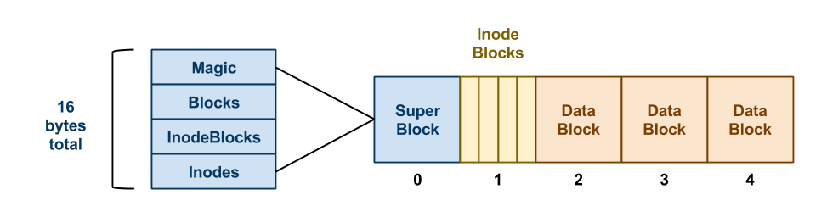
Summary of the Phase I report
//
typedef unsigned char* bitmap_t;
struct fs_superblock {
int magic;
int nblocks;
int ninodeblocks;
int ninodes;
};

Slide 7
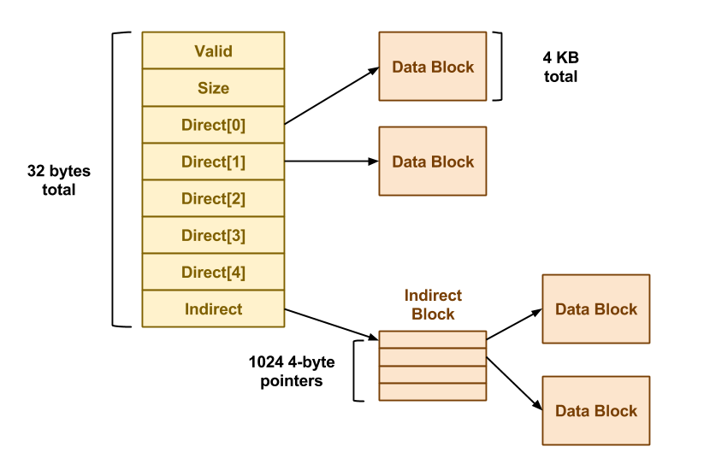
Summary of the Phase I report
struct fs_inode {
int isvalid;
int size;
int direct[DATA_POINTERS_PER_INODE];
int indirect;
};
union fs_block {
struct fs_superblock super;
struct fs_inode inodes[INODES_PER_BLOCK];
int pointers[DATA_POINTERS_PER_BLOCK];
char data[DISK_BLOCK_SIZE];
};

Slide 8
REFERENCES (As per IEEE format and must be Numbered
consecutively in order of first mention) & Annexures / Appendix
Time Administration of Virtual File System Operations
Saloni Parekh;Arnav Deshpande;N. Narayanan Prasanth
A New Design of In-Memory File System Based on File Virtual Address Framework
Edwin H.-M. Sha;Xianzhang Chen;Qingfeng Zhuge;Liang Shi;Weiwen Jiang
IEEE Transactions on ComputersYear: 2016 | Volume: 65, Issue: 10 |
Overtmpfs: A virtual memory file system based on tmpfs
Hao Li;Yongping Xiong;Jian Ma
Proceedings of 2011 International Conference on Computer Science and Network Technology
Virtual file system for scalable media formats: Architecture proposal
for managing and handling scalable media files
Heiko Sparenberg;Alexander Schmitt;Robert Scheler;Siegfried Foessel;Karlheinz Brandenburg
2011 14th ITG Conference on Electronic Media Technology

