Slide 1

SARS covid-19 detection through AI
Team-4
Mission:Possible
SPRING 2023 - CS 691- CAPSTONE PROJECT
PROFESSOR HENRY WONG
PACE UNIVERSITY
1

Slide 2
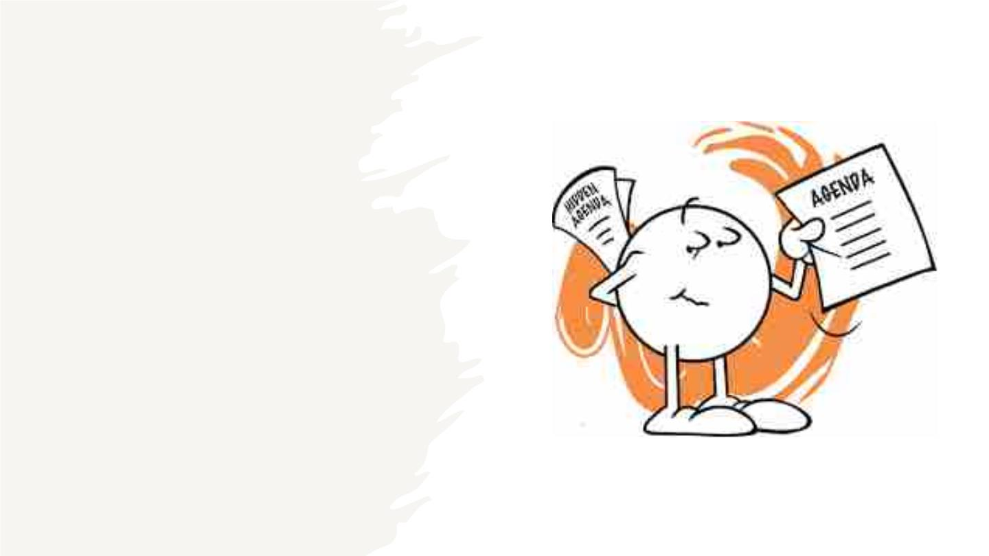
Agenda
2

Slide 3

Agenda
1.Improvement from Professor’s Feedback.
2. Project Description
3. Personas
10. Retrospective
11. Sprint 5
4. Minimum Viable Product
12. Product Demo-Sprint 4
13. Live Application Demo
5. Technologies
6. Architecture Diagrams
14. Technical paper
7. Sprint 3 Recap
8. Product Backlog, User Stories and Sprint 4
Backlog
9. Metrics
3

Slide 4

Agenda
1.It's worth noting that Artificial Intelligence is a subset of machine learning. Our focus is on utilizing machine
learning to detect cases of covid-19. Within machine learning, we make use of specific techniques such as
Convolution Neural Networks (CNN) and Recurrent Neural Networks (RNN).
2.CNN is a type of neural network architecture that is mainly utilized in deep learning algorithms.
It is specifically designed to process pixel data, making it ideal for tasks such as image recognition.
CNNs operate by extracting relevant features from the input data through a series of convolution
and pooling layers, followed by fully connected layers for classification or regression purposes.
3.RNN is a type of neural network that is capable of recognizing sequential patterns within data and using
them to predict the most probable next scenario. Unlike other types of neural networks that process inputs
independently, RNNs are able to maintain a memory of past inputs and use it to influence their outputs. This
makes them particularly useful in tasks such as natural language processing, speech recognition, and time-
series prediction.
4.We opted to use CNN for our project as it is well-suited for tasks such as medical analysis, drug
discovery, and image analysis. On the other hand, we did not use RNN as it is more appropriate
for tasks such as text summarization, speech recognition, and entity extraction.
4

Slide 5
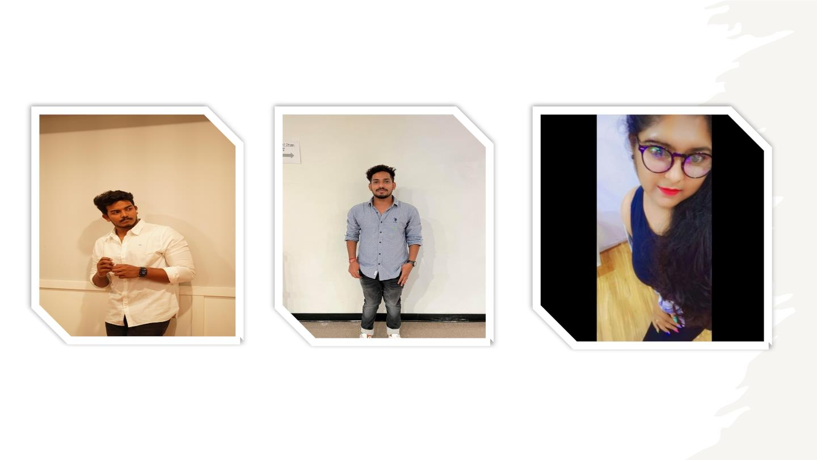
Team Member Roles and Responsibilities
Vekatesh
(Quality Analyst)
Vamshi
(Product manager)
Reshma Gonu
(Developer)
5

Slide 6
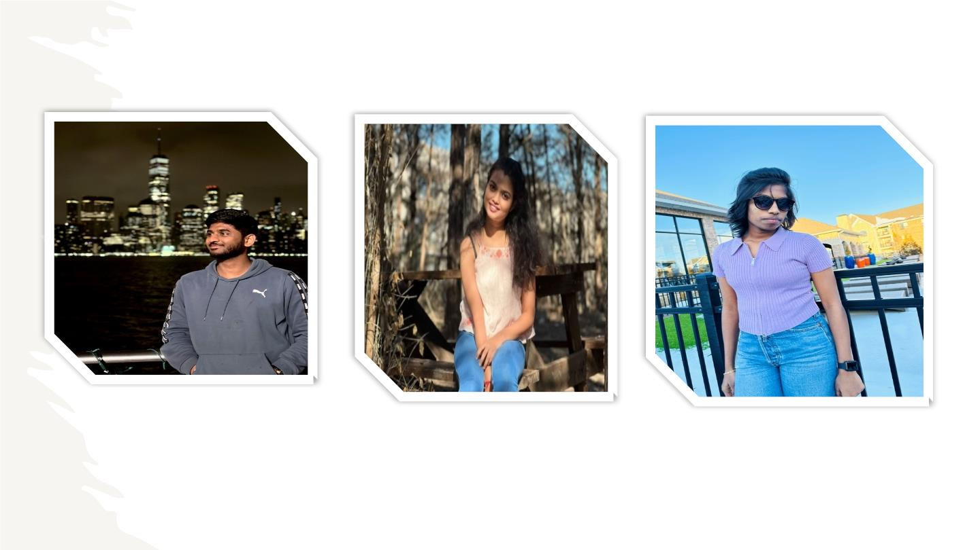
Hanith atluri
(Tester)
Alekhya
(Facilator)
Anusha Nunna
(Developer)
6

Slide 7

Improvements made from Professor Feedback
1.The team did not implement the last feedback provided by the professor
→Based on professors feedback this time we create the tables for Product backlog and Sprint backlog
2.User stories were missing
→ We have added the user stories for this sprint-4
3.The team is unable to show its demo
→We have shown our demo for sprint-3 lately and sprint-4 in-time
4.Next Sprint you have to show a Demo of your MVP in which just login is insufficient.
→We have showed the demo for covid-19 reports feedback for this deliverable we will implement more.
5.Regarding Technical Paper
→This time all of our team members work on Tech paper
6.Team was missing the Stories Not Completed slide.
→This time we add Stories Not Completed slide as well.
7. Team velocity report and Burn down chart.
→This time we have deliver the stories properly and we took the report correctly
7

Slide 8
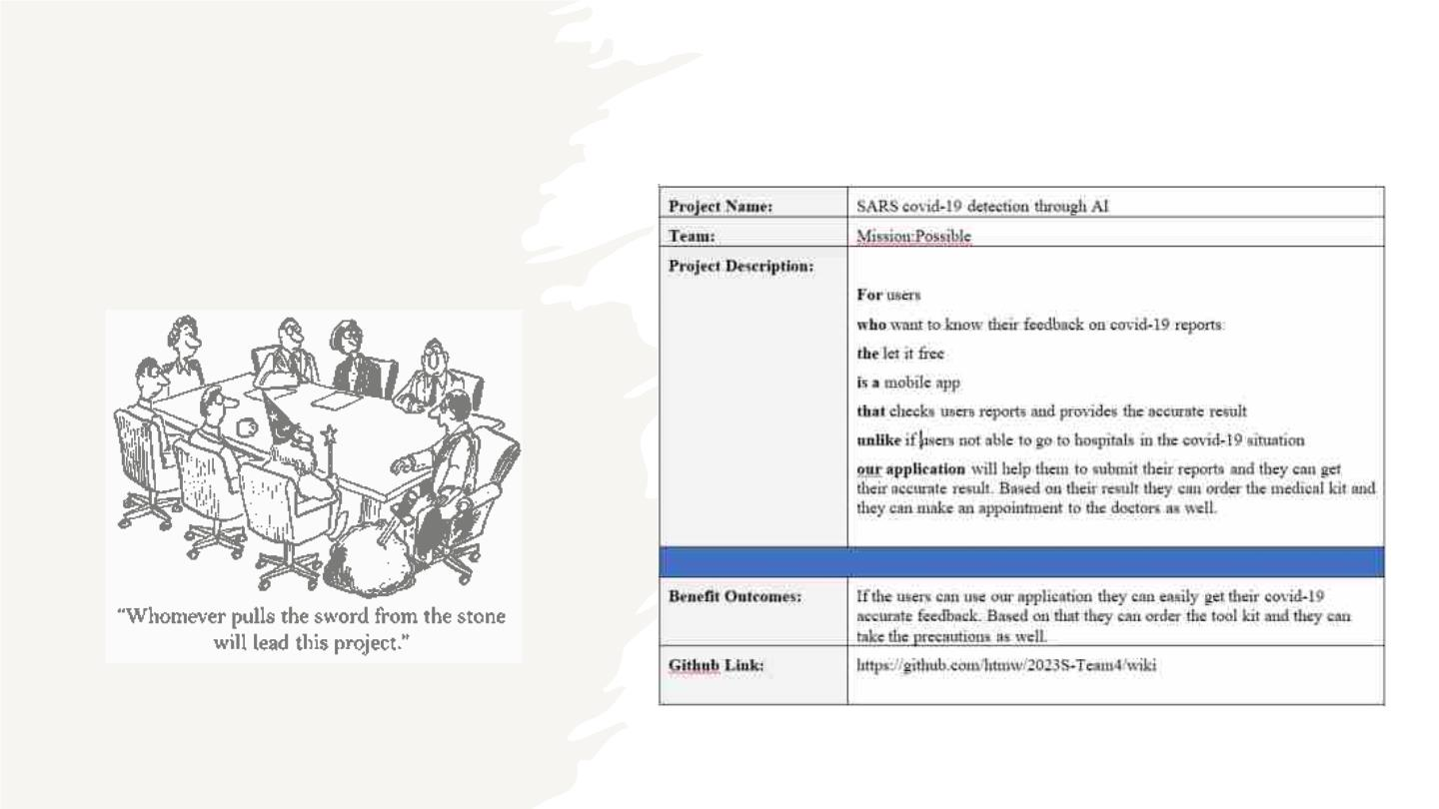
Project
Description
8

Slide 9
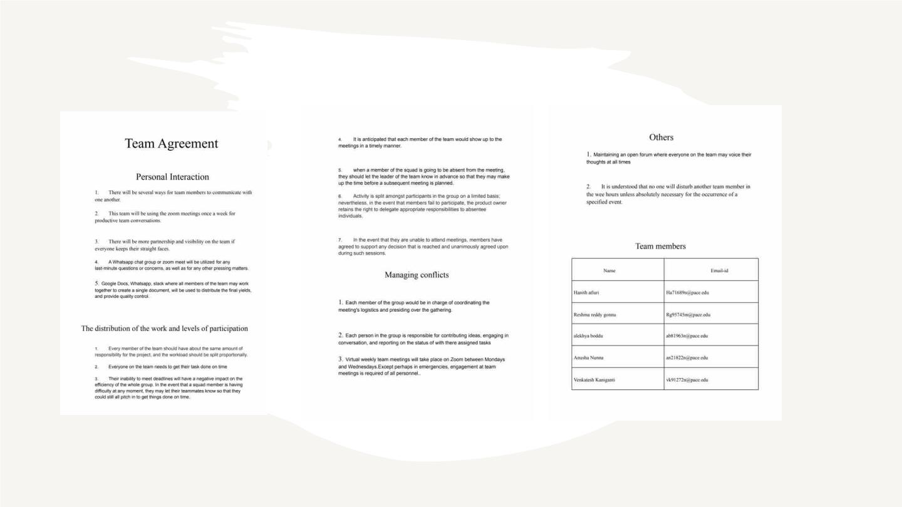
Team Working Agreement
9

Slide 10

PERSONAS
10

Slide 11

JIMMY ANDERSON
AGE :- 28 YEARS
GENDER:- MALE
HE WENT TO THE HOSPITAL TO GET CHECKED OUT SINCE HE WASN'T
FEELING VERYWELL, AND THE DOCTORS WANTED TO SEE WHETHER HE
WAS SHOWING ANY SIGNS OF CONVULSIONS.
THE CT SCAN WAS CARRIED OUT, AND THE FINDINGS WERE GATHERED.
YET, NONE OF THE DOCTORS ARE AVAILABLE TO TALK ABOUT THE
PAPERS AND PROVIDE THEIR FEEDBACK. HE ISABLE TO INPUT THE
REPORT INTO THE PROGRAM AND OBTAIN THE FINDINGS BY MAKING
USE OFTHE SARS COVID-19 DETECTION WITH AI TECHNOLOGY

Slide 12
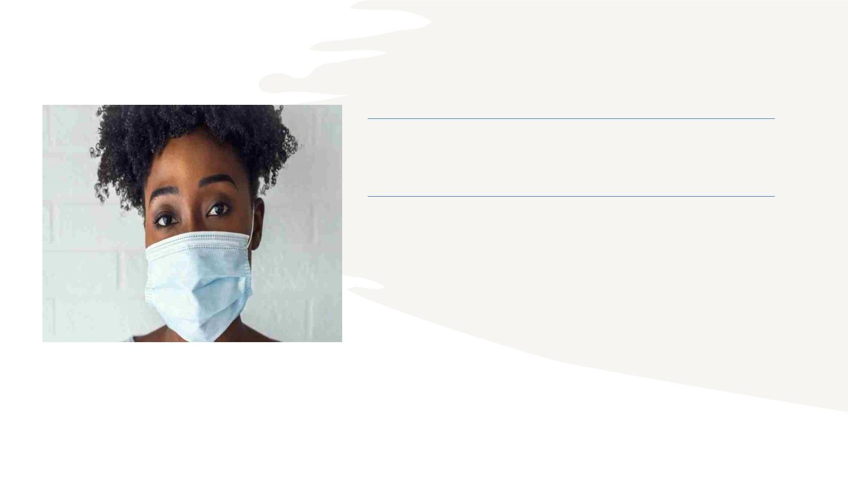
ALENA WILLIAMS
AGE :- 32 YEARS
GENDER:- FEMALE
SHE IS UNSURE ABOUT THE COVID 19.SHE REALLY WANT TO TEST
HER OWN ABILITIES.SHE CAN ORDER TESTING KITS BY
UTILIZING SARS COVID 19
DETECTION VIA ARTIFICIAL INTELLIGENCE. BECAUSE OF HER
CHILDREN, SHE IS UNABLE TO RELIABLYAPPROACH HER INFANT
CHILD WHEN HE OR SHE IS EXPERIENCING SYMPTOMS.
12

Slide 13
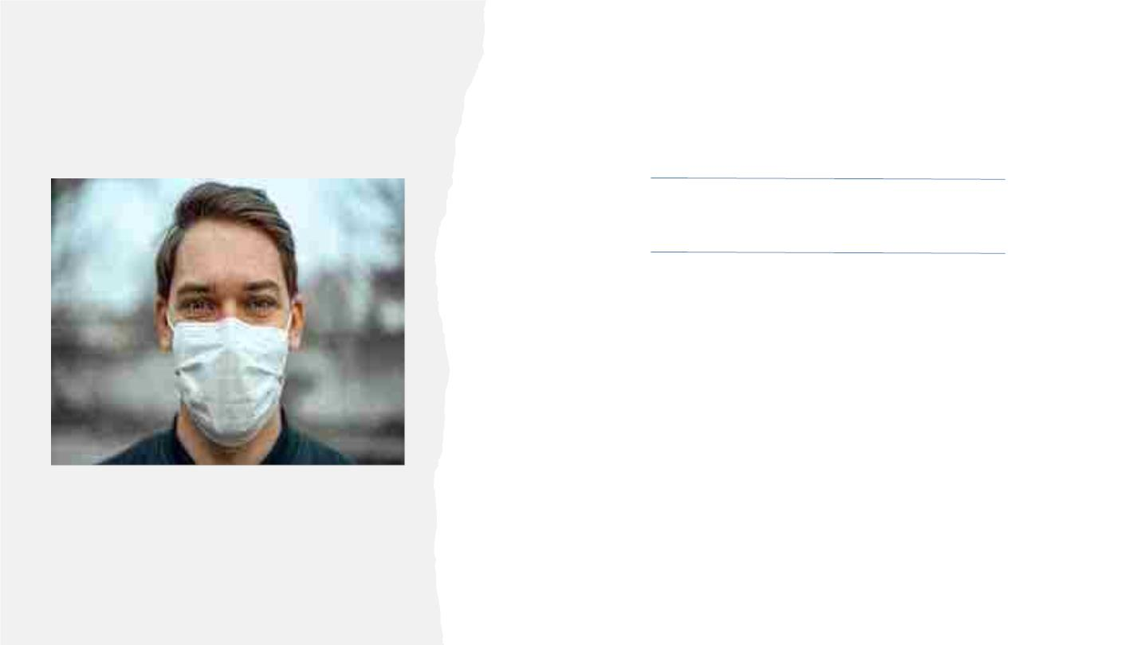
CHARLES JOHN
AGE :- 23 YEARS
GENDER:- MALE
HE WENT TO THE HOSPITAL TO GET WEIGHED OUT BECAUSE HE
HADN'T BEEN FEELING VERY WELL, ANDTHE DOCTORS THERE
LOOKED FOR SIGNS OF CONVULSIONS IN HIM.
HE IS CONFINED TO THE HOUSE AND UNABLE TO GO
ANYWHERE ELSE BECAUSE OF THE SIDE EFFECTS OF COVID-19.
HE IS ABLE TO DISCUSS HER HUSBAND'S ILLNESS WITH A
CHATBOT THAT EMPLOYS SARS COVID-19 DETECTION UTILIZING
AI, AND IN RETURN, SHE WILL OBTAIN ADVICE FROM TRAINED
MEDICAL SPECIALISTS

Slide 14
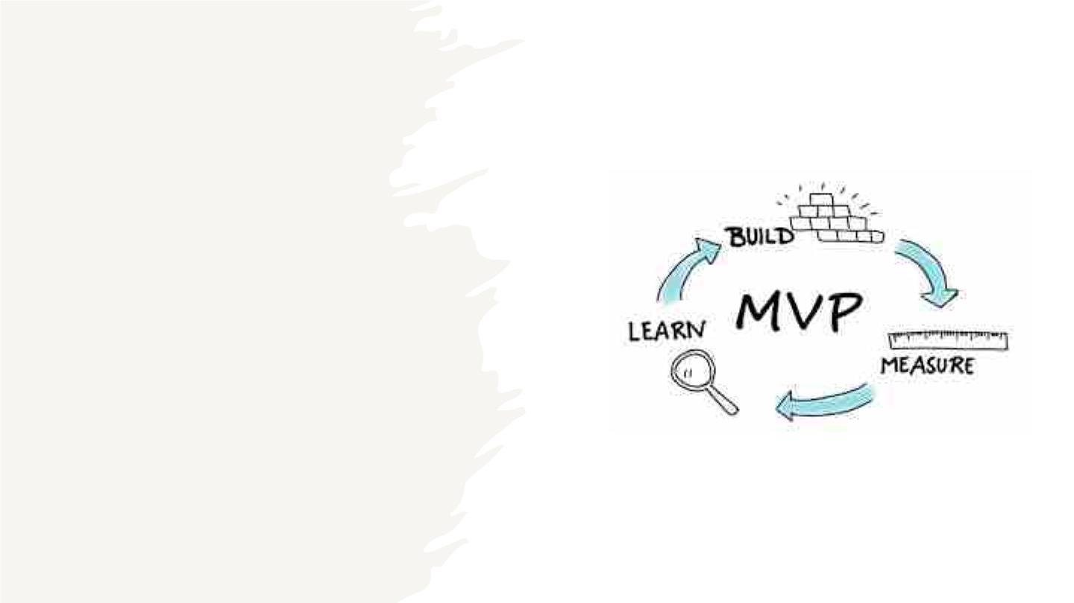
MINIMAL VIABLE
PRODUCT
14

Slide 15
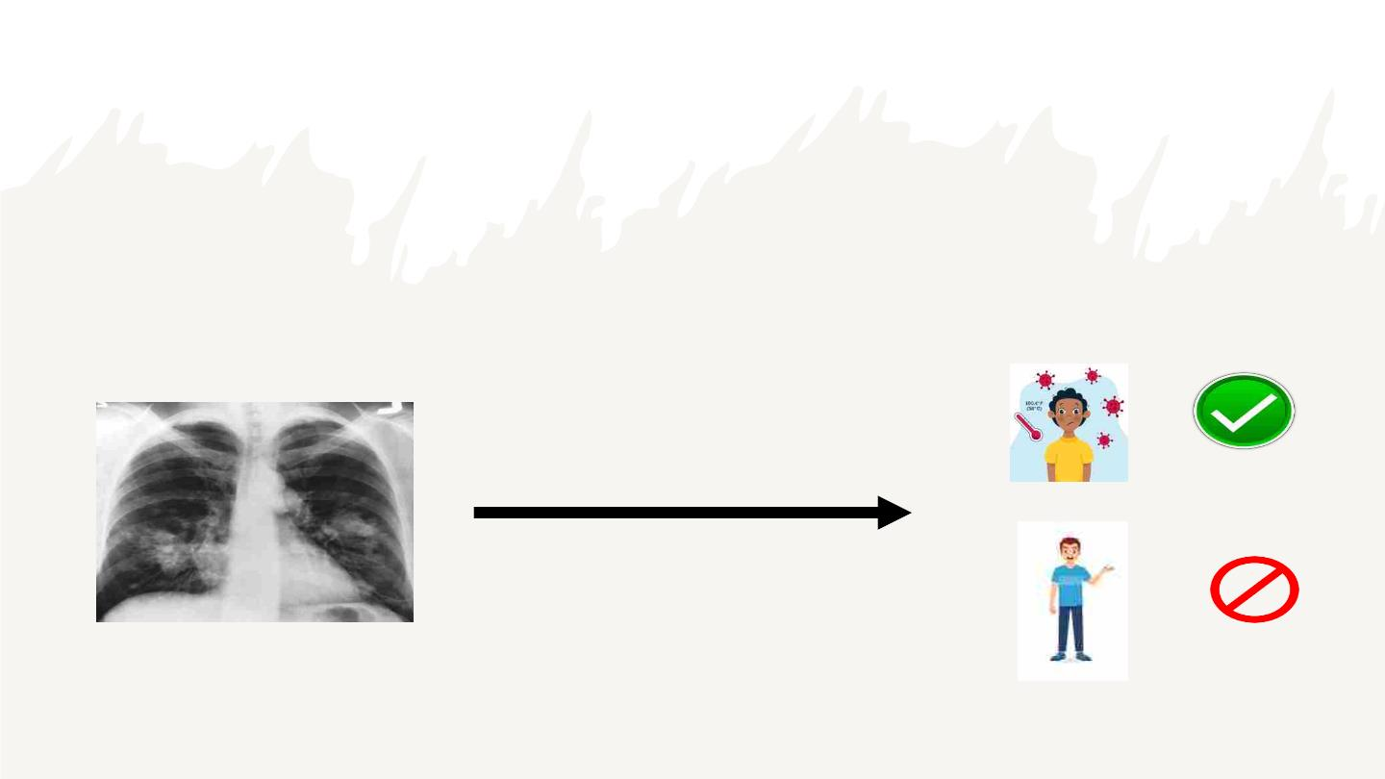
MINIMAL VIABLE PRODUCT
The software takes as input a patient's X-ray results and outputs whether the patient has been influenced by
covid (a "positive" result) or not (a "negative" result).
INPUT
OUTPUT

Slide 16

Technologies and Algorithms

Slide 17
Technologies and Algorithms
Planning:
Step 1: Image Dataset Exploration.
Step II: Importing Pretrained Model.
Step III: Splitting dataset into testing& training dataset to find accuracy of
the model.
Step IV: Actual image input for analysis.
Step V: Testing & debugging
ALGORITHM:
Step 1: A publicly available chest x-ray images dataset is taken for the development
of the system.
Step 2: Steps like exploration and feature extraction are performed to make the
dataset suitable for the use.
Step 3: Once the dataset is ready, we will split it into train and test dataset.
Step 4: Pretrained ML model will be used for training and testing and accuracy will
be determined.
Step 5: Once everything is done then the user can provide actual test data for
COVID19 Prediction.
Step 6: User Interface is provided using Streamlit PythonModule.
17

Slide 18
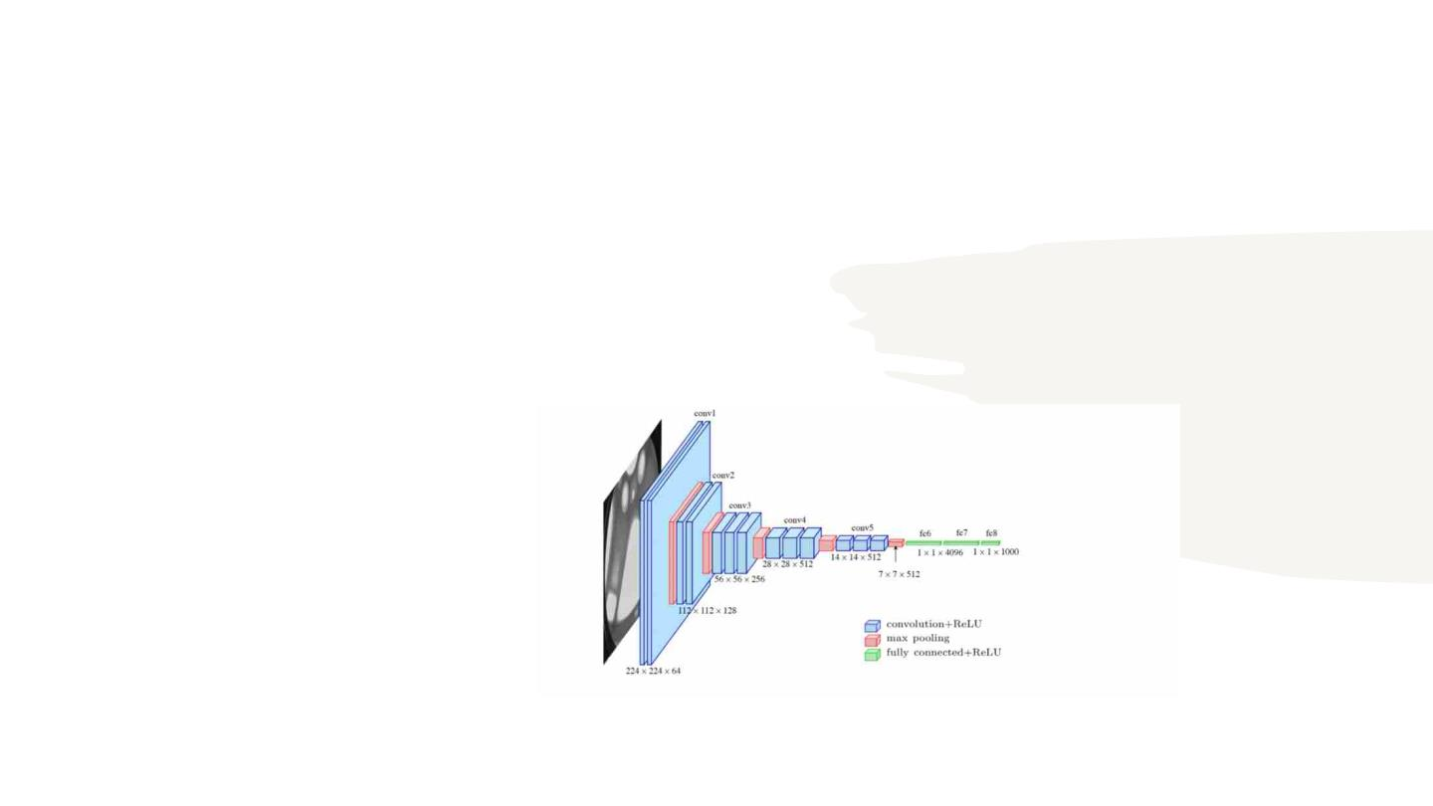
•
•
Convolutional Neural Network:
Recently, CNNs are the most studied machine learning (ML)
algorithms for the medical lesions diagnosis using images. The
justification behind this is that CNNs retain complex features while
scanning input images. As stated above, spatial relationships are of
primary importance in radiology, such as how the bone joins the
muscle, or where the standard lung tissue interfaces with infected cells.
18

Slide 19
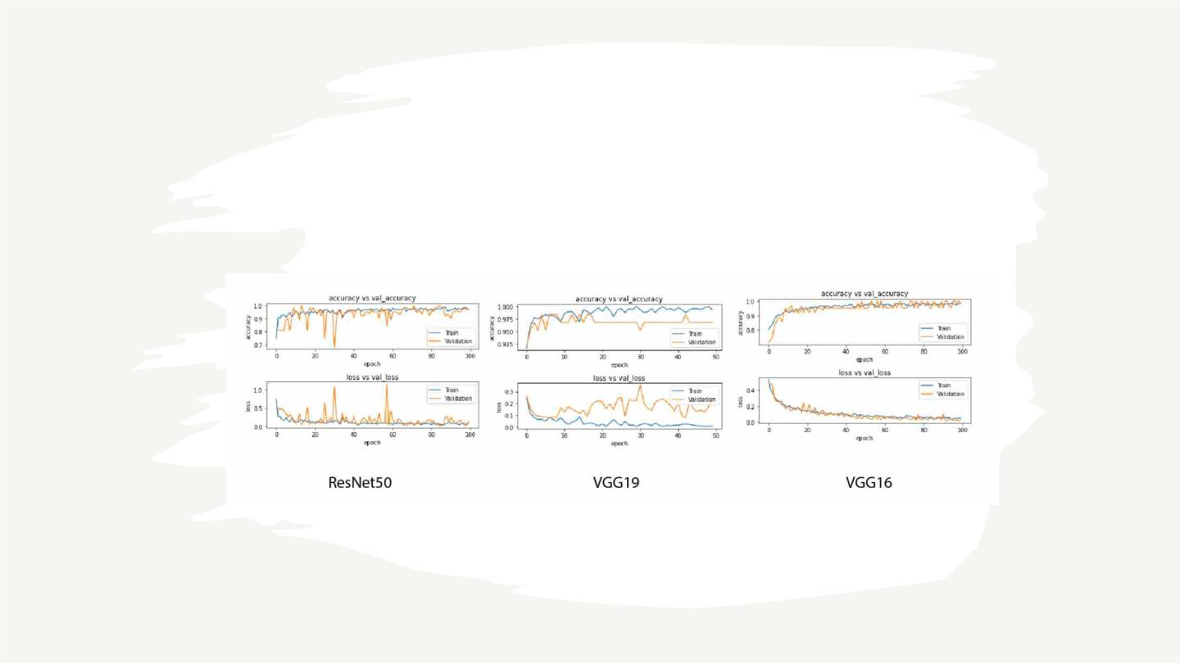
Machine Learning Model: Statistics Gathering
19

Slide 20
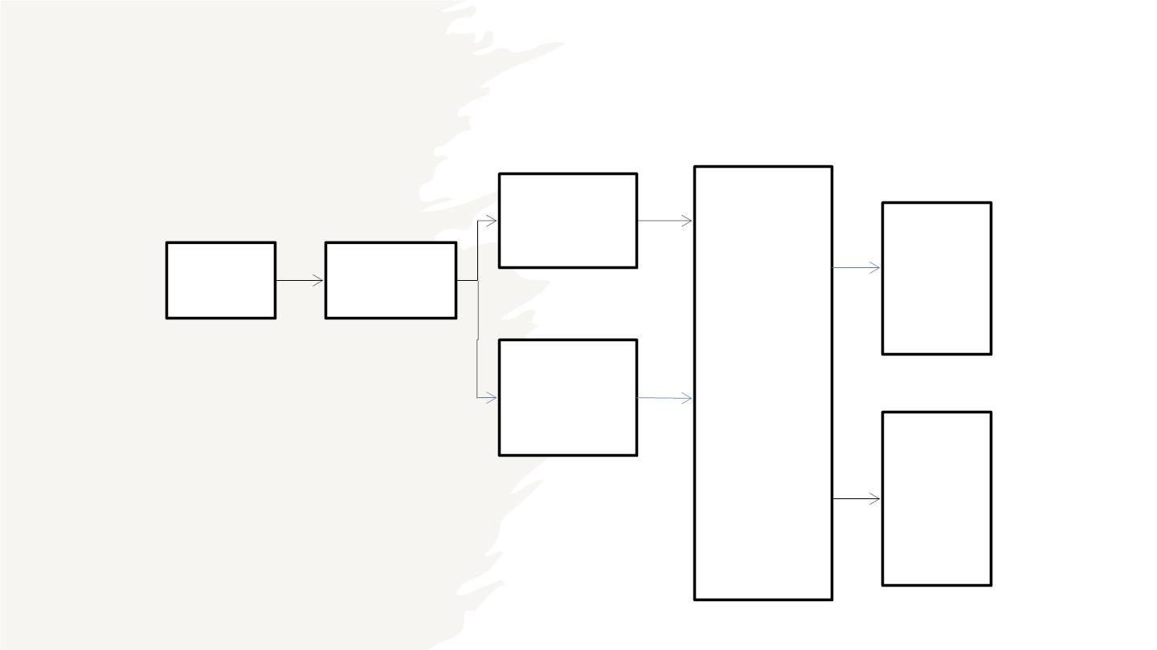
System Architecture:
Training
dataset
COVID
19
Images(
dataset)
Model
feature
extraction
ML
classifiers
Testing
datase
t
Normal
20

Slide 21

●
Explored a variety of essential machine learning algorithms, such as linear regression, logistic
regression, decision tree, KNN algorithm, TensorFlow, deep learning classification, image
recognition, and pattern recognition.
Recap of sprint-3
●
●
Discussed different UML diagrams, including architecture, sequence diagram to better
understand our project's design and structure.
Analyzed the remaining items in the product backlog and walked through them to ensure a
clear understanding of what still needs to be accomplished.
21

Slide 22
SPRINT 3 VS SPRINT 4
Sprint 3
Sprint 4
Login
MVP
Feedback
Remainders
CHAT BOT
Deployment
22

Slide 23
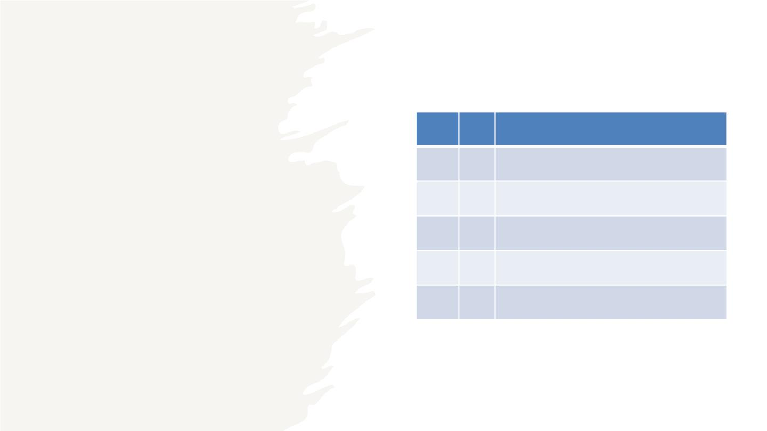
Issue
Type Key
Name
SARS-
Task
Task
Task
Task
12 Develop the deliverable one presentation
SARS-
13 Set up weekly meetings
SARS-
14 Assign roles to the team
SARS- Configure the development tools Jira and
15 GitHub
Sprint 1
Task SA1R6S- Develop a crucial business application.
23

Slide 24
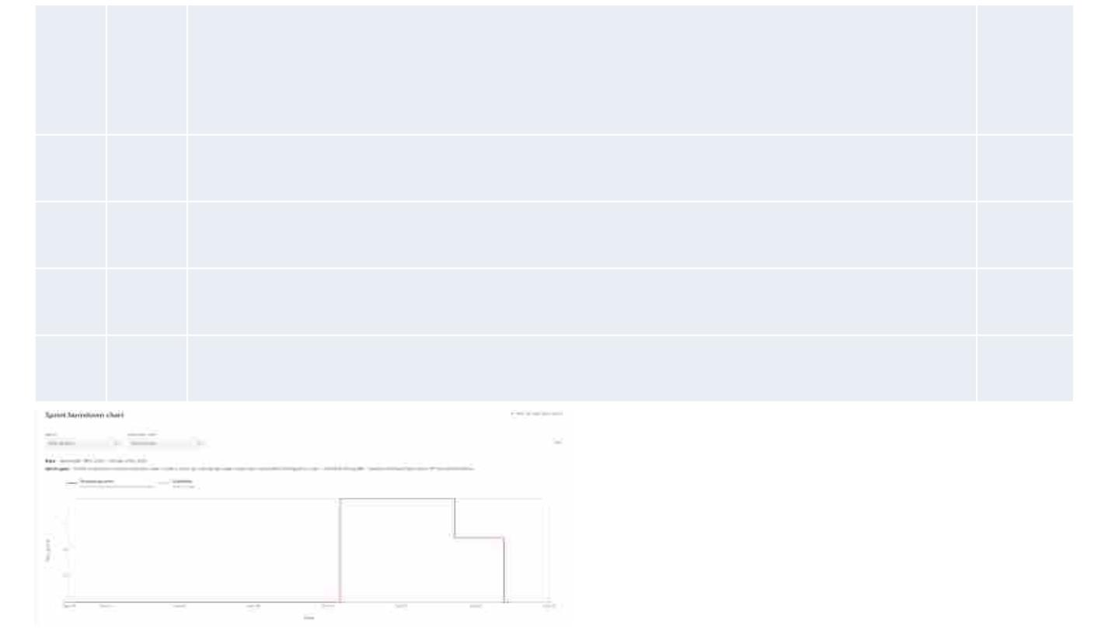
Story
Points
Estimat
e
Issue
Type Key
Sprint_02
DCS- I want to log out of the signed-in gateway so that I may access my
Story 14 patient information on the app.
3
5
5
3
DCS- As a customer, I want to register myself to the application So that I can
Story 13 keep my account private and login using email/phone and password.
DCS- I want to sign in as a user so that I may sign in using my full name and
Story 12 account information through the portal.
DCS-
Task 10 Create MVP Prototype – android studio
24

Slide 25
Product
backlogging
25

Slide 26
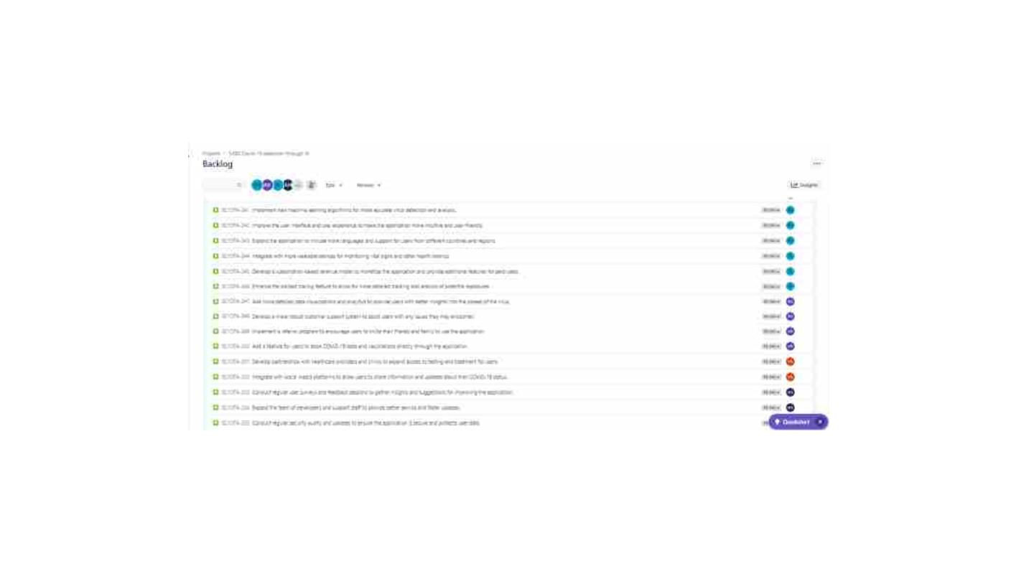
26

Slide 27
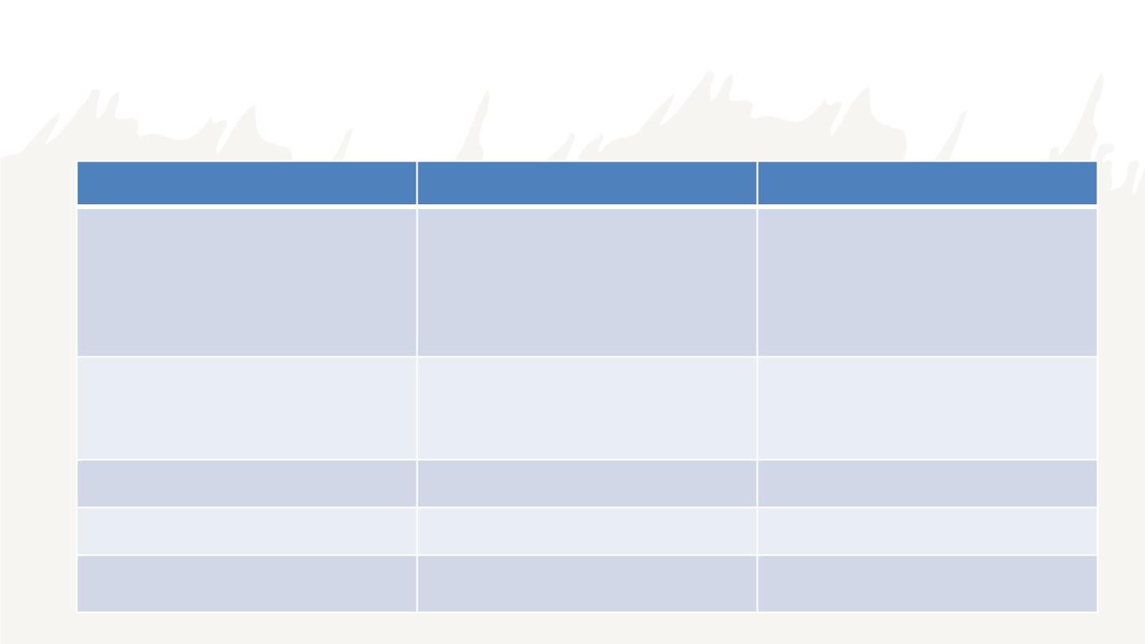
Sprint-4 Backlog / Sprint Backlog
Issue Type
Name
Story Points Estimate
Story
As a User,
3
I want to submit my x-ray reports in the
application for evaluation to predict the
covid-19.
Story
As a User,
4
I want to discuss my/other health
condition via chatbot
Story
Story
Task
MVP
4
3
6
Deployment
Finish Technicalpaper

Slide 28

User stories and acceptance criteria
28

Slide 29
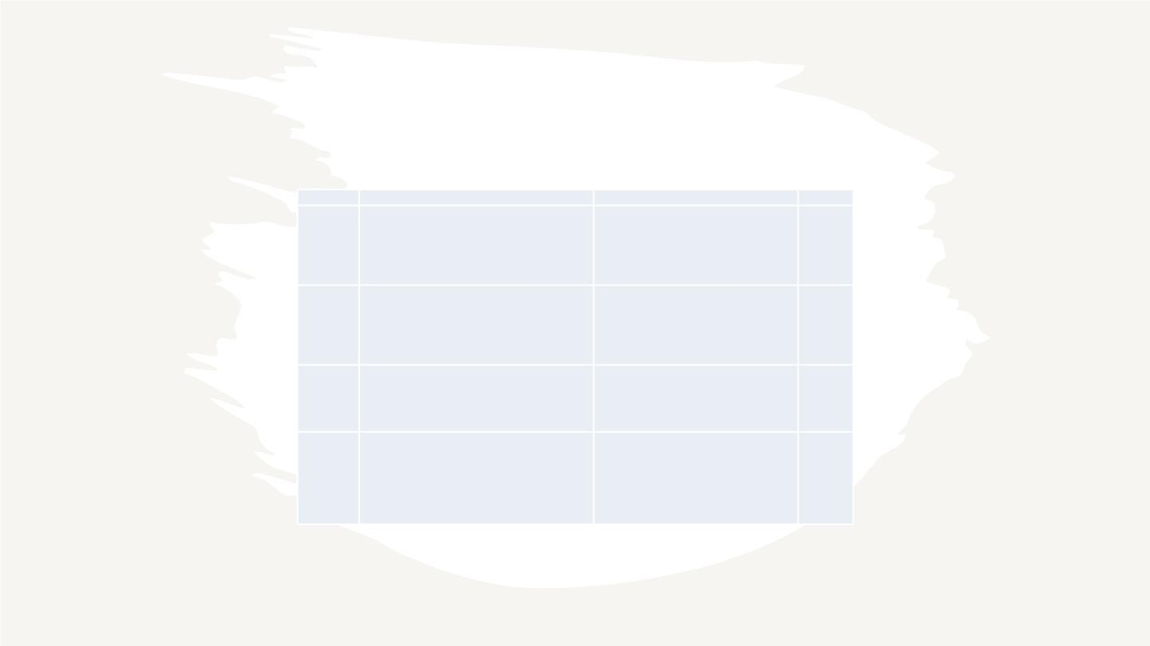
User stories and acceptance criteria
SCIDTA
user story
Acceptance criteria
Place
Scenario : User needs to send updates on
As a user, I can able to provide update on health his health Given I logged in as user, When I
condition to the bot so that I can get ouptus of the open the application and click on bot option
SCIDTA-220 reports
then I can share updates on my health
BOT
Scenario : User needs to suggestions on
drug usage Given I logged in as user, When I
As a user, I need suggestion on drug usage so that I open bot and give the inputs of reports and
bot an suggest the medications
SCIDTA-221 can use it from the bot
BOT
BOT
Scenario: User needs to suggestions on drug
usage Given I logged in as user, Giving
As a user , I need suggestions to choose required health report to the bot and give is drug
SCIDTA-222 drug to cure myself so that I can cure my self
usage and specifications
Scenario : User needs to check confirm
disease by providing symptoms Given I
logged in as user, When I logged in and open
bot then I need an interface where I can
As a user, I can able to check my symptoms by
SCIDTA-223 providing inputs so that I can be sure of my health provide my symptoms and get confirmation
BOT
29

Slide 30

Test cases
30

Slide 31

Test cases
Test Id User story Id Test Case
Current state
Test Data
steps to follow
login->bot
Expected Result
Result
user should able to get a
interface of chat bot where
he can able to share his
updates
User should able
to open chat bot User logged into the portal user details( Login details)
TS-48
TS-49
SCIDTA-220
SCIDTA-220
Pass
User should able
to send updates
via chat bot
user details( Login details) ,
User logged into the portal Update message
User should able to send the
messgae he wish to share
login->bot->send
Pass
user need to
open durgs
interface and
find required
drug
User should able to get a
new interface where he find
information related to drugs Pass
TS-50
SCIDTA-221
User logged into the portal user details( Login details)
login-Chat bot
user could able
to get
suggestions
related to a drug
usage
User can able to have get
relevant information about
the usage of their drug which
user details( Login details),
User logged into the portal drug details
login->chatbot ->
details
TS-51
TS-52
SCIDTA-221
SCIDTA-222
there are using
Pass
Pass
User should able
to get
suggestions to
User can get alternative drug
login-> main activity-- using chat bot so, based on
>Chat bot their availability
choose the drug User logged into the portal user details, main activity
31

Slide 32
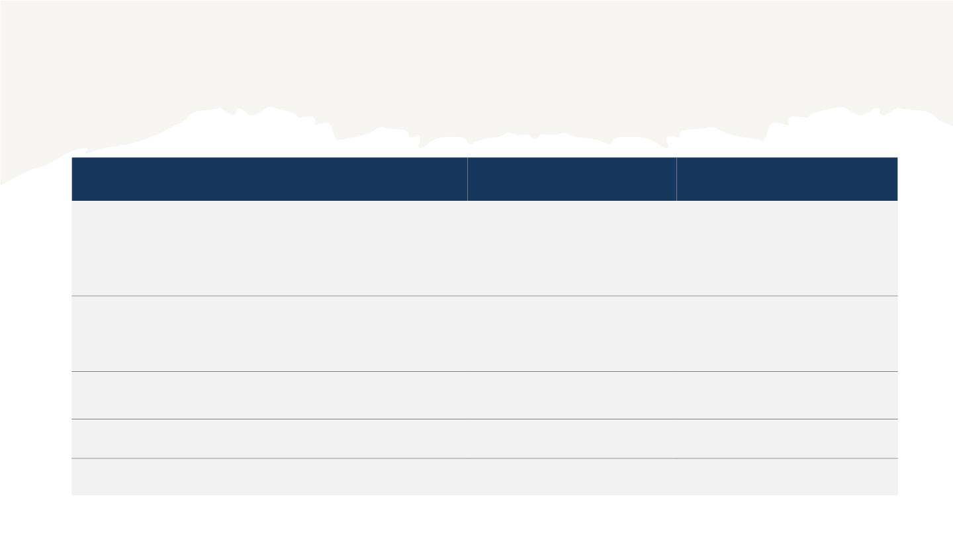
Stories completed
NAME
STATUS
DATE
As a User,
Done
4/28/2023
I want to submit my X-ray reports in the application for
evaluation to predict the covid-19.
As a User,
Done
4/28/2023
I want to discuss my/other health condition via chatbot
MVP
Done
Done
Done
4/25/2023
4/30/2023
5/2/2023
Deployment
Draft Technicalpaper
32

Slide 33

Name
status
Date
As a user , I need suggestions to choose required drug to cure myself so
that I can cure my self
To-DO TBD
To-DO TBD
To-DO TBD
To-DO TBD
To-DO TBD
To-DO TBD
Stories not
completed
As a user, I can able to check my symptoms by providing inputs so that I
can be sure of my health
As a user , I need personal treatment recomandations so that I stable
my health condition
As a user, I can able to fetch infected area's details so that I can avoid
commuting that area
As a user, I can send voice messages to explain my health situation so
that it could be easy to explain
As a doctor/admin , I can able to listen the voice messages sent by the
user so that I can easily understand user problem
33

Slide 34
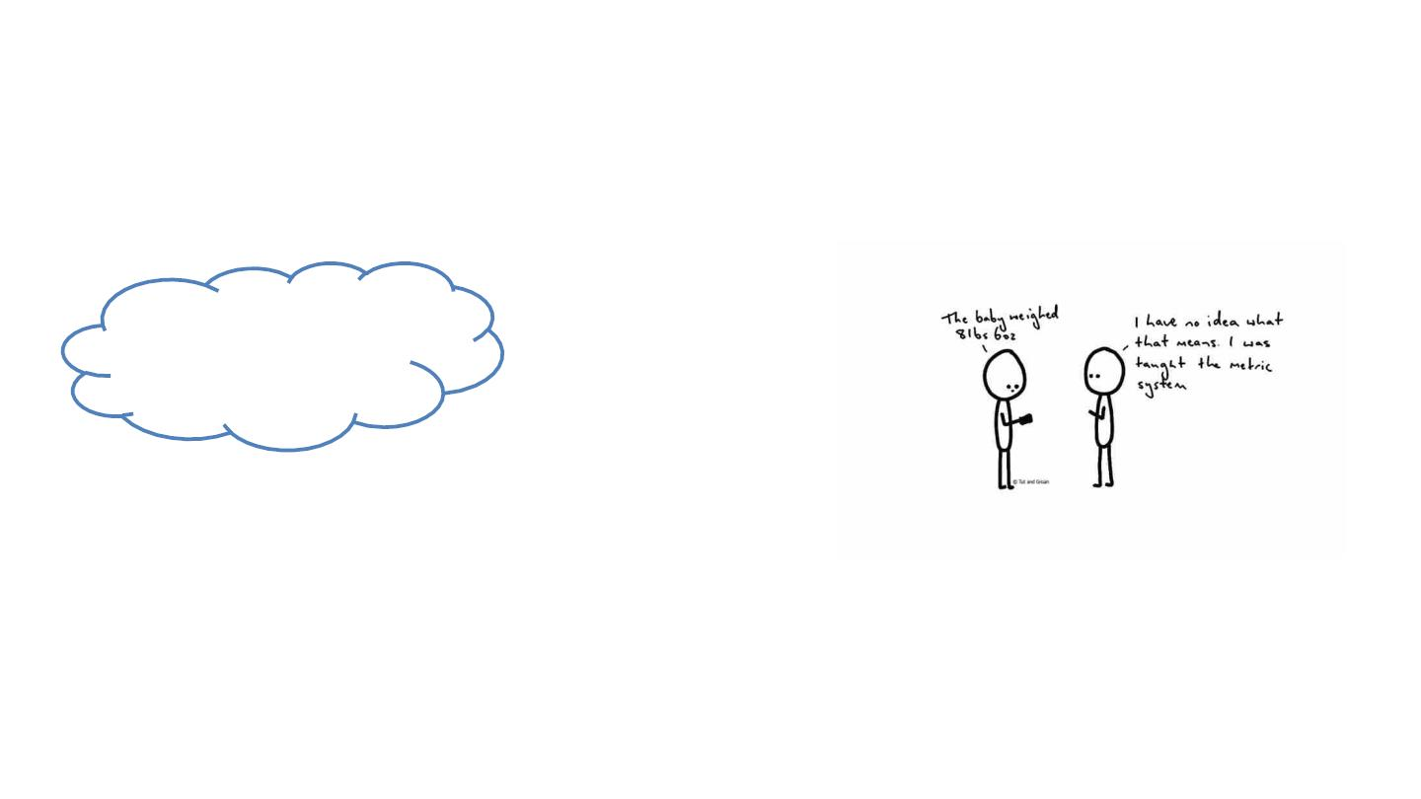
Metrics
34

Slide 35
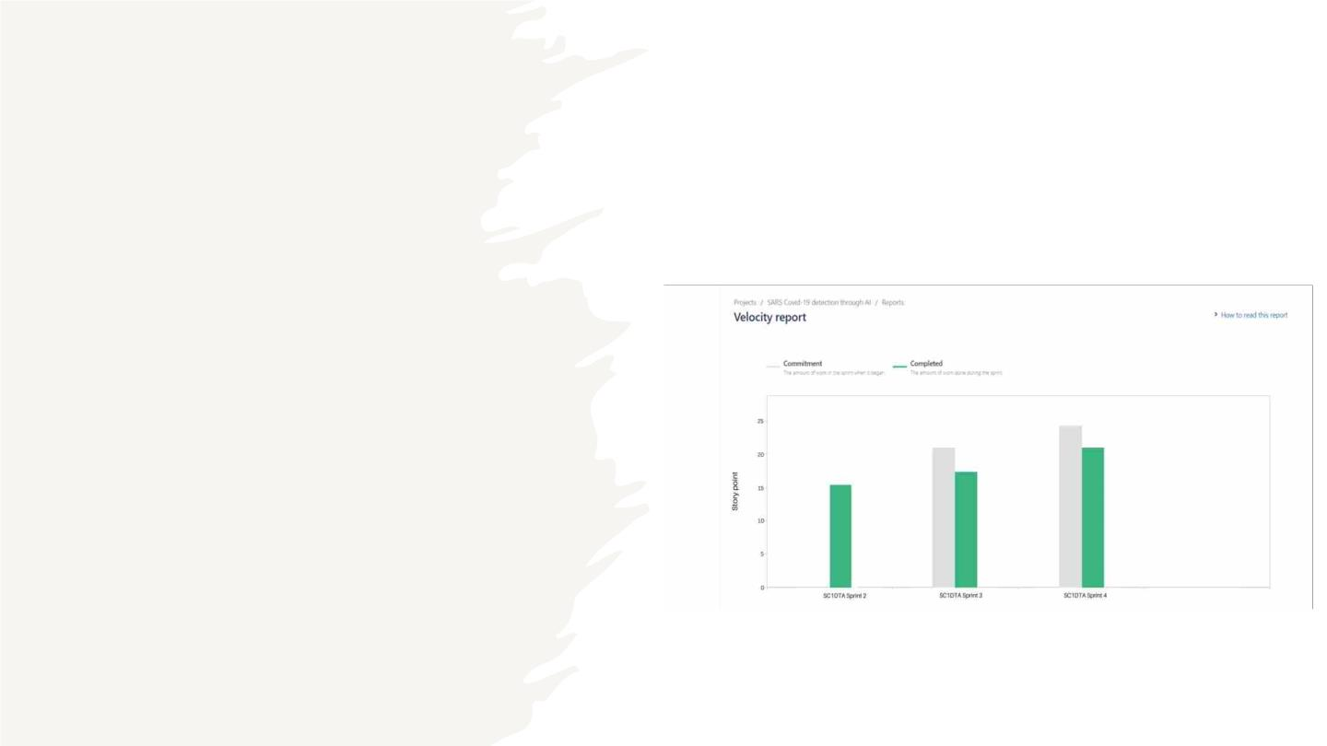
Team velocity - this sprint
35

Slide 36
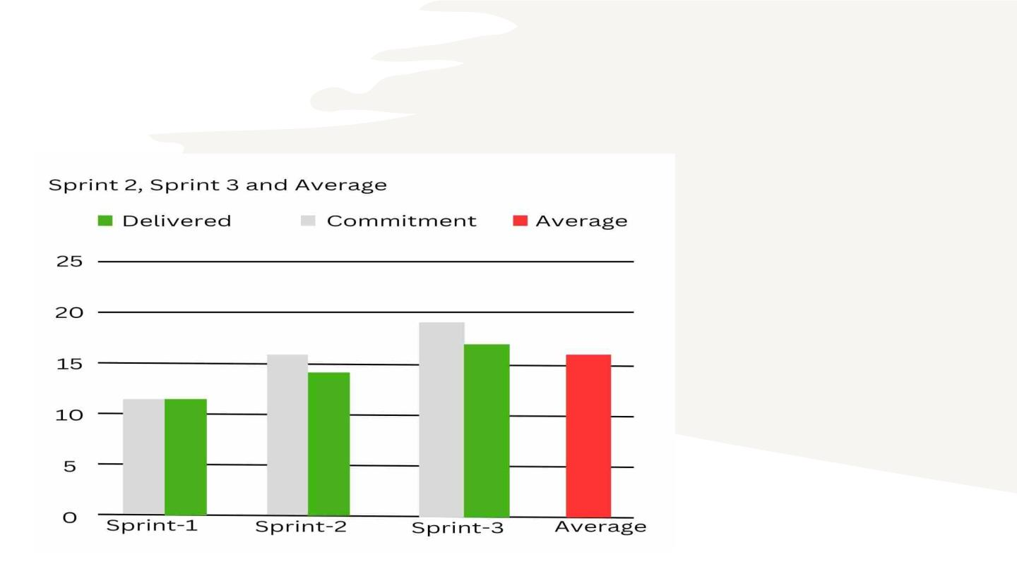
Team's historical velocity (average)
36

Slide 37
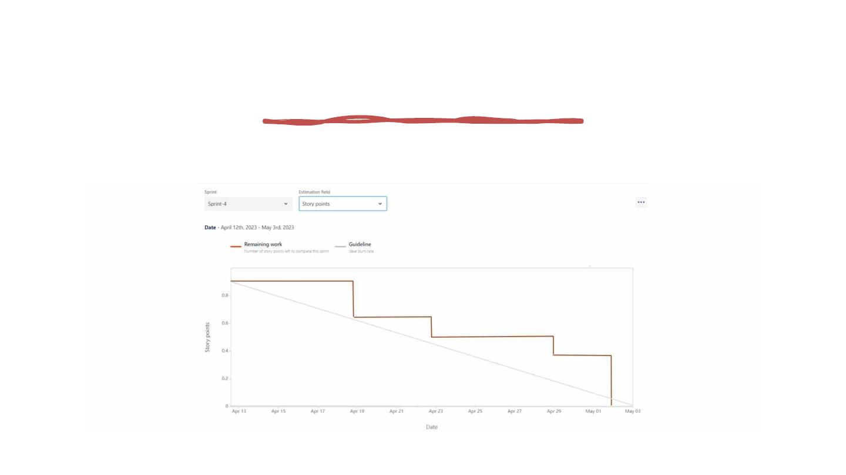
Burndown Charts
37

Slide 38

v The completion ratio of a story refers to
the percentage of stories delivered in a
sprint that meet the initial commitment.
v If our team commits to completing 30
user stories in a sprint and successfully
delivers 25 of them, then our story
completion ratio would be 90%.
Completed/Committed
Ratio
v Story completion ratio is calculated as
(total number of delivered stories / total
number of committed stories) x 100.
38

Slide 39

Retrospective
39

Slide 40

WHAT WENT WELL
WHAT CAN BE IMPROVED
This time we add more features to
our deliverable and it works
correctly. Our team endeavor was
successful overall, and good
communication was crucial to that
accomplishment. Throughout the
development process
We want to correct our
mistakes based on
professor’s feedback.
Coordination should be
improved in between team
members.
Need to discuss more
about project ideas in the
meetings.
Retrospective
WHAT ACTION WE TAKE TO
IMPROVE
Need to make communication open and
transparent. Need to conduct more
meetings. And will discuss more about
project ideas so that we can develop our
application more better.
40

Slide 41
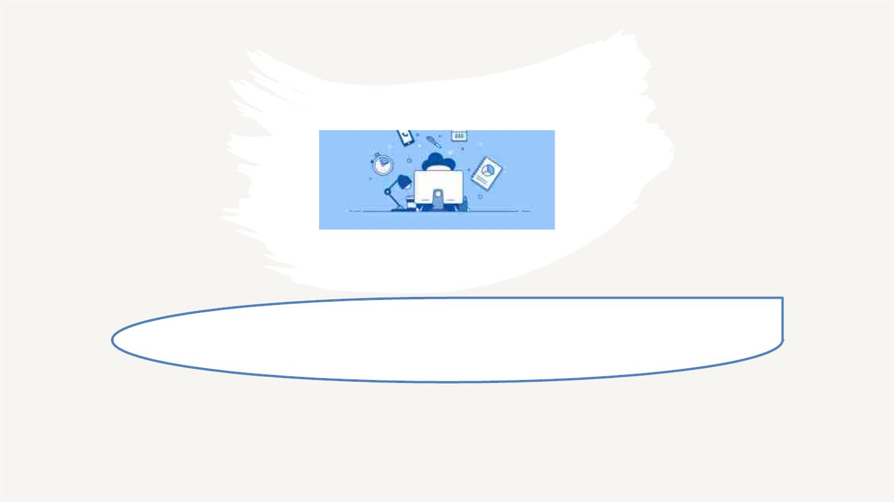
Sprint-5
41

Slide 42

Story Point
Estimate
Issue
Type
Name
Status
Story
As an user, I want to order medications
for COVID-19 include antiviral drugs.
which can help reduce inflammation in
the lungs
To Do
3
Story
As an user, I want to get Facilities for that To Do
are equipped with the necessary medical
supplies and equipment to manage
4
Stories planned
and committed for
Sprint 5
pAas tai ennut ss ewr ,i tIhwCaOnVt ItDo-r1e9c e i v e a report
indicating whether they have tested
positive or negative for the virus.
Story
Story
Story
To Do
To Do
3
4
5
As an user, I want to do regular checkup
Checklist, So that I can get the graphical
analysis on my health reports.
As a user, I want to know my health status To Do
through the collection and interpretation
of health data by monitoring and analysis
of my reports.
42

Slide 43
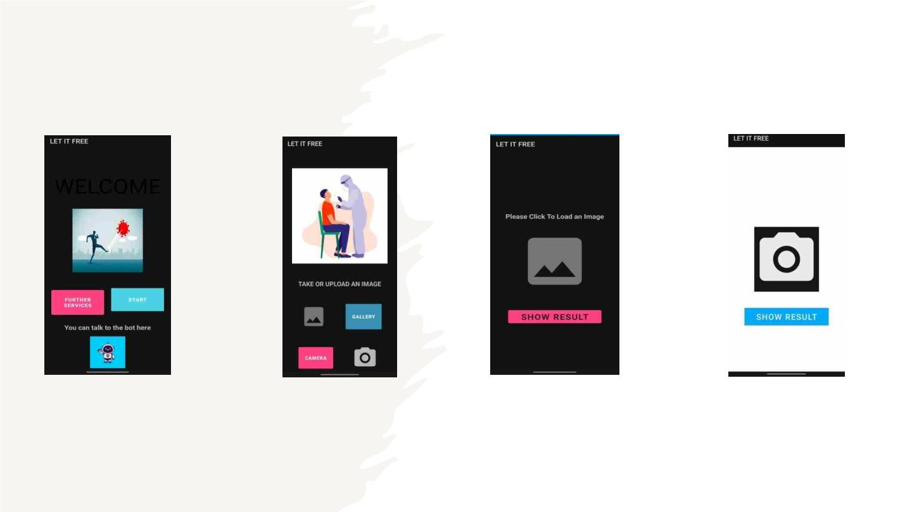
Slides of app screenshot
43

Slide 44
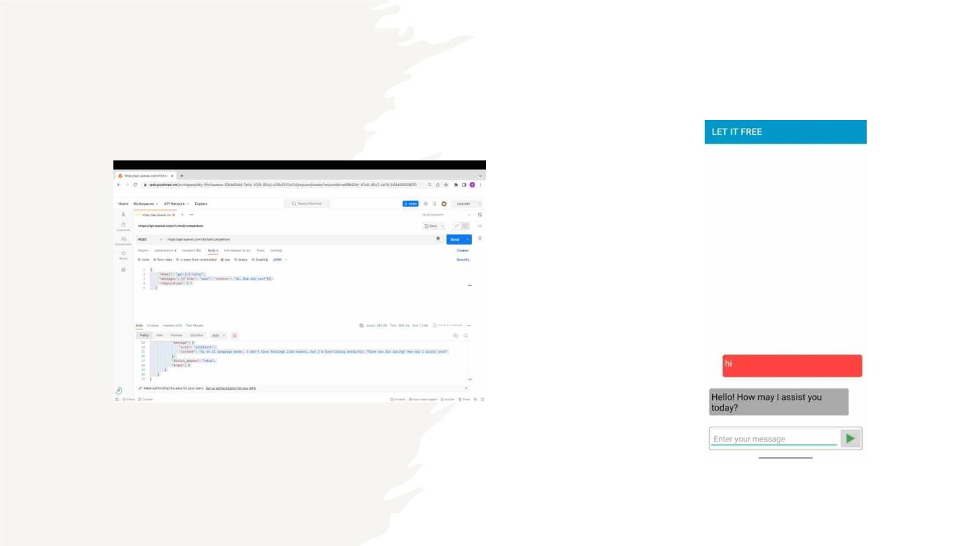
SLIDES FOR API
44

Slide 45

GitHub Link
https://github.com/htmw/2023S-Team4
LET IT FREE TECHNICAL PAPER
Technical paper Link
API Document
Deployment manual
45

Slide 46

Live Application
Demo
46

Slide 47

Live Application Demo
47

Slide 48

48

