Slide 1

VaycayNation: Driving Website Traffic Through Second-Screen Analytics
Marketing Analytics Case Study
Haniyah Saleem

Slide 2


VaycayNation: The Opportunity
German Travel Start-Up Since 2016
Rapid growth challenged by visibility gap
Only 10% brand awareness among customers
90% consideration rate amongst aware customers
TV advertising drives 40% of first-time visits
Awareness bottleneck represents massive untapped potential

Slide 3

Why Change Was Essential
Previous Strategy
Results
Intuition-based TV campaigns
Many adverts produced zero measurable impact
Inconsistent, untested adverts
Previous CMO dismissed
New Approach
"No data, no money!"
Analytics-driven decision making

Slide 4
Data Preparation & Processing Workflow
Data Cleaning & Validation
Data Transformation
Feature Engineering
Removed duplicates, standardised fields, verified lift calculations
Converted date-time formats, extracted Day of Week
Created Prime Time variable (20:00–22:00), encoded dummy variables
Exploratory Data Structuring
Final Analysis-Ready Dataset
Built pivot tables across genre, channel, day of week, creative spot
Exported clean dataset ready for ANOVA and regression analysis

Slide 5
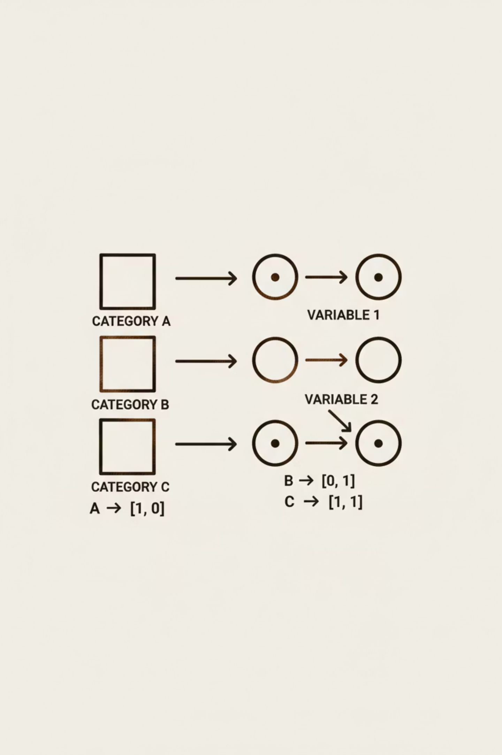
Dummy Variable Creation for Regression
Creative Spot Dummies
7 dummy variables (SpotD_1 to SpotD_7)
One spot excluded as reference category
Channel Dummies
4 dummy variables (ChannelD_1 to ChannelD_4)
Includes Kabel1, RTL, VOX with base category
Genre Dummies
20 dummy variables (GenreD_1 to GenreD_20)
Adventure, Basketball, Cartoon, Documentary, Family, News, Politics, Romance, Thriller, Soap, Sitcom, Travel, etc.
Day of Week Coding
Numeric values: Fri=1, Mon=2, Sat=3, Sun=4, Thu=5, Tue=6, Wed=7

Slide 6
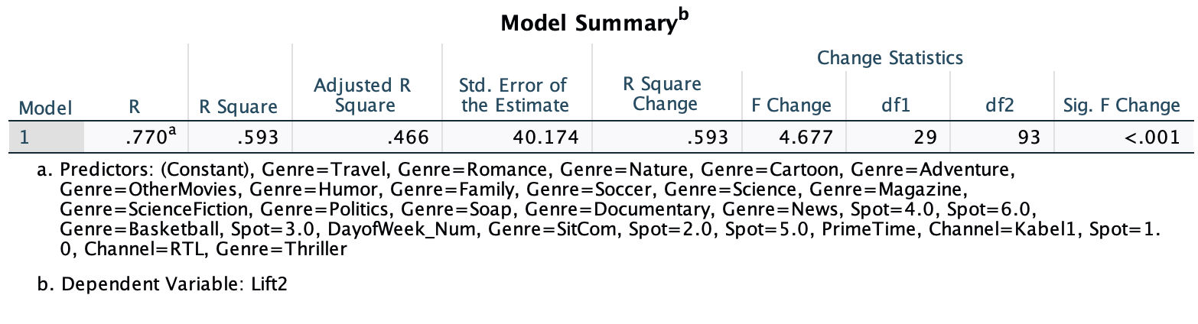
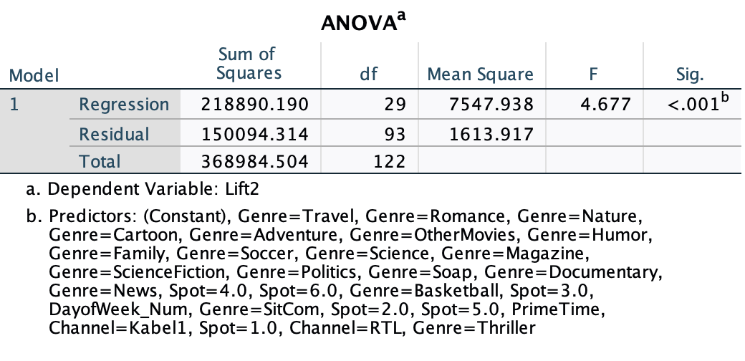
Regression Analysis
R = .770, R² = .593, Adjusted R² = .466.
p < .001 → Model is statistically significant.
The model explains ~59% of the variation in incremental visits.

Slide 7
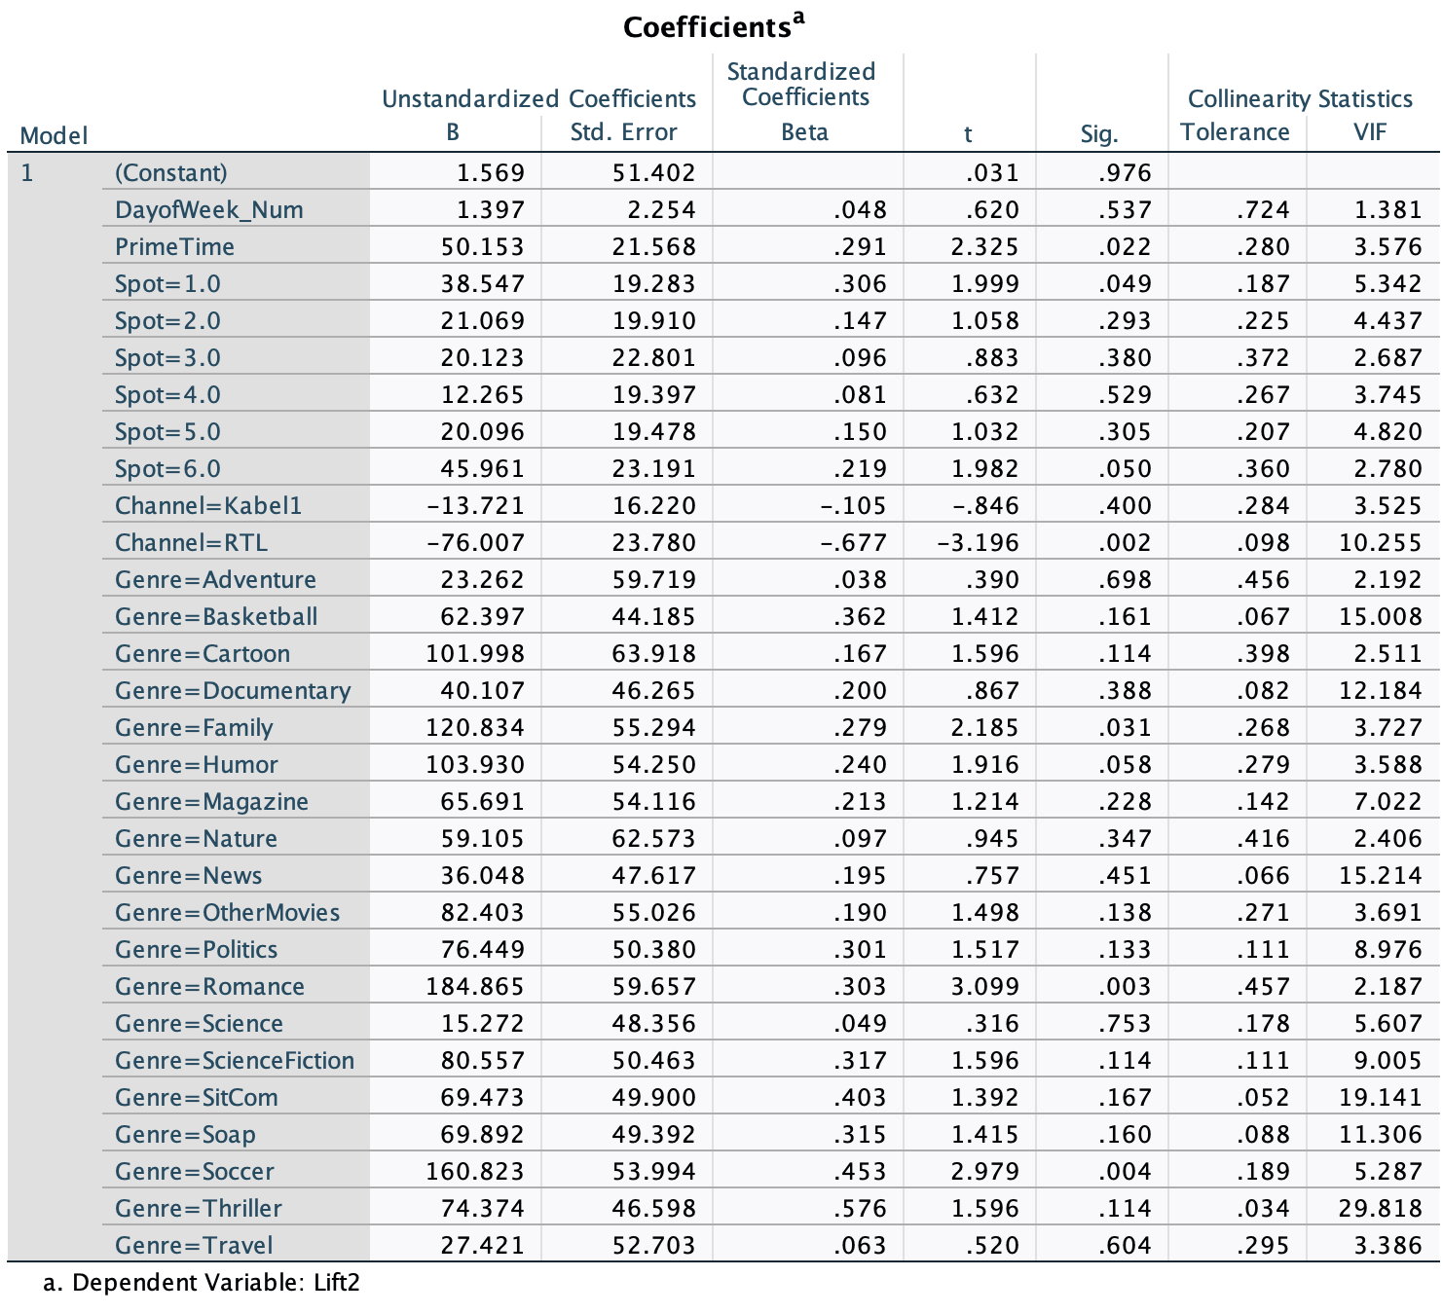
Regression Analysis
Prime Time (20–22h) → +50 visits, p = .022
Spot 1 → +38 visits, p = .049, Spot 6 → +46 visits, p = .050.
These two creatives significantly outperform Spot 7 (weakest).
RTL → –76 visits, p = .002 - significantly reduces website visits.
Romance programs → +185 visits, p = .003,
Family programs → +121 visits, p = .031.
These genres strongly increase lift.

Slide 8
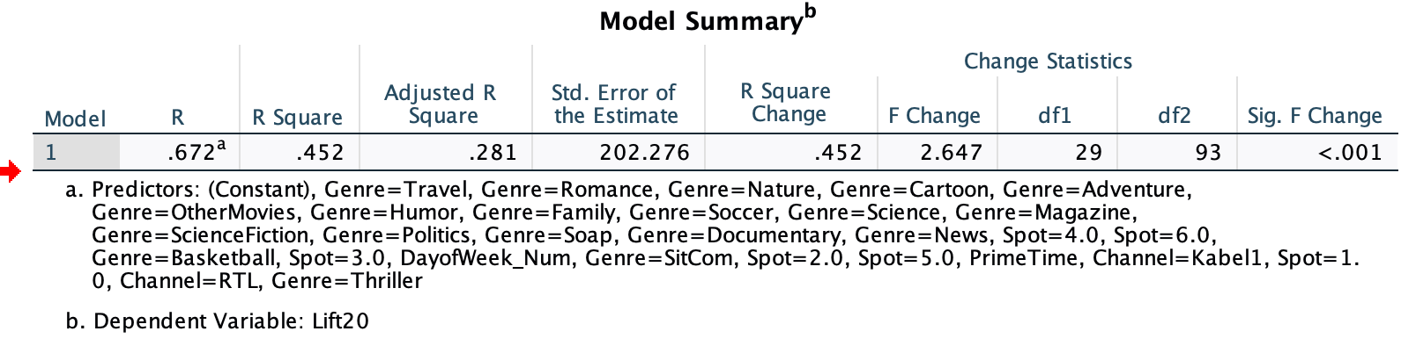
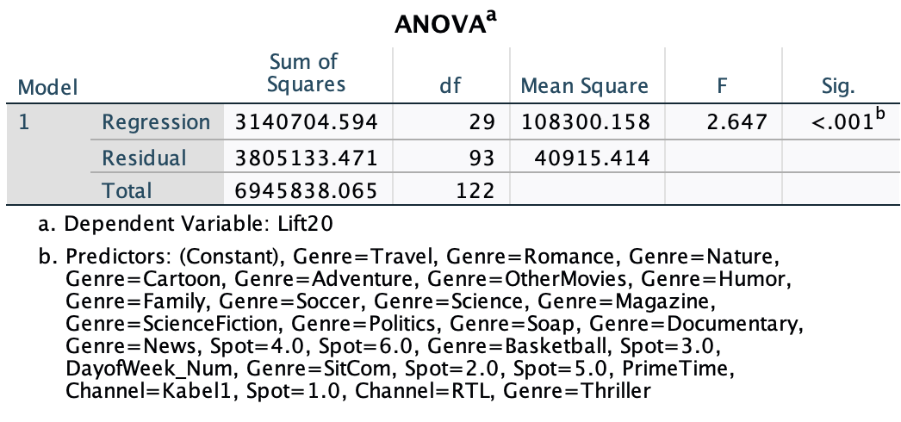
Regression Analysis
R = .672, R² = .452, Adjusted R² = .281.
(F = 2.65, p < .001) → Model is statistically significant.
The model explains ~45% of the variation in incremental visits.

Slide 9
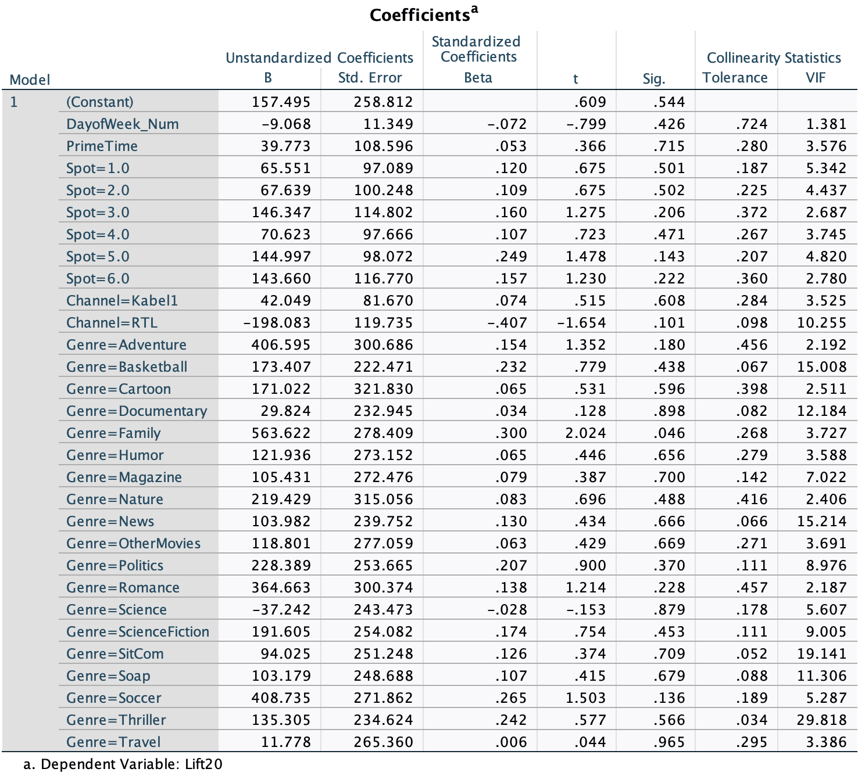
Regression Analysis
None of the spots significantly outperform Spot 7.
Creative has minimal impact on Lift20.
Prime Time and Day of week – no effect.
RTL underperforms, but not statistically reliable.
Family content → +564 visits (p = .046).
Managers should not rely on Lift20 alone for optimization,
Lift2 is more stable and meaningful.

Slide 10
Dataset Overview
1
2
Time Period
Ad Airings
22 December 2017 – 25 January 2018
123 total broadcasts analysed
3
4
Creative Variants
Key Variables
7 different advert executions (Spot 1–7)
Channel placement
Position in commercial break
Programme genre
Website visits before/after

Slide 11

Measuring Incremental Lift
Methodology
Incremental lift = Visits (after) − Visits (before)
Primary Window
Robustness Check
2-minute measurement window
20-minute measurement window
Standard approach for immediate impact
Captures sustained interest
This isolates advert-caused traffic from natural variation

Slide 12
Overall Performance
68.7
123
7
Average Incremental Visits
Total Airings
Creative Variants
Per advert airing across all 123 broadcasts
Analysed across five-week period
Different advert executions tested
High variation between spots reveals content quality matters enormously

Slide 13
Day of the week Ranking
Mean Incremental Lift by Day of Week
For Lift2: Saturday and Sunday followed by Wednesday.
For lift20: Sat and Friday followed by Monday.

Slide 14
Spot Ranking
Mean Incremental Lift 2 and Lift20 by Spot​
For Lift2: Spot 6 outperforms.
Average = 70.5​.
Action: Spot 7 requires redesign or removal
For lift20: Spot 5 outperforms (382.65).
Average : 289.82​
Action : Spot 7​ requires redesign or removal
.

Slide 15





What Drives Performance Variation?
Channel Selection
Content Quality
Audience engagement levels
Creative execution and messaging
Timing
Time of day and day of week
Programme Genre
Context and viewer mindset
Position
Placement within commercial break

Slide 16
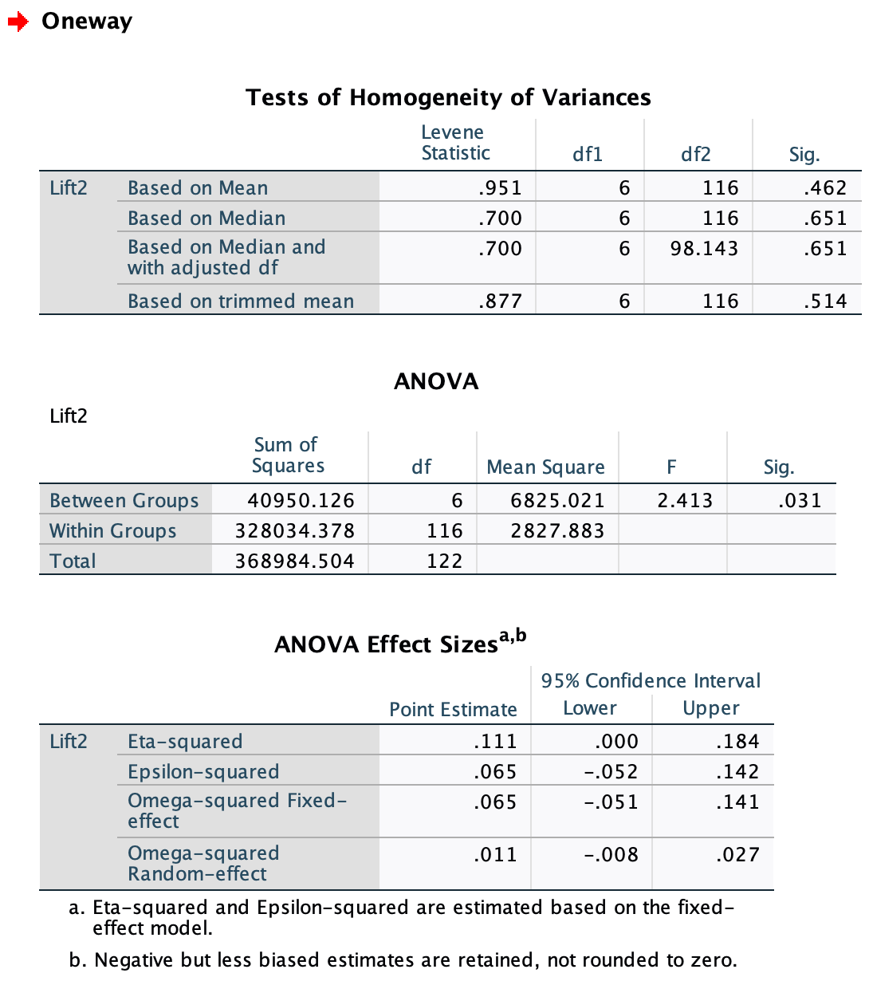
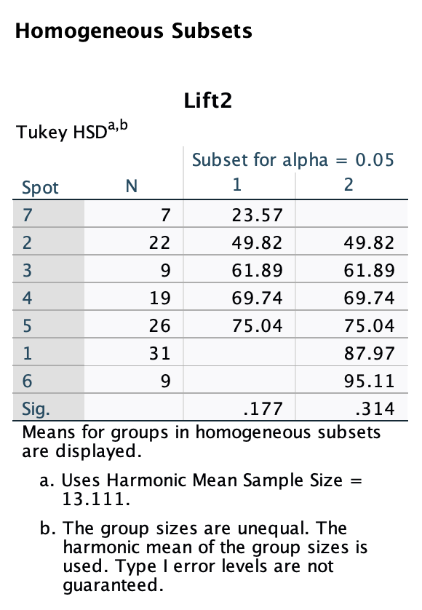
ANOVA Summary – Spot Lift2
Main Findings for Spot Analysis
ANOVA Sig = 0.031.
Statistically significant differences exist among the 7 spots.
F(6,116) = 2.41, p = .031.
At least one spot performs differently from the others.
Eta² = 0.111 (≈ 11%) - Small-to-moderate effect size.
Spot 7 forms its own low-performing group.
Spots 1 and 6 appear only in the high-performing subset.
KEY FINDING: Spot performance varies, with Spots 1 and 6 highest and Spot 7 lowest.
NOTE: Statistical significance was defined as a p-value of less than 0.05 (Infanger & Schmidt, 2019; Shreffler & Huecker, 2023).
Notes:
Slide 1 — Overall Statistical Findings
Variances are equal across spots (Levene’s p = .462) → ANOVA assumptions met.
Lift2 differs significantly across the 7 creative spots (F(6,116)=2.41, p = .031).
Effect size is small–moderate (η² = 0.111), meaning creative matters but is not the only driver.
Slide 2 — Performance Pattern (Practical Insights)
Spot 7 is clearly the lowest-performing spot.
Spots 1 and 6 show the strongest Lift2 performance.
Other spots (2–5) fall in the middle range with no clear statistical separation.
Tukey tests show no significant pairwise differences, but means indicate a top group vs. bottom group pattern.

Slide 17

ANOVA Summary – Spot Lift20
Main Findings for Spot Analysis
Variances are equal across spots (Levene’s p > .05).
ANOVA shows a significant spot effect on Lift20: F(6,116) = 2.60, p = .021.
Spot explains ~12% of Lift20 variance (η² = .119), a small-to-moderate effect.
Only one significant pairwise difference in post-hoc tests.
Spot 5 produces significantly higher Lift20 than Spot 7 (~260 more visits; p = .036).
All other spot comparisons are not significant.
KEY FINDING: Spot 5 is the only identified high performer vs. Spot 7, which is the clear low performer in sustained lift.
Notes:
Slide 1 — Overall Statistical Findings
Variances are equal across spots (Levene’s p = .462) → ANOVA assumptions met.
Lift2 differs significantly across the 7 creative spots (F(6,116)=2.41, p = .031).
Effect size is small–moderate (η² = 0.111), meaning creative matters but is not the only driver.
Slide 2 — Performance Pattern (Practical Insights)
Spot 7 is clearly the lowest-performing spot.
Spots 1 and 6 show the strongest Lift2 performance.
Other spots (2–5) fall in the middle range with no clear statistical separation.
Tukey tests show no significant pairwise differences, but means indicate a top group vs. bottom group pattern.

Slide 18
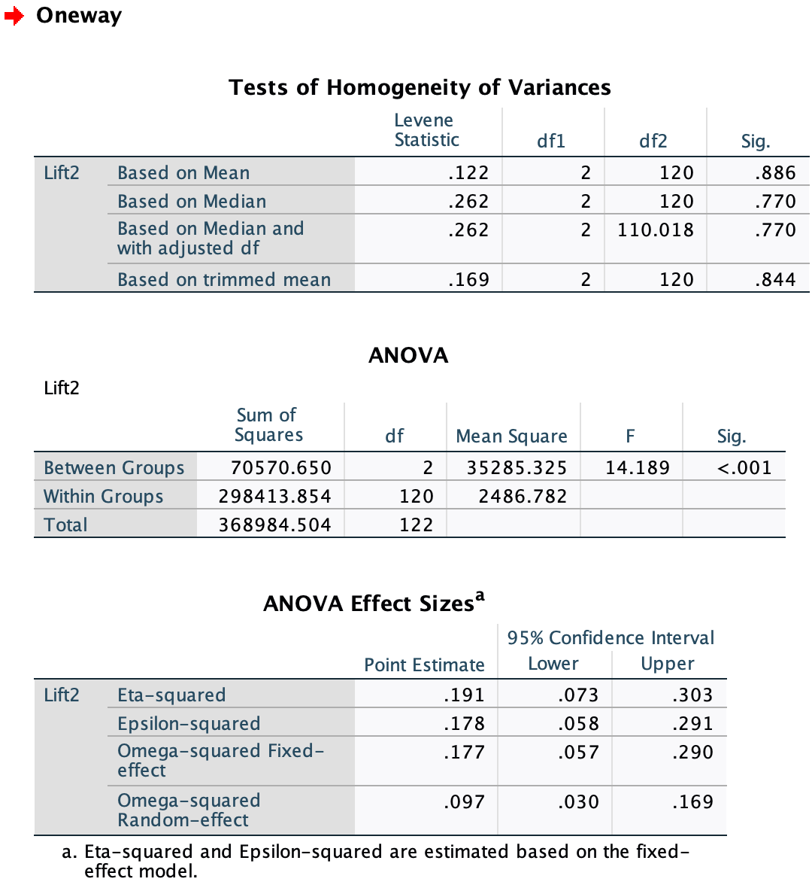
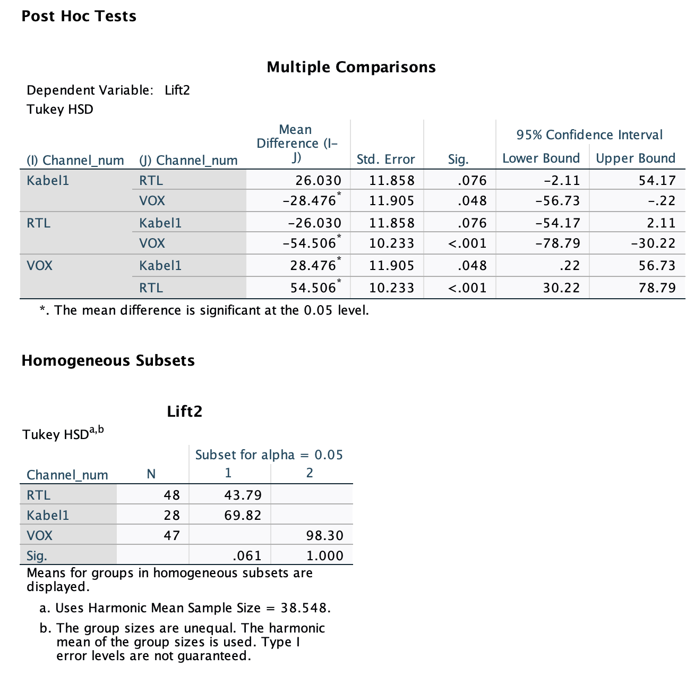
ANOVA Summary – Channel Lift2
Main Findings for Channel Analysis
Variances are equal across channels (Levene’s p = .886)
Strong ANOVA effect: F(2,120) = 14.19, p < .001.
Channel has a higher and meaningful impact on Lift2
(η² = .191 ≈ 19%).
VOX is the highest-performing channel
RTL is the lowest-performing channel.
Kabel1 performs moderately better.
KEY FINDING: VOX delivers the highest Lift2, outperforming Kabel1 and RTL.

Slide 19
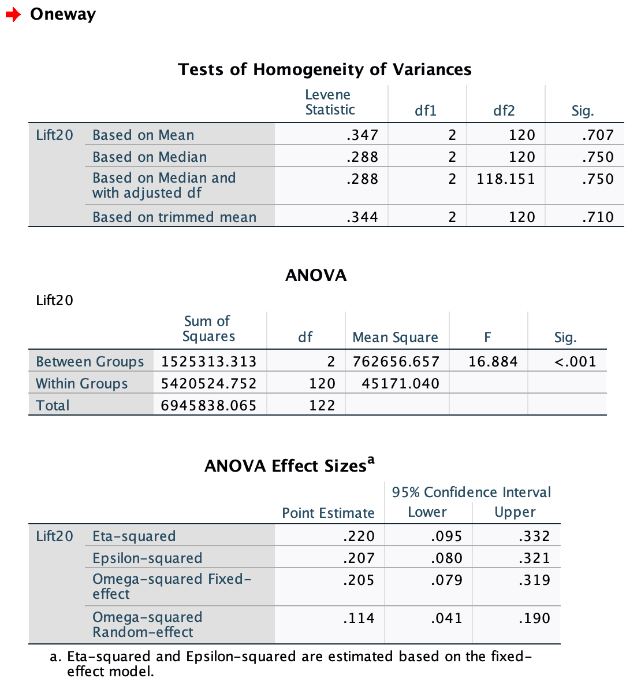
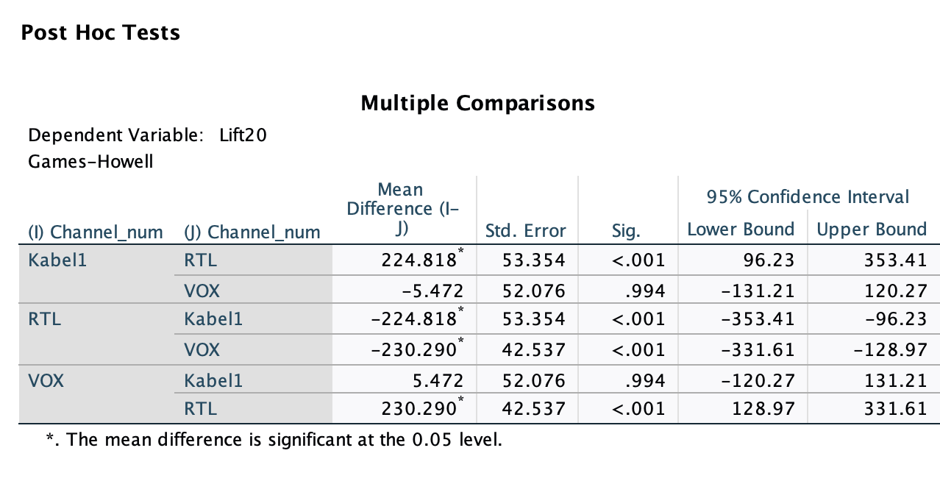
ANOVA Summary – Channel Lift20
Main Findings for Channel Analysis
Variances are equal across channels (Levene’s p > .70).
Strong ANOVA effect: F(2,120) = 16.88, p < .001.
Channel explains 22% of the variation in Lift20 (η² = .22),
a moderate-to-large effect.
Channel placement influences sustained website lift.
RTL is the lowest-performing channel.
Kabel1 and VOX do not differ from each other.
KEY FINDING: RTL underperforms, while Kabel1 and VOX deliver strong, similar long-term lift.

Slide 20
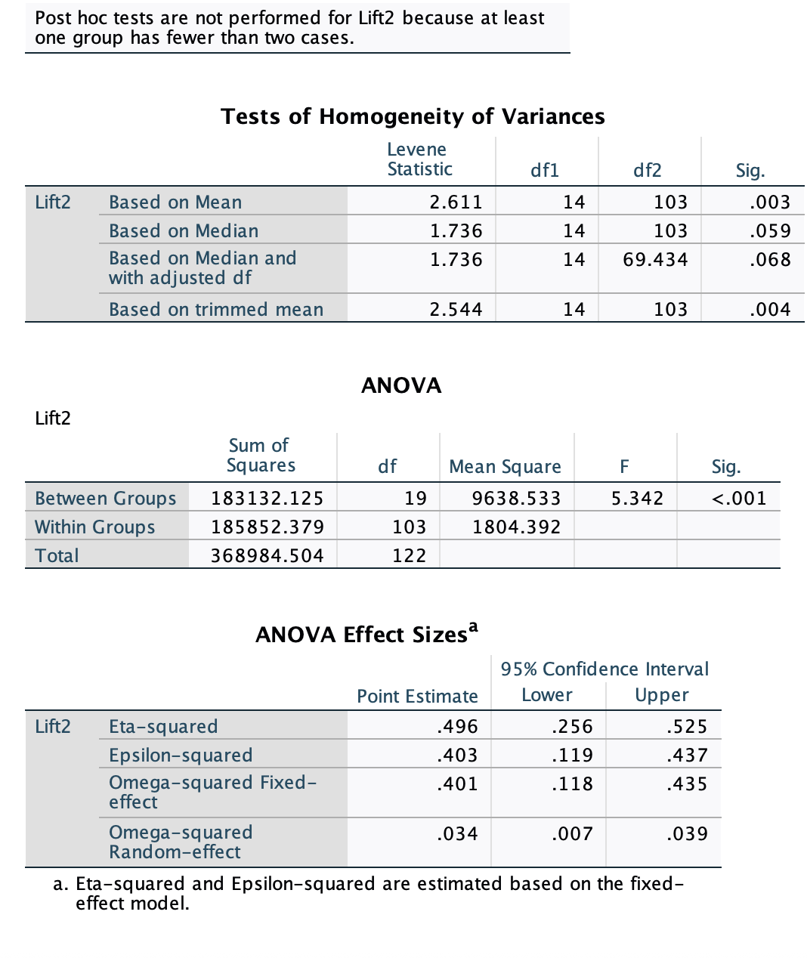
ANOVA Summary – Genre Lift2
Main Findings for Genre Analysis
Strong ANOVA effect: F(19,103) = 5.34, p < .001.
Very large effect size: η² = 0.496 (~50%).
Genre explains far more variance than channel (~19%) or creative (~11%).
Post-hoc tests were not performed because at least one genre group
had fewer than 2 cases.
Genre accounts for half of all lift variation, indicating that context of programming
strongly influences response.
KEY FINDING: Genre drives the largest differences in Lift2 across all factors analyzed.
Notes:
Slide 1 — Overall Statistical Findings
Variances are equal across spots (Levene’s p = .462) → ANOVA assumptions met.
Lift2 differs significantly across the 7 creative spots (F(6,116)=2.41, p = .031).
Effect size is small–moderate (η² = 0.111), meaning creative matters but is not the only driver.
Slide 2 — Performance Pattern (Practical Insights)
Spot 7 is clearly the lowest-performing spot.
Spots 1 and 6 show the strongest Lift2 performance.
Other spots (2–5) fall in the middle range with no clear statistical separation.
Tukey tests show no significant pairwise differences, but means indicate a top group vs. bottom group pattern.

Slide 21
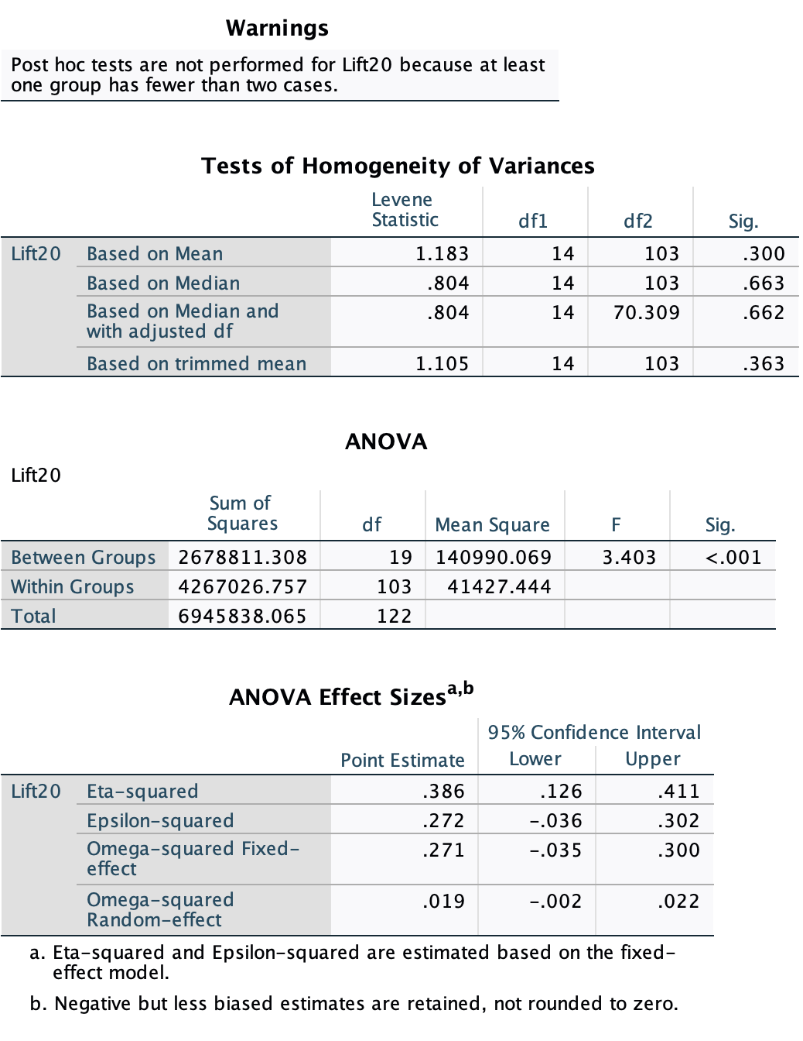
ANOVA Summary – Genre Lift20
Main Findings for Genre Analysis
Strong ANOVA effect: Lift20: F(19,103) = 3.40, p < .001.
Genre explains ~39% of the variance in Lift20 (η² = .386), a large effect.
Genre remains a powerful contextual factor shaping 20-minute sustained website lift.
Post-hoc tests were not performed because at least one genre group
had fewer than 2 cases.
Genre is one of the strongest long-term drivers, exceeding the influence
of individual spots and channels.
KEY FINDING: Genre has a strong impact on Lift20, explaining nearly 40% of sustained website lift differences across programs.
Notes:
Slide 1 — Overall Statistical Findings
Variances are equal across spots (Levene’s p = .462) → ANOVA assumptions met.
Lift2 differs significantly across the 7 creative spots (F(6,116)=2.41, p = .031).
Effect size is small–moderate (η² = 0.111), meaning creative matters but is not the only driver.
Slide 2 — Performance Pattern (Practical Insights)
Spot 7 is clearly the lowest-performing spot.
Spots 1 and 6 show the strongest Lift2 performance.
Other spots (2–5) fall in the middle range with no clear statistical separation.
Tukey tests show no significant pairwise differences, but means indicate a top group vs. bottom group pattern.

Slide 22



Key ANOVA Insights
Genre is the strongest driver of website lift
Genre explains ~50% of Lift2 and ~39% of Lift20 → by far the largest effect.
The context of the program matters more than the ad creative or channel.
Channel has a meaningful, medium-size impact
VOX performs highest for Lift2; RTL performs lowest across both Lift2 and Lift20.
For Lift20, Kabel1 and VOX perform similarly and both outperform RTL substantially.
Creative spot matters, but much less
Lift2: Spot 1 & 6 highest; Spot 7 lowest.
Lift20: Only significant difference is Spot 5 > Spot 7; all others behave similarly.
Program genre is the biggest driver of website lift, channel matters strongly,
and creative spot has a smaller but still measurable impact—RTL underperforms while VOX and Spot 5/1/6 deliver stronger results.

Slide 23



Managerial Implications
Which Spot Performs Best?
Creative vs. Placement & Timing
Spot 6 is the strongest performer.
Spot 1 also performs well.
Spot 7 is the weakest.
Genre is the biggest driver of lift.
Channel matters more strongly than creative spots.
Prime time adds +50 visits.
Timing Effects
Prime time (20–22h): +50 immediate visits, significant.
Best days: Friday–Sunday (high usage, operational insight).

Slide 24

Summer Campaign Recommendations
01
02
Deploy Best-Performing Creative
Optimise Broadcast Timing
Use Spot 6 as primary execution (95.11 average lift)
Focus on prime time (20:00–22:00) and high-usage days (Fri–Sun)
03
04
Select High-Engagement Channels
Secure Favourable Ad Positions
Prioritize VOX and Kabel1 with strong-performing genres: Romance, Family, Soccer etc.
Target early to middle positions within commercial breaks.

Slide 25


Projected Campaign Impact
Website Traffic Lift
Revenue Projection
Based on 120 incremental visits:
Purchase rate: 12%
Expected purchases: 14
95
Basket value: €450
€6,300
Spot 6 baseline lift
Revenue per optimised airing
26%
Prime time multiplier effect
Expected optimised lift: 110–130+ visits per airing

Slide 26

Strategic Action Plan
1
2
3
Prioritise Spot 6
Refine Underperformers
Negotiate Premium Slots
Deploy as primary creative execution across all campaigns
Redesign or eliminate weak creatives, especially Spot 7
Secure prime-time placements on high-engagement channels
4
5
Focus Channel Strategy
Continuous Testing
Concentrate budget where historical engagement proved strongest
Implement ongoing A/B testing of creatives, placements, and timing
Analytical rigour transforms television advertising from expense to measurable investment

Slide 27
References:
Infanger D, Schmidt-Trucksäss A. P value functions: An underused method to present research results and to promote quantitative reasoning.
Stat Med. 2019 Sep 20;38(21):4189-4197.
Shreffler J, Huecker MR. Hypothesis Testing, P Values, Confidence Intervals, and Significance. [Updated 2023 Mar 13]. In: StatPearls [Internet].
Treasure Island (FL): StatPearls Publishing; 2025 Jan-. Available from: https://www.ncbi.nlm.nih.gov/books/NBK557421/

