Slide 1

DATA ANALYST INTERNSHIP
Sales Performance Dashboard
Task 4 • Interactive Business Dashboard
PREPARED BY:
HANIYA RAFEEQUE SIDDIQUI
Built with Tableau Public
Sales | Profit | Trends | Regions | Products

Slide 2
Dashboard at a Glance
Designed to turn sales data into quick business insights
01
KPI Overview
Sales • Profit • Quantity • Profit Margin
02
Trend Analysis
Sales performance across time
03
Business Breakdown
Category and regional comparison
04
Product Performance
Top 10 products by sales
05
Interactive Filters
Region • Category • Order Date

Slide 3
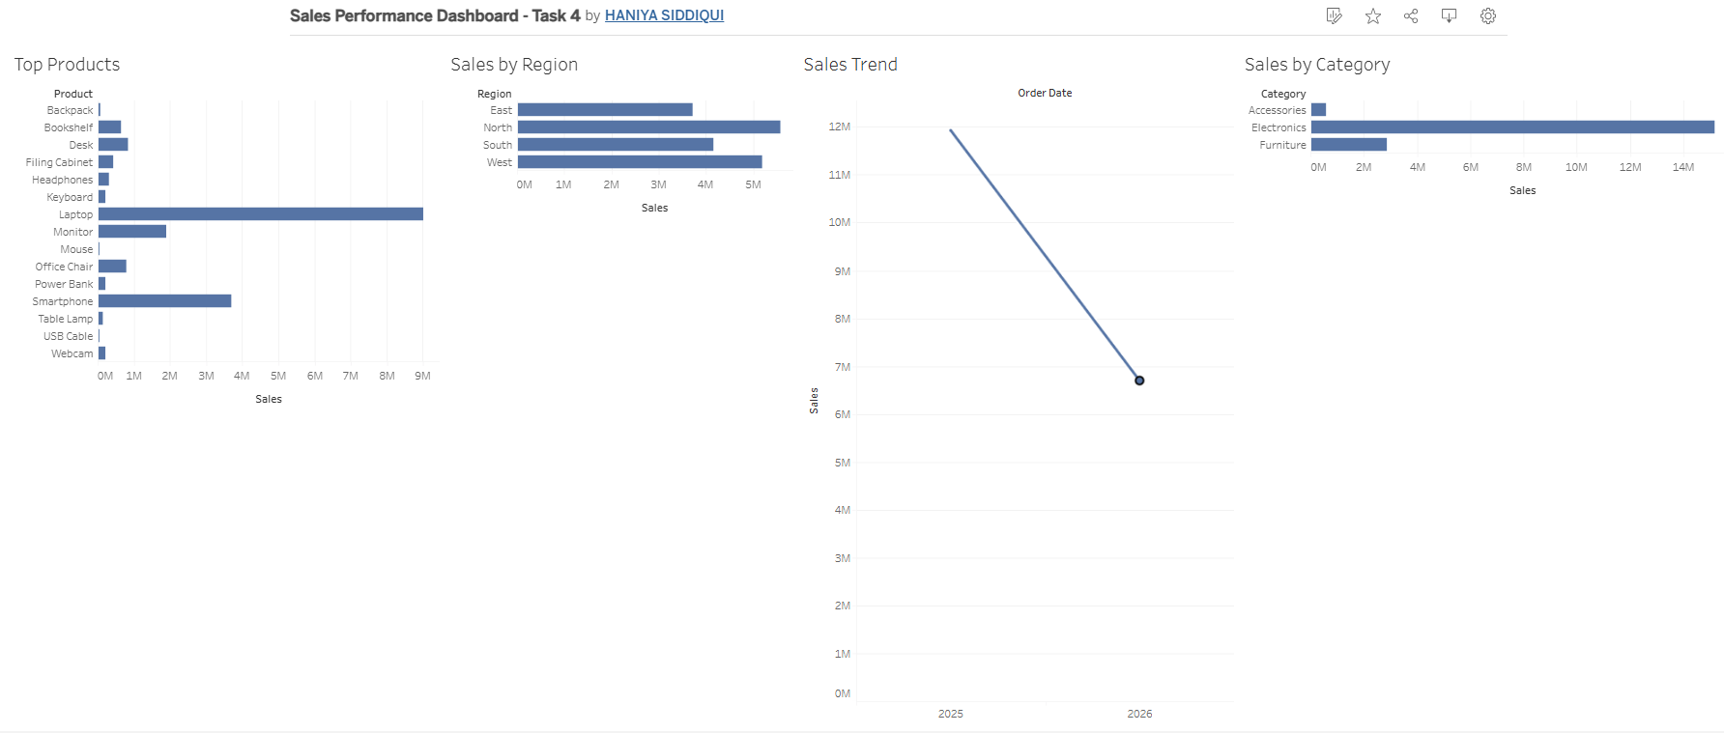
Interactive Dashboard
Tableau Public | Sales Performance Dashboard

Slide 4
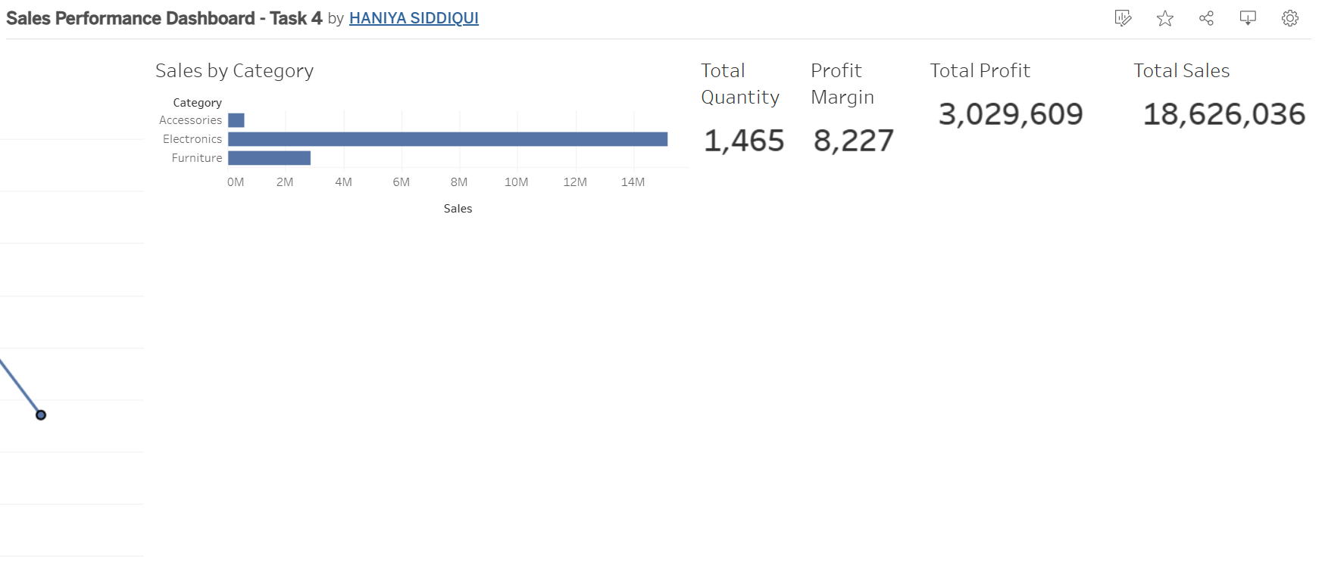
Interactive Dashboard
Tableau Public | Sales Performance Dashboard

Slide 5
Sales Performance Dashboard
Our interactive dashboard was created using Tableau Public to analyze:
📊 Sales & Profit Performance
📈 Sales Trends
🌍 Regional Performance
🏆 Top Products
🎛️ Interactive Filters
View the Live Dashboard: https://public.tableau.com/app/profile/haniya.siddiqui/viz/SalesPerformanceDashboard-Task4/Dashboard1#1
Tool Used: Tableau Public Dashboard Type: Interactive Business Dashboard

Slide 6
Business Insights & Conclusion
01
Quickly monitors overall sales and profitability.
02
Trend analysis helps identify changes in sales over time.
03
Category and region views highlight stronger-performing segments.
04
Top-product analysis shows major contributors to sales.
05
Interactive filters let stakeholders explore different views.
A simple interactive dashboard that supports faster, data-driven business decisions.

