Slide 1
Job submission using Slurm
Haniye Kashgarani
hkashgar@uwyo.edu

Slide 2
Topics
Slurm Workload Manager
Job submission on Teton
Other Slurm commands
Head node vs Compute nodes

Slide 3
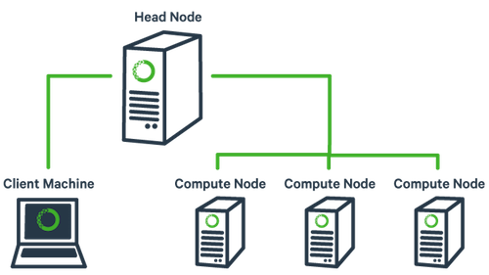
Head node vs Compute nodes
Typically when you access a cluster system you are accessing a head node.
Compute nodes are the nodes on which work runs. It performs the computational work in a cluster.
Since there may be many users simultaneously logged into cluster headnode, it's important not to run intensive tasks on the headnode. Such tasks should be performed on compute nodes.
Note: Never run a job directly on the head node!

Slide 4
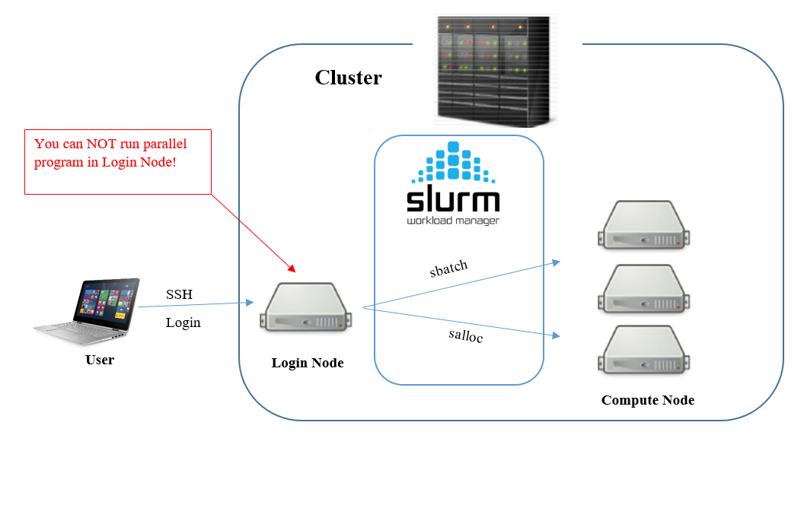
Slurm Workload Manager
Scheduler on ARCC: SLURM
Slurm is highly scalable cluster management and job scheduling system for large and small Linux clusters.
Slurm is a flexible and scalable scheduler that implements job scheduling, allocate desirable resources, and time to specific job.
Compute nodes
https://pdc-support.github.io/hpc-intro/09-scheduling/

Slide 5
Job Script
A job script is a text file containing job setup information for the batch system followed by commands to be executed.
It can be created using any text editor and may be given any name.
A job script is simply a shell script. It consists of SLURM directives, comments, and executable statements.

Slide 6
Slurm Job Script
#!/bin/bash
#SBATCH --chdir="/project/wystack-poptml/hkashgar/3-Slurm-materials/solver-and-instances"
#SBATCH --account=wystack-poptml
#SBATCH --time=0-01:00:00
#SBATCH --partition=teton
#SBATCH --job-name=instance1-%J
#SBATCH --output=./instance1-%J.out
#SBATCH --error=./instance1-%J.error
./abcdsat_r18 instances/instance-3.cnf

Slide 7
Slurm Commands
sinfo: reports the state of partitions and nodes managed by Slurm
sbatch: is used to submit a job script for later execution
sbatch submit_job
srun: is used to submit a job for execution or initiate job steps in real time
srun
squeue: reports the state of jobs or job steps.
sacct: is used to report job or job step accounting information about active or completed jobs.

Slide 8
Git repo
https://github.com/haniyeka/WyStack-materials

Slide 9
Additional Sources
https://slurm.schedmd.com/quickstart.html
https://slurm.schedmd.com/tutorials.html
https://hpc.iastate.edu/guides/introduction-to-hpc-clusters/slurm
https://ucdavis-bioinformatics-training.github.io/2017_2018-single-cell-RNA-sequencing-Workshop-UCD_UCB_UCSF/day1/cluster.html
https://www.osc.edu/supercomputing/batch-processing-at-osc/job-scripts
https://pdc-support.github.io/hpc-intro/09-scheduling/

