Slide 1
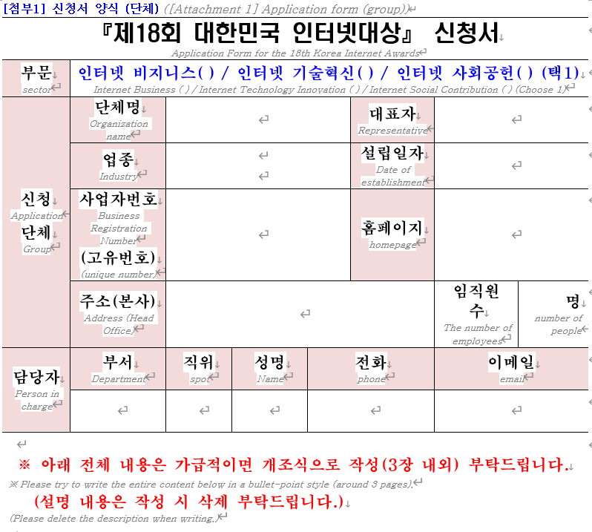
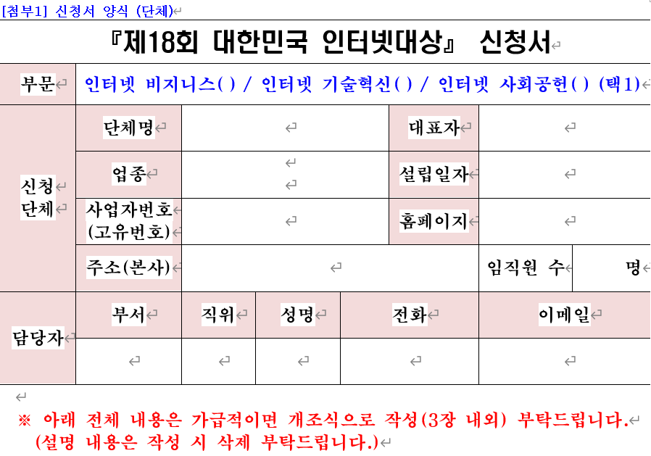

Korean Only
Korean(+English)
DocuBridge
input.docx
output.docx

