Slide 1

CDIO – Autumn 2015

Slide 2
Content
Project members
Project goals
System
Flow chart
OpenStreetMap
Features
Neural Network
Post processing
Result
Discussion
Questions

Slide 3







Project members

Slide 4
Project goal
Background
Vricon

Slide 5
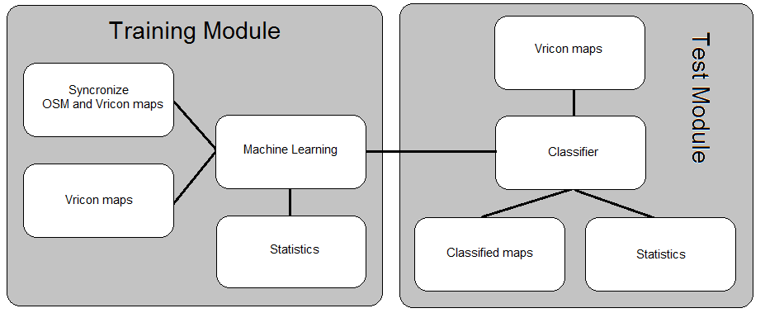
System – flow chart

Slide 6
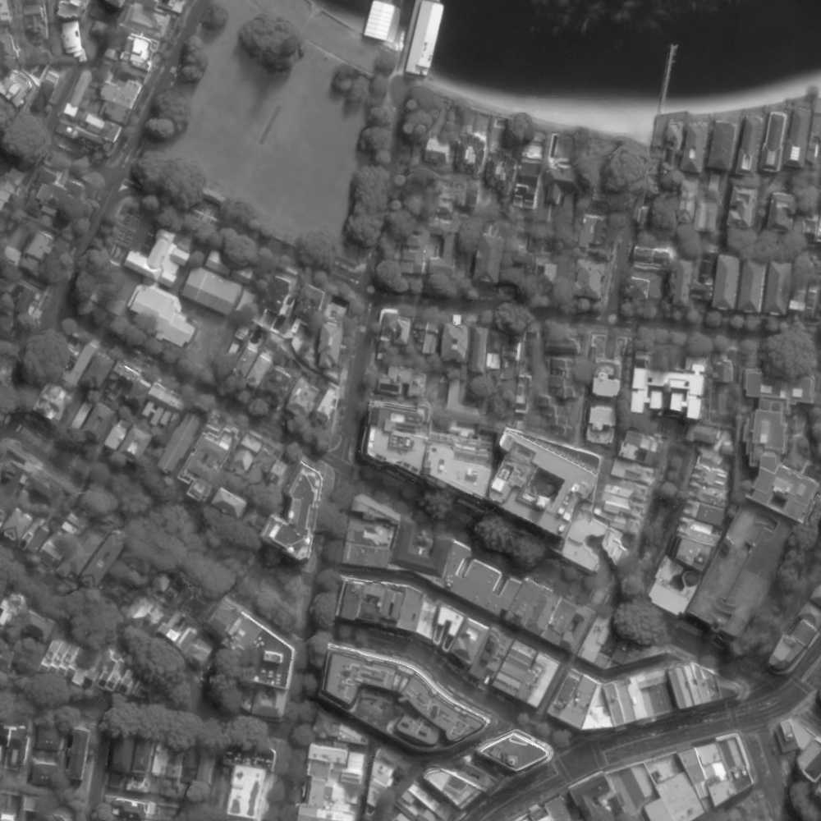
System - OpenStreetMap
Ground truth

Slide 7
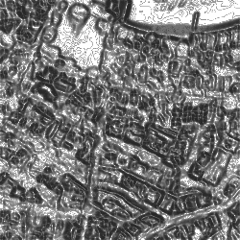
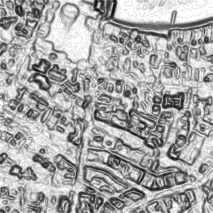
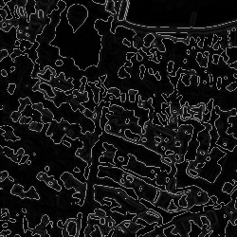
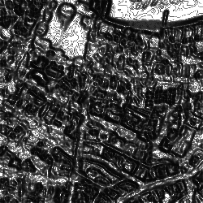
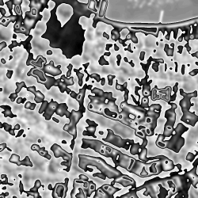
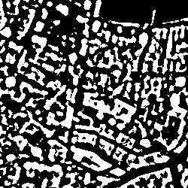
System - Features
Gray level co-occurrence matrix
Energy
Homogeneity
Dissimilarity
ASM
Mean value
Height map

Slide 8
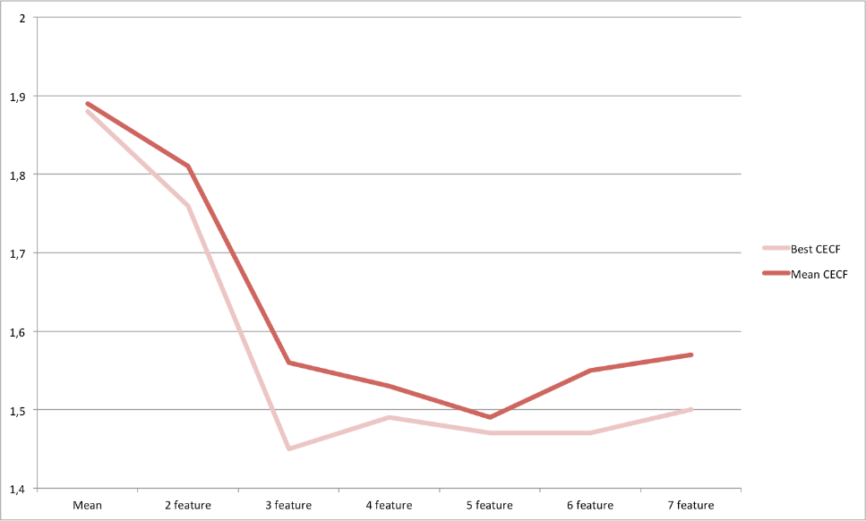
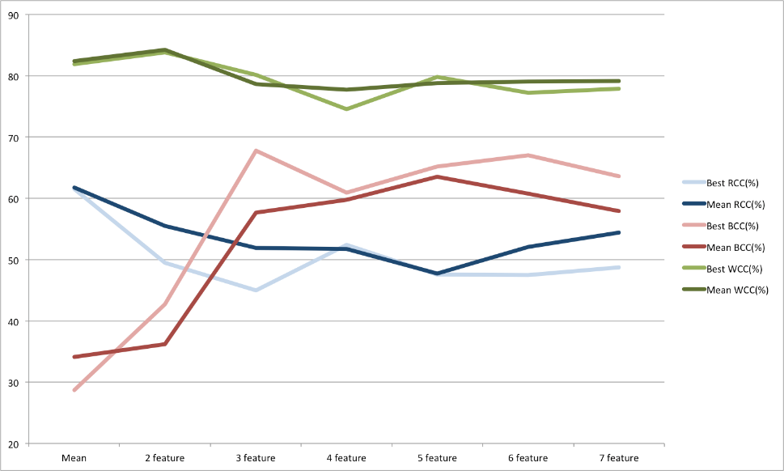
System – features
Approach

Slide 9
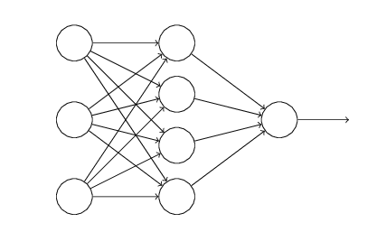
System – Neural Network
Neural Network
Approach

Slide 10
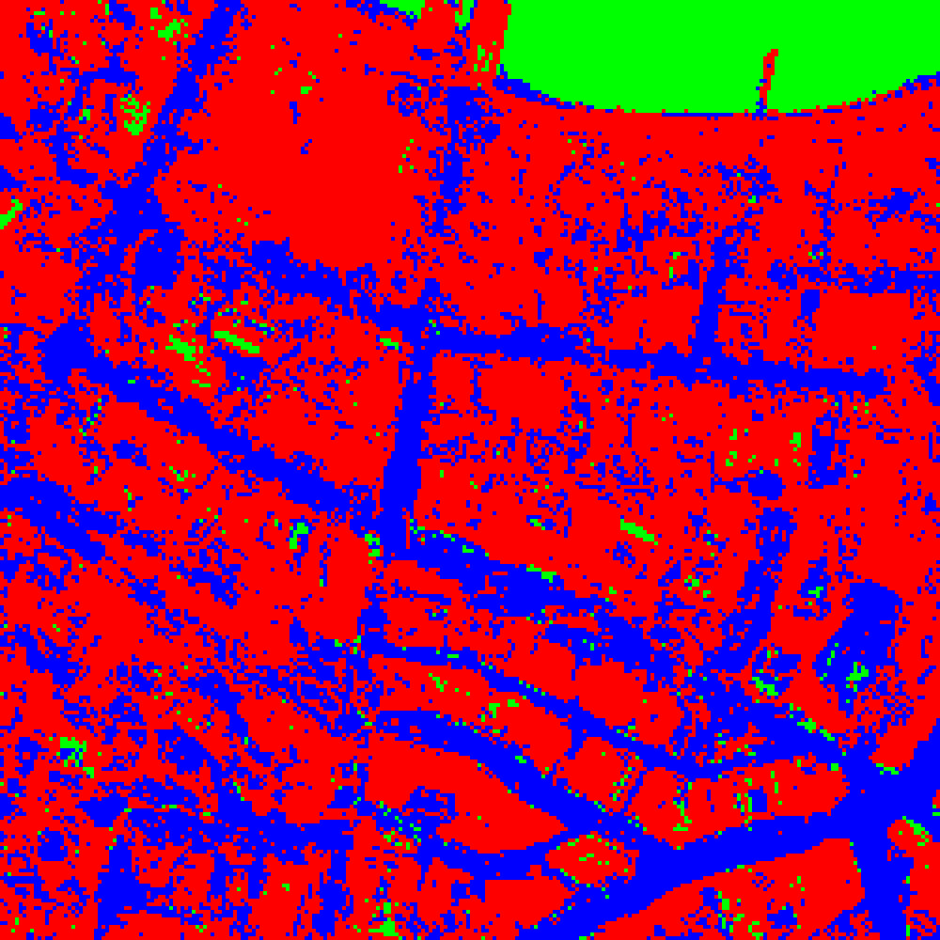
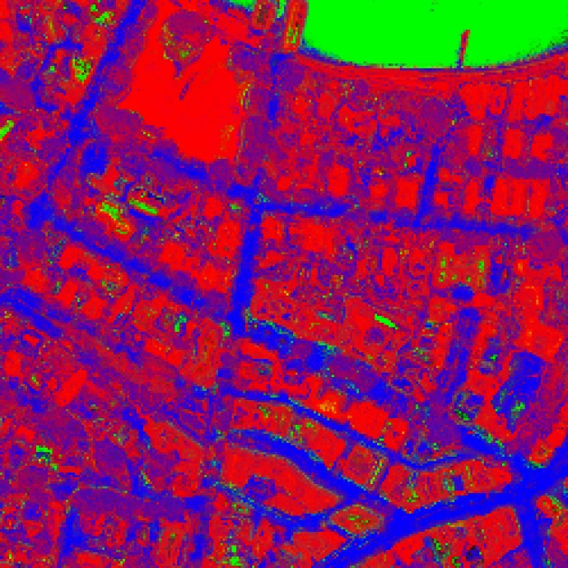
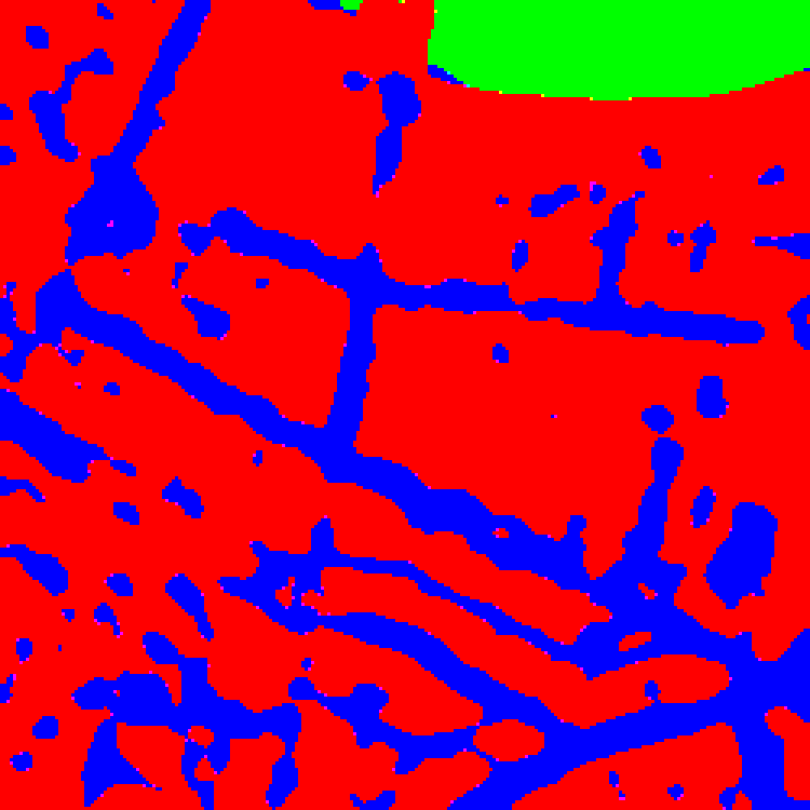
Post processing
ProcessG

Slide 11

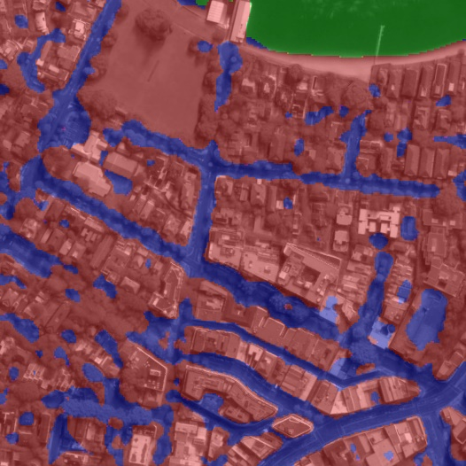
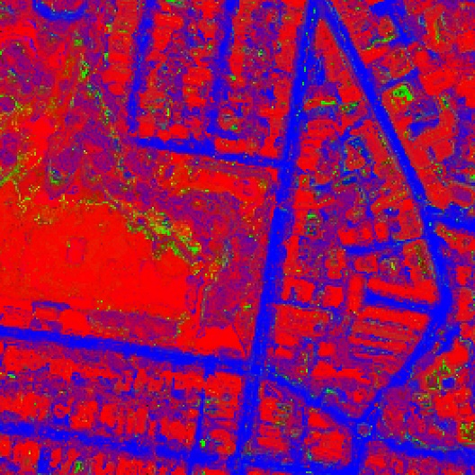
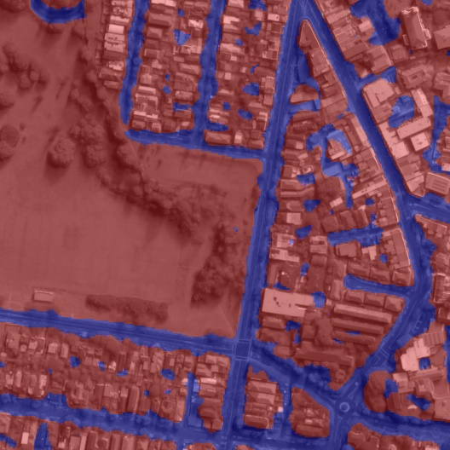
Result

Slide 12
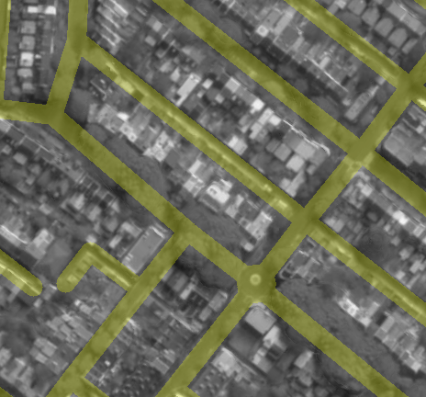
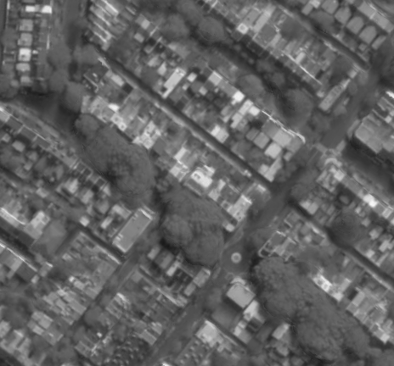
Discussion
Trees
Road width

Slide 13
Discussion
Trees as road

Slide 14
Questions?

