Slide 1
Flight ticket price prediction and description
MGT3614 – Business Analytics
Project Presentation
MAY 2023

Slide 2
K Hannah Jessica – 20BCE7468

Slide 3
Table of Contents
Problem Statements
Data Description
Descriptive Analytics
Predictive Analytics
Findings and Insights
Interpretation and Business Recommendations
Codes & Data Files

Slide 4
Problem Statement
The main motive of this project is to predict and to analyze the flight fare among various airline companies using exploratory data techniques on some features such as price, duration, Flight Code, airline company, Duration, and more available in the dataset. A lot of factors that affect the overall price of airline tickets, including the airline, the date of travel, source, destination, route, duration, and so on. Each provider seems to have its own unique set regulations and methods for determining pricing. Recent breakthroughs in Artificial Intelligence (AI) and Machine Learning (ML) allow for the inference of such principles as well as the modelling of price volatility. This project is a study conducted on predicting flight prices. Utilizing two datasets for testing and training, this study analyses various machine learning methods for predicting flight prices.

Slide 5
Data Description
The dataset we have used for the study of predictive and descriptive analysis include various features regarding the Flight tickets and their prices. We have taken the dataset from Kaggle.
Data Collection: Data was collected for 50 days, from February 11th to March 31st, 2022 from Ease my trip website via octoparse scraping tool in two parts : economy and business class tickets.
Data Content: Containing information about flight booking options from the website Easemytrip for flight travel between India's top 6 metro cities. There are 300261 datapoints and 11 features in the dataset.
The features of the dataset are mentioned below:
Airline: The name of the airline company is stored in the airline column.
Flight: Flight stores information regarding the plane's flight code.
Source City: City from which the flight takes off.

Slide 6
Data Description
Class: The information on seat class.
Departure Time: The information about the departure time.
Stops: The number of stops between the source and destination cities.
Arrival Time: The information about the arrival time.
Destination City: City where the flight will land.
Duration: The overall amount of time it takes to travel between cities in hours.
Days Left: This is a derived characteristic that is calculated by subtracting the trip date by the booking date.
Price: The information of the ticket price. This will be the target variable for predictive analytics.

Slide 7
Descriptive Analytics
We define descriptive analytics as the most common, fundamental form of business analytics used to monitor trends and keep track of operational performance by summarizing and highlighting patterns in past and existing data. The practice of descriptive analytics produces business metrics, reports, and KPIs (Key Performance Indicators) to help businesses track their performance and different trends. As a result, companies understand what's happened thus far and, when combined with the other types of business analytics, get an idea of why things happened, what things may occur, and how to prepare for future events. Descriptive analytics provides metrics that help businesses figure out the return rate on different social media initiatives. Descriptive analytics gathers information over long periods, and that accumulated information can be used to track the company's progress by comparing the metrics for different periods.

Slide 8
Descriptive Analytics
How Descriptive Analytics Works
Descriptive analytics takes a full range of raw data and parses it to draw conclusions that managers, investors, and other stakeholders may find useful and understandable. This data provides an accurate picture of past performance and how that differs from other comparable periods. It can also be used to compare the performance with others within the same industry. These performance metrics can be used to flag areas of strength and weakness to inform management strategies.
Companies can use descriptive analytics to gain valuable insight into how they are performing. Because it is generally an industry-specific tool, one company can use it to compare its performance and position in the marketplace with its competitors by looking at its past performance, such as growth in its revenue and sales.

Slide 9
Descriptive Analytics
How Is Descriptive Analytics Used?
Descriptive analytics is a very important tool that can be used in different parts of any business. That's because it allows companies to understand how well it is performing and where there may be inefficiencies. Corporate management can identify areas for improvement and use it to motivate different teams to implement changes for continued success. There are two primary methods by which data is collected for descriptive analytics. These are data aggregation and data mining.
Steps in Descriptve analysis
Identifying which metrics to analyze.
Identifying and locating the data.
Compiling the data.
Data analysis.

Slide 10
Predictive Analytics
The term predictive analytics refers to the use of statistics and modeling techniques to make predictions about future outcomes and performance. Predictive analytics looks at current and historical data patterns to determine if those patterns are likely to emerge again. This allows businesses and investors to adjust where they use their resources to take advantage of possible future events. Predictive analysis can also be used to improve operational efficiencies and reduce risk. Predictive models are used for all kinds of applications, including weather forecasts, creating video games, translating voice to text, customer service, and investment portfolio strategies. All of these applications use descriptive statistical models of existing data to make predictions about future data. Predictive analytics is also useful for businesses to help them manage inventory, develop marketing strategies, and forecast sales.

Slide 11
Predictive Analytics
How Predictive analysis is used?
Predictive analytics is a decision-making tool in a variety of industries. Predictive modeling is often used to clean and optimize the quality of data used for such forecasts. Predictive analytics plays a key role in advertising and marketing. Companies can use models to determine which customers are likely to respond positively to marketing and sales campaigns. Business owners can save money by targeting customers who will respond positively rather than doing blanket campaigns. Predictive analytics is good for forecasting, risk management, customer behavior analytics, fraud detection, and operational optimization. Predictive analytics can help organizations improve decision-making, optimize processes, and increase efficiency and profitability.

Slide 12
Findings and Insights
Vistara and Air India have wider price range than other airline companies and they have expensive tickets than others, as business class tickets are only available on Vistara and Air India. On the other hand, Air Asia offers the cheapest tickets among other airline companies. When we compare the ticket prices of Vistara and Air India, Vistara mostly offers expensive prices than Air India.
As the flight duration increases till 20 hours, ticket price also increases. After 20 hours, the ticket price decreases as the flight duration increases.
The more stops there are, the higher ticket price there are for all airlines, except for Air Asia. The ticket price ranges of Air Asia for different number of stops are similar. For this reason, The Air Asia can be the low cost airline company.
As the number of days left for the departure decreases between 20 and 2 days, ticket price increases. On the other hand, ticket prices remain almost stable between 50 and 20 days left for the departure. Additionally, in business class, it is possible to find cheaper tickets in one day before the departure than the day before.

Slide 13
Findings and Insights
Flights leaving or arriving at late night have the cheaper prices compared to other times. In addition to late night, flights arriving in the early morning or leaving in the afternoon are cheaper than other options. On the other hand, flights leaving at night have the expensive prices compared to other times.
Flights leaving from or arriving at Delhi have the cheaper prices compared to other source and destination cities. On the other hand, other source and destination cities have similar price ranges.
According to the mutual information scores, knowing the duration, class, whether the airline is Vistara or Air India, the number of days left for departure, whether the source city or destination city is Delhi or Mumbai and the number of stops can result in better prediction of ticket prices.

Slide 14
Interpretation and Business Recommendations Interpretations
The dataset is obtained to conduct various statistical hypothesis tests in order to get meaningful information from it. The Algorithms would be used to train the dataset and predict a continuous target variable. A thorough study of the data will aid in the discovery of valuable insights that will be of enormous value to passengers.
The ticket prices vary between classes as the mean price of Business class tickets are almost 8 times of the mean price of Economy Class tickets.
According to the comparison of the result of regression models, Extra Trees Regressor and Random Forest Regressor models have the higher R squared scores and adjusted R squared values, as they have lower error values compared to other models. Extra Trees Regressor gives the best result with R^2 score equals to 0.984734 and MAE score equals to 1151.195.
There are strong correlation with Class and Price. It can be also concluded from the price range analysis in Class detail.

Slide 15
Interpretation and Business Recommendations Business Recommendations
Airline Companies have tremendous amount of data about past flights which have already faced some issues that may happen in near future. So, they can build various machine learning models to study different patterns based on the data available to predict the issues and solve them . This will help in providing a enhanced and smooth customer experience which in return brings profit tenfold.
The Civil Aviation Body and airline company should make use of machine learning to predict the price ranges and analyze the customer behaviour during different situations and update the neccessities using intelligent systems.

Slide 16
Code & Data Files DATASET
 | airline | flight | source_city | departure_time | stops | arrival_time | destination_city | class | duration | days_left | price
0 | SpiceJet | SG-8709 | Delhi | Evening | zero | Night | Mumbai | Economy | 2.17 | 1 | 5953
1 | SpiceJet | SG-8157 | Delhi | Early_Morning | zero | Morning | Mumbai | Economy | 2.33 | 1 | 5953
2 | AirAsia | I5-764 | Delhi | Early_Morning | zero | Early_Morning | Mumbai | Economy | 2.17 | 1 | 5956
3 | Vistara | UK-995 | Delhi | Morning | zero | Afternoon | Mumbai | Economy | 2.25 | 1 | 5955
4 | Vistara | UK-963 | Delhi | Morning | zero | Morning | Mumbai | Economy | 2.33 | 1 | 5955
5 | Vistara | UK-945 | Delhi | Morning | zero | Afternoon | Mumbai | Economy | 2.33 | 1 | 5955
6 | Vistara | UK-927 | Delhi | Morning | zero | Morning | Mumbai | Economy | 2.08 | 1 | 6060
7 | Vistara | UK-951 | Delhi | Afternoon | zero | Evening | Mumbai | Economy | 2.17 | 1 | 6060
8 | GO_FIRST | G8-334 | Delhi | Early_Morning | zero | Morning | Mumbai | Economy | 2.17 | 1 | 5954
9 | GO_FIRST | G8-336 | Delhi | Afternoon | zero | Evening | Mumbai | Economy | 2.25 | 1 | 5954
10 | GO_FIRST | G8-392 | Delhi | Afternoon | zero | Evening | Mumbai | Economy | 2.25 | 1 | 5954
11 | GO_FIRST | G8-338 | Delhi | Morning | zero | Afternoon | Mumbai | Economy | 2.33 | 1 | 5954
12 | Indigo | 6E-5001 | Delhi | Early_Morning | zero | Morning | Mumbai | Economy | 2.17 | 1 | 5955
13 | Indigo | 6E-6202 | Delhi | Morning | zero | Afternoon | Mumbai | Economy | 2.17 | 1 | 5955
14 | Indigo | 6E-549 | Delhi | Afternoon | zero | Evening | Mumbai | Economy | 2.25 | 1 | 5955
15 | Indigo | 6E-6278 | Delhi | Morning | zero | Morning | Mumbai | Economy | 2.33 | 1 | 5955
16 | Air_India | AI-887 | Delhi | Early_Morning | zero | Morning | Mumbai | Economy | 2.08 | 1 | 5955
17 | Air_India | AI-665 | Delhi | Early_Morning | zero | Morning | Mumbai | Economy | 2.17 | 1 | 5955
18 | AirAsia | I5-747 | Delhi | Evening | one | Early_Morning | Mumbai | Economy | 12.25 | 1 | 5949
19 | AirAsia | I5-747 | Delhi | Evening | one | Morning | Mumbai | Economy | 16.33 | 1 | 5949
20 | GO_FIRST | G8-266 | Delhi | Early_Morning | one | Evening | Mumbai | Economy | 11.75 | 1 | 5954

Slide 17
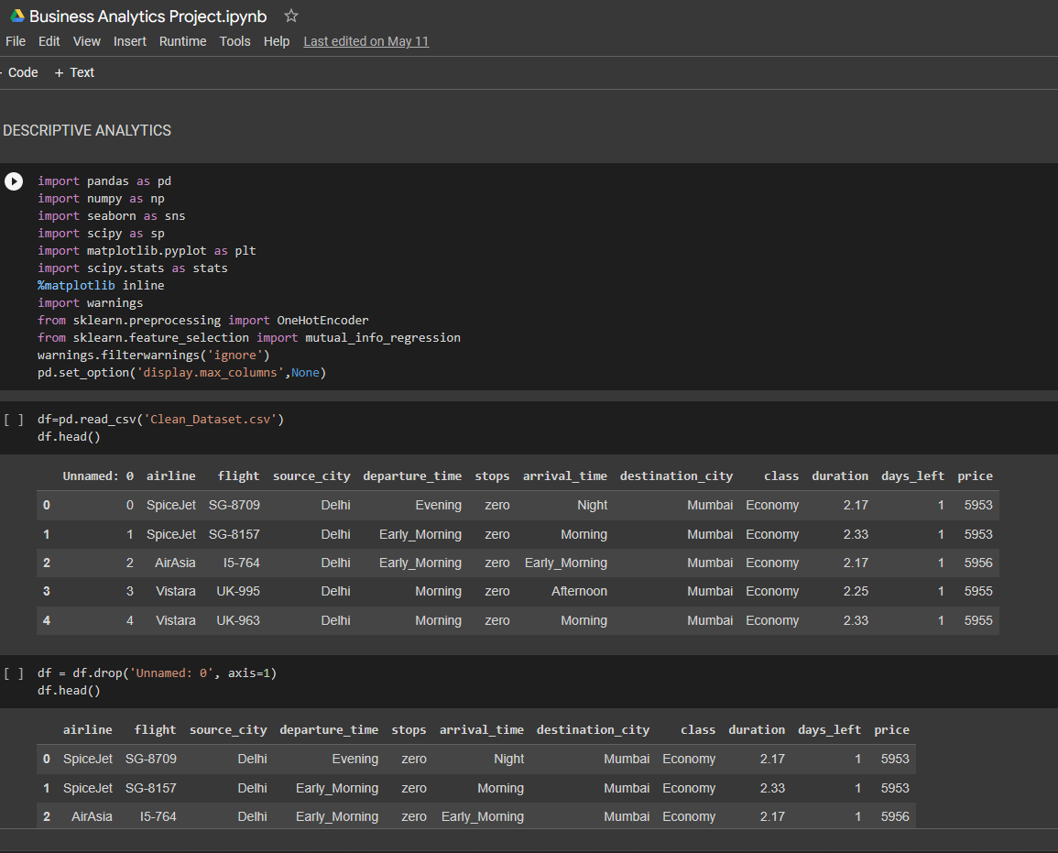
Code & Data Files

Slide 18
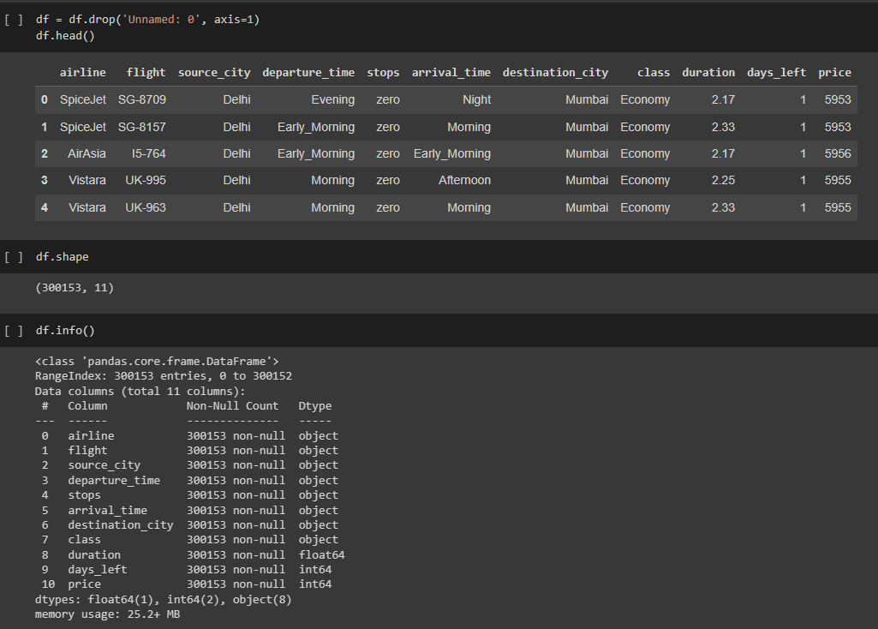

Slide 19
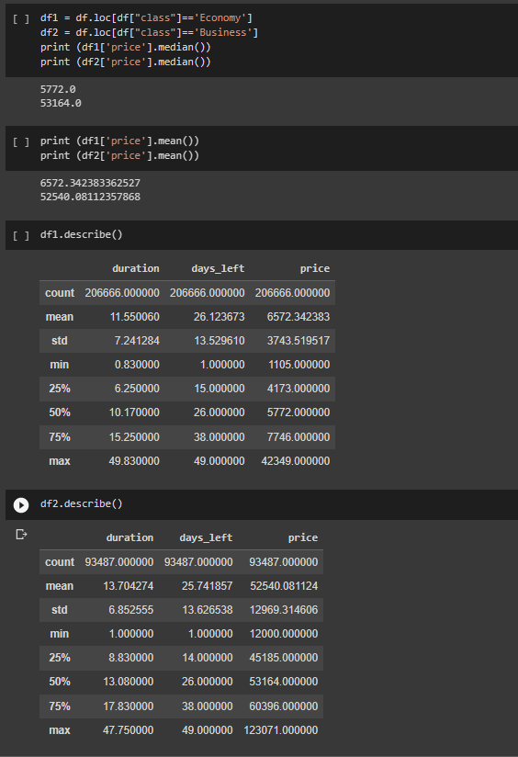
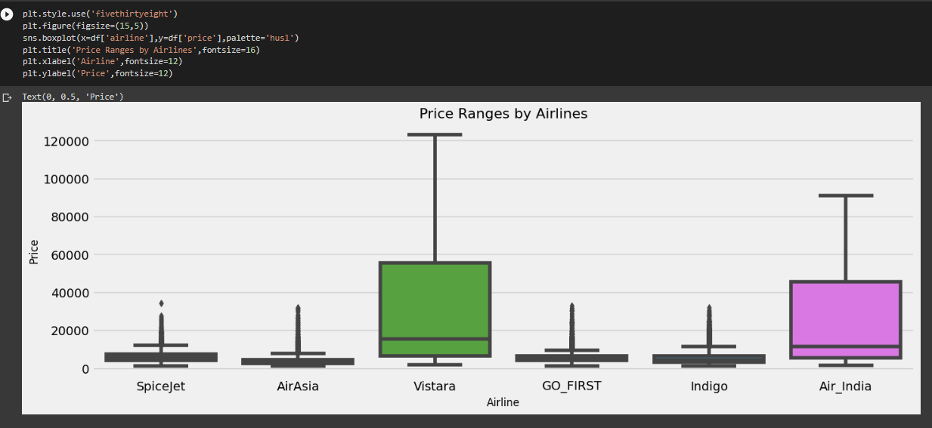

Slide 20
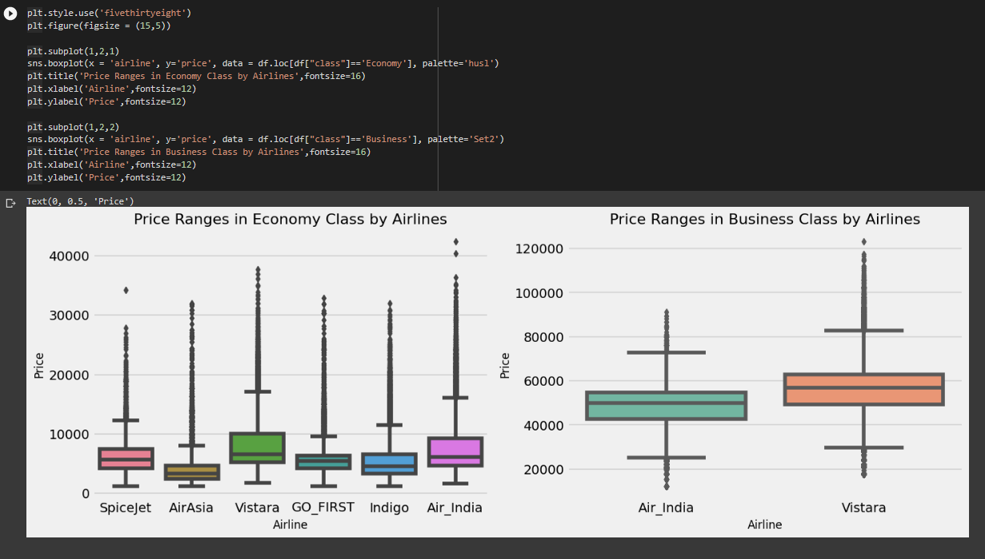

Slide 21
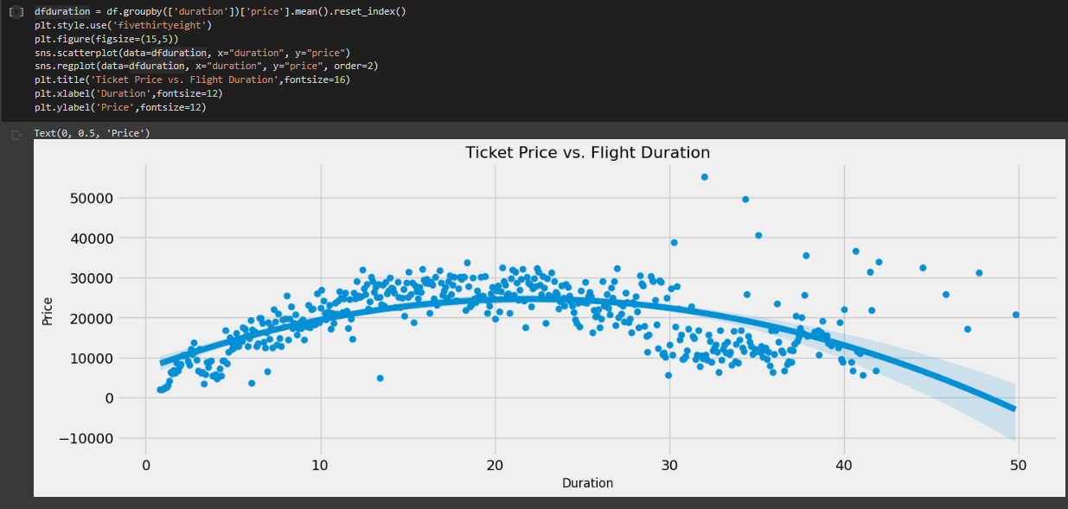

Slide 22
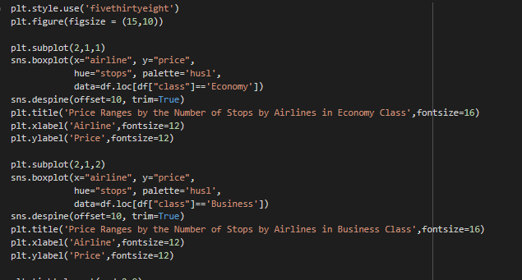
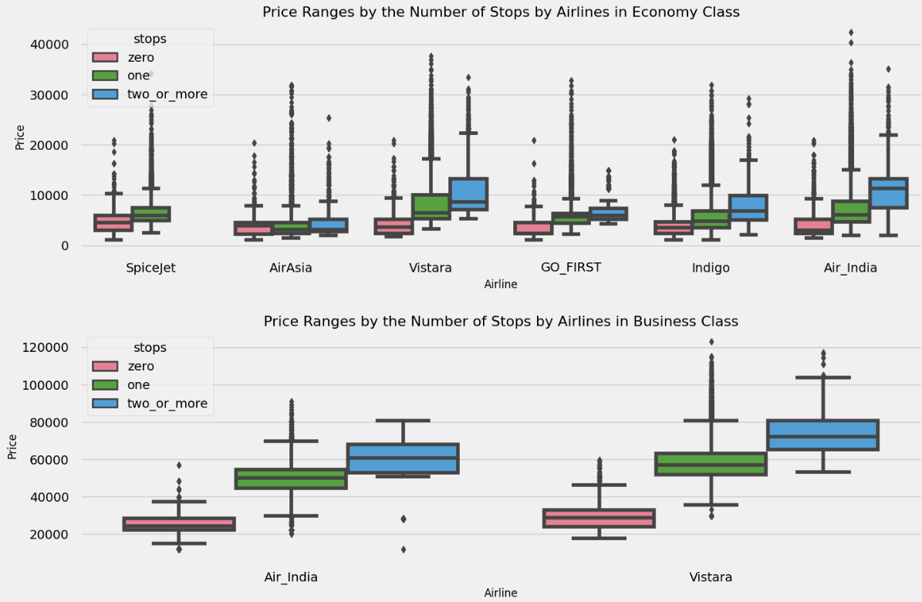

Slide 23
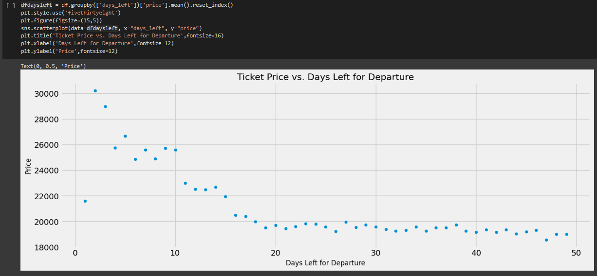

Slide 24
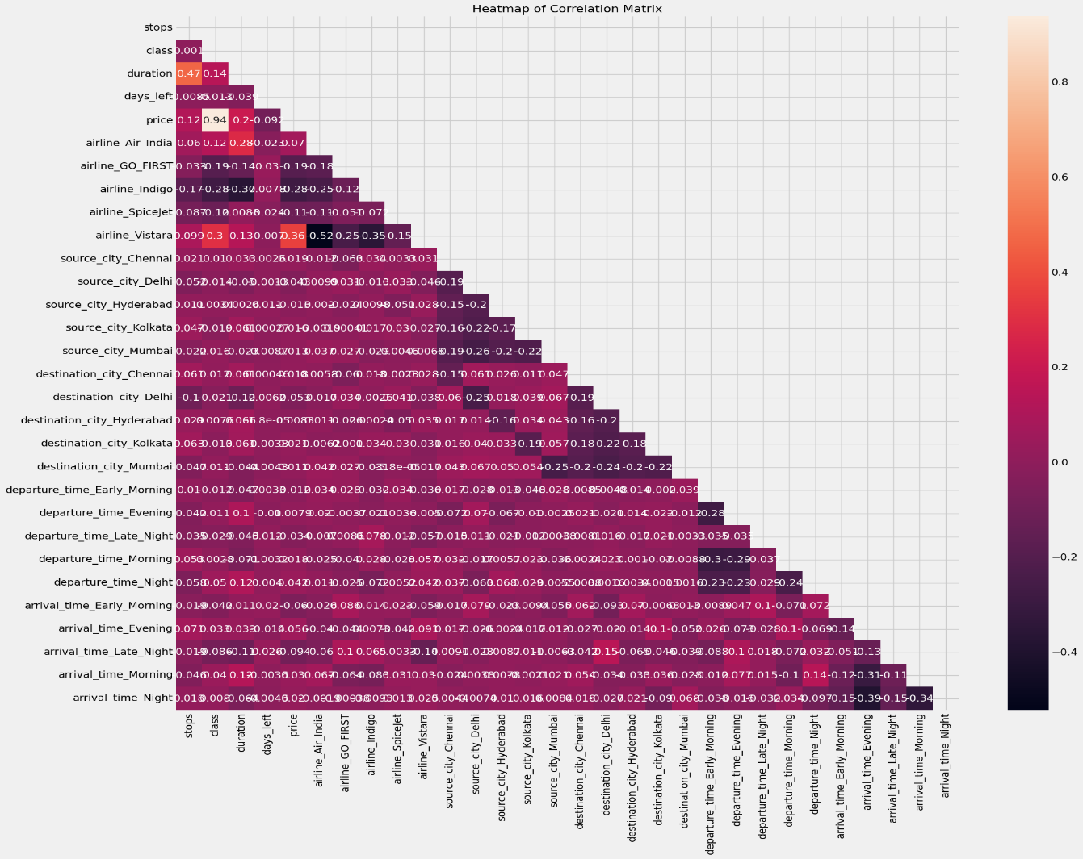
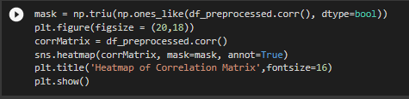

Slide 25
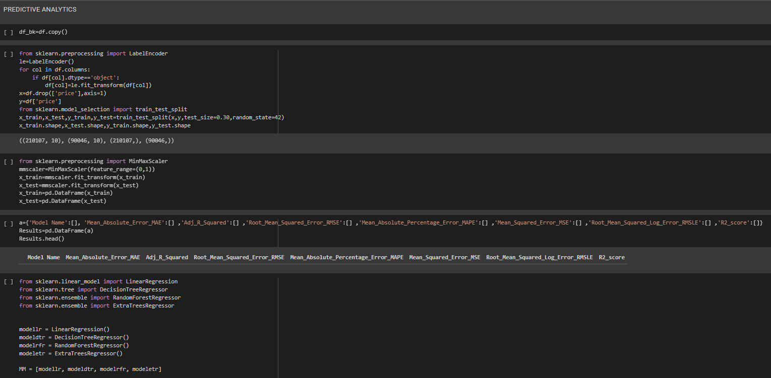

Slide 26
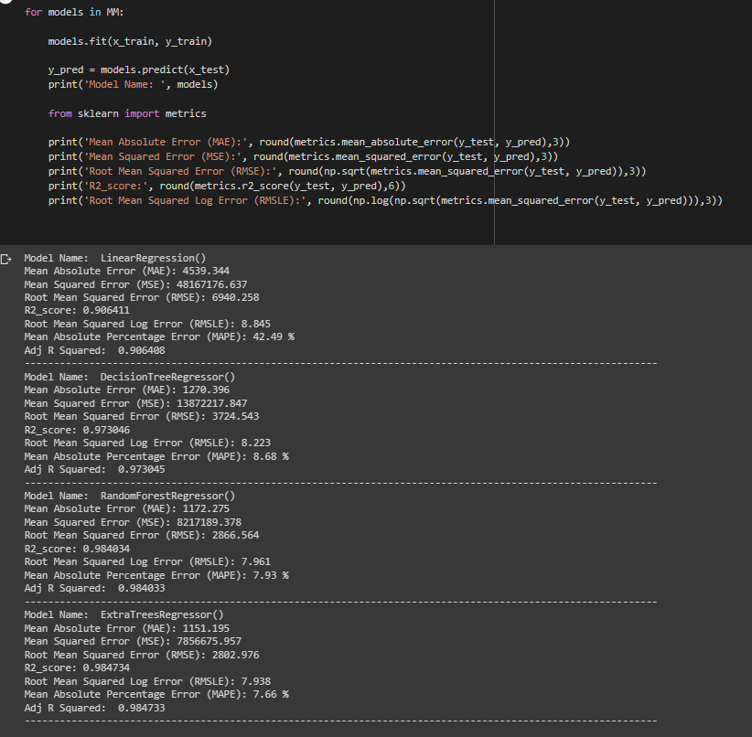

Slide 27
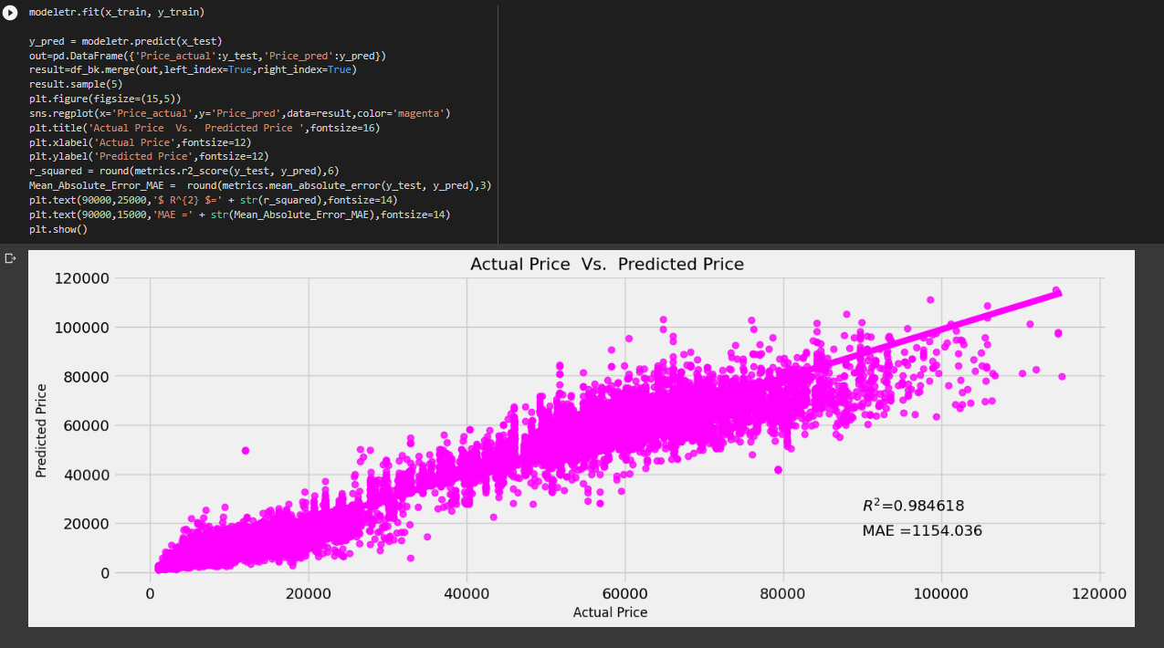

Slide 28
Thank You
jessica.20bce7468@vitap.ac.in

