Slide 1
Stratus Summary
한정일 2020-12-17

Slide 2
개요
Preliminary (System C)
Syntax & Compiler
PE_ARRAY(Output Stationary)
Floating-point Divider
NPU Top

Slide 3
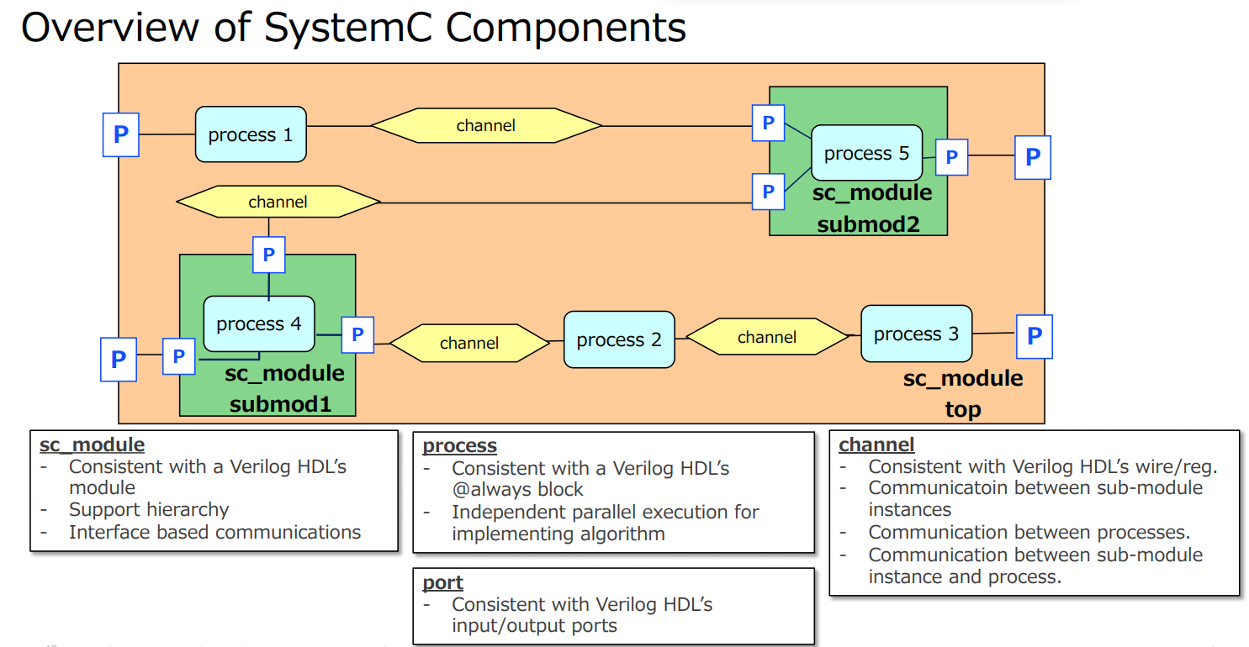
1. Preliminary (System C)

Slide 4
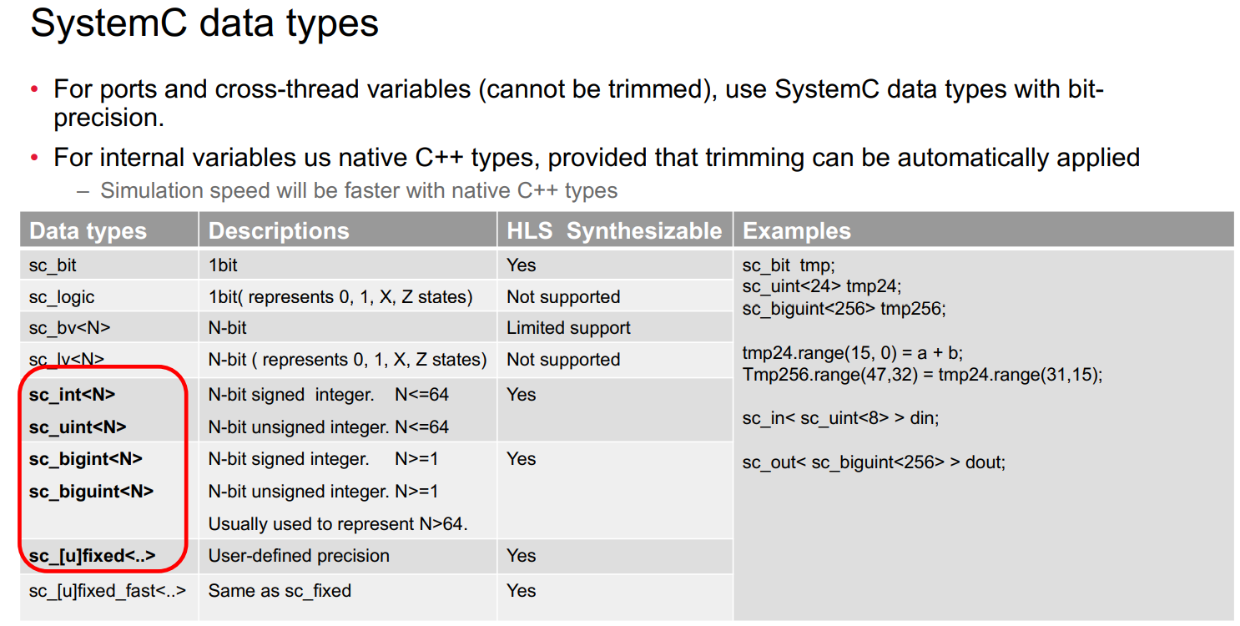

Slide 5
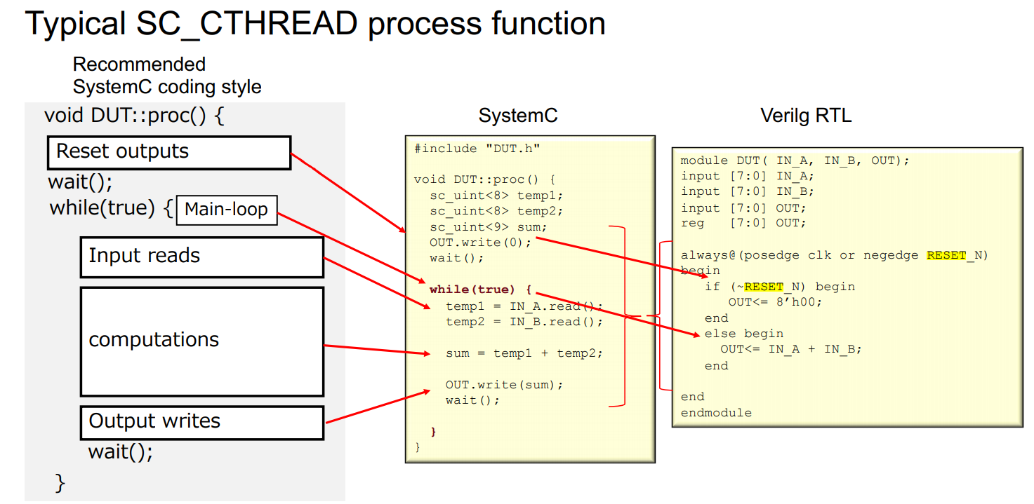

Slide 6
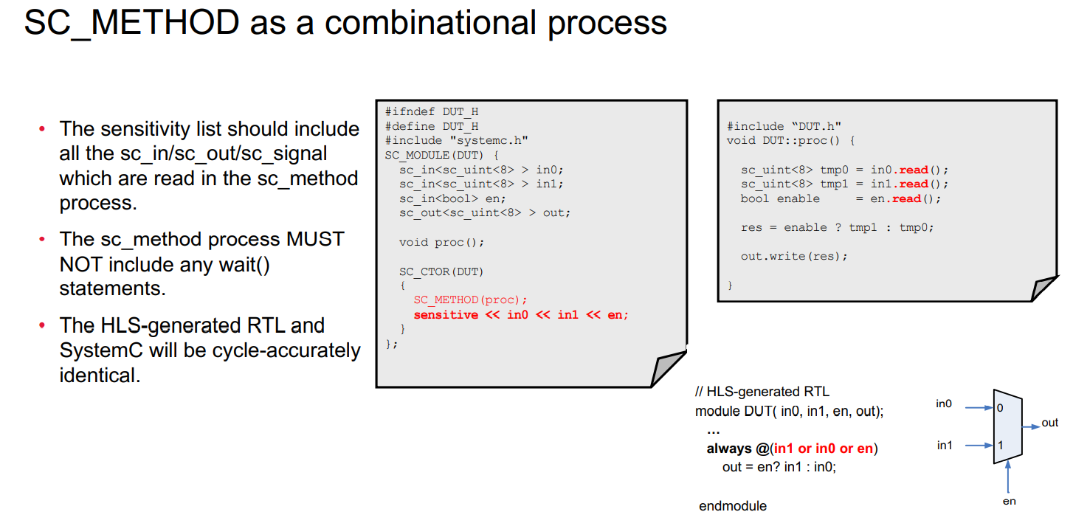

Slide 7
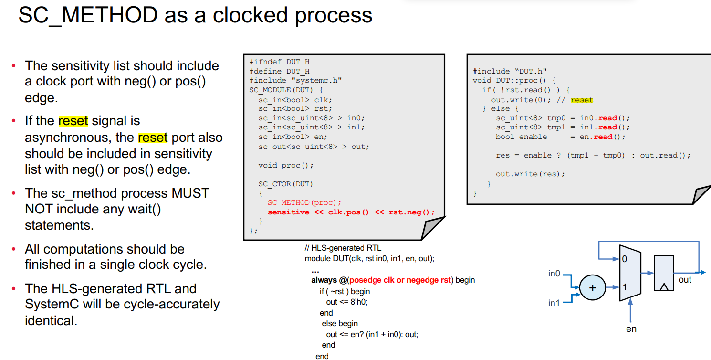
endmodule

Slide 8
2. Syntax & Compiler
-. Type Definition
sc_in<sc_uint<8>> a; (X) sc_in< sc_uint<8> > a; (O)
sc_vector<sc_in<sc_int<10>>> b; (X) sc_vector< sc_in< sc_int<10> > > b; (O)
sc_signal<sc_int<8>> c; (X) sc_signal< sc_int<8> > c; (O)
-. SC_CTOR Mapping
sc_in< sc_int<10> > scr_0_s0[32]; No mapping
sc_vector< sc_in< sc_int<10> > > src_0_s0; Mapping
sc_vector를 사용할 경우 error 발생, sc_in 사용
-. std::to_string( )
현재 “not a member of std” error 발생
instance name 할당 시 사용하는데, for loop 대신 풀어서 선언

Slide 9
3. PE_ARRAY (Output Stationary)
-. Behavioral Synthesis (RTL)
BASIC vs. DP_OPT : DP_OPT 성능 우위 (뒷장 참조)
pe_array_rtl.v, mac_rtl.v 생성
-. Logic Synthesis (Gate-level, 45nm process)
Tool : Cadence Genus
Library : GPDK045/gsclib045_svt_v4.4/slow_vdd1v2_basicCells.lib

Slide 10
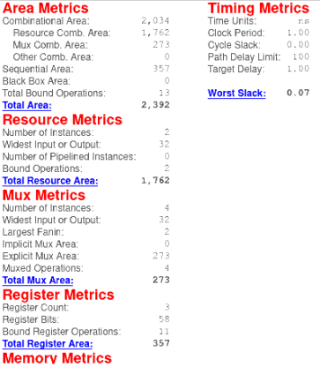
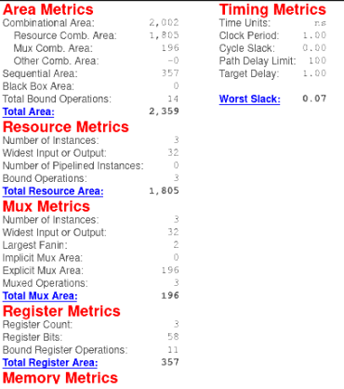
-. mac_rtl.v Analysis (Summary)
(1) BASIC
(2) DP_OPT

Slide 11
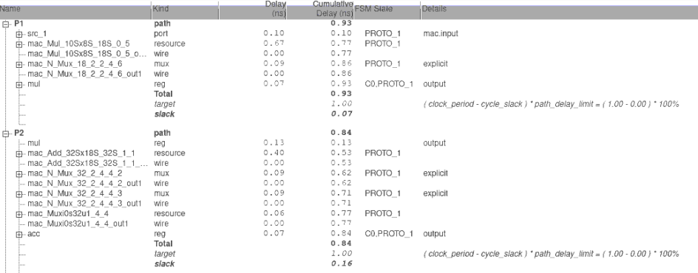
-. mac_rtl.v Analysis (Timing, DP_OPT)
(1) Timing Attribute (project.tcl)
set CLOCK_PERIOD "1.0“
set_attr clock_period $CLOCK_PERIOD
#set_attr cycle_slack 0.4
set_attr default_input_delay 0.1
set_attr message_detail 3
set_attr path_delay_limit 100
(2) Timing Metrics (1 GHz, No margin)
(3) Timing Metrics (Fail @1GHz, 40% Margin)

Slide 12
-. Multi-dimensional Array
SC_MODULE(pe_array)
{
sc_in<bool> clk;
sc_in<bool> rstn;
sc_in<bool> enable;
sc_in<bool> src_vld;
sc_in<bool> clear;
sc_in<bool> init;
sc_in<bool> start; // Added on 2020/11/27 by hanji
sc_in< sc_uint<8> > systolic_en;
sc_in< sc_uint<8> > systolic_depth;
sc_in< sc_uint<8> > mac_shift_len;
#ifdef GEN_WRAP
sc_in< sc_int<FEATURE_BIT_WIDTH> >src_0_s0[32];
sc_in< sc_int<FEATURE_BIT_WIDTH> >src_0_s1[32];
sc_in< sc_int<FEATURE_BIT_WIDTH> >src_0_s2[32];
sc_in< sc_int<FEATURE_BIT_WIDTH> >src_0_s3[32];
sc_in< sc_int<FEATURE_BIT_WIDTH> >src_0_s4[32];
sc_in< sc_int<FEATURE_BIT_WIDTH> >src_0_s5[32];
sc_in< sc_int<FEATURE_BIT_WIDTH> >src_0_s6[32];
sc_in< sc_int<WEIGHT_BIT_WIDTH> > src_1[32];
sc_out< sc_int<ACCUMULATOR_BIT_WIDTH> > pe_data[32];
. 현재 2-dimensional array가 적용되고 있는 in/out 신호를 RTL로
변환할 경우 2-dimensional array가 flatten 되어 출력되는 현상 발생
. 문제 해결을 위해 project.tcl에서 다음과 같은 attribute 적용
define_hls_config pe_array DPA --flatten_arrays=none
. pe_array.h에서 다음과 같은 attribute 적용
SC_CTOR(pe_array) : clk("clk"),
rstn("rstn"),
enable("enable"),
src_vld("src_vld"),
clear("clear"),
init("init"),
start("start"), // Added on 2020/11/27 by hanji
systolic_en("systolic_en"),
systolic_depth("systolic_depth"),
mac_shift_len("mac_shift_len"),
#ifndef GEN_WRAP
HLS_FLATTEN_ARRAY(src_0_s0, OFF);
HLS_FLATTEN_ARRAY(src_0_s1, OFF);
HLS_FLATTEN_ARRAY(src_0_s2, OFF);
HLS_FLATTEN_ARRAY(src_0_s3, OFF);
HLS_FLATTEN_ARRAY(src_0_s4, OFF);
HLS_FLATTEN_ARRAY(src_0_s5, OFF);
HLS_FLATTEN_ARRAY(src_0_s6, OFF);
HLS_FLATTEN_ARRAY(src_1, OFF);
HLS_FLATTEN_ARRAY(pe_data, OFF);
. 위의 옵션으로 문제 해결이 되지 않아 RTL Wrapper를 추가해서 대응하고 있는
상황

Slide 13
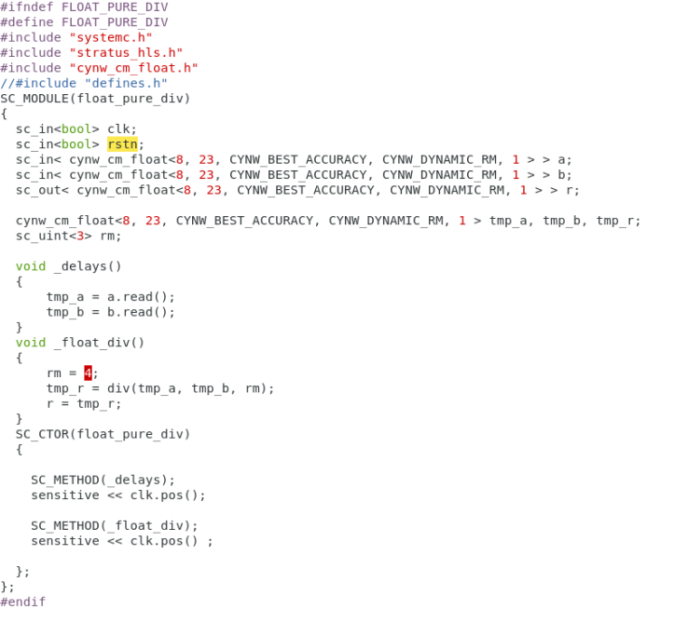
4. Floating-point Divider
(1) Divider using divider function (cynw_cm_float library)
-. Fixed Latency = 9 (Implemented in a sequential fashion)

Slide 14
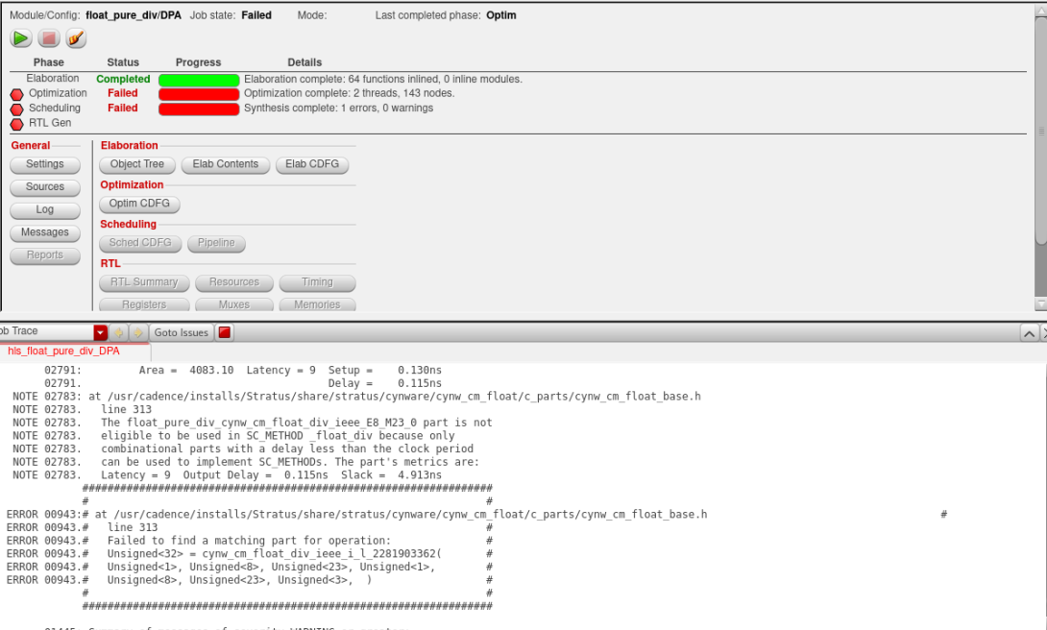
-. Error during scheduling

Slide 15
(2) Divider using HWC
-. Error during scheduling
sc_dt::scfx_ieee_float inst_z_float;
inst_z_float = inst_a_float / inst_b_float;
sc_uint<1> sign2 = inst_z_float.negative();
sc_uint<8> exp2 = (inst_z_float.exponent()+127);
sc_uint<23> frac2 = inst_z_float.mantissa(); // Error : Unable to resolve pointer or array indirection
z_inst = (sign2, exp2, frac2); // Errror : Unable to resolve all pointer or array indirection in the design

Slide 16
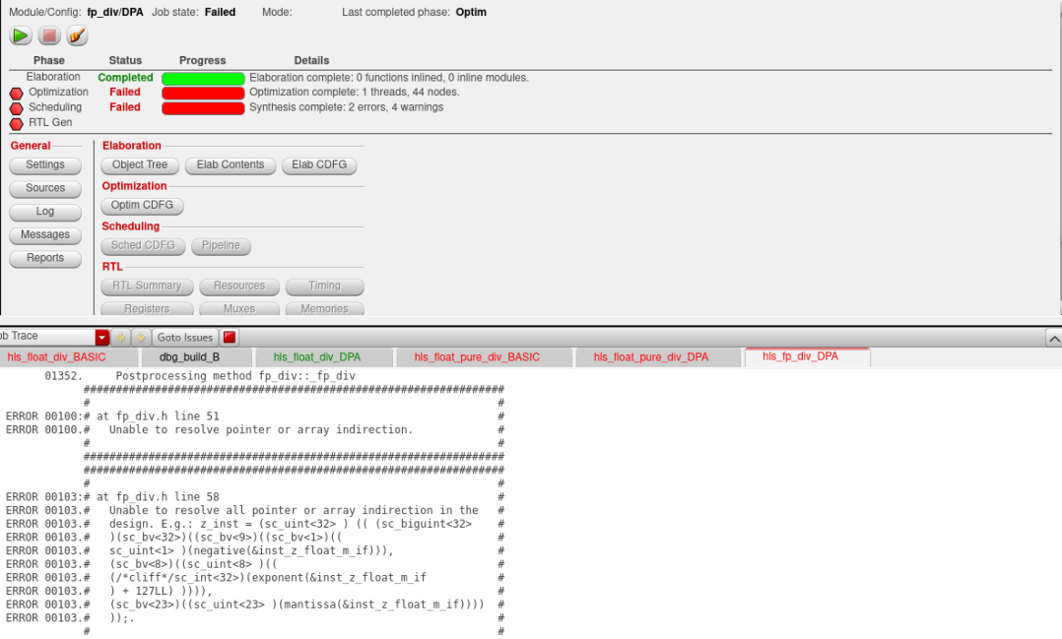

Slide 17
(3) Divider using Reciprocal function and Multiplier (cynw_cm_float library)
A/B = 1/B(Reciprocal Function) * A (Multiplier)
B
Reciprocal
Function
Multiplier
R
A
Delay

Slide 18
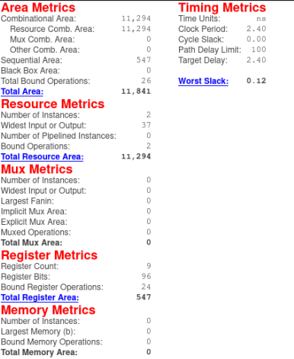
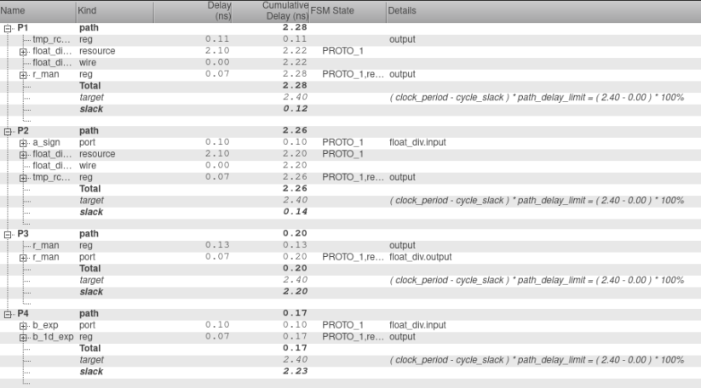
-. float_div_rtl.v Analysis
(3-1) Summary
(3-2) Timing Metrics (Genus/45nm: 416 MHz, No margin)

Slide 19
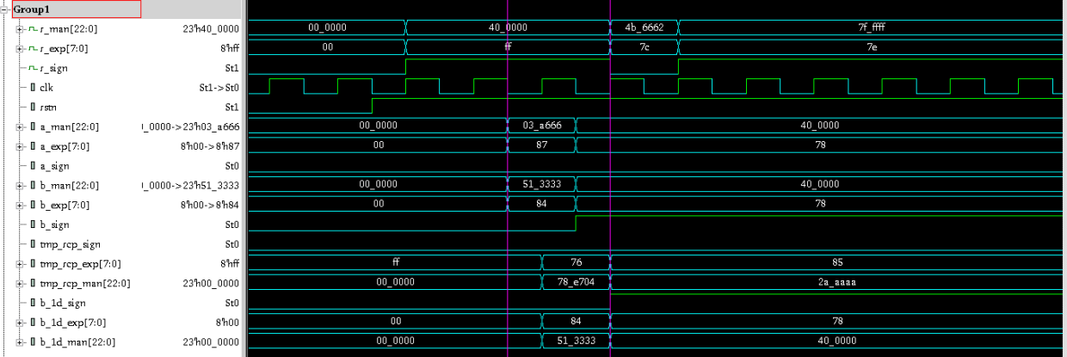
-. RTL Verification (Function)

Slide 20
(4) Synthesis Results (Stratus vs. DW )
Synthesizer : Design Compiler
Library : sc9mc_ln14lpp_base_rvt_c16_ss_nominal_max_0p720v_m40c_sadhm.db
 | Stratus (Reciprocal Function + Multiplier) | DW (Divider)
Speed (MHz) | 480 | 171
Area (nm²) | 1936.0 | 3176.4
Power (mW) | 1.6963 | 0.3787 (1.0630 @480MHz)
Latency | 2 | 1

Slide 21
5. NPU Top
npu top
addr_gen
controller
controller
bias
st_feature
pw_feature
apb_mst
apb_slv
(reg_field)
feature_wirte
st_weight
pw_weight
bn
sram_bn
addr
sram_bias
cache
SFU
pe_array
finish_gen
sram_weight
data
sram_feature
: HWC
: RTL(Stratus)

Slide 22
SFU
learn_clip
float2fix
avg_pool
in_buff
fix2float
linear_dequant
linear_dequant
bn_float32
relu_offset_float
bias_add
sfu_
out_buff
: HWC
: RTL(Stratus)

Slide 23
-. Reset 적용 (Stratus C Model)
HWC에 빠져 있는 Reset을 기술해야 초기값 설정이 가능한 RTL 생성 가능 (필수)
현재 RTL에 적용하고 있는 Asynchronous Reset 기술 (Stratus C)
Synchronous Reset의 경우 sensitivity list에서 rstn.neg() 제거
void _of_counter()
{
if (!rstn.read()) {
of_cnt.write(0);
}
else if (of_clear.read())
of_cnt = 0;
else if (of_enable.read())
of_cnt = of_cnt.read() + 1;
}
SC_METHOD(_of_counter);
sensitive << clk.pos() << rstn.neg();

Slide 24
-. st_feature_addr_gen.h
void _st_feature_addr_valid()
{
st_feature_addr_valid =
run_2d.read() && (!is_zero.read());
}
void _st_feature_addr_valid()
{
st_feature_addr_valid =
run_2d.read() && (!is_zero_1d.read());
}
SC_METHOD(_st_feature_addr_valid);
sensitive << run_2d << is_zero_1d;
SC_METHOD(_st_feature_addr_valid);
sensitive << run_2d << is_zero_1d;
Status : Mismatch 발생 (HWC Simulation vs. Stratus Generated RTL Simulation)
발생 원인 → HWC 코드 그대로 RTL 생성하는 경우, (!is_zero.read()) 항목이
RTL 생성됨.
HWC Simulation에서는 sensitivity list의 is_zero_1d로 기술되어
있는 항목으로 시뮬레이션 결과가 나타나 Mismatch 발생.
Simulator(Xcelium)가 Bug를 발견하지 못하는 상황

Slide 25
-. st_weight_addr_gen.h
sc_uint<8> pof = 32;
#define POF_VAL 32
Status : Error (Syntax)
Data member initializer is not allowed
void _of_ctrl2()
{
pof = 32;
of_clear = (of_enable.read()) && (of_cnt.read() == of_cnt_max.read() – POF_VAL);
}
Stratus :
RTL Generation OK and Equivalent to HWC

Slide 26
void _set_max_num()
{
ix_cnt_max = filter_width;
iy_cnt_max = filter_height;
if_cnt_max = filter_channel;
ox_cnt_max = feature_width.read() - filter_width.read() + (pad_left_size.read() + pad_right_size.read());
oy_cnt_max = feature_height.read() - filter_height.read() + (pad_top_size.read() + pad_bottom_size.read());
of_cnt_max = out_feature_channel.read();
cnt_max = filter_width.read() * filter_height.read();
}
void _cnt_max2()
{
if (!rstn.read()) {
ox_cnt_max2.write(0);
oy_cnt_max2.write(0);
}
else {
if (stride_x.read() == 1)
ox_cnt_max2 = ox_cnt_max.read() + 1;
else if (stride_x.read() == 2)
ox_cnt_max2 = (ox_cnt_max.read() >> 1) + 1;
else if (stride_x.read() == 4)
ox_cnt_max2 = (ox_cnt_max.read() >> 2) + 1;
else
ox_cnt_max2 = ox_cnt_max.read() + 1;
if (stride_y.read() == 1)
oy_cnt_max2 = oy_cnt_max.read() + 1;
else if (stride_y.read() == 2)
oy_cnt_max2 = (oy_cnt_max.read() >> 1) + 1;
else if (stride_y.read() == 4)
oy_cnt_max2 = (oy_cnt_max.read() >> 2) + 1;
else
oy_cnt_max2 = oy_cnt_max.read() + 1;
}
}
void _set_max_num()
{
ix_cnt_max = filter_width;
iy_cnt_max = filter_height;
if_cnt_max = filter_channel;
ox_cnt_max = ((feature_width.read() - filter_width.read() + (pad_left_size.read() + pad_right_size.read())) / stride_x.read()) + 1;
oy_cnt_max = ((feature_height.read() - filter_height.read() + (pad_top_size.read() + pad_bottom_size.read())) / stride_y.read()) + 1;
of_cnt_max = out_feature_channel.read();
}
Timing : 43.5 MHz => 667 MHz (Genus)

Slide 27
-. pw_weight_addr_gen.h
void _set_max_num()
{
if_cnt_max = filter_channel;
ox_cnt_max = feature_width.read() - filter_width.read() + (pad_left_size.read() + pad_right_size.read());
oy_cnt_max = feature_height.read() - filter_height.read() + (pad_top_size.read() + pad_bottom_size.read());
of_cnt_max = out_feature_channel.read();
}
void _cnt_max2()
{
if (!rstn.read()) {
ox_cnt_max2.write(0);
oy_cnt_max2.write(0);
}
else {
if (stride_x.read() == 1)
ox_cnt_max2 = ox_cnt_max.read() + 1;
else if (stride_x.read() == 2)
ox_cnt_max2 = (ox_cnt_max.read() >> 1) + 1;
else if (stride_x.read() == 4)
ox_cnt_max2 = (ox_cnt_max.read() >> 2) + 1;
else
ox_cnt_max2 = ox_cnt_max.read() + 1;
if (stride_y.read() == 1)
oy_cnt_max2 = oy_cnt_max.read() + 1;
else if (stride_y.read() == 2)
oy_cnt_max2 = (oy_cnt_max.read() >> 1) + 1;
else if (stride_y.read() == 4)
oy_cnt_max2 = (oy_cnt_max.read() >> 2) + 1;
else
oy_cnt_max2 = oy_cnt_max.read() + 1;
}
}
void _set_max_num()
{
if_cnt_max = filter_channel;
ox_cnt_max = ((feature_width.read() - filter_width.read() + (pad_left_size.read() + pad_right_size.read())) / stride_x.read()) + 1;
oy_cnt_max = ((feature_height.read() - filter_height.read() + (pad_top_size.read() + pad_bottom_size.read())) / stride_y.read()) + 1;
of_cnt_max = out_feature_channel.read();
}
Timing : 43.5 MHz => 667 MHz (Genus)

Slide 28
-. bias_addr_gen.h
void _of_counter()
{
if (init.read())
of_cnt = 0;
if (of_clear.read())
of_cnt = 0;
else if (of_enable.read())
of_cnt = of_cnt.read() + 1;
}
void _of_counter()
{
if (!rstn.read()) // Added on 2020/12/14 by hanji
of_cnt.write(0);
else if (init.read())
of_cnt = 0;
else if (of_clear.read())
of_cnt = 0;
else if (of_enable.read())
of_cnt = of_cnt.read() + 1;
}
* Scheduling Error (Stratus) vs. No Error (HWC)
00197: #############################[ Protocol Violation ]###########################
00197:
00197: Protocol block "_of_counter_method" was relaxed to meet a schedule
00197: See User Guide section titled "Latency and Protocol Block Errors."
00197: The addition of the following cycle(s):
00197: [ Cycle1 (VIOL_2) ]
00197: Violated this protocol block

Slide 29
-. feature_write_addr_gen.h
(1) Scheduling Error (Stratus) vs. No Error (HWC)
#################################################################
ERROR 00100:# at feature_write_addr_gen.h line 144
ERROR 00100.# Unable to resolve pointer or array indirection.
#################################################################
#################################################################
ERROR 00100:# at feature_write_addr_gen.h line 144
ERROR 00100.# Unable to resolve pointer or array indirection.
#################################################################
ERROR 00103:# at feature_write_addr_gen.h line 144
ERROR 00103.# Unable to resolve all pointer or array indirection in the
ERROR 00103.# design. E.g.: switch( (sc_int<32>)(num_available(&(
ERROR 00103.# (sc_biguint<1508> )(sc_bv<1508>)(
ERROR 00103.# (sc_bv<1444>)((sc_bv<1218>)((sc_bv<992>)(
ERROR 00103.# (sc_bv<960>)((sc_bv<928>)((sc_bv<896>)(
ERROR 00103.# (sc_bv<832>)((sc_bv<768>)((sc_bv<736>)(
ERROR 00103.# (sc_bv<704>)((sc_bv<672>)((sc_bv<608>)(
(2) RTL 생성이 되지만, sc_fifo 선언이 된 부분이 0으로 출력(FIFO 기능 생성이
안되는 문제)
sc_fifo< sc_biguint<320> > fifo_write_data;
void _fifo_read()
{
if (!rstn.read()) {
fifo_out.write(0);
}
while (true)
{
wait(1);
if (fifo_write_data.num_available())
{
fifo_out = fifo_write_data.read();
}
}
}

Slide 30
(3) sc_fifo 대신 FIFO 기능 기술하여 해결
sc_signal< sc_biguint<320> > fifo_mem[8];
void _fifo_write() {
if (!rstn.read()) {
for (size_t i = 0; i < 8; i++)
{
fifo_mem[i].write(0);
}
}
else if (wr_en.read() == 1 && fifo_cnt.read() != 7)
fifo_mem[wr_ptr.read()] = src.read();
}
void _wr_en() {
if (src_vld.read() == 1)
wr_en = 1;
else
wr_en = 0;
}
void _rd_en() {
if (write_address_valid.read() == 1 && fifo_cnt.read() != 0)
rd_en = 1;
else
rd_en = 0;
}
void _wr_ptr() {
if (!rstn.read())
wr_ptr.write(0);
else if (wr_en.read() == 1 && fifo_cnt.read() != 7)
wr_ptr = wr_ptr.read() + 1;
}
void _rd_ptr() {
if (!rstn.read()) rd_ptr.write(0);
else if (rd_en.read() == 1 && fifo_cnt.read() != 0)
rd_ptr = rd_ptr.read() + 1;
}
void _fifo_read() {
if (rd_en.read() == 1 && fifo_cnt.read() != 0)
fifo_out = fifo_mem[rd_ptr.read()].read();
else
fifo_out.write(0);
}
void _fifo_cnt() {
if (!rstn.read())
fifo_cnt.write(0);
else if (src_vld.read() == 1)
fifo_cnt = fifo_cnt.read() + 1;
else if (write_address_valid.read() == 1 && fifo_cnt.read() != 0)
fifo_cnt = fifo_cnt.read() - 1;
}

Slide 31
(4) sfu_valid 신호가 write 타이밍과 동일 시점에 생성될 경우
void _fifo_cnt()
{
if (!rstn.read())
fifo_cnt.write(0);
else if (src_vld.read() == 1 && write_address_valid.read() == 1 && fifo_cnt.read() != 0)
fifo_cnt = fifo_cnt.read();
else if (src_vld.read() == 1)
fifo_cnt = fifo_cnt.read() + 1;
else if (write_address_valid.read() == 1 && fifo_cnt.read() != 0)
//else if (fifo_cnt.read() != 0)
fifo_cnt = fifo_cnt.read() - 1;
}

Slide 32
-. mac.h (PE_ARRAY)
(1) src_valid 신호가 invalid 되는 시점이 mac_clear 타이밍과 동일 시점에 생성될 경우
void _multiplier()
{
if (!rstn.read()) { // Added on 2021/01/27 by hanji
mul.write(0);
}
else {
if (src_vld)
mul = src_0.read() * src_1.read();
else if (src_vld.read() == 0 && clear.read() == 1)
mul = src_0.read() * src_1.read();
}
}

Slide 33
-. avg_pool.h (SFU)
(1) sfu_valid 신호가 accumulation clear 타이밍과 동일 시점에 생성될 경우
void _acc_data()
{
if (!rstn.read()) {
for (size_t i = 0; i < 32; i++)
acc_data[i].write(0);
}
else if (init)
{
for (size_t i = 0; i < 32; i++)
acc_data[i].write(0);
}
else if (acc_data_enable_1d.read() == 0 && enable.read() == 1 && acc_data_clear_1d.read() == 1) {
for (size_t i = 0; i < 32; i++) {
acc_data[i].write(in_data[i].read());
}
}
else if (acc_data_enable.read() == 1 && enable.read() == 1)
{
for (size_t i = 0; i < 32; i++)
{
if (acc_data_clear.read() == 1)
{
acc_data[i].write(in_data[i].read());
}
else
{
sc_int<64> tmp;
tmp = in_data[i].read() + acc_data[i].read();
if (tmp > INT32_MAX || tmp < INT32_MIN)
{
//cout << "@AVG_POOL : INT32_MAX : " << INT32_MAX << endl;
//cout << "@AVG_POOL : INT32_MIN : " << INT32_MIN << endl;
//cout << "@AVG_POOL : WARNING Avg Pooling Data Overflow : " << tmp << endl;
if (tmp > INT32_MAX)
acc_data[i].write(INT32_MAX);
else
acc_data[i].write(INT32_MIN);
}
else {
acc_data[i].write(in_data[i].read() + acc_data[i].read());
}
}
}
}
}

Slide 34
-. in_buff.h (SFU)
sc_fifo< sc_biguint<1024> > fifo;
Scheduling Error (Stratus) vs. No Error (HWC)
################################################################
ERROR 00100:# at in_buff.h line 84
ERROR 00100.# Unable to resolve pointer or array indirection.
################################################################
################################################################
ERROR 00100:# at in_buff.h line 84
ERROR 00100.# Unable to resolve pointer or array indirection.
################################################################
################################################################
ERROR 00103:# at in_buff.h line 84
ERROR 00103.# Unable to resolve all pointer or array indirection in the
ERROR 00103.# design. E.g.: switch( (sc_uint<1>)(((sc_uint<32>)(
ERROR 00103.# (sc_int<32> )(num_available(&( (sc_biguint<1508>
(2) RTL 생성이 되지만, sc_fifo 선언이 된 부분이 0으로 출력(FIFO 기능 생성이
안되는 문제)
void _fifo_read()
{
if (enable.read())
{
if (fifo.num_available() && read_cnt.read() == 0)
{
fifo.read(out_tmp);
read_cnt = 3;
read_en = 1;
}
else
{
read_en = 0;
}
if (read_cnt.read() != 0)
{
read_cnt = read_cnt.read() - 1;
}
for (size_t i = 0; i < 32; i++)
{
int pos = i * 32;
w_data[i].write(out_tmp.range(pos + 31, pos).to_int());
}
}
}

Slide 35
(3) sc_fifo 대신 FIFO 기능 기술하여 해결
sc_signal< sc_biguint<1024> > fifo[8];
void _fifo_read()
{
if (enable.read() == 1 && rd_en.read() == 1 && fifo_cnt.read() != 0)
out_tmp = fifo[rd_ptr.read()].read();
}
void _in_data_concate()
{
if (in_data_valid.read() == 1) {
for (size_t i = 0; i < 32; i++) {
int pos = i * 32;
in_tmp.range(pos + 31, pos) = in_data[i].read();
}
concate_in_data.write(in_tmp);
}
else {
in_tmp = 0;
concate_in_data.write(in_tmp);
}
}
void _fifo_write()
{
if (!rstn.read()) {
for (size_t i = 0; i < 8; i++) {
fifo[i].write(0);
}
}
else if (enable.read() == 1 && wr_en.read() == 1 && fifo_cnt.read() != 7)
fifo[wr_ptr.read()] = concate_in_data.read();
}
void _w_data()
{
for (size_t i = 0; i < 32; i++) {
int pos = i * 32;
w_data[i].write(out_tmp.range(pos + 31, pos).to_int());
}
}
void _fifo_cnt()
{
if (!rstn.read())
fifo_cnt.write(0);
else if (in_data_valid.read() == 1)
fifo_cnt = fifo_cnt.read() + 1;
else if (rd_en.read() == 1 && fifo_cnt.read() != 0)
fifo_cnt = fifo_cnt.read() - 1;
}

Slide 36
void _wr_en()
{
if (in_data_valid.read() == 1)
wr_en = 1;
else
wr_en = 0;
}
void _rd_en()
{
if (tmp_rd_ptr.read()(1,0) == 3)
rd_en = 1;
else
rd_en = 0;
}
void _read_en()
{
read_en = rd_en.read();
}
void _wr_ptr()
{
if (!rstn.read())
wr_ptr.write(0);
else if (wr_en.read() == 1 && fifo_cnt.read() != 7)
wr_ptr = wr_ptr.read() + 1;
}
void _tmp_rd_ptr()
{
if (!rstn.read())
tmp_rd_ptr.write(0);
else if (fifo_cnt.read() != 0)
tmp_rd_ptr = tmp_rd_ptr.read() + 1;
}
void _rd_ptr()
{
rd_ptr = tmp_rd_ptr.read()(4,2) ;
}

Slide 37
-. fix2float.h (SFU)
void _fix2float()
{
if (!rstn.read())
dst.write(0);
else if (enable.read() == 1)
{
if (src_valid.read() == 1)
{
float tmp = fixed32_to_float32(src.read(), fraction_len.read());
sc_dt::scfx_ieee_float id(tmp);
sc_uint<1> sign2 = id.negative();
sc_uint<8> exp2 = id.exponent() + 127;
sc_uint<23> frac2 = id.mantissa();
sc_dt::scfx_ieee_float inst_z_float;
dst = (sign2, exp2, frac2); }
}
else
{
dst = src.read().to_uint();
}
}
Scheduling Error (Stratus) vs. No Error (HWC)
#######################################################
ERROR 00100:# at fix2float.h line
ERROR 00100.# Unable to resolve pointer or array indirection. #######################################################
ERROR 00103:# at fix2float.h line 47
ERROR 00103.# Unable to resolve all pointer or array indirection in the
ERROR 00103.# design. E.g.: dst = (amtmp002 ? (sc_uint<32> )
ERROR 00103.# ((amtmp001 ? (sc_uint<32> )
ERROR 00103.# ((sc_biguint<32> )(sc_bv<32>)((sc_bv<9>)
((sc_bv<1>)((sc_uint<1>
ERROR 00103.# )(
ERROR 00103.# negative(&id_m_if))),
ERROR 00103.# (sc_bv<8>)((sc_uint<8> )((
ERROR 00103.# (/*cliff*/sc_int<32>)(exponent(&id_m_if)
ERROR 00103.# + 127LL) )))),
ERROR 00103.# (sc_bv<23>)((sc_uint<23> )(mantissa(&id_m_if))))) :
ERROR 00103.# (sc_uint<32> )
ERROR 00103.# (_fix2float_dst_next))) : (sc_uint<32> )
ERROR 00103.# ((sc_uint<32> )tmp0));.
######################################################

Slide 38
(2) fix2float 기능 기술하여 해결
void _r_in_data_sign()
{
if (!rstn.read()) {
r_in_data.write(0);
r_sign.write(0);
}
else if (!enable.read()) {
r_in_data.write(0);
r_sign.write(0);
}
else if (src_valid.read()) {
if (src.read()(31,31)) {
r_in_data = (~src.read()) + 1;
r_sign = 1;
}
else {
r_in_data = src.read();
r_sign = 0;
}
}
}
void _r_fraction_len()
{
if (!rstn.read())
r_fraction_len.write(0);
else if (!enable.read())
r_fraction_len.write(0);
else
r_fraction_len = 127 - fraction_len.read()(7,0);
}
void _comb_sig()
{
zero_sig = (r_in_data.read() == 0) ? 1 : 0;
z_m = r2_in_data.read()(30,8);
z_e = 31 - r2_shift_num.read();
guard = r2_in_data.read()(7,7);
round_bit = r2_in_data.read()(6,6);
sticky = (r2_in_data.read()(5,0) != 0) ? 1 : 0;
}
void _r2_in_data()
{
if (!rstn.read())
r2_in_data.write(0);
else if (!src_valid_1d.read())
r2_in_data.write(0);
else if (zero_sig.read())
r2_in_data.write(0);
else
r2_in_data = r_in_data.read() << shift_num.read();
}

Slide 39
void _r_z()
{
if (!rstn.read()) {
r_z_m.write(0);
r_z_e.write(0);
r_z_s.write(0);
}
else if (!src_valid_2d) {
r_z_m.write(0);
r_z_e.write(0);
r_z_s.write(0);
}
else if (r2_zero_sig) {
r_z_m.write(0);
r_z_e.write(0);
r_z_s.write(0);
}
else if ((guard.read() == 1) && ((round_bit.read() == 1) || (sticky.read() == 1) || (r2_in_data.read()(8,8) == 1))) {
r_z_m = z_m.read() + 1;
if (z_m.read() == 0x7fffff)
r_z_e = z_e.read() + 1;
else
r_z_e = z_e.read();
r_z_s = r2_sign.read();
}
else {
r_z_m = z_m.read();
r_z_e = z_e.read();
r_z_s = r2_sign.read();
}
}
void _dst()
{
if (!rstn.read())
dst.write(0);
else if (!enable.read())
dst.write(0);
else if (!src_valid_3d.read())
dst.write(0);
else if (r3_zero_sig.read())
dst.write(0);
else {
dst = (sc_int<1>(r_z_s.read()), sc_int<8>(r_z_e.read() + r_fraction_len.read()), sc_int<23>(r_z_m.read())); }
}
void _dst_valid()
{
if (!rstn.read())
dst_valid.write(0);
else if (!enable.read())
dst_valid.write(0);
else
dst_valid = src_valid_3d.read();
}

Slide 40
-. bn_float32.h (SFU)
sc_uint<32> tmp1_mul_coeff[8];
cynw_cm_float<8, 23, CYNW_BEST_ACCURACY, CYNW_DYNAMIC_RM, 1> tmp2_mul_coeff[8];
sc_signal< cynw_cm_float<8, 23, CYNW_BEST_ACCURACY, CYNW_DYNAMIC_RM, 1> > mul_coeff[8];
void _separate_write_coeff()
{
for (int i = 0; i < 8; i++) {
tmp1_mul_coeff[i] = bn_data.read().range((32 * 2 * i) + 31, 32 * 2 * i).to_uint();
}
}
void _separate_read_coeff()
{
for (int i = 0; i < 8; i++) {
tmp2_mul_coeff[i].raw_bits(tmp1_mul_coeff[i]);
mul_coeff[i].write(tmp2_mul_coeff[i]);
}
}

Slide 41
Scheduling Error
00197: ########################################[ Protocol Violation ]######################################
00197:
00197: Protocol block "_separate_read_coeff_method" was relaxed to meet a schedule
00197: See User Guide section titled "Latency and Protocol Block Errors."
00197: The addition of the following cycle(s):
00197: [ Cycle2 (VIOL_2) ]
00197: [ Cycle3 (VIOL_3) ]
00197: Violated this protocol block
00197: Found 3 path(s) that caused violation
00197:
00197: Clock period : 2.600
00197: Cycle slack : 0.000
00197: --------------------------------
00197: Effective clock period: 2.600
00197:
00197: *****************************************[ Violator Path 1 ]****************************************
00197:
00197: OP ID Source Resource Incr Accum
00197:
00197: DFFD DFF (Clk->Q) 0.114 0.114
00197: OP138 bn_float32.h:107,38 bn_float32_RAM_8X1_1.ports().write() [ memory read ] 0.066 0.179
00197:
00197: -----------------------------------[ Cycle 3 !!! VIOLATION !!! ]---------------------------------
00197: OP ID Source Resource Incr Accum
00197:
00197: OP138 bn_float32.h:107,38 bn_float32_RAM_8X1_1.out1.read() [ memory read ] 0.114 0.114
00197: OP139 bn_float32.h:107,14 < mul_coeff_sign_0: output port > 0.066 0.179
00197:
00197:
00197: =================================================================================================

Slide 42
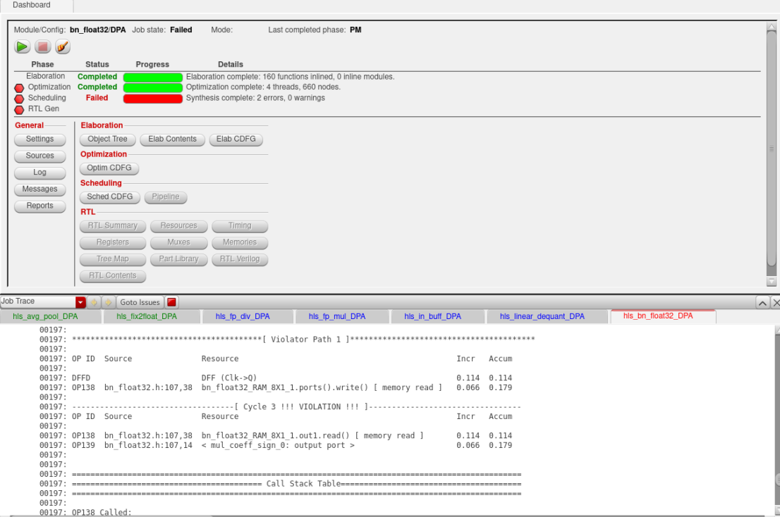
(2) RTL Wrapper로 구현

Slide 43
-. float2fix.h (SFU)
void _r_in_data()
{
if (!rstn.read()) {
r_in_data.write(0);
}
else if (src_valid.read()) {
r_in_data = src.read();
}
}
void _a_m_e_s()
{
if (!rstn.read()) {
a_m.write(0);
a_e.write(0);
a_s.write(0);
}
else if (!src_valid_1d.read()) {
a_m.write(0);
a_e.write(0);
a_s.write(0);
}
else {
a_m = (sc_uint<1>(1), r_in_data.read()(22, 0), sc_uint<8>(0));
a_e = r_in_data.read()(30, 23) - 127;
a_s = r_in_data.read()(31, 31);
}
}
void _comb_sig()
{
zero_sig = ((signed)(a_e.read()) == (-127)) ? 1 : 0;
max_sig = ((signed)(a_e.read()) > 31) ? 1 : 0;
zm_sig = zero_sig | max_sig;
shift_num = 31 - a_e.read();
}
void _r_a_m()
{
if (!rstn.read()) {
r_a_m.write(0);
}
else if (!src_valid_2d) {
r_a_m.write(0);
}
else if (zm_sig) {
r_a_m.write(0);
}
else {
r_a_m = a_m.read() >> shift_num.read();
}
}

Slide 44
void _dst()
{
if (!rstn.read())
dst.write(0);
else if (!src_valid_3d.read())
dst.write(0);
else if (r_zero_sig.read())
dst.write(0);
else if (r_max_sig.read())
dst.write(0);
else if (r_a_m.read()(31, 31))
dst.write(0);
else {
if (r_a_s.read())
dst = (~r_a_m.read()) + 1;
else
dst = r_a_m.read();
}
}
void _dst_valid()
{
if (!rstn.read())
dst_valid.write(0);
else
dst_valid = src_valid_3d.read();
}

Slide 45
-. Stratus vs. RTL
 |  | Stratus |  | RTL
 |  | Max Frequency (MHz) | Area(nm²) | Max Frequency (MHz) | Area(nm²)
ADDR_GEN | st_f_addr_gen | 892 | 2,506 | 899 | 2,470
 | st_w_addr_gen | 905 | 2,285 | 906 | 2,234
 | pw_f_addr_gen | 926 | 1,606 | 923 | 1,477
 | pw_w_addr_gen | 917 | 1,195 | 955 | 978
 | f_write_addr_gen | 1,847 | 4,036 | 1,665 | 4,173
 | bn_addr_gen | 1,590 | 383 | 1,827 | 234
 | bias_addr_gen | 1,587 | 304 | 1,603 | 251
 | Total | 892 | 12,315 | 899 | 11,817
PE_TOP | cache | 1,618 | 6,478 | 1,633 | 6,670
 | mac | 1,584 | 329 | 1,570 | 339
 | pe_array | 1,044 | 58,476 | 1,000 | 60,246
 | Total | 1,044 | 58,476 | 1,000 | 60,246
SFU | avg_pool | 1,417 | 5,925 | 505 | 8,375
 | in_buff | 1,633 | 12,023 | 891 | 11,970
 | fix2float | 1,442 | 3,058 | 572 | 2,291
 | linear_dequant(fp_div) | 471 | 14,092 | 163 | 21,614
 | bn_float32(fp_add, fp_mul) | 431 | 9,490 | 476 | 14,592
 | relu_offset_float32(fp_cmp) | 1,496 | 1,084 | 939 | 1,896
 | learn_clip (float2fix, fp_add, fp_mul) | 421 | 11,156 | 478 | 15,212
 | bias_add | 1,203 | 2,331 | 517 | 2,542
 | out_buff | 3,964 | 986 | 1,729 | 868
 | finish_gen | 1,518 | 97 | 932 | 92
 | sfu_top | 416 | 66,592 | 158 | 90,264
 | Total | 416 | 66,592 | 158 | 90,264
Synthesis Result (Design Compiler)

Slide 46
(2) Operation Time (Clock Cycle)
 | Layer0 | Layer1 | Layer2 | Layer3 | Layer4 | Layer5 | Layer6 | Layer7 | Layer8 | Layer9 | Layer10 | Layer11 | Layer12 | Layer13 | Layer14
Stratus | 351,358 | 125,562 | 215,136 | 62,844 | 164,988 | 125,564 | 279,678 | 31,482 | 139,901 | 62,842 | 254,589 | 15,803 | 127,358 | 31,482 | 242,045
RTL | 389,150 | 163,336 | 215,311 | 81,800 | 165,142 | 163,336 | 279,830 | 41,032 | 140,054 | 81,800 | 254,742 | 20,648 | 127,510 | 41,032 | 242,198
 | Layer15 | Layer16 | Layer17 | Layer18 | Layer19 | Layer20 | Layer21 | Layer22 | Layer23 | Layer24 | Layer25 | Layer26 | Layer27 | Layer28 | Total
Stratus | 31,482 | 242,045 | 31,482 | 242,045 | 31,482 | 242,045 | 31,482 | 242,045 | 7,962 | 121,085 | 15,802 | 235,773 | 1,720 | 33,095 | 3,740,177
RTL | 41,032 | 242,198 | 41,032 | 242,198 | 41,032 | 242,198 | 41,032 | 242,198 | 10,456 | 121,238 | 20,648 | 235,926 | 1,962 | 33,239 | 3,963,310
Stratus-generated RTL : Original RTL 대비 223,133 cycle 개선 (5.6%)

