Slide 1
TypeScript
Evolution of front-end development

Slide 2
Agenda
What is the typescript
Why we need typescript
Sample code

Slide 3
What is TypeScript
TypeScript is a frontend programming language, it lets you write JavaScript the way you really want to. TypeScript is a typed superset of JavaScript that compiles to plain JavaScript. Any browser. Any host. Any OS. Open Source.
Developed and maintained by Microsoft
It is free and open source
It compiles to javascript, any existing javascript programs are also valid javascript programs

Slide 4
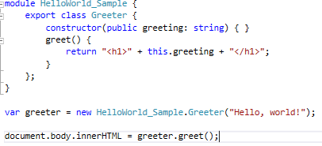
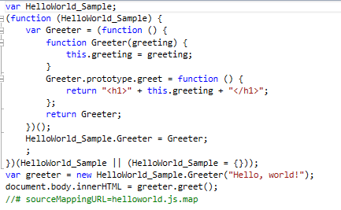
TypeScript

Slide 5
Why do we need typescript
Rich IDE support with autocomplete and code navigation features
Safe automatic refactorings
Typo discovered when it is compiled
Class-based OO, with inheritance, private members, interfaces and Generics
Module support (namespace in c#)
Any javascript code is a valid TypeScript code
Work with javascript libraries. (angular, typescript, react, vue, backbones)

Slide 6
Demo
How we change the way to develop traditional javascript project

