Slide 1
TypeScript
Evolution of front-end development

Slide 2
Agenda
What is the typescript
Why we need typescript
Sample code

Slide 3
What is TypeScript
TypeScript lets you write JavaScript the way you really want to. TypeScript is a typed superset of JavaScript that compiles to plain JavaScript. Any browser. Any host. Any OS. Open Source.
Developed and maintained by Microsoft
It is free and opensource
It compiles to javascript, any existing javascript programs are also valid javascript programs

Slide 4
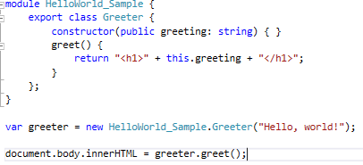
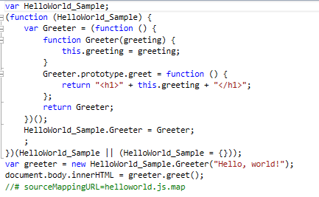
TypeScript

Slide 5
Typescript compiles to javascript
Debug typescript
IDE support, code navigation
Intellisense
Typo discovered when it is compiled
Object oriented, inheritance, interfaces.
Module
Generics
Work with javascript libraries. (angular, typescript, react, vue, backbones)

