Slide 1
TypeScript
Evolution of front-end development

Slide 2
Agenda
What is the typescript
Why we need typescript
Sample code

Slide 3
What is TypeScript
TypeScript lets you write JavaScript the way you really want to. TypeScript is a typed superset of JavaScript that compiles to plain JavaScript. Any browser. Any host. Any OS. Open Source.
Developed and maintained by Microsoft
It is free and open source
It compiles to javascript, any existing javascript programs are also valid javascript programs

Slide 4
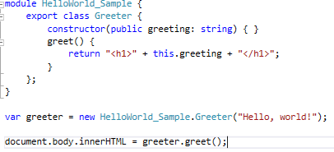
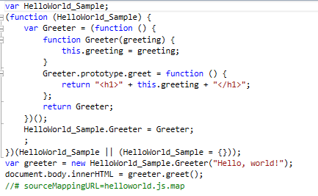
TypeScript

Slide 5
Why do we need typescript
Classes (parent, child, abstract)
Modules
Interfaces
Generics
Rich IDE support
Notes:
Classes: TypeScript introduces the notion of class-based object-oriented programming. This makes it fairly simple to structure code into classes, create class hierarchies, and manage the scope and visibility of methods and data throughout the system.
Modules: TypeScript’s modules are similar to namespaces in C#, allow defining variables, functions, classes off of the global scope. TypeScript also uses modules to declare the API that third-party libraries expose. It’s done through so called “ambient internal or external modules,” which contain only declarations and interfaces, but no implementation. This way it’s possible to provide the same level of IDE / type checker support for code that is available in pure JavaScript as if it was written in TypeScript. Such ambient declarations are stored in “.d.ts” files.
IDE: Typos caught at compilation time, intellisense, and code navigation.

Slide 6
Typescript compiles to javascript
Debug typescript
IDE support, code navigation
Intellisense
Typo discovered when it is compiled
Object oriented, inheritance, interfaces.
Module
Generics
Work with javascript libraries. (angular, typescript, react, vue, backbones)
Notes:
by theory, you never write native javascripts anymore, you just write ts. Because ts has so many benefits (such as type safety, module, object oriented, so it is really good for large scale application development,, and it is complied to javascript. For example, the heritage, and select committee we developed before, they were really complex projects, angular code was written with javascript, a lots redundant variables and functions, and it is really hard to maintain by other developers, even myself, sometimes hard to follow my own code, which was written few days ago.

