Slide 1
TypeScript
Evolution of front-end development

Slide 2
Agenda
What is the typescript
Why we need typescript
Sample code

Slide 3
What is TypeScript
TypeScript is a frontend programming language, it lets you write JavaScript the way you really want to. TypeScript is a typed superset of JavaScript that compiles to plain JavaScript. Any browser. Any host. Any OS. Open Source.
Developed and maintained by Microsoft
It is free and open source
It compiles to javascript, any existing javascript programs are also valid javascript programs

Slide 4
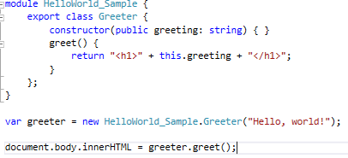
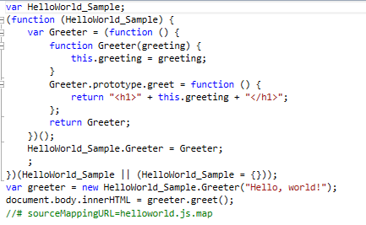
TypeScript

Slide 5
Why do we need typescript
Rich IDE support with autocomplete and code navigation features
Safe automatic refactorings
Typo discovered when it is compiled
Class-based OO, with inheritance, private members, interfaces and Generics
Module support (namespace in c#)
Any javascript code is a valid TypeScript code
Work with javascript libraries. (angular, typescript, react, vue, backbones)
Notes:
by theory, you never write native javascripts anymore, you just write ts. Because ts has so many benefits (such as type safety, module, object oriented, so it is really good for large scale application development,, and it is complied to javascript. For example, the heritage, and select committee we developed before, they were really complex projects, angular code was written with javascript, a lots redundant variables and functions, and it is really hard to maintain by other developers, even myself, sometimes hard to follow my own code, which was written few days ago.

Slide 6
Demo
How we change the way to develop traditional javascript project

