Slide 1
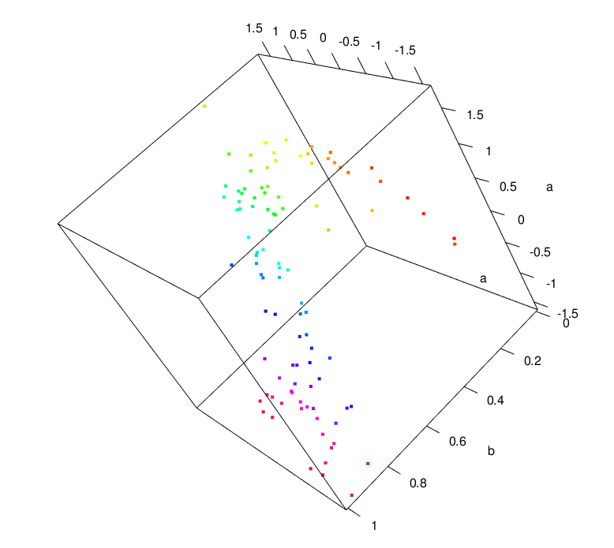
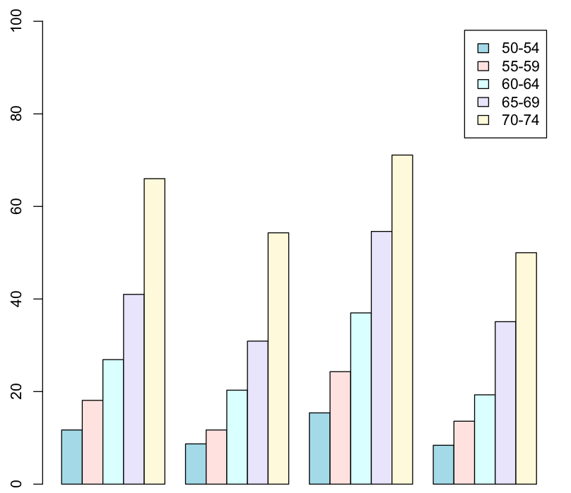
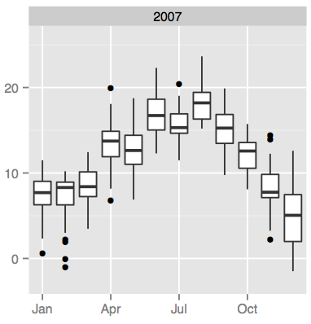
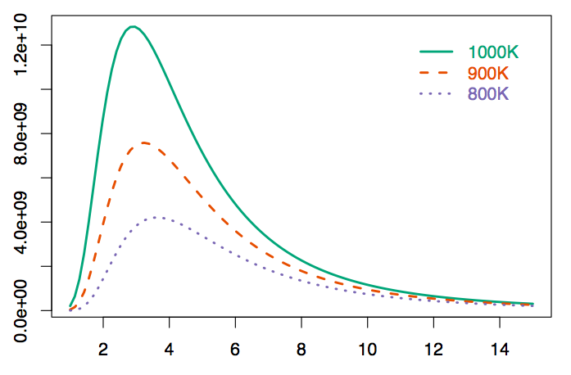
Basics of Using R
Xiao He

Slide 2
Agenda
What is R?
Basic operations
Different types of data objects
Importing data
Basic data manipulation

Slide 3
Agenda
What is R?
Arithmetic operations
Different types of data objects
Importing data
Basic data manipulation

Slide 4
What is r?
Free open source statistical programming language.
Comes with many statistical functions.
Thousands of statistical packages users can download.
Requires users to write code.

Slide 5
What is r?
Free open source statistical programming language.
Comes with many statistical functions.
Thousands of statistical packages users can download.
Ability to produce high quality plots.
Requires users to write code.

Slide 6
What is r?
Free open source statistical programming language.
Comes with many statistical functions.
Thousands of statistical packages users can download.
Ability to produce high quality plots.
Requires users to write code.
CASE SENSITIVE!

Slide 7
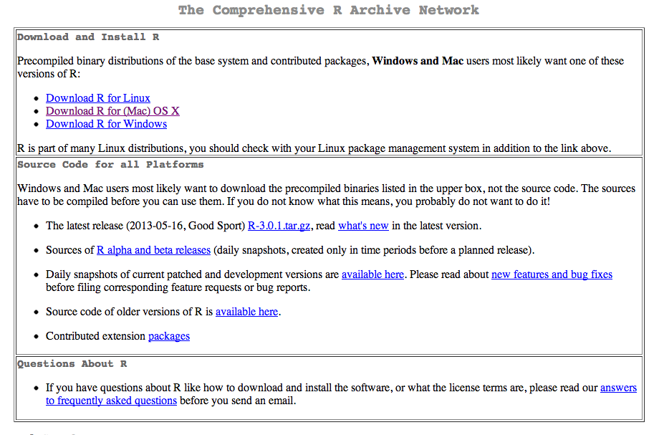
What is r?
Download: http://cran.r-project.org/ (choose a mirror)
Choose a version compatible with your OS

Slide 8
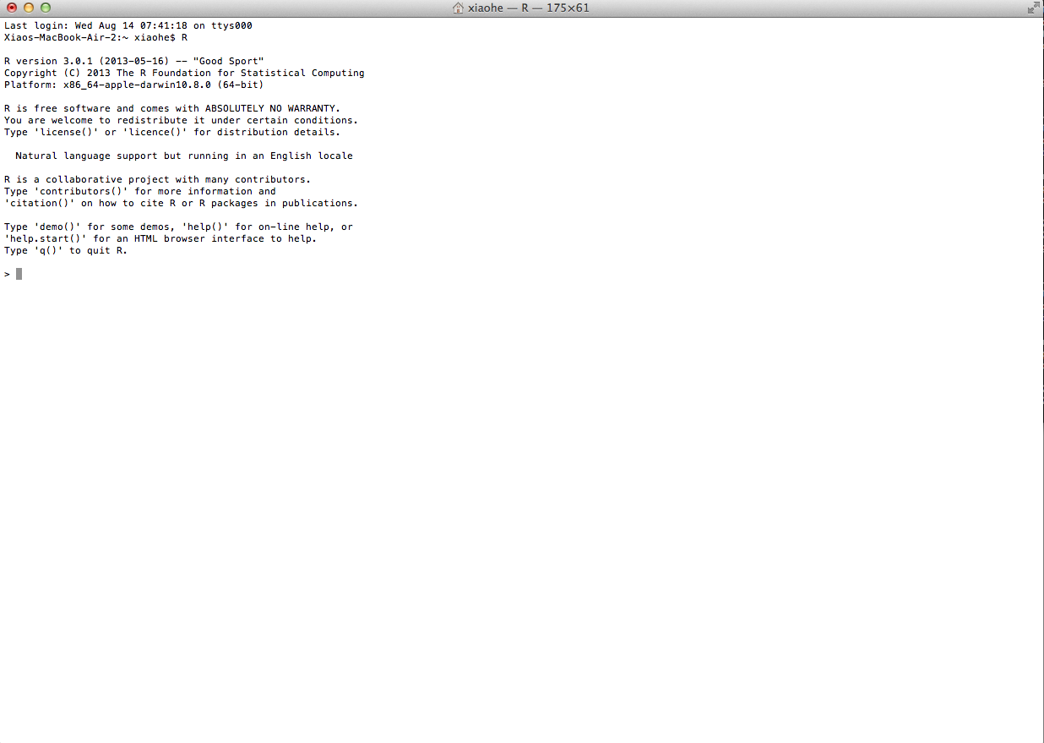
What is r?
Command-line style

Slide 9
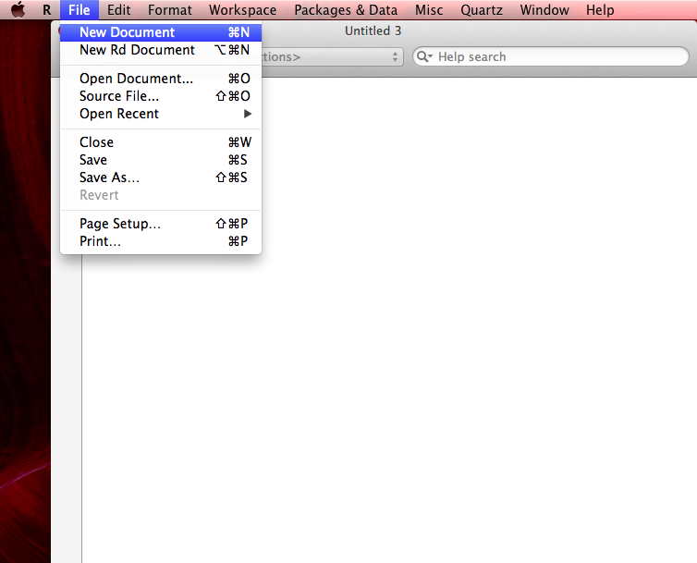
What is r?
Command-line style
If you are working on some more complicated or longer scripts, or if you want to save the scripts you are working on, it’s a good practice to write your code in a script editor. (In R, go to File > “New Document” (Mac) or “New Script” (Windows)).

Slide 10
Agenda
What is R?
Basic operations
Different types of data objects
Importing data
Basic data manipulation

Slide 11
Basic operations
Arithmetic operations:
+, -, *(elem.-wise mult.), /, ^ or **, sqrt() , abs()
%*% (matrix mult.)
Order of operations applies!!
Use parentheses to order operations if needed.
(2 - 3)/4 vs. 2 - 3/4
Assignment:
"<-" : Assigning a value (on the right side of <- to a name on the left side of <-.
Data objects can be created using <-.
E.g., a <- 2 (assigning 2 to an object named a)

Slide 12
Basic operations
EXERCISE 1: Arithmetic operations and assignment
Ex1.1:
Ex1.2:
Ex1.3: Assign the result of Ex1.1 to an object named ex1.1
Notes:
----- Meeting Notes (9/26/13 08:02) -----
3.2 - 2.5*sqrt(33)/1.4^3 - pi
2.5*(3.4 - sqrt(1.2))/1.3 * pi
Ex1.1 <- 3.245
Ex1.1

Slide 13
Agenda
What is R?
Basic operations
Different types of data objects
Importing data
Basic data manipulation

Slide 14

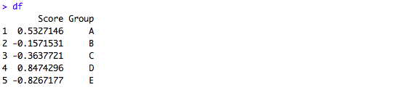
Data objects
Vectors
Matrices
Data frames (tables)

Slide 15
Data objects
Dimensionless
Data points of the same type:
e.g., numeric or character string, but not both.
How do we create vectors?
Use c(…)
Vectors
Matrices
Data frames (tables)

Slide 16
Data objects
EXERCISE 2: Creating vectors
Ex2.1: Create a vector named v1 that stores the following values: 2, 4, 1, 4, 6, 1
Ex2.2: Create a vector named v2 that stores the following character strings: "apple", "pear", "kiwi", ”plum”
Ex2.3: Create a vector named v3 that stores the following values: 1.3, 0.2, 3.2, 5.1, 4.3, 6.7
Ex2.4: Create a vector named v4 that stores the following Booleans: TRUE, FALSE, FALSE, TRUE
Ex2.5: Concatenate v1 and v3, and name the resulting vector v5.
Ex2.6: Check the number of elements in a vector using length().
Notes:
----- Meeting Notes (9/26/13 08:02) -----
v1 <- c(2, 4, 1, 4, 6, 1)

Slide 17
Data objects
Vectors
Matrices
Data frames (tables)
2-dimensional
Data points of the same type:
e.g., numeric or character string, but not both.
How do we create matrices?

Slide 18
Data objects
EXERCISE 3: Create matrices
Create a 3 by 2 matrix that stores the following values:
Column 1: 2.3, 2.1, 3.4
Column 2: 4.3, 1.2, 5.2
**There are a few ways of doing this.

Slide 19
Basic operations
EXERCISE 3
Column 1: 2.3, 2.1, 3.4
Column 2: 4.3, 1.2, 5.2
1). Create two vectors and then use cbind().
2). Use cbind() without explicitly creating vectors.
3). Create one vector to store all 6 values, and use matrix() to convert it into a matrix.
4). Use matrix() without explicitly creating a vector.
5). Check the dimensions of a matrix using dim(), nrow(), and ncol().
EXERCISE 2: Creating data objects
Ex2.2: Create a 3 by 2 matrix named m1 that stores the following values:
Column 1: 2.3, 2.1, 3.4
Column 2: 4.3, 1.2, 5.2
**There are a few ways of doing this.

Slide 20
Data objects
Vectors
Matrices
Data frames
2-dimensional
Can store different data types.
How do we create data frames?

Slide 21
Data objects
EXERCISE 4: Creating data frames
Ex4.1: Convert a matrix into a data frame:
Ex4.2: Create a data frame using data.frame().
Suppose we have 2 variables: the 1st variable is called `score`, and the 2nd variable is called `id`.
score: 68, 70, 82, 96
id: "subj1", "subj2", "subj3", "subj4"
Ex4.2: Check the dimensions using dim(), nrow(), and ncol().

Slide 22
Agenda
What is R?
Basic operations
Different types of data objects
Importing data
Basic data manipulation

Slide 23
IMPORT DATA
Natively supported data files:
.txt, .dat, .csv
Some R packages extend support to data formats of other popular statistical programs, such as SPSS, STATA, and SAS.
e.g., the R package `foreign` and the R package `RODBC` (Excel)
(There are additional ways to import data that are not discussed here)

Slide 24
IMPORT DATA: VECTORS & MATRICES
Import vectors and matrices using scan().
(Due to time constraint, won’t discuss this here)
scan() reads data points from a file (e.g., .txt and .dat).

Slide 25
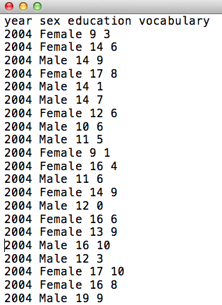
IMPORT DATA: DATA FRAMES
Windows: "C:\Users\XiaoHe\Desktop\my_data_file.csv”
Mac: "/Users/xiaohe/Dropbox/R workshop/my_data_file.csv”
NOTE: On windows, the path cannot be used as is, you have to change the slashes from backward slash “\” to forward slashes “/”; OR you can change all the single backward slashes to DOUBLE backward slashes.
"C:\Users\XiaoHe\Desktop\my_data_file.csv"
"C:/Users/XiaoHe/Desktop/my_data_file.csv”
Or
➔"C:\\Users\\XiaoHe\\Desktop\\my_data_file.csv”
Import data frames using read.table().
read.table(file, header = FALSE, sep = "", ...)
file: path and the name of the file to be read in.*
header: whether the 1st row contains column names.
sep: a character that separates values in a row.
*You can use file.choose() instead typing out the file path and file name.
1. Let’s import the dataset vocab.txt and save it as vocab. First, open the text file using a text editor to see what the dataset looks like.
vocab <- read.table(file="path/to/vocab.txt", header=FALSE)
Is the code above correct or wrong given what you saw in the data file?
vocab <- read.table(file="path/to/vocab.txt", header=TRUE) #Correct code
head(vocab)
str(vocab) #str() lets us display the structure of an R
#object.
Notes:
----- Meeting Notes (9/26/13 08:52) -----
vocab <- read.table(file="/Users/xiaohe/Dropbox/R workshop/vocab.txt", header=TRUE)

Slide 26
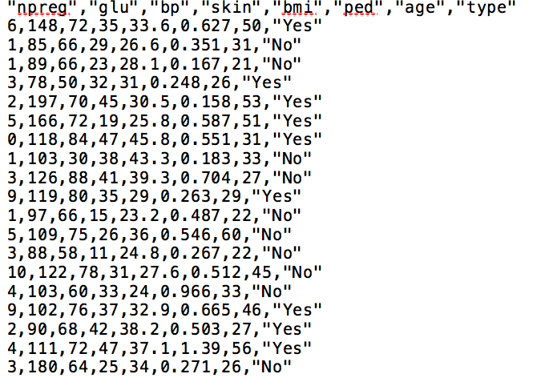
IMPORT DATA: DATA FRAMES
Import data frames using read.table().
read.table(file, header = FALSE, sep = "", ...)
file: path and the name of the file to be read in.*
header: whether the 1st row contains column names.
sep: a character that separates values in a row.
*You can use file.choose() instead typing out the file path and file name.
2. Let’s import another set of data, called pima.csv and save it as pima. First, open the text file using a text editor to see what the dataset looks like.
pima <- read.table(file=file.choose(), header=TRUE, sep=",")
head(pima)
str(pima)

Slide 27
IMPORT DATA: DATA FRAMES
Import datasets stored in formats not natively supported, using the package `foreign`.
`foreign` must be installed.
In R, installing a package can be done using install.packages("pkg_name")
After installing a package, we need to load it using library(pkg_name) when we want to use it.
So to install `foreign`, we do install.packages("foreign")
To use the functions in `foreign`, we do library(foreign)

Slide 28
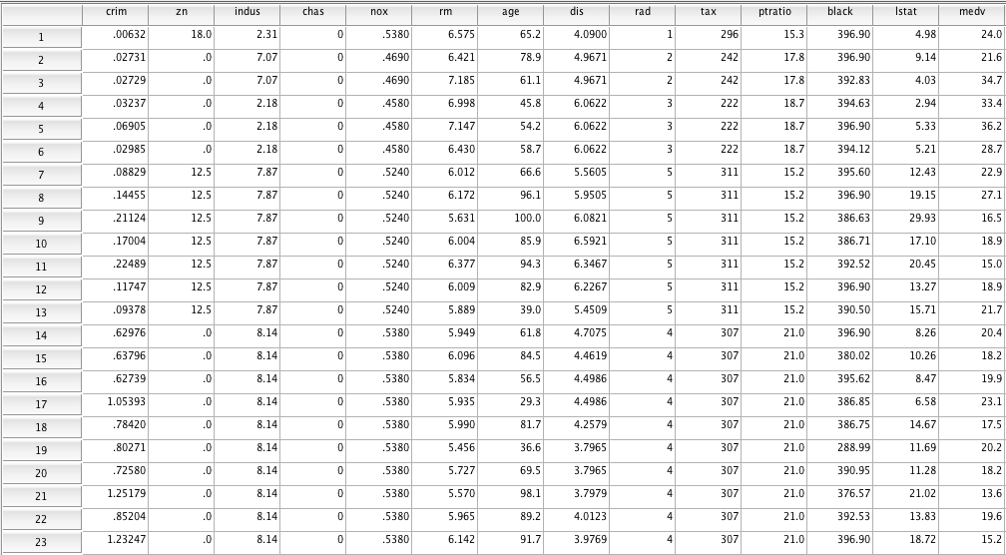
IMPORT DATA: DATA FRAMES
Import datasets stored in formats not natively supported, using the package `foreign`.
read.spss() → SPSS
read.dta() → STATA
read.xport() → SAS
Let’s now import an SPSS dataset called boston.sav.

Slide 29
IMPORT DATA: DATA FRAMES
Import datasets stored in formats not natively supported, using the package `foreign`.
read.spss() → SPSS
read.dta() → STATA
read.xport() → SAS
Let’s now import an SPSS dataset called boston.sav.
boston <- read.spss(file.choose(), to.data.frame=TRUE)
head(boston)

Slide 30
Agenda
What is R?
Basic operations
Different types of data objects
Importing data
Basic data manipulation

Slide 31
Manipulate data objects
Subsetting
Vectors: (we will use the vector v1 we created earlier)
> v1
[1] 2 4 1 4 6 1
a). Selecting observations using `[index]`.
b). Delete observations using `[-index]` (negative index).
Exercise 5
Ex5.1: Select one observation: Select the 2nd obs.
Ex5.2: Select contiguous observations: Select the 3rd, 4th, and 5th obs.
Ex5.3: Select non-contiguous observations: Select the 1st, 4th & 5th obs.

Slide 32
Manipulate data objects
Subsetting
Vectors: (we will use the vector v1 we created earlier)
> v1
[1] 2 4 1 4 6 1
a). Selecting observations using `[index]`.
b). Delete observations using `[-index]` (negative index).
Exercise 5 (cont’d)
Ex5.4: Delete one observation: delete the 2nd obs.
Ex5.5: Delete contiguous observations: delete the 3rd, 4th, & 5th obs.
Ex5.6: Delete non-contiguous observations: delete the 1st, 4th, & 5th obs.

Slide 33
Manipulate data objects
Subsetting
Matrices: (we will use the matrix m1a we created earlier)
> m1a
[,1] [,2]
[1,] 2.3 4.3
[2,] 2.1 1.2
[3,] 3.4 5.2
Matrices are 2-D, so we can use both the row index and the col index for sub-setting – [row_index, col_index].
Exercise 5 (cont’d)
Ex5.7: Select a single data point: select the 3rd row in the 2nd column
Ex5.8: Select an entire column/row: select the 3rd row; select the 1st column.

Slide 34
Manipulate data objects
Subsetting
Matrices: (we will use the matrix m1a we created earlier)
> m1a
[,1] [,2]
[1,] 2.3 4.3
[2,] 2.1 1.2
[3,] 3.4 5.2
Matrices are 2-D, so we can use both the row index and the col index for sub-setting – [row_index, col_index].
Exercise 5 (cont’d)
Ex5.9: An example involving non-contiguous rows: select the 1st and the 3rd rows in the 1st col.
(Negative indices also work for matrices, but won’t be shown here)

Slide 35
Manipulate data objects
Subsetting
Data frames: (we will use the data frame vocab we imported earlier)
> head(vocab) #display the first 6 rows
year sex education vocabulary
1 2004 Female 9 3
2 2004 Female 14 6
3 2004 Male 14 9
4 2004 Female 17 8
5 2004 Male 14 1
6 2004 Male 14 7
Since data frames are 2-D, we can also use the row index and the col index to extract and subset data: [row_index, col_index]
Ex5.10: Save the 2nd to the 4th row in a new data frame named vocab.a.

Slide 36
Manipulate data objects
Subsetting
Data frames: (we will use the data frame vocab we imported earlier)
> head(vocab) #display the first 6 rows
year sex education vocabulary
1 2004 Female 9 3
2 2004 Female 14 6
3 2004 Male 14 9
4 2004 Female 17 8
5 2004 Male 14 1
6 2004 Male 14 7
Since data frames are 2-D, we can also use the row index and the col index to extract and subset data: [row_index, col_index]
Ex5.11: Save the 2nd and the 3th rows of columns 2 and 4.

Slide 37
Manipulate data objects
Subsetting
Data frames: (we will use the data frame vocab we imported earlier)
> head(vocab) #display the first 6 rows
year sex education vocabulary
1 2004 Female 9 3
2 2004 Female 14 6
3 2004 Male 14 9
4 2004 Female 17 8
5 2004 Male 14 1
6 2004 Male 14 7
We can also use `df_name$col_name` to extract an individual column.
Ex5.12: Extract the year column.

Slide 38
Manipulate data objects
Subsetting
Data frames: (we will use the data frame vocab we imported earlier)
> head(vocab) #display the first 6 rows
year sex education vocabulary
1 2004 Female 9 3
2 2004 Female 14 6
3 2004 Male 14 9
4 2004 Female 17 8
5 2004 Male 14 1
6 2004 Male 14 7
We can also use `df_name[, "col_name"]` to extract columns.
Ex5.13: (a) Extract the education column
(b) Extract both the vocabulary and the education columns,
NOTE: This method will also work with matrices that have column names.

Slide 39
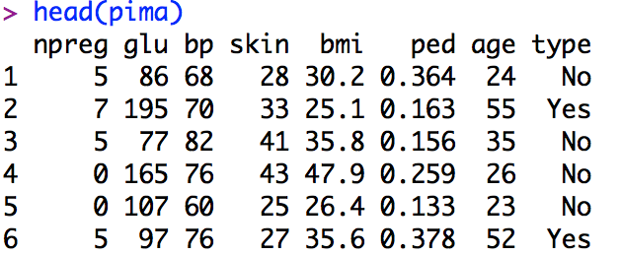
Manipulate data objects
Subsetting data frames using subset()
subset(x, subset, select)
x: data frame
subset: logical expr. indicating elements or rows to keep.
select: column(s) to be selected; default: all columns.
Ex5.14: Let’s select a subset of pima for women with more than 10 pregnancies:

Slide 40
Manipulate data objects
Subsetting data frames using subset()
subset(x, subset, select)
x: data frame
subset: logical expr. indicating elements or rows to keep.
select: column(s) to be selected; default: all columns.
Ex5.15: Select a subset of pima for women with more than 10 pregnancies AND at least 44 years of age.

Slide 41
Manipulate data objects
Subsetting data frames using subset()
subset(x, subset, select)
x: data frame
subset: logical expr. indicating elements or rows to keep.
select: column(s) to be selected; default: all columns.
Ex5.16: Select a subset of pima for women who were either never pregnant or women who had more than 12 pregnancies, and we only want the first 3 cols.
Ex5.17: Select a subset of pima for women who had more than 10 pregnancies and did not have diabetes.

Slide 42
Misc.
1. Check what objects are currently in your workspace
ls()
objects()
2. Remove objects
rm(object1_name, object2_name)
rm(list=ls()) #removes all objects, so be careful!!
3. Unload a previously loaded package
detach("package:package_name", unload=TRUE)
4. Check the arguments of a function
args(function_name)
5. Help file
?function_name
6. Write a data frame to file
?write.table(df_name, "file_name")
check ?write.table for additional arguments.

Slide 43
Thanks!

