Slide 1
Introduction to R
Dr. Jieh-Shan George Yeh
jsyeh@pu.edu.tw

Slide 2
Outlines
Intro to R & RStudio
Intro to basics
Vectors
Matrices
Factors
Data frames
Lists

Slide 3
Intro to R & RStudio

Slide 4

R programming language
R is a free software programming language and software environment for statistical computing and graphics.
The R language is widely used among statisticians and data miners for developing statistical software and data analysis.
With over 2 million users worldwide R is rapidly becoming the leading programming language in statistics and data science.
http://www.r-project.org/

Slide 5
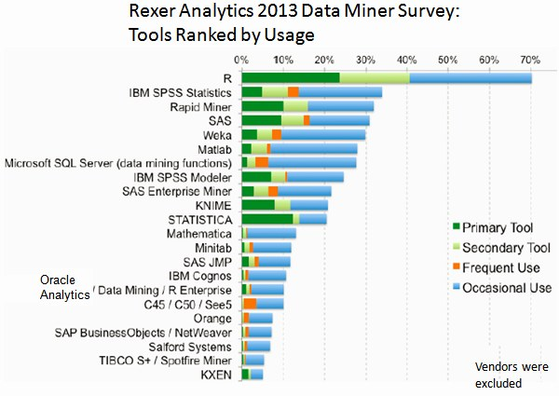
Rexer Analytics 2013 Data Miner Survey Highlights
http://www.kdnuggets.com/2013/10/rexer-analytics-2013-data-miner-survey-highlights.html

Slide 6
R programming language
R is a GNU project.
R is freely available under the GNU General Public License, and pre-compiled binary versions are provided for various operating systems.
R uses a command line interface; however, several graphical user interfaces are available for use with R.

Slide 7
R programming language
R is an interpreted language; users typically access it through a command-line interpreter.
R's data structures include vectors, matrices, arrays, data frames (similar to tables in a relational database) and lists.

Slide 8

RStudio
RStudio is a free and open source integrated development environment (IDE) for R.
Two editions:
RStudio Desktop, where the program is run locally as a regular desktop application;
RStudio Server, which allows accessing RStudio using a web browser while it is running on a remote Linux server.
http://www.rstudio.com/

Slide 9
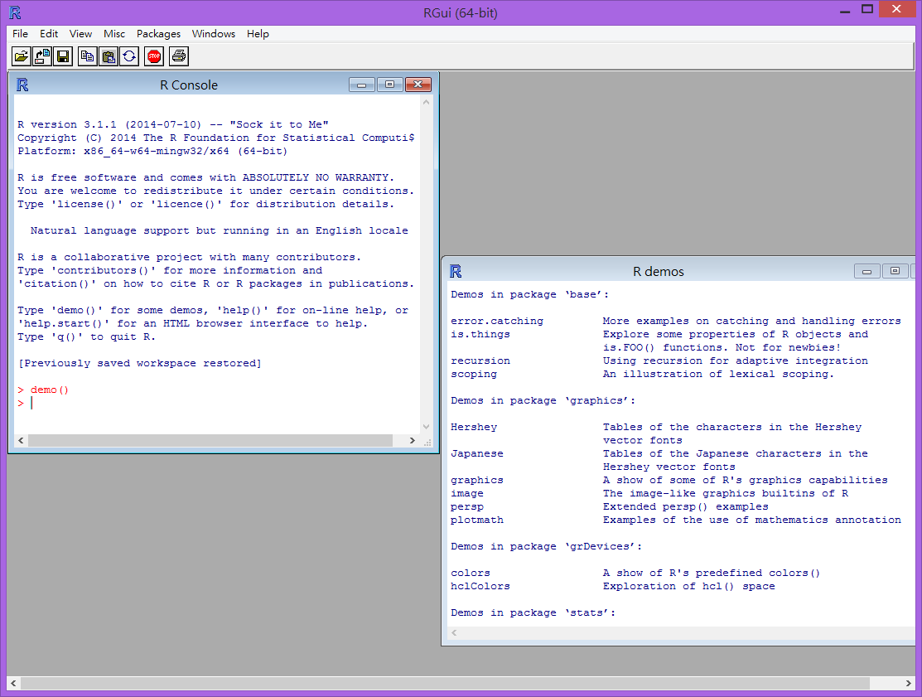
RGui

Slide 10
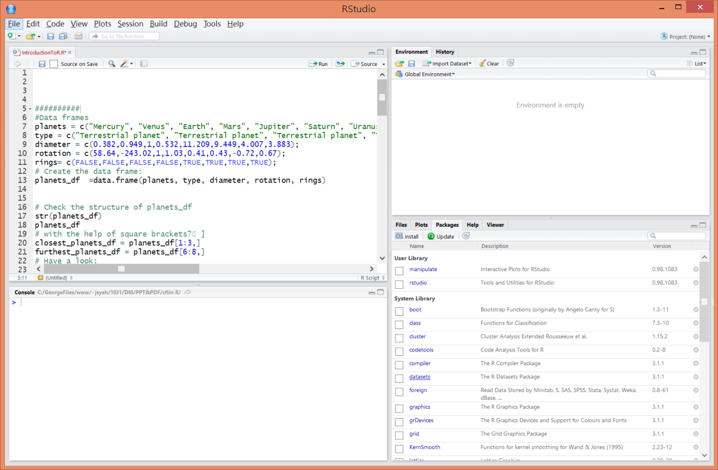
RStudio

Slide 11
Intro to basics

Slide 12
How it works
R makes use of the # sign to add comments, such that you and others can understand what the R code is about.
Comments are not run as R-code, so they will not influence your result.
The output of your R code is shown in the console, while graphs are shown in the upper right corner.

Slide 13
# The hashtag is used to add comments
# Show some demo graphs generated with R
demo("graphics")
# Calculate 3+4
3 + 4

Slide 14
Little arithmetics with R
Arithmetic operators:
Addition: +
Subtraction: -
Multiplication: *
Division: /
Exponentiation: ^
Modulo: %%
The last two might need some explaining:
The ^ operator takes the number left to it to the power of the number on its right-hand side: for example 3^2 is 9.
The modulo returns the remainder of the division of the number left to it by the number on its right-hand side, for example 5 modulo 3 or 5%%3 is 2.

Slide 15
Example
# An addition
5 + 5
# A subtraction
5 – 5
# A multiplication
3 * 5
# A division
(5 + 5)/2
# Exponentiation
2^5
# Modulo
17%%4

Slide 16
Variable assignment
A basic concept in (statistical) programming is called a variable.
A variable allows you to store a value (e.g. 4) or object (e.g. a function description) in R. Then later you can use this variable's name to easily access the value or object that is stored within this variable.
You can assign a value 4 to a variable my_variable with the command:
my_variable = 4.

Slide 17
Example
# Assign the value 42 to x
x = 42
y <- 20
# Print out the value of the variable x
X
y

Slide 18
Basic data types in R
R works with numerous data types. Some of the most basic types to get started are:
Decimals values like 4.5 are called numerics.
Natural numbers like 4 are called integers.
Boolean values (TRUE or FALSE) are called logical (TRUE can be abbreviated to T and FALSE to F).
Text (or string) values are called characters.
Note that R is case sensitive!

Slide 19
Example
my_numeric = 42
# The quotation marks indicate that the variable is of type character
my_character = "forty-two"
my_logical = FALSE #all capital

Slide 20
What's that data type?
Remember when you added 5 + "six" and got an error due to a mismatch in data types? You avoid such embarrassing situations by checking the data type of a variable upfront. You can do this as follow:
class(some_variable_name)
typeof(some_variable_name)
mode(some_variable_name)

Slide 21
Example
# Declare variables of different types
my_numeric = 42
my_character = "forty-two"
my_logical = FALSE
# Check which type these variables have:
class(my_numeric)
class(my_character)
class(my_logical)

Slide 22
Vectors

Slide 23
Create a vector
In R, you create a vector with the combine function c(). Between the brackets you place the vector elements separated by a comma. For example:
numeric_vector = c(1,2,3)
character_vector = c("a","b","c")
boolean_vector = c(TRUE,FALSE)
Once you have created these vectors in R, you can use them to do calculations.

Slide 24
Example
After one week in Las Vegas and still zero Ferrari's in your garage, you decide it is time to start using your data analytical superpowers.
Before doing a first analysis, you decide to first collect the winnings and losses for the last week:
For poker_vector:
On Monday you won 140$
Tuesday you lost 50$
Wednesday you won 20$
Thursday you lost 120$
Friday you won 240$
For roulette_vector:
On Monday you lost 24$
Tuesday you lost 50$
Wednesday you won 100$
Thursday you lost 350$
Friday you won 10$

Slide 25
Example
# Poker winnings from Monday to Friday
poker_vector = c(140,-50,20,-120,240)
# Roulette winnings form Monday to Friday
roulette_vector = c(-24, -50, 100, -350, 10)

Slide 26
Naming a vector
# Poker winnings from Monday to Friday
poker_vector = c(140, -50, 20, -120, 240)
# Roulette winnings form Monday to Friday
roulette_vector = c(-24, -50, 100, -350, 10)
# give a name to poker_vector
names(poker_vector) = c('Monday', 'Tuesday', 'Wednesday', 'Thursday', 'Friday')
names(roulette_vector) = c('Monday', 'Tuesday', 'Wednesday', 'Thursday', 'Friday')

Slide 27
Naming a vector (2)
There is a more efficient way to do this: assign the days of the week vector to a variable!
Just like you did with your poker and roulette returns, you can also create a variable that contains the days of the week. This way you can use and re-use it.

Slide 28
Example
# Poker winnings from Monday to Friday
poker_vector = c(140,-50,20,-120,240)
# Roulette winnings form Monday to Friday
roulette_vector = c(-24,-50,100,-350,10)
# Create the variable days_vector containing "Monday","Tuesday","Wednesday","Thursday","Friday“
days_vector = c( "Monday","Tuesday","Wednesday","Thursday","Friday")
#Assign the names of the day to the roulette and poker_vectors
names(poker_vector) = days_vector
names(roulette_vector) =days_vector

Slide 29
Calculating total winnings
Now, you want to find out the following type of information:
How much has been your overall profit or loss per day of the week?
Have you lost money over the week in total?
Are you winning/losing money on poker or on roulette?
To get the answers, you have to do arithmetic calculations on vectors.
Important to know is that if you sum two vectors in R, it takes the element-wise sum. For example: c(1,2,3)+c(4,5,6) is equal to c(1+4,2+5,3+6) or c(5,7,9). Let's try this first!

Slide 30
A_vector = c(1, 2, 3)
B_vector = c(4, 5, 6)
# Take the sum of A_vector and B_vector
Total_vector = A_vector + B_vector

Slide 31
# daily total
total_daily = poker_vector +roulette_vector
# calculates the sum of all elements of a vector
total_poker = sum(poker_vector)
total_roulette = sum(roulette_vector)
total_week = total_poker+total_roulette

Slide 32
Vector selection
# Define new variable based on a selection
poker_wednesday = poker_vector[3]
# Define new variable based on a selection
poker_midweek = poker_vector[c(2, 3, 4)]
# Define new variable based on a selection
roulette_selection_vector = roulette_vector[2:5]
#Notice how the vector 2:5 is placed between the square brackets to select element 2 up to 5.

Slide 33
Selection by comparison - Step 1
The (logical) comparison operators known to R are:
< for less than
> for greater than
>= for greater than or equal to
== for equal to each other
!= not equal to each other
The nice thing about R is that you can use these comparison operators also on vectors.
For example, the statement c(4,5,6) > 5
returns: FALSE FALSE TRUE.
In other words, you test for every element of the vector if the condition stated by the comparison operator is TRUE or FALSE.

Slide 34
Example
# What days of the week did you make money on poker
selection_vector = poker_vector > 0
selection_vector

Slide 35
Selection by comparison - Step 2
You can select the desired elements, by putting selection_vector between square brackets when selecting from poker_vector. This works, because by default R only selects those elements where selection_vector is TRUE. For selection_vector this means where poker_vector > 0.

Slide 36
Example
# What days of the week did you make money on poker
selection_vector = poker_vector > 0
# Select from poker_vector these days
poker_winning_days = poker_vector[selection_vector]
poker_winning_days

Slide 37
Matrices

Slide 38
What's a matrix?
In R, a matrix is a collection of elements of the same data type (numeric, character, or logical) arranged into a fixed number of rows and columns. Since you are only working with rows and columns, a matrix is called two-dimensional.
In R, you can construct a matrix with the matrix function, for example: matrix(1:9, byrow=TRUE, nrow=3)
The first argument, is the collection of elements that R will arrange into the rows and columns of the matrix. Here, we use 1:9 which constructs the vector c(1,2,3,4,5,6,7,8,9).
The argument byrow indicates that the matrix is filled by the rows. If we want the vector to be filled by the columns, we just place bycol=TRUE or byrow=FALSE.
The third argument nrow indicates that the matrix should have three rows.

Slide 39
Example
# Construction of a matrix with 3 rows containing the numbers 1 up to 9
matrix(1:9, byrow = TRUE, nrow = 3)

Slide 40
Example
# Box office Star Wars: In Millions! The first element: US, Second element: Non-US
new_hope = c(460.998007, 314.4)
empire_strikes = c(290.475067, 247.9)
return_jedi = c(309.306177, 165.8)
# Add your code below to construct the matrix
star_wars_matrix = matrix(c(new_hope, empire_strikes, return_jedi), nrow = 3, byrow = TRUE)
star_wars_matrix

Slide 41
Example
# Similar to vectors, you can add names for the rows and the columns of a matrix
colnames(star_wars_matrix) = c("US", "non-US")
rownames(star_wars_matrix) = c("A New Hope", "The Empire Strikes Back", "Return of the Jedi")
star_wars_matrix

Slide 42
Example
# Box office Star Wars: In Millions (!) Construct matrix:
box_office_all = c(461, 314.4, 290.5, 247.9, 309.3, 165.8)
movie_names = c("A New Hope", "The Empire Strikes Back", "Return of the Jedi")
col_titles = c("US", "non-US")
star_wars_matrix = matrix(box_office_all, nrow = 3, byrow = TRUE, dimnames = list(movie_names, col_titles))

Slide 43
Adding a column for the Worldwide box office
# rowSums() conveniently calculates the totals for each row of a matrix.
worldwide_vector = rowSums(star_wars_matrix)
# Bind the new variable worldwide_vector as a column to star_wars_matrix
all_wars_matrix = cbind(star_wars_matrix, worldwide_vector)

Slide 44
# Box office Star Wars: In Millions (!) > > # Matrix containing first trilogy box office > star_wars_matrix US non-US
A New Hope 461.0 314.4
The Empire Strikes Back 290.5 247.9
Return of the Jedi 309.3 165.8
> # Matrix containing second trilogy box office > star_wars_matrix2 US non-US
The Phantom Menace 474.5 552.5
Attack of the Clones 310.7 338.7
Revenge of the Sith 380.3 468.5
> # Combine both Star Wars trilogies in one matrix > all_wars_matrix = rbind(star_wars_matrix, star_wars_matrix2) > all_wars_matrix

Slide 45
Example
# Print box office Star Wars: In Millions (!) for 2 trilogies all_wars_matrix
total_revenue_vector = colSums(all_wars_matrix)
total_revenue_vector
movie_revenue_vector = rowSums(all_wars_matrix)
movie_revenue_vector

Slide 46
Selection of matrix elements
my_matrix[1,2] selects from the first row the second element.
my_matrix[1:3,2:4] selects rows 1,2,3 and columns 2,3,4.
If you want to select all elements of a row or column, no number is needed before or after the comma:
my_matrix[,1] selects all elements of the first column.
my_matrix[1,] selects all elements of the first row.

Slide 47
Example
# the arithmetic mean
non_us_all = mean(star_wars_matrix[, 2])
non_us_some = mean(star_wars_matrix[1:2, 2])

Slide 48
# Box office Star Wars: In Millions (!)
box_office_all = c(461, 314.4, 290.5, 247.9, 309.3, 165.8)
movie_names = c("A New Hope", "The Empire Strikes Back", "Return of the Jedi")
col_titles = c("US", "non-US")
star_wars_matrix = matrix(box_office_all, nrow = 3, byrow = TRUE, dimnames = list(movie_names, col_titles))
ticket_prices_matrix = matrix(c(5, 5, 6, 6, 7, 7), nrow = 3, byrow = TRUE, dimnames = list(movie_names, col_titles))
#
visitors = star_wars_matrix/ticket_prices_matrix
#
average_us_visitor = mean(visitors[, 1])
average_non_us_visitor = mean(visitors[, 2])

Slide 49
Factors

Slide 50
What's a factor
The term factor refers to a statistical data type used to store categorical variables.
A categorical variable can belong to a limited number of categories.
A continuous variable can correspond to an infinite number of values.
The statistical models you will develop in the future treat both types in a different way.
Example of a categorical variable
'Gender'. As you hopefully know by now, a human individual can either be "Male" or "Female". So "Male" and "Female" are here the (only two) values of the categorical variable "Gender", and every observation can be assigned to either the value "Male" of "Female".

Slide 51
Example
#The function factor() will encode the vector as a factor
gender_vector = c("Male", "Female", "Female", "Male", "Male")
factor_gender_vector = factor(gender_vector)
factor_gender_vector

Slide 52
Categorical variables
Two types of categorical variables: a nominal categorical variable and an ordinal categorical variable.
A nominal variable is a categorical variable without an implied order. This means it is impossible to say that 'one is worth more than the other'.
Example: animals_vector, with the categories "Elephant", "Giraffe", "Donkey" and "Horse".
An ordinal variables do have a natural ordering.
Example: temperature_vector with the categories: "Low", "Medium" and "High".

Slide 53
animals_vector = c("Elephant", "Giraffe", "Donkey", "Horse")
temperature_vector = c("High", "Low", "High", "Low", "Medium")
factor_animals_vector = factor(animals_vector)
factor_temperature_vector = factor(temperature_vector, order = TRUE, levels = c("Low", "Medium", "High"))
factor_animals_vector
factor_temperature_vector

Slide 54
Factor levels
#R allows you to change the names of factor levels with the function levels()
survey_vector = c("M", "F", "F", "M", "M")
factor_survey_vector = factor(survey_vector)
levels(factor_survey_vector) = c("Male", "Female")
factor_survey_vector

Slide 55
Summarizing a factor
survey_vector = c("M", "F", "F", "M", "M")
factor_survey_vector = factor(survey_vector)
levels(factor_survey_vector) = c("Female", "Male")
factor_survey_vector
summary(survey_vector)
summary(factor_survey_vector)

Slide 56
Ordered factors
speed_vector = c("Fast", "Slow", "Slow", "Fast", "Ultra-fast")
factor_speed_vector = factor(speed_vector, ordered = TRUE, levels = c("Slow", "Fast", "Ultra-fast"))
# Print
factor_speed_vector
# R prints automagically in the right order
summary(factor_speed_vector)
compare_them = factor_speed_vector[2] > factor_speed_vector[5]
# Is data analyst 2 faster than data analyst 5
compare_them

Slide 57
Data frames

Slide 58
What's a data frame?
A data frame is a dataset of different data types.
A data frame has the variables of a dataset as columns and the observations as rows.
Example:
# Built-in R dataset stored in a data frame
mtcars

Slide 59
Example
# Have a quick look at your data
head(mtcars)
tail(mtcars)
# Investigate the structure of the mtcars dataset
str(mtcars)

Slide 60
Creating a data frame
Example: construct a data frame that describes the main characteristics of 8 planets in our solar system.
planets = c("Mercury", "Venus", "Earth", "Mars", "Jupiter", "Saturn", "Uranus", "Neptune");
type = c("Terrestrial planet", "Terrestrial planet", "Terrestrial planet", "Terrestrial planet", "Gas giant", "Gas giant", "Gas giant", "Gas giant")
diameter = c(0.382,0.949,1,0.532,11.209,9.449,4.007,3.883);
rotation = c(58.64,-243.02,1,1.03,0.41,0.43,-0.72,0.67);
rings= c(FALSE,FALSE,FALSE,FALSE,TRUE,TRUE,TRUE,TRUE);
# Create the data frame:
planets_df =data.frame(planets, type, diameter, rotation, rings)

Slide 61
Selection of data frame elements
# Check the structure of planets_df
str(planets_df)
planets_df
# with the help of square brackets [ ]
closest_planets_df = planets_df[1:3,]
furthest_planets_df = planets_df[6:8,]
# Have a look:
closest_planets_df
furthest_planets_df

Slide 62
Selection of data frame elements
# use of the variable name
furthest_planets_diameter = planets_df[3:8,"diameter"]
# use the $-sign to look up all the elements of the variable behind the sign
# Create the rings_vector
rings_vector = planets_df$rings
# Select the information on planets with rings:
planets_with_rings_df = planets_df[rings_vector, ]

Slide 63
# Planets smaller than earth:
small_planets_df = subset(planets_df, planets_df$diameter <1)

Slide 64
Sorting
# order() is applied on a variable, gives you in return the position of each element
a = c(100,9,101)
order(a)
# a[order(a)] gives you the ordered vector
a[order(a)]

Slide 65
Example
# What is the correct ordering based on the planets_df$diameter variable?
positions = order(planets_df$diameter, decreasing = TRUE)
# Create new 'ordered' data frame:
largest_first_df = planets_df[positions, ]

Slide 66
Lists

Slide 67
What is a list in R?
Vectors (one dimensional array) holds numeric, character or logical values. The elements in one vector all have the same datatype.
Matrices (two dimensional array) holds numeric, character or logical values. The elements in one matrix all have the same datatype.
Data frames (two-dimensional objects) holds numeric, character or logical values. Within a column all elements have the same datatype, but between columns not necessarily.
Lists gather a variety of objects under one name (the name of the list) in an ordered way.

Slide 68
Example
# Vector with numerics from 1 up to 10
my_vector = 1:10
# Matrix with numerics from 1 up to 9
my_matrix = matrix(1:9, ncol=3)
# First 10 elements of the built-in data frame mtcarsmy_df = mtcars[1:10,]
# Construct list with these different elements:
my_list = list(my_vector, my_matrix, my_df)
# Construct list with these different elements:
my_List=list(VECTOR=my_vector, MATRIX=my_matrix, DATAFRAME=my_df)

Slide 69
Example
actors = c("Jack Nicholson", "Shelley Duvall", "Danny Lloyd", "Scatman Crothers", "Barry Nelson")
sources = c("IMDb1", "IMDb2", "IMDB3")
comments = c("Best Horror Film I have Ever Seen", "A truly brilliant and scary film from Stanley Kubrick", "A masterpiece of psychological horror")
scores = c(4.5, 4, 5)
reviews = data.frame(scores, sources, comments)

Slide 70
# Create named list
shining_list = list(moviename = "The Shining", actors = actors, reviews = reviews)
# Select from the shining_list:
last_actor = shining_list$actors[length(shining_list$actors)]
second_review = shining_list$reviews[2, ]
shining_list[[2]][5]
shining_list[[3]][2,]
# Add the year to shining_list
shining_list = c(shining_list, year=1980)
# Have a look at
shining_list.str(shining_list)

Slide 71
Useful R Function
> example # Run the example from the help page for an object
> data # List the available data sets or import a data
set
> library # List available packages or attach a package
> objects # List the objects in the workspace

Slide 72
Change Working Directory
# Create a folder in C:\temp\Rdata first
> setwd("C://temp//Rdata")
# set new working directory

Slide 73
Others
# clear console screen
Ctrl+L
#Getting help with functions and features
help(solve)
?solve
#The examples on a help topic
example(solve)

Slide 74
Others
# Executing commands from or diverting a file
source("commands.R")
# diverting output to a file
sink("record.lis")
# restores it to the console once again
sink()

Slide 75
# display the names of the objects which are currently stored within R
objects()
ls()
# To remove objects
rm(x, y, z, ink, junk, temp, foo, bar)
# remove everything in the working environment.
rm(list = ls())

