Slide 1
R Programming
Yang, Yufei

Slide 2
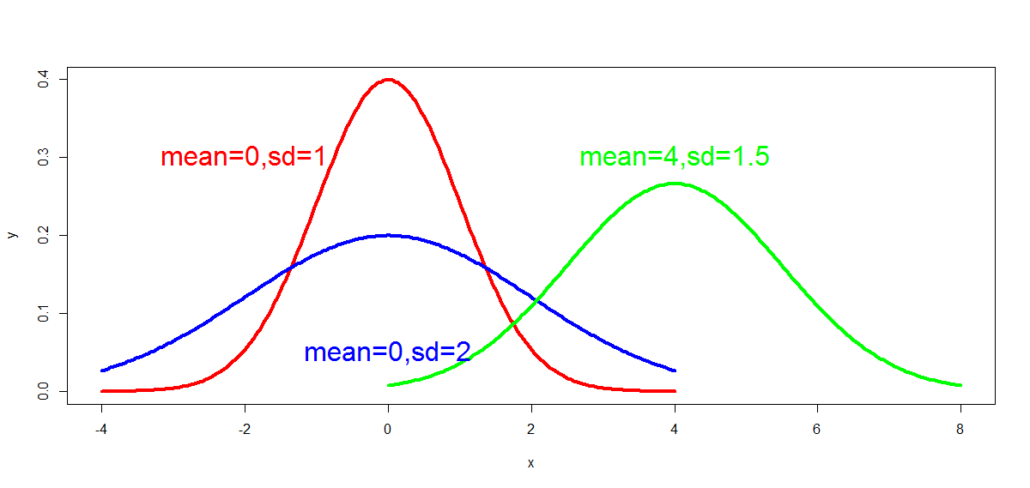
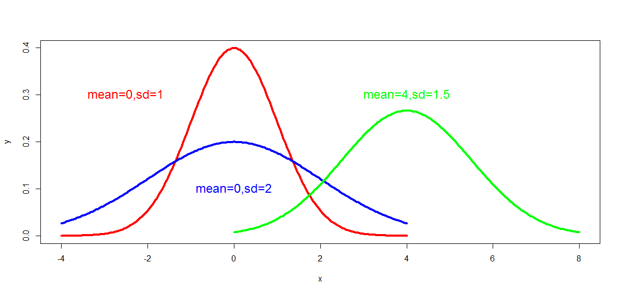
Normal distribution

Slide 3
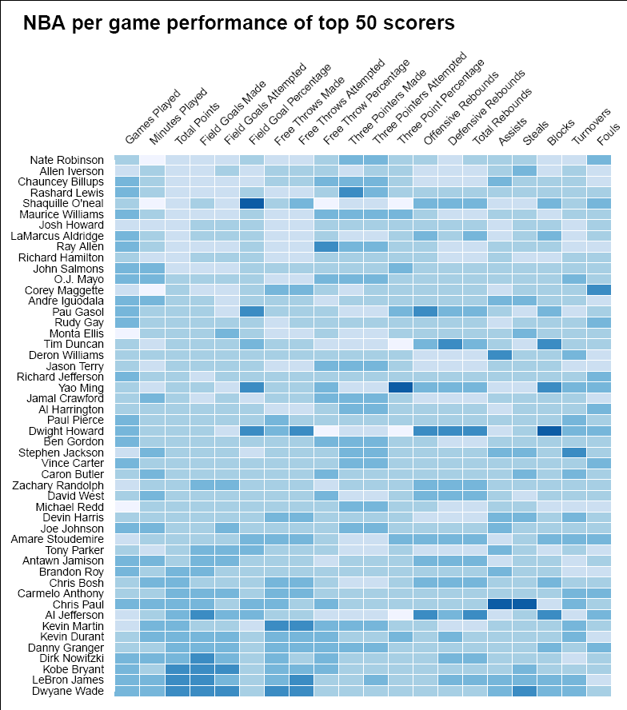

Slide 4
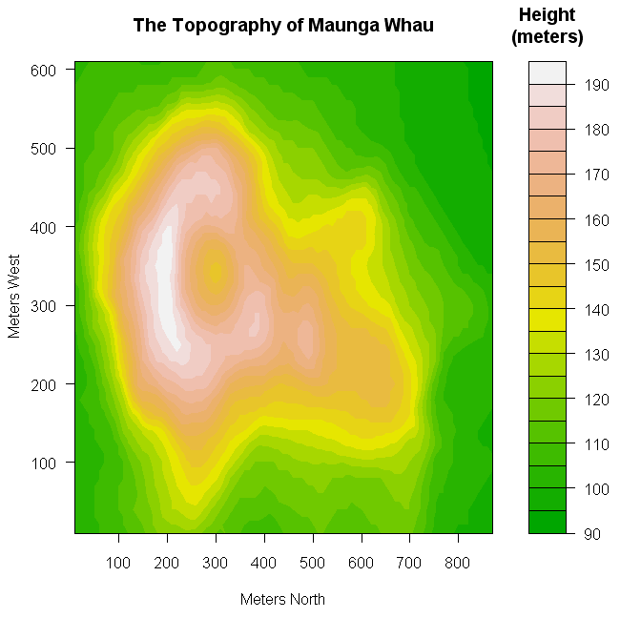

Slide 5
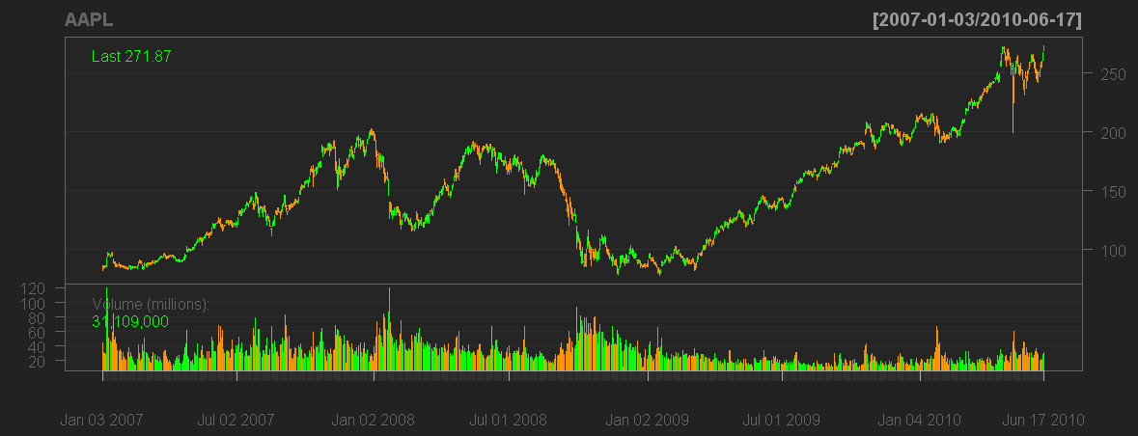

Slide 6
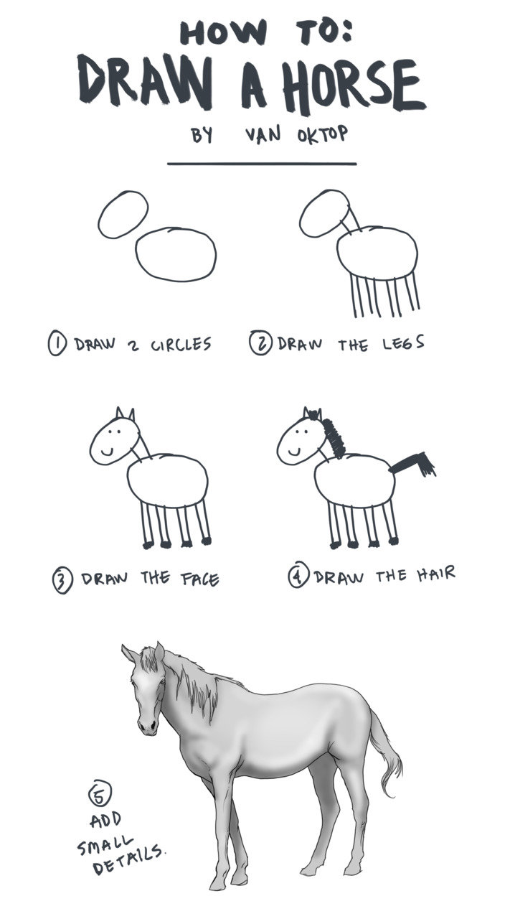

Slide 7
How to get R
R is freely available from the Comprehensive R Archive Network (CRAN) at http://cran.r-project.org.
Choosing a mirror which locates in China (e.g., http://mirrors.ustc.edu.cn/CRAN). Select the version for your operating system.

Slide 8
R studio
Is a powerful and productive user interface for R.
It’s free and open source
It works great on Windows, Mac, and Linux.

Slide 9

Holding your nose and closing your eyes, could you distinguish Cola from Sprite.

Slide 10
Data type
1. 0 means wrong judgement; 1 means right
1,0,0,1,1
numeric
2. Record the judgement directly
“right”, ”wrong”, ”wrong”, “right”, “right”
character
3. Whether it is a right judgement?
TRUE, FALSE,FALSE, TRUE, TRUE
logical

Slide 11
Vector
One-dimensional array
Containing only one data type
e.g.,
1,0,0,1,1
“right”, ”wrong”, ”wrong”, “right”, “right”
TRUE, FALSE,FALSE, TRUE, TRUE

Slide 12
Creating data
c()
a.num <- c(1,0,0,1,1)
a.cha <- c(“right”, ”wrong”, ”wrong”, “right”, “right”)
a.log <- c(TRUE, FALSE,FALSE, TRUE, TRUE)
> print(a.num)
[1] 1 0 0 1 1
> mode(a.num)
[1] "numeric"
> length(a.num)
[1] 5

Slide 13
Creating data
> c <- 1:3
> print(c)
[1] 1 2 3
> d <- seq(1, 3, by=1)
> print(d)
[1] 1 2 3
> e <- rep(c,times=3)
> print(e)
[1] 1 2 3 1 2 3 1 2 3
> c(1:5,seq(11,13,1))
[1] 1 2 3 4 5 11 12 13
colon operator
seq()
rep()

Slide 14
logical vector
> a.num <- 0:4
> a.cha <- c("a","b","c","d","e")
> a.log <- a.num>2
> print(a.log)
[1] FALSE FALSE FALSE TRUE TRUE
> a.cha[a.log]
[1] "d" "e"

Slide 15
Referring element
Using a numeric vector of positions within brackets
> b <- c(1, 2, 5, 3, 6, -2, 4)
> b[2]
[1] 2
> b[2:3]
[1] 2 5
> b[c(2,3,5)]
[1] 2 5 6

Slide 16
Missing value(NA, NaN)
If the value of a variable is unknown, the value is NA.
Numeric calculations whose result is undefined produce the value NaN.
> print(0/0)
[1] NaN
> a.miss <- c(25,NA,NaN,11)
> is.na(a.miss)
[1] FALSE TRUE TRUE FALSE
> is.nan(a.miss)
[1] FALSE FALSE TRUE FALSE

Slide 17
Arithmetic operator
Operator | Description | Sample
+ | Addition
- | Subtraction
* | Multiplication
/ | Division
** or ^ | Exponentiation(x^y equal to x^{y})
%% | Modulus | 5%%2 is 1
%/% | Integer division | 5%/%2 is 2

Slide 18
> a<-1:3
> a*2
[1] 2 4 6
> print(1:3*2)
> print(1:(3*2))
[1] 2 4 6
[1] 1 2 3 4 5 6

Slide 19
Statistic functions
Functions | Description | Sample
mean() | Mean | mean(c(1,2,3,6)) returns 3.
median() | Median | median(c(1,2,3,4)) returns 2.5
sd() | Standard deviation | sd(c(1,2,3,4)) returns 1.29
var() | Variance | var(c(1,2,3,4)) returns 1.67
sum() | Sum | sum(c(1,2,3,4)) returns 10
max() | Max | min(c(1,2,3,4)) returns 1
min() | Min | max(c(1,2,3,4)) returns 4

Slide 20
Exercise
1. Creat the vector below using “seq”, “rep” and “:”
quiz1 <- c(1,2,3,6,8,10,2,2,2)
2. Counting how many elements in quiz2 is larger than 13. Pick the elements with same index in quiz1.
quiz2 <- 11:19
3. Calculating the average difference between elements with same index.
Relevant commands and operators
c, seq, rep, :, length, mean, sum, -

Slide 21
Object
object is anything that can be assigned to a variable, which could be constants, data structures, functions or graphs).
ls()
rm()
rm(list=ls())

Slide 22
Factor
A special type of vector with levels attribute
Representing categorical data
> a.fac <- factor(c("right", "wrong", "wrong", "right", "right"),levels=c("right","wrong"))
> print(a.fac)
[1] right wrong wrong right right
Levels: right wrong
> table(a.fac)
a.fac
right wrong
3 2

Slide 23
Factor
> mode(a.fac)
[1] "numeric"
> unclass(a.fac)
[1] 1 2 2 1 1
attr(,"levels")
[1] "right" "wrong"
> b.fac <- factor(c(1,0,0,1,1),levels=c(1,0),labels=c("right","wrong"))
> print(b.fac)
[1] right wrong wrong right right
Levels: right wrong

Slide 24
Exercise
quiz <- c(1,2,3,6,8,10,2,2,2)
How many elements are equal to 2?
Relevant commands and operators
factor, table

Slide 25
Matrix
Maybe a girl couldn’t distinguish the two drinks, but a boy could.
1 | 0
0 | 1
1 | 0
1 | 1
0 | 0
Two-dimensional array
Containing only one data type

Slide 26
Creating data
matrix()
> a <- c(1,0,1,1,0,0,1,0,1,0)
> a.matrix <- matrix(a, nrow=5, ncol=2, dimnames=list(c("first","second","third","fourth","fifth"), c("boy","girl")))
> print(a.matrix)
boy girl
first 1 0
second 0 1
third 1 0
fourth 1 1
fifth 0 0

Slide 27
Creating data
dim()
> a <- 1:6
> dim(a)<-c(2,3)
> a
[,1] [,2] [,3]
[1,] 1 3 5
[2,] 2 4 6

Slide 28
Creating data
> a <- 1:3
> b <- 11:13
> cbind(a,b)
a b
[1,] 1 11
[2,] 2 12
[3,] 3 13
> rbind(a,b)
[,1] [,2] [,3]
a 1 2 3
b 11 12 13
cbind()
rbind()

Slide 29
Referring element
> a.matrix[1,1]
[1] 1
> a.matrix[1,]
boy girl
1 0
> a.matrix[,1]
first second third fourth fifth
1 0 1 1 0
> a.matrix[1:2,1:2]
boy girl
first 1 0
second 0 1

Slide 30
Exercise
1. Creating a matrix below:
2. Exchange the rows and columns.
1 | 5 | 9
2 | 6 | 10
3 | 7 | 11
4 | 8 | 12

Slide 31
Data frame
Several people are tested, we want to summary the results.
name | gender | right | total
Siyu | female | 4 | 10
Shaohuan | female | 5 | 11
Xiao | male | 6 | 11
Xiaoqing | female | 7 | 12
character | character | numeric | numeric

Slide 32
Creating data
data.frame()
> a.data <- data.frame (name=c("Siyu","Shaohuan","Xiao","Xiaoqing"), gender=c("female","female","male","female"), right=4:7, total=rep(10,4))
> print(a.data)
name gender right total
1 Siyu female 4 10
2 Shaohuan female 5 11
3 Xiao male 6 11
4 Xiaoqing female 7 12
> length(a.data)
[1] 4

Slide 33
Referring element
> a.data["name"]
name
1 Siyu
2 Shaohuan
3 Xiao
4 Xiaoqing
> a.data$name
[1] Siyu Shaohuan Xiao Xiaoqing
Levels: Shaohuan Siyu Xiao Xiaoqing
>as.character(a.data$name)
[1] "Siyu" "Shaohuan" "Xiao" "Xiaoqing"

Slide 34
Referring element
> a.data[1:2,c("name","gender")]
name gender
1 Siyu female
2 Shaohuan female
> a.data[a.data$gender=="female" & a.data$right>5,]
name gender right total
4 Xiaoqing female 7 11

Slide 35
logical operator
R command | meaning
> | larger than
< | less than
>= | larger than or equal to
<= | less than or equal to
== | equal to
! | not
& | and
| | or

Slide 36
Editing data frame
> a.data$prefer <- c("Cola","Cola","Sprite","Sprite")
> print(a.data)
name gender right total prefer
1 Siyu female 4 10 Cola
2 Shaohuan female 5 11 Cola
3 Xiao male 6 11 Sprite
4 Xiaoqing female 7 12 Sprite

Slide 37
stringsAsFactors option
logical: should character vectors be converted to factors?
> out<-vector(length=2,mode="character")
> mydata <- data.frame(a=1:4,name=c("a","b","c","d"))
> mydata_FALSE <- data.frame(a=1:4, name=c("a","b","c","d"), stringsAsFactors=F)
> out[1] <- mydata[1,2]
> out[2] <- as.character(mydata[1,2])
> out[3] <- mydata_FALSE[1,2]
> print(out)
[1] "1" "a" "a"

Slide 38
with()
> with(a.data,{
+ a.test<-name[gender=="female" & right>5]
+ b.test<<-name[gender=="female" & right>5]
+ print(a.test)
+ print(b.test)
+ })
[1] Xiaoqing
Levels: Shaohuan Siyu Xiao Xiaoqing
[1] Xiaoqing
Levels: Shaohuan Siyu Xiao Xiaoqing
> print(a.test)
Error in print(a.test) : object 'a.test' not found
> print(b.test)
[1] Xiaoqing
Levels: Shaohuan Siyu Xiao Xiaoqing

Slide 39
Exercise
name | gender | right | total
Siyu | female | 4 | 10
Shaohuan | female | 5 | 11
Xiao | male | 6 | 11
Xiaoqing | female | 7 | 12
Produce a data frame named cola to store the value
Calculate the proportion of right judgement and add this to the data frame
How many females have a more than 50% frequence to give the right judgement.

Slide 40
data structure
Vector
Factor
Matrix
Data frame
Array
List

Slide 41
Setting working directory
R needs to read or write some files, you should told it a directory.
setwd()
getwd()
> setwd("C:/Users/dell/Documents")
> getwd()
[1] "C:/Users/dell/Documents"

Slide 42
Data output
write.table()
“prints its required argument x (after converting it to a data frame if it is not one nor a matrix) to a file ”
write.table(x, file = "", append = FALSE, quote = FALSE, sep = “\t", row.names = FALSE, col.names = TRUE)
getwd()

Slide 43
Exercise
Write the data frame cola to a file named “cola_sprite”
Try the options

Slide 44
Data input
read.table()
“Reads a file in table format and creates a data frame from it.”
read.table(file, header = FALSE, sep = "", quote = "\"'", as.is = !stringsAsFactors, skip = 0, comment.char = "#")

Slide 45
Exercise
Add “#” to the begin of the first column, second line.
Read the data from “cola_sprite” to a new data frame
Try the options

Slide 46

Packages
install.packages(): install the package
library() : load the package
install.packages("effects")
library("effects")

Slide 47
How to get help
Built-in help system
e.g., “?matrix”
Google
Mail list
Forums

Slide 48
Conditional execution
if (cond) statement
if (cond) statement1 else statement2
> a <- 1:2
> for(i in 1:length(a)){
+ if(a[i]>1){
+ print(paste(a[i],"is larger than 1",sep=" "))
+ }
+ else{
+ print(paste(a[i],"is not larger than 1",sep=" "))
+ }
+ }
[1] "1 is not larger than 1"
[1] "2 is larger than 1"

Slide 49
Loop
for (var in seq) statement
> a <- 1:4
> for (i in 1:length(a)){
+ print("hello world")
+ }
[1] "hello world"
[1] "hello world"
[1] "hello world"
[1] "hello world"

Slide 50
> a.vec <- vector(mode="numeric",length=5)
> print(a.vec)
[1] 0 0 0 0 0

Slide 51
Exercise
Using “for” to loop the cola data frame, using if to print the lines where right is larger than 5 times.

Slide 52
Data converting
a.num <- 0:4
a.cha <- c("a","b","c","d")
a.log <- c(T,F,F,T)
as.logical(a.num)
as.character(a.num)
as.logical(a.cha)
as.numeric(a.cha)
as.logical(a.log)
as.numeric(a.log)

