Slide 1
What is R
Muhammad Omer

Slide 2
What is R
R is the programing language software for statistical computing and data analysis
The R language is extensively used between data miners and statisticians for a data analysis and statistical software.
R is also an implementation S programing language which is combine with lexical scoping and which was created by John Chambers at Bell Labs.

Slide 3
What is R
R programing language was created by Ross Ihaka and Robert Gentleman
R programming language was created at University of Auckland, New Zealand and it is developed by the R Development Core Team lately.
R was named partly under the first name of two creators and author and somewhat as a on the name of S.

Slide 4
What is R
R is also a static graphics, which means it can produce really high quality graphs.
R programming language is really wide through the practice of user-submitted package for particular functions or particular area of study.
The additional features of R, which is Dynamic and interactive graphics are available through additional package.

Slide 5
What is R
In programming, R language is an integrated language which means that R users characteristically access it through a command-line interpreter.
In programming R, language supports matrix athematic which is likely similar to other languages such as APL and MATLAB.
In programming R language also supports procedural programming and object-oriented programming.
In addition, In R programming language C, C++ and Fortran code can be related and used in advanced functions

Slide 6
What is R
R contains virtually every data manipulation, statistical model, and chart that the modern data scientist much have.
R programming language has designed specifically for data analysis, which means R programing can process data analyses faster then any other statistical software.
R is to use to develop the latest methods in statistics, machine learning, and predictive modeling around the world.

Slide 7
The R environment
R integrated programming language software facilities for data manipulation and graphics displays, some of the R important environment are as follows.
It gives an effective data handling and storage facility.
It also gives the operators for calculations on arrays, in particular matrices
It also gives a large, clear, integrated collection of intermediate tools for data graphical facilities for data analysis and display either on-screen or on hardcopy.
In addition it also gives a well-developed, simple and effective programming language which includes conditionals, loops, user-defined recursive functions and input and output facilities.

Slide 8
What is R and its basic functions
Some of the basic functions that R programming language can implement
Clustering
Classical statistical tests
Classification
R Linear modeling
Nonlinear modeling
Time-series analysis

Slide 9
What is R and why we use R
First we use R it is because its free and it’s a open source project, which means you can hands-on on R for free.
Because of R is open, so you can inspect the code and tinker with it as much as you like which is provided to you by GNU General Public License Version 2.
In R, all the programming or the data analysis done by writing codes, scripts and functions not by pointing and clicking.

Slide 10
What is R and why we use R
One of the reason why we use R is because it promotes experiment and exploration, which means it can improve data analysis.
R users can do their data analyses in a fraction of the time.
With R, pre-defined set of routines are not limited which means you can use or developed codes through open source community.
R is excellent to work with or combine with different application like MYSQL database, Google Maps API and GIS analysis toolkit.

Slide 11
What is R and why we use R
Another reason that we can use R is that the users can able to create 3-D surfaces which makes the data more effective.
In function, the syntax of R is similar to somewhat JavaScript.
The primary data type in R is the Vector which is called a container vector.
Vector elements can be express using []. For example p[3] is 5.

Slide 12

What is R Video (source YouTube)

Slide 13
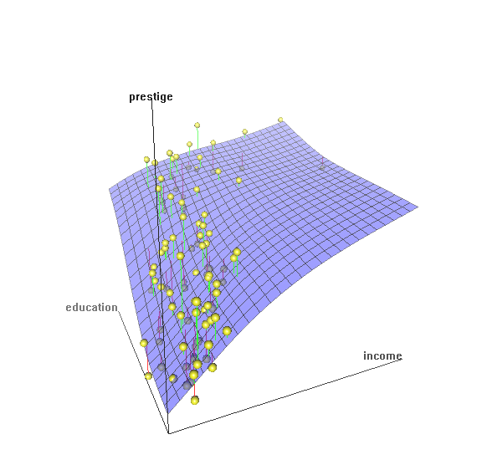
What is R

Slide 14
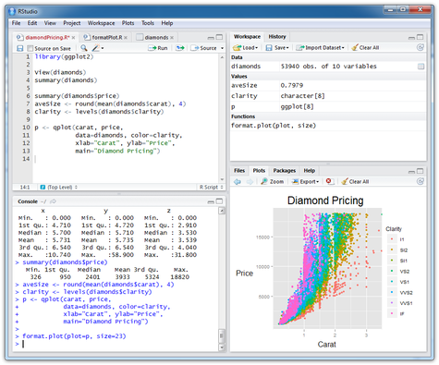
What is R

Slide 15
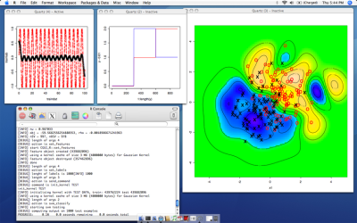
What is R

Slide 16
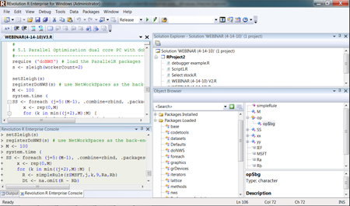
What is R

Slide 17
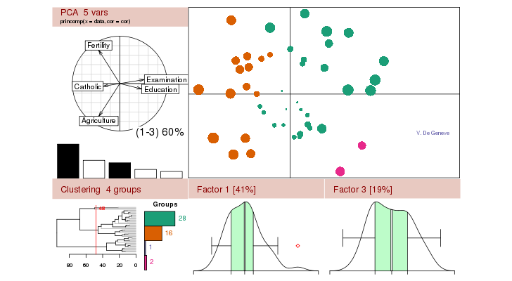
What is R

Slide 18
References
http://www.r-project.org/about.html
http://www.revolutionanalytics.com/what-r
http://www.inside-r.org/why-use-r
http://en.wikipedia.org/wiki/R_(programming_language)
http://en.wikibooks.org/wiki/R_Programming
http://www.johndcook.com/blog/r_language_for_programmers/#introduction

