Slide 1

What Is “R” Programming
By Jacob Grogan

Slide 2
What Is “R”?
“R” is a language and environment for statistical computing and graphics
“R” is an Open Source software for research in statistical methodology
One of R’s strengths is the ease with which well-designed publication-quality plots can be produced, including mathematical symbols and formulae where needed
Used among statisticians and data miners
“R” is available as Free Software in source code form

Slide 3
History of “r”
“R was initially written by Ross Ihaka and Robert Gentleman at the Department of Statistics of the University of Auckland in Auckland, New Zealand. In addition, a large group of individuals has contributed to R by sending code and bug reports.”
R was posted on Statlib and announced on the s–news mailing list in August of 1993
Since mid-1997 there has been a core group (the “R Core Team”) who can modify the R source code archive

Slide 4
Primary Functions of “R”
“R” is an integrated suite of software facilities for data manipulation, calculation and graphical display
The core of “R” is an interpreted computer language which allows branching and looping as well as modular programming using functions

Slide 5
More functions of “R”
“R” is:
an effective data handling and storage facility
a suite of operators for calculations on arrays, in particular matrices
a large, coherent, integrated collection of intermediate tools for data analysis
graphical facilities for data analysis and display either on-screen or on hardcopy
a well-developed, simple and effective programming language which includes conditionals, loops, user-defined recursive functions and input and output facilities.

Slide 6
Statistical Features of “R”
“R” is an environment for statistical analysis: Available in the R language are functions for virtually every data manipulation, statistical model, or chart that the data analyst could ever need.
Statistical uses in many different fields which include but are not limited to:
Empirical Finance, Statistical Genetics, Chemo metrics and Computational Physics, Data Mining and Machine Learning

Slide 7
Programming Features of “R”
“R” is a complete, interactive, object-oriented language: designed by statisticians, for statisticians.
The language provides objects, operators and functions that make the process of exploring, modeling, and visualizing data a natural one.
Complete data analyses can often be represented in just a few lines of code.

Slide 8
List of code editors for “R”
Basic code editors provided by Rguis
RStudio: GUI-based IDE for R
Vim-R-Tmux: R working environment based on vim and tmux
Emacs (ESS add-on package)
gedit and Rgedit
RKWard
Eclipse
Tinn-R
Notepad++ (NppToR)

Slide 9
Operating systems that are “r” supported
It compiles and runs on a wide variety of UNIX platforms and similar systems (including FreeBSD and Linux)
Windows and MacOS
There is only one version of R for Mac OS X

Slide 10
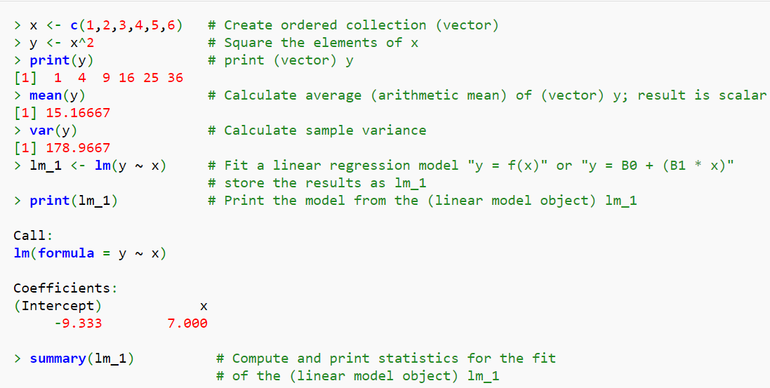
Example Code

Slide 11
conclusion
“R” is a widely used statistical programming language used on multiple platforms for data analysis
“R” was created in 1993 and is an open source software that is available to users in source code format
Object oriented programming language
“R” is most importantly an environment within which statistical techniques are implemented

Slide 12
References
http://www.r-project.org/about.html
http://cran.r-project.org/doc/FAQ/R-FAQ.html#Why-is-R-named-R_003f
https://www.stat.auckland.ac.nz/~ihaka/downloads/Interface98.pdf
http://www.inside-r.org/what-is-r
http://www.revolutionanalytics.com/r-language-features-applications-and-extensions
http://manuals.bioinformatics.ucr.edu/home/programming-in-r#TOC-R-Basics

