Slide 1

Decision Trees
Hank Butler
February 19, 2021

Slide 2
Objectives – Decision Trees
Explain what are Decision Trees/How They Work
Written
Verbal
Build a Decision Tree
Follow along with me
Classification
Regression
Exercise / Application
Build a decision tree
One for Classification
One for Regression
Improve upon initial tree by adjusting parameters.

Slide 3
Review
Supervised Learning
We want to predict a certain outcome from a given input and we HAVE examples of input/output pairs.
Classification
Want to predict a class label
Examples
Regression
Want to predict a continuous number
Examples

Slide 4
Review – continued
Generalization
Overfitting
Underfitting

Slide 5
Review – Continued
Jupyter Notebooks
Scikit-Learn
Train_test_split

Slide 6
Decision Trees
Has anybody used or can explain a decision tree?
Scikit-Learn Documentation
Decision Tree Documentation

Slide 7
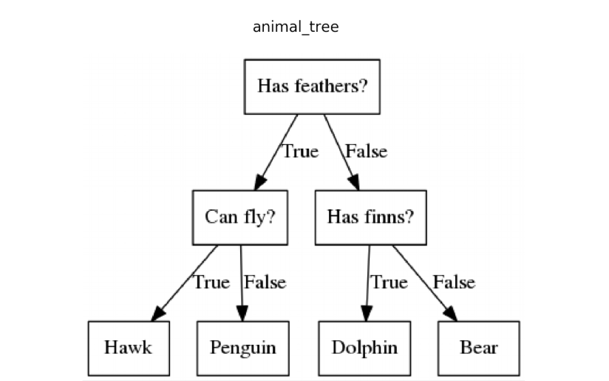
Quick Example of a Decision Tree

Slide 8
Decision Trees
Widely used models for Classification and Regression Tasks
Foundation of Ensemble Models we will see shortly.
Essentially, they learn a hierarchy of if/else questions, leading to a decision.
Like the Game “20 Questions”
Goal is to create a model that predicts the value of a target variable by learning simple decision rules inferred from the data features.
Notes:
Learning a decision tree means learning the sequence of if/else questions that gets us to the test/answer most quickly.
To build a tree, algo searches over all possible tests and finds the one that is most informative about the target variable.
=recursive process yields a binary tree of decisions with each node containing a test.
=Process is repeated until each region in the partition only contains a single target variable
=A prediction or new data point is made by checking which region of that partition of the feature space the point lies in and then predicting the majority of that region.
Possible for regression tasks, using exact same technique.
=Output is a mean target of training points on leaf.

Slide 9
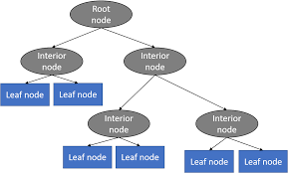
Different Parts of a Decision Tree
Top is called Root Node or simply Root
If there is a split, then it’s called an Interior Node
If Tree ends, it is called a Leaf Node.

Slide 10
Advantages of Decision Trees
Simple to understand and interpret
Requires little data preparation
Able to handle numerical and categorical data
Note that Scikit-Learn does not support categorical variables (use dummy variables)
Uses a white box model
Explanation is easily explained by Boolean logic

Slide 11
Disadvantages of Decision Tree
Can create over-complex trees that do not generalize well
Overfitting
Can be unstable because small variations in the data might result in a different tree being generated
Trees can be biased if some classes dominate, ensure dataset is balanced prior to fitting

Slide 12
Overfitting
Decision Trees make very few assumptions about the training data
If left unconstrained, tree structure will adapt itself to training data and most likely overfit
Avoiding Overfitting
Need to restrict tree’s freedom during training -> “Pre-Pruning”
Parameters
max_depth
min_samples_split
min_samples_leaf
min_weight_fraction_leaf
max_leaf_nodes
max_features

Slide 13
Follow Along
My Jupyter Notebook on GitHub
Decision_Tree.ipynb
Classification
Scikit Learn Breast Cancer Dataset
Regression Tree
Salary / Years of Experience
Salary Data
Historical Prices of Ram
Ram Prices Data

Slide 14
Your Turn
Find a Dataset (NOTHING TOO CRAZY)
Kaggle
UCI ML Repository
Scikit Learn Built-In Datasets
Do some Exploratory Data Analysis on it.
Build a Classification Decision Tree
Try without adjusting parameters
Then try with adjusting parameters
Write up how model changes after adjusting parameters
Build a Decision Tree Regression
Same Steps

