Slide 1
Predicting CryptoAsset Prices Based on BTC, ETH, LTC Prices and Volume.
Hank Butler, MS
Springboard Data Science Career Track
May 2020

Slide 2
Overview
The goal of the project is to see how Bitcoin price and volume affect the price of Ethereum and Litecoin.
Daily returns for each asset will also be forecasted.

Slide 3
Data Wrangling
Kraken Digital Asset Exchange
Third Party Python Library
Pulls data directly into Pandas DataFrame
Date-time set as index
Very user-friendly
Notes:
Mention data error. There was a random date, July 7, 2020, where all the values besides OHLC prices were zero. Thought there was going to be a data issue, but resolves itself if you continually re-run data pull. Data pull function has log transformation in it, so 0 error would show up if there was the data pull error.

Slide 4
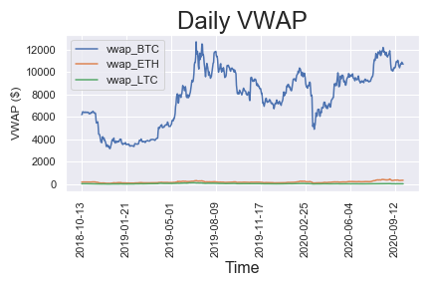
Exploratory Data Analysis
Volume Weighted Avg. Price (VWAP)
First chart shows all three asset prices
Massive difference in scale.
Notes:
VWAP encapsulates the price movements throughout day so better than using high and lows.
Also, open and close isn’t like regular stock data since crypto exchanges don’t have formal market openings and closings.

Slide 5
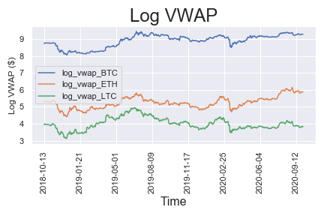
EDA – con’t
Log VWAP
Log transformation scales data
Notes:
Log scales data and also normalizes returns. Much easier to see relationship now.

Slide 6
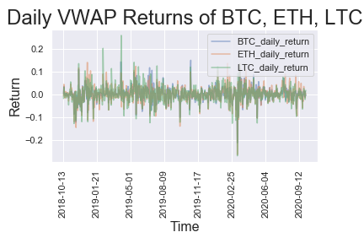
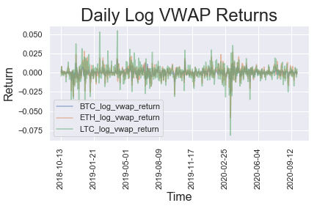
EDA – Con’t
Daily Returns
Log Daily Returns
Notes:
See similarities between them.

Slide 7
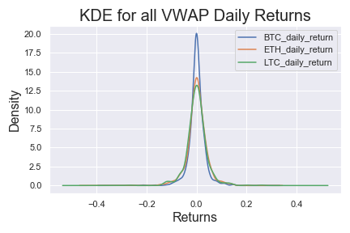
EDA – Con’t
KDE’s of returns.
Notes:
Fairly symmetric with some left skew which are negative returns. The relative normal distribution is good to see before modeling. Modeling assumes normal distribution.

Slide 8
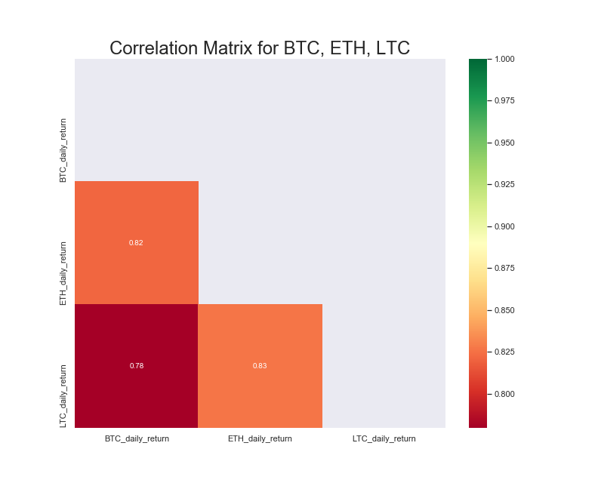
EDA – con’t
Correlation Heat Map for Returns.

Slide 9
Data Pre-Processing
Exported .csv file after pulling data from API
.read_csv() method from Pandas
Have to reindex data
.pct_change() function was used to calculate daily and log daily returns.
Notes:
Reindex issue first appeared when started EDA. The prices were trending negatively which raised suspicion.

Slide 10
Modeling – First Stages
Augmented Dickey-Fuller Test
Tests for stationarity
Notes:
Before doing any time-series analysis, the Augmented Dickey Fuller Test (ADFuller Test) was conducted on the VWAP, Log VWAP, Daily VWAP Returns, and Log Daily VWAP Returns. The purpose of the ADFuller Test is to see if the time-series is stationary, the properties do not depend on the time at which the series is observed. The expectation is that the price series will be non-stationary, due to trends in the price, and that the returns series will be stationary. The expectation for the returns being stationary is from their plots and histograms not showing an identifiable trend.
After running the ADFuller Tests, the expectations were generally accurate. The only price series that was stationary was Ethereum, although its log price was non-stationary. All returns series were stationary.

Slide 11
Modeling – Auto_Arima
Auto_Arima package determines models based on minimizing AIC.
Used before doing Vector AutoRegression to provide general outlook on what to expect.
Notes:
The ADFuller Tests results were done to establish whether or not the series needed to be differenced to make it stationary and model. The Auto_Arima package was used to model each price and return series and provide an expectation for the Vector AutoRegression of Returns. Each model had a Moving Average (MA) component that ranged from 1 to 4. Only the price models were integrated (meaning they were ARIMA models). The most interesting observation was that ETH and BTC did not have an Autoregressive component which suggests that yesterday’s price does not have an influence on today’s price. However, LTC had an AR component of 4, which indicates the lagged prices from one to four days ago affect today’s price.

Slide 12
Modeling – Vector AutoRegression (VAR)
VAR was used to forecast returns.
Decent job, however returns are near distributed around 0
Forecast for returns is roughly 0.
After multiple steps ahead, forecast simply becomes trend.
Correlation matrix for returns
BTC_daily_return ETH_daily_return LTC_daily_return
BTC_daily_return 1.000000 0.822321 0.773713
ETH_daily_return 0.822321 1.000000 0.832074
LTC_daily_return 0.773713 0.832074 1.000000

Slide 13
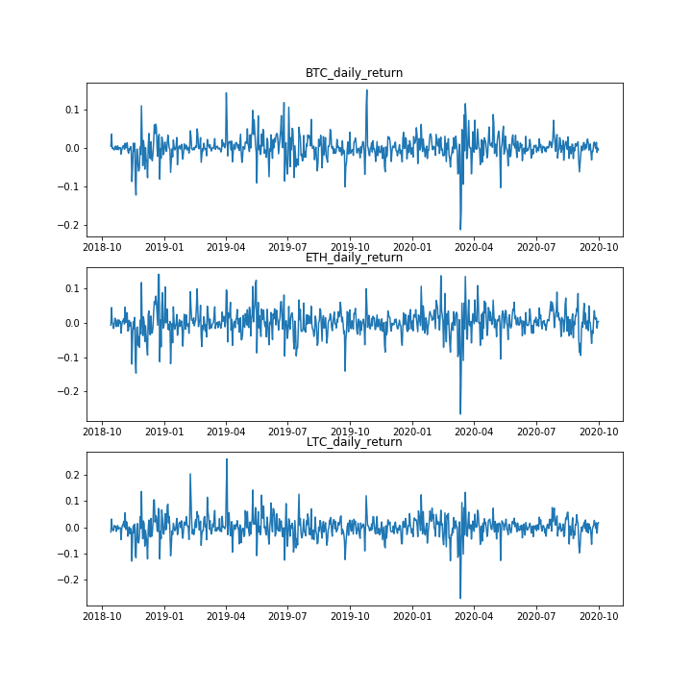
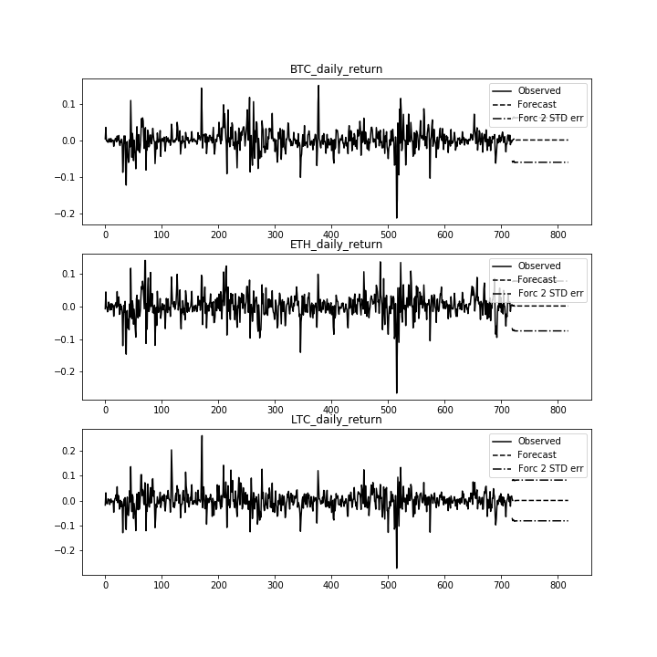
Vector AutoRegression

Slide 14
Modeling - Regressions
Interested in:
Bitcoin and Litecoin prices affecting Ethereum
Bitcoin and Ethereum prices affecting Litecoin
Then factoring in Volume

Slide 15
Modeling – Regression
Started with Linear Regression
Tried Random Forests
Also tried Gradient Boosting Regression after an Random Forest was overfitting.

Slide 16
Results
Best models
Ethereum (with Volume)
Random Forest – R-sq of 0.96 on test set
Litecoin (without Volume)
Random Forest – R-sq of 0.83 on test set
Baseline
Compared models to just predicting today’s price based on yesterday’sprice
Model’s performed better
Notes:
The best model for Ethereum was a random forest regression factoring Bitcoin price, Litecoin Price, and Volume. The R-squred on the training set was 0.98 and 0.96 on the test set. It is a very well fit model that generalizes well.
The best model for Litecoin was a random forest regression factoring Bitcoin price and Ethereum price. The R-squared on the training set was 0.92 and 0.83. It is slightly overfit but generalizes best out of all Litecoin models.
When compared to the baseline of just using yesterday’s price to predict today’s price, each model is better than the baseline. The baseline Ethereum R-squared was only 0.639, compared to the 0.96 from our best model. However the baseline Litecoin R-squared was marginally lower than our model’s R-squared, 0.801 and 0.83 respectively.

Slide 17
Next Steps
Know that the relationship between assets can be quantified
Foundation of trading strategy
Next analysis
Factor in volatility
More advanced forecast model
Notes:
We know that there is a relationship between the assets that can be quantified. This could be used as the foundation for a mean reversion trading strategy.
Further analysis could be used to analyze the effects of volatility on prices. Bitcoin and other crypto-assets have received significant attention for their price swings. If there is a significant trend in volatility, it could also be used as a trading strategy.

