Slide 1
High confidence picture and category
836, 11, 779, 951, 1, 574, 847, 954, 9, 934
https://gist.github.com/yrevar/942d3a0ac09ec9e5eb3a
#1, 11, 779, 847, 574, 951(?)

Slide 2
遇到的困難
1. batch forward 一個batch只有一個輸出ok
2. 怎麼知道現在的輸出對應哪張圖片ok
3. m,w的選擇ok
4. 實踐的細節ok

Slide 3
Batch size: same output
Batch=1
all_max_num:
[1, 11, 574, 779, 836, 847, 9, 934, 951, 954]
all_max_val:
[20.937334060668945, 20.477014541625977, 26.368059158325195, 19.504655838012695, 17.460559844970703, 19.33688735961914, 18.462112426757812, 12.791252136230469, 11.959511756896973, 12.229040145874023]
Batch=2
all_max_num:
[1, 11, 574, 779, 836, 847, 9, 934, 951, 954]
all_max_val:
[20.937334060668945, 20.477014541625977, 26.368059158325195, 19.504655838012695, 17.460559844970703, 19.33688735961914, 18.462112426757812, 12.791252136230469, 11.959511756896973, 12.229040145874023]

Slide 4
金魚1 20.937334060668945 m:1~25 w:5 r=max g=max b=max 相位皆為0
all_max_num:
[1, 1, 1, 1, 1, 1, 1, 1, 1, 1, 1, 1, 1, 1, 1, 1, 1, 1, 1, 1, 1, 1, 1, 1, 1, 1, 1, 1, 1, 1, 1, 1, 1, 1, 1, 1, 1, 1, 1, 1, 1, 1, 1, 1, 1, 1, 1, 1, 1, 1, 1, 1, 1, 1, 1, 1, 1, 1, 1, 1, 1, 1, 1, 1, 1, 1, 1, 1, 1, 1, 1, 1, 1, 1, 1, 1, 1, 1, 1, 1, 1, 1, 1, 1, 1, 1, 1, 1, 1, 1, 1, 1, 1, 1, 1, 1, 1, 1, 1, 1]
all_max_val:
[20.691612243652344, 20.691612243652344, 20.691612243652344, 20.691612243652344, 20.475170135498047, 20.475170135498047, 20.475170135498047, 20.475170135498047, 20.43303108215332, 20.43303108215332, 20.43303108215332, 20.43303108215332, 20.39443588256836, 20.39443588256836, 20.39443588256836, 20.39443588256836, 20.01136589050293, 20.01136589050293, 20.01136589050293, 20.01136589050293, 19.257305145263672, 19.257305145263672, 19.257305145263672, 19.257305145263672, 18.444910049438477, 18.444910049438477, 18.444910049438477, 18.444910049438477, 17.414756774902344, 17.414756774902344, 17.414756774902344, 17.414756774902344, 16.286176681518555, 16.286176681518555, 16.286176681518555, 16.286176681518555, 15.29297924041748, 15.29297924041748, 15.29297924041748, 15.29297924041748, 14.581188201904297, 14.581188201904297, 14.581188201904297, 14.581188201904297, 13.835679054260254, 13.835679054260254, 13.835679054260254, 13.835679054260254, 13.122114181518555, 13.122114181518555, 13.122114181518555, 13.122114181518555, 12.55345344543457, 12.55345344543457, 12.55345344543457, 12.55345344543457, 12.028670310974121, 12.028670310974121, 12.028670310974121, 12.028670310974121, 11.393244743347168, 11.393244743347168, 11.393244743347168, 11.393244743347168, 10.8926420211792, 10.8926420211792, 10.8926420211792, 10.8926420211792, 10.451191902160645, 10.451191902160645, 10.451191902160645, 10.451191902160645, 10.093518257141113, 10.093518257141113, 10.093518257141113, 10.093518257141113, 9.748120307922363, 9.748120307922363, 9.748120307922363, 9.748120307922363, 9.459554672241211, 9.459554672241211, 9.459554672241211, 9.459554672241211, 9.197614669799805, 9.197614669799805, 9.197614669799805, 9.197614669799805, 8.952610969543457, 8.952610969543457, 8.952610969543457, 8.952610969543457, 8.720296859741211, 8.720296859741211, 8.720296859741211, 8.720296859741211, 8.513372421264648, 8.513372421264648, 8.513372421264648, 8.513372421264648]

Slide 5
金魚1 20.937334060668945 m:1~25 w:5 r=max g=max b=max 相位隨機1~1000
all_max_num:
[1, 1, 1, 1, 1, 1, 1, 1, 1, 1, 1, 1, 1, 1, 1, 1, 1, 1, 1, 1, 1, 1, 1, 1, 1, 1, 1, 1, 1, 1, 1, 1, 1, 1, 1, 1, 1, 1, 1, 1, 1, 1, 1, 1, 1, 1, 1, 1, 1, 1, 1, 1, 1, 1, 1, 1, 1, 1, 1, 1, 1, 1, 1, 1, 1, 1, 1, 1, 1, 1, 1, 1, 1, 1, 1, 1, 1, 1, 1, 1, 1, 1, 1, 1, 1, 1, 1, 1, 1, 1, 1, 1, 1, 1, 1, 1, 1, 1, 1, 1]
all_max_val:
[20.743104934692383, 20.833017349243164, 20.884952545166016, 20.91229248046875, 20.689178466796875, 20.71794319152832, 20.76282501220703, 20.401573181152344, 20.599159240722656, 20.588773727416992, 20.65499496459961, 20.729700088500977, 20.727144241333008, 20.47150993347168, 20.699825286865234, 20.78129768371582, 20.530229568481445, 20.502227783203125, 20.138710021972656, 20.776750564575195, 20.533185958862305, 20.851470947265625, 20.579179763793945, 19.866086959838867, 19.725032806396484, 20.735820770263672, 19.735393524169922, 20.54094123840332, 20.474456787109375, 20.542200088500977, 20.257266998291016, 20.331188201904297, 19.60016441345215, 20.487987518310547, 18.197086334228516, 20.722305297851562, 19.289560317993164, 18.88404083251953, 18.98951530456543, 20.43336296081543, 18.04850196838379, 20.279020309448242, 19.752912521362305, 16.574256896972656, 16.34539031982422, 20.663469314575195, 20.43462371826172, 15.029293060302734, 20.227041244506836, 15.512748718261719, 20.21929359436035, 15.260384559631348, 18.958572387695312, 14.942049980163574, 17.04144287109375, 15.567926406860352, 17.749969482421875, 20.420791625976562, 17.283889770507812, 20.534883499145508, 20.28339385986328, 12.573484420776367, 15.714624404907227, 20.41396141052246, 20.264381408691406, 11.007525444030762, 17.996749877929688, 18.397769927978516, 19.776588439941406, 12.472015380859375, 20.63665771484375, 10.574695587158203, 12.386792182922363, 14.60838508605957, 20.801883697509766, 19.59688377380371, 18.88370132446289, 14.614209175109863, 13.930169105529785, 11.057106971740723, 12.929366111755371, 14.191717147827148, 19.536001205444336, 10.663750648498535, 10.42181396484375, 12.974868774414062, 19.756256103515625, 19.161298751831055, 10.124216079711914, 15.960762977600098, 13.714134216308594, 8.738981246948242, 18.497480392456055, 15.930639266967773, 11.940340042114258, 16.911540985107422, 12.022971153259277, 14.926450729370117, 9.788768768310547, 19.57425880432129]

Slide 6
金魚1 20.937334060668945 m:5 w:1~25 r=max g=max b=max 相位固定0
[19.859167098999023, 19.859167098999023, 19.859167098999023, 19.859167098999023, 21.262510299682617, 21.262510299682617, 21.262510299682617, 21.262510299682617, 21.756277084350586, 21.756277084350586, 21.756277084350586, 21.756277084350586, 21.264049530029297, 21.264049530029297, 21.264049530029297, 21.264049530029297, 20.01136589050293, 20.01136589050293, 20.01136589050293, 20.01136589050293, 19.256242752075195, 19.256242752075195, 19.256242752075195, 19.256242752075195, 21.542917251586914, 21.542917251586914, 21.542917251586914, 21.542917251586914, 19.541118621826172, 19.541118621826172, 19.541118621826172, 19.541118621826172, 22.061155319213867, 22.061155319213867, 22.061155319213867, 22.061155319213867, 21.159954071044922, 21.159954071044922, 21.159954071044922, 21.159954071044922, 15.910959243774414, 15.910959243774414, 15.910959243774414, 15.910959243774414, 12.104768753051758, 12.104768753051758, 12.104768753051758, 12.104768753051758, 20.63518524169922, 20.63518524169922, 20.63518524169922, 20.63518524169922, 16.43999481201172, 16.43999481201172, 16.43999481201172, 16.43999481201172, 21.548959732055664, 21.548959732055664, 21.548959732055664, 21.548959732055664, 21.2583065032959, 21.2583065032959, 21.2583065032959, 21.2583065032959, 17.570980072021484, 17.570980072021484, 17.570980072021484, 17.570980072021484, 16.416879653930664, 16.416879653930664, 16.416879653930664, 16.416879653930664, 13.414887428283691, 13.414887428283691, 13.414887428283691, 13.414887428283691, 14.36984634399414, 14.36984634399414, 14.36984634399414, 14.36984634399414, 22.30530548095703, 22.30530548095703, 22.30530548095703, 22.30530548095703, 21.41668128967285, 21.41668128967285, 21.41668128967285, 21.41668128967285, 14.972430229187012, 14.972430229187012, 14.972430229187012, 14.972430229187012, 21.133195877075195, 21.133195877075195, 21.133195877075195, 21.133195877075195, 16.144561767578125, 16.144561767578125, 16.144561767578125, 16.144561767578125]

Slide 7
鴕鳥9 18.462112426757812 m:0,4…100 w:5 r=max g=max b=max 相位固定0

Slide 8
w=2*pi*f=2*pi/T w=2*pi/m m是隨機整數 最大r,g,b的相位必需是(w*pi/m)*整數 其他隨意
隨著最大r,g,b 變大圖片越來越容易flip

Slide 9
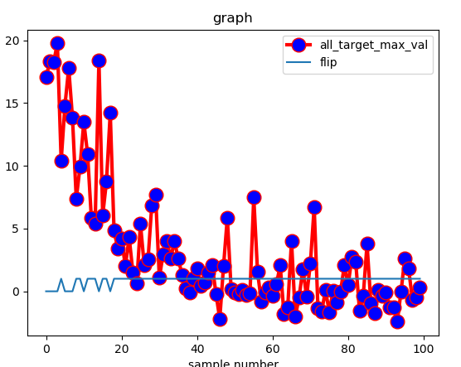
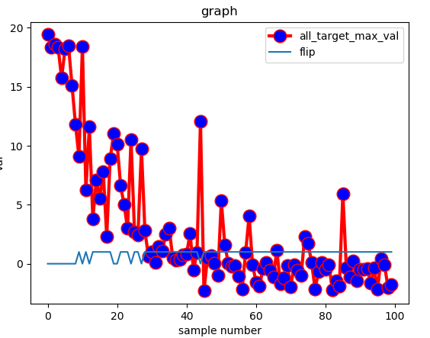
9鴕鳥 m=1,4,8…100 w=23,38,55,90 w大 容易flip

Slide 10
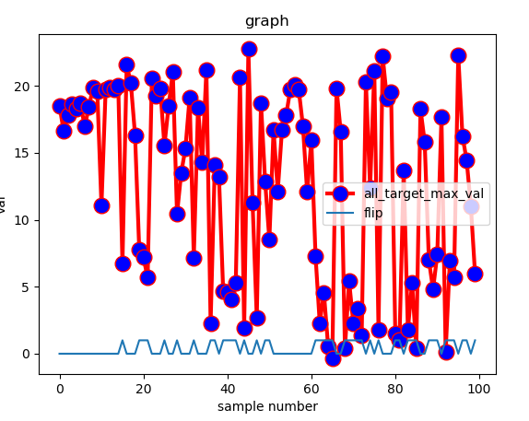
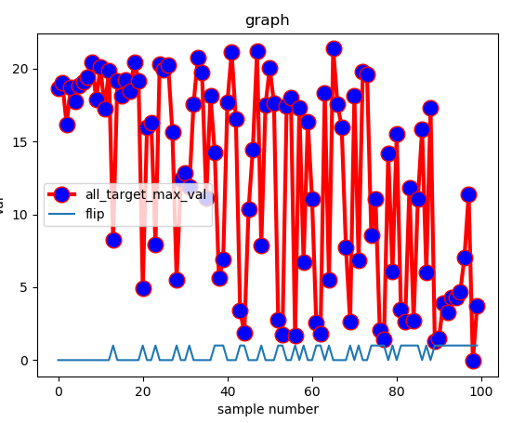
9鴕鳥 m=1,4,8…100 w=1,2,3,4 w小 不容易flip 即使m大還是不一定flip

Slide 11
Kaggle
2 minute paper
iccv/eccv/cvpr workshop
paul.weng@sjtu.edu.cn

Slide 12
BrainNet detect brain wave

