Slide 1
Unicity Distance and Shannon’s Theory of Cryptography
Liu Chang
Zhan Dongcheng
Zhan Shihan
Zhang Ziyi

Slide 2
1. BACKGROUND
2. SPURIOUS KEYS
3. ENTROPY OF A NATURAL LANGUAGE AND REDUNDANCY
4. UNICITY DISTANCE
5. INTERPRETATION AND APPLICATION

Slide 3
BACKGROUND

Slide 4
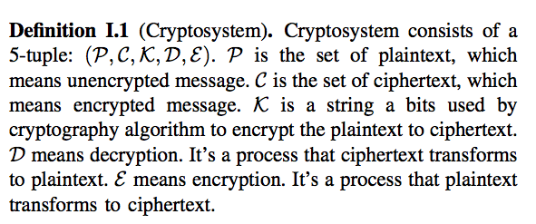

Slide 5
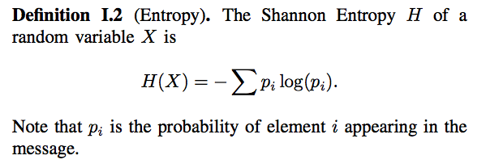

Slide 6
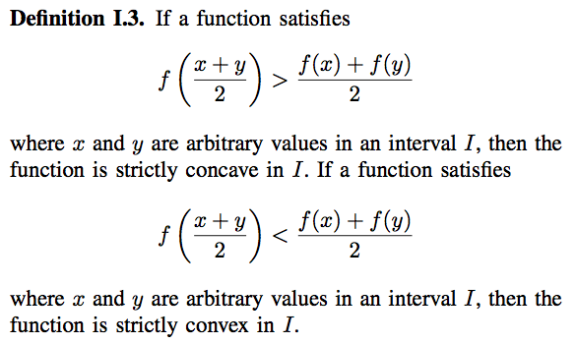

Slide 7
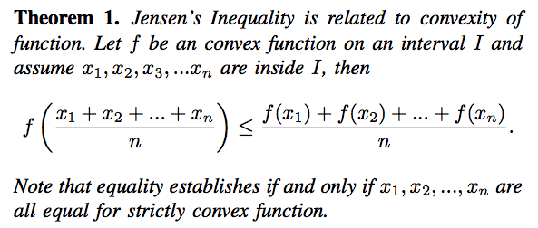

Slide 8
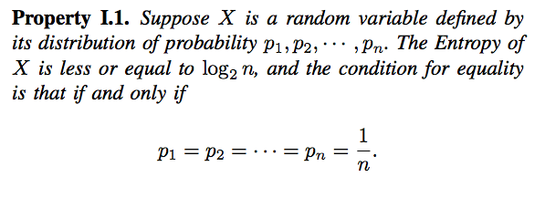

Slide 9


Slide 10
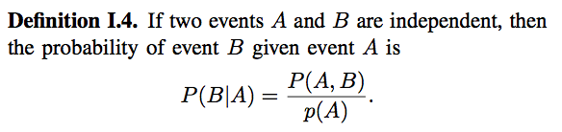

Slide 11
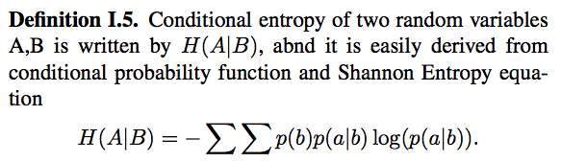

Slide 12
SPURIOUS KEYS

Slide 13


Slide 14
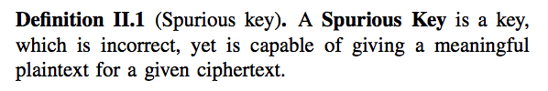

Slide 15
ENTROPY OF A NATURAL LANGUAGE AND REDUNDANCY

Slide 16
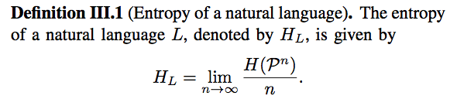

Slide 17
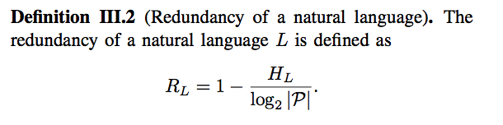

Slide 18
UNICITY DISTANCE

Slide 19
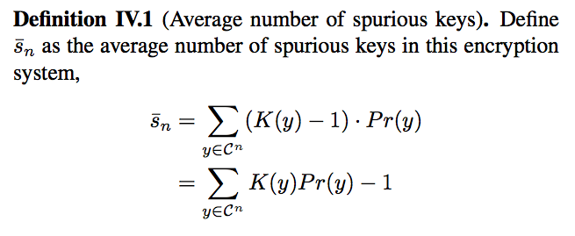

Slide 20
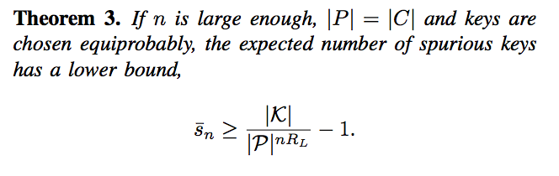

Slide 21
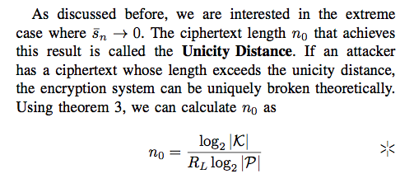

Slide 22
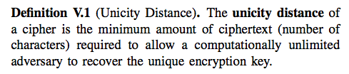
INTERPRETATION AND APPLICATION

Slide 23
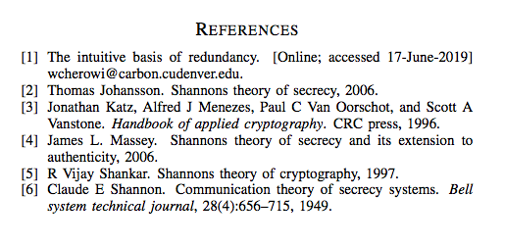
References

Slide 24
Thank you for listening

