Slide 1
DCLAB Proposal
Team04
吳庭毅 陳品睿 林沛翰

Slide 2
Outline
Topic: Tetris
Supported Function
What we need

Slide 3
Outline
Topic: Tetris
Supported Function
What we need

Slide 4
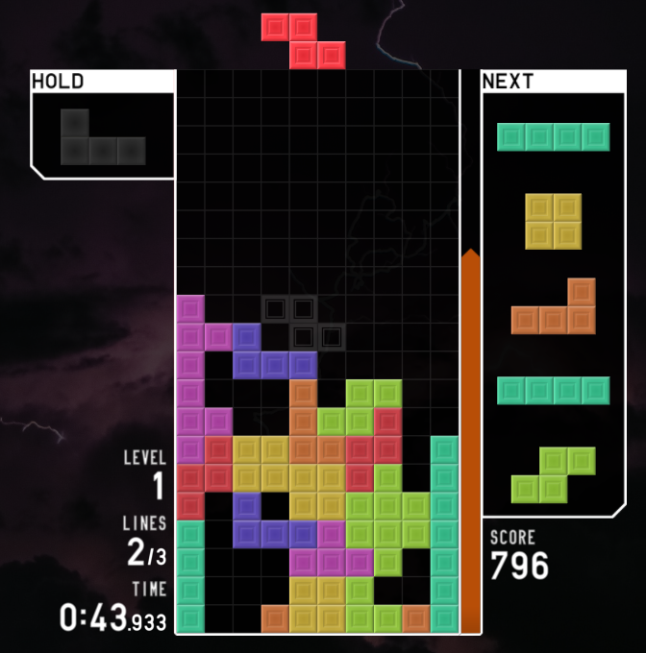
Topic: Tetris
TETR.IO

Slide 5
Outline
Topic: Tetris
Supported Function
What we need

Slide 6
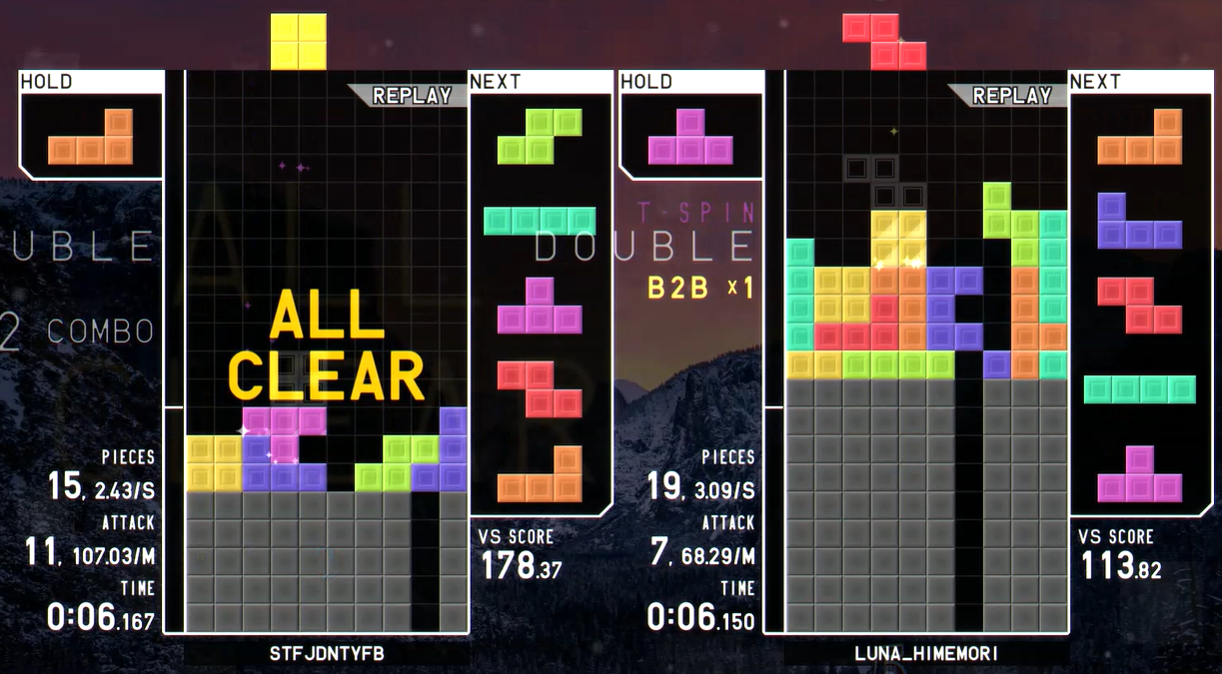
Supported Function
Multi-Player

Slide 7
Supported Function
Hold and Next

Slide 8
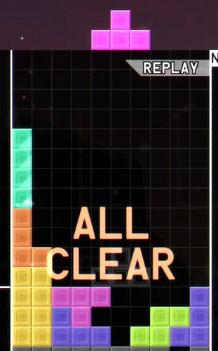
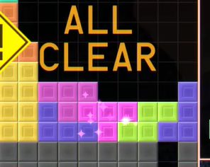
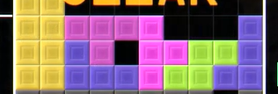
Supported Function
Lock Delay and T-SPIN

Slide 9
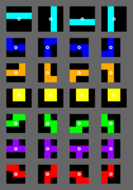
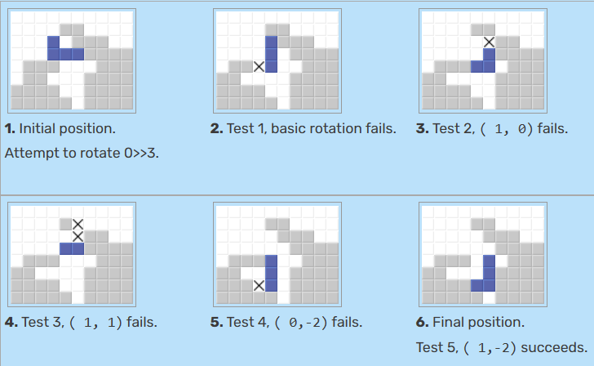
Supported Function
SRS and Wall kick
Reference : SRS | Tetris Wiki | Fandom

Slide 10
Supported Function
Other Bonus…
Reference : SRS | Tetris Wiki | Fandom

Slide 11
Outline
Topic: Tetris
Supported Function
What we need

Slide 12
What we need
FPGA、Keyboard、Speaker、Display(VGA、LCD、seven-segment display)......

